Slide 1
Project Compiled by :
3-14-11-0414
3-14-11-0417
3-14-11-0419
3-14-11-0422
3-14-11-0432
3-14-11-0434
3-14-11-0451

Slide 2
Prediction of opening weekend box office performance

Slide 3
INTRODUCTION:
The term ‘Box office’ is used in the context of the film industry. It refers to the amount of business a particular movie makes .The movie industry is a business with a high profile, and a highly variable revenue stream.
A single movie can be the difference between millions of dollars of profits or losses for a studio in a given year.

Slide 4
It’s not surprising, therefore, that movie studios are intensely interested in predicting revenues from movies; the popular nature of the product results in great interest in gross revenues from the general public as well.
The statistical analysis of the box office revenue is also highly important for the creative industries and also a source of interest for the fans.
As we know, producing movie is one of the riskiest businesses, the movie industry being highly dynamic. The involvement of various factors makes it more ambiguous. Here our objective is to set up a model for predicting the box office success.

Slide 5
OBJECTIVE:
We know that the opening weekend box office performance of a particular movie largely determines its total revenue. Hence for simplicity, we try to predict only the opening weekend performance of a movie.
Now we know that different type of films has different classes of audiences. Thus taking movies without considering their genre (type) will not be meaningful.
Hence our objective is to find different models for predicting the box office success for different types of movies.

Slide 6
DATA:
Source of data:
We have collected our data from the following websites:
www.boxofficemojo
www.imdb.com
www.metacritic.com

Slide 7
The variables used for our analysis are as follows
RESPONSE: Our response is opening weekend
box office collection
For the prediction purpose ,we have taken into account the following
Covariates
1.Production Budget
2.No of screens
3.Metacritic rating
4.Star Power.
5.Release Timing
6.Sequel

Slide 8
Normality
For any kind of analysis, we must check whether our
response variable follows a normal distribution or not.
We first perform the Shapiro-Wilk’s normality test.
At first we applied Shapiro- Wilk’s test on our response y (opening weekend box office collection). The p-value obtained in this test is = 1.136e-13(<0.05)
As our response is not normal we need to transform it to a normal variable taking some transformation.
After checking some transformation we finally come to a conclusion that fourth-root transformation whose p-value after using shapiro-Wilks’ Test comes out to be =0.6187 .
Thus we choose fourth root of y as our response.

Slide 9
Choice of Movies
We selected the time period 2012-13 for our analysis and we collect our data from the movies of this time interval.
By simple random sampling method we selected 117 movies from all the movies of 2012-2013.
Before doing so we at first divided the movies on the basis of genre.
since we know that different type of films has different classes of audience and hence the analysis of
all the films taking together will not be meaningful.
So we need to classify the selected films into a number of
mutually exclusive and exhaustive genres. So we divide the movies
into five major genres namely
(A) action
(B) animation
(C) comedy
(D) drama
(E) thriller

Slide 10
Interpretation of the regression coefficients corresponding to the variables used in the model
Y: opening weekend box office collection
X : 1,if sequel
: 0,otherwise
The model is of the form
Y=α+βx
Now we need to give interpretation of b [estimate of β] obtained from the above model.
case 1: (high positive value of b)
If the movie is a sequel then it has positive impact on opening weekend box office collection.
case 2: (high negative value of b)
If the movie is a sequel then it has a negative effect on box office collection , i.e., box office collection is lesser if it is a sequel.
case 3: (small value (-ve or +ve) of b )
Sequel has no impact on box office collection.
[Similarly assigning a value 1 to x if a movie is released in a festive season, 0 otherwise, we can give similar kind of interpretation of b in case the indicator variable is release time]

Slide 11
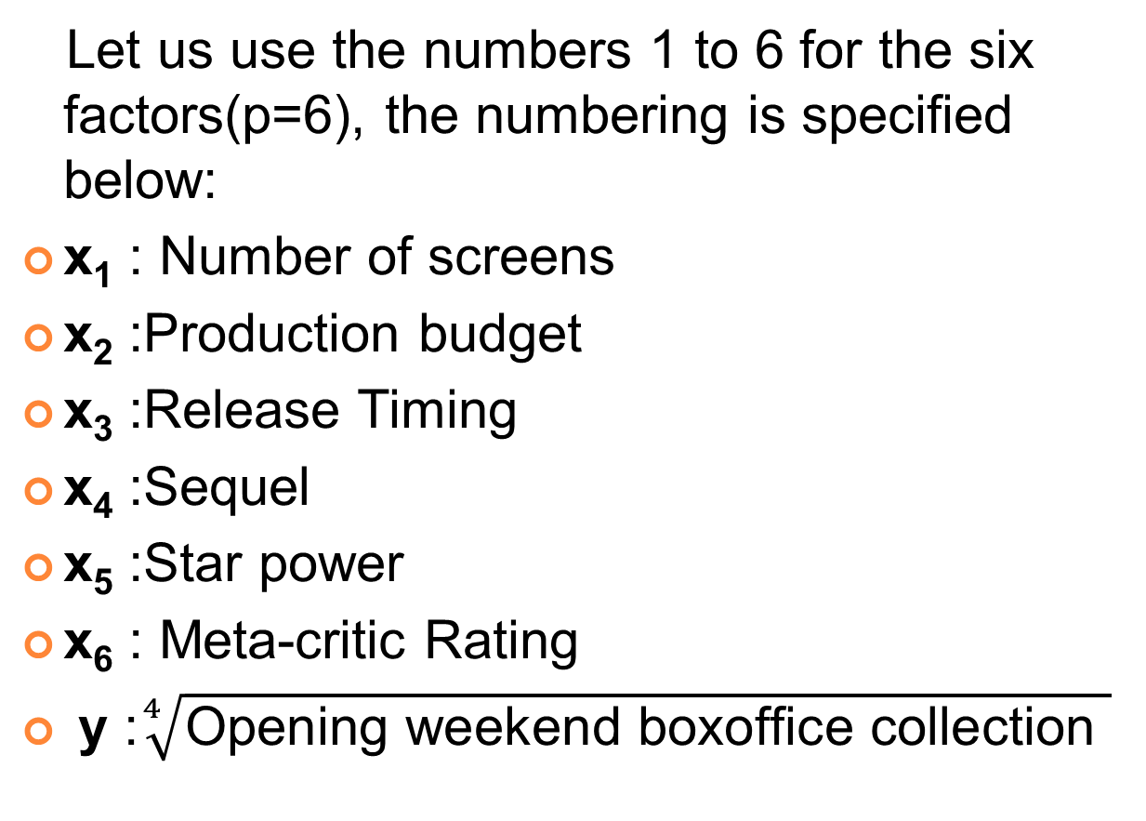
analysis
Let us use the numbers 1 to 6 for the six factors(p=6), the numbering is specified below:
x₁ : Number of screens
x₂ :Production budget
x₃ :Release Timing
x₄ :Sequel
x₅ :Star power
x₆ : Meta-critic Rating
y :$\sqrt[4]{\text{Opening} \text{weekend} \text{boxoffice} \text{collection} }$

Slide 12
action
After sampling we get n=26.
The multiple correlation coefficient (r_{y.123456} )= 0.924121
We now test for the significance of the multiple correlation coefficient. So we test
H₀ :ρ_{y.123456}=0 vs H₁ : not H₀
The test statistic F, under H₀ , follows an F distribution with df = (6,19) ,the value of F comes to be 18.5228
We reject H₀ iff F>F_{α;6,19} = 2.62832, where α=0.05 is the desired level of significance.
Here F> F_{α;6,19}
Hence we reject H_{0.}
Thus we may conclude that in the light of the given data these factors all taken together have an effect on the response at 5% level of significance.
Now we try to find out those factors which can be used as predictors .

Slide 13
(1)The correlation coefficients between y and the factors are given below:
r_{y1}=0.889; r_{y2}=0.731; r_{y3}=-0.264; r_{y4}=0.558; r_{y5}=0.337; r_{y6}= 0.255
We see that r_{y1} is maximum. So factor1, i.e., No. of screens is chosen as predictor.
Here we need to check whether the effect of x1(i.e, no of screens) is significant or not.
We have to test
H₀ :ρ_{y1}=0 vs H₁ : not H₀
The appropriate test statistic F, which under H₀, follows an F distribution with df=(1,24).Its value comes to be 90.4607. We reject H₀ against H₁iff F>F_{α;1,24} =4.25
Here F> F_{α;1,24}
Hence we reject H₀.
Therefore ρ_{y1} is significantly different from 0.
Thus we take number of screens as predictor at 5% level of significance.

Slide 14
(2) We need to calculate the 1st order partial correlation coefficients, which are given as follows:
r_{y2.1}=0.091 ; r_{y3.1}= -0.052; r_{y4.1}= 0.359; r_{y5.1}= -0.044; r_{y6.1}= 0.490
r_{y6.1} is maximum, so we test whether it is significant.
H₀: ρ_{y6.1}=0 vs H₁: not H₀
The test statistic is given by F which under H₀, follows an F distribution with df=(1,23) whose value is 7.26
F_{α;1,23}=4.27
Since F> F_{α;1,23} so we reject H₀. So factor6 i.e. rating is worthwhile in predicting the response at 5% level of significance.

Slide 15
(3) Now we calculate the 2nd order partial correlation coefficients.
r_{y2.16}= 0.177; r_{y3.16}= 0.033; r_{y4.16}= 0.254; r_{y5.16}= -0.129;
herer_{y4.16}is maximum therefore we check whether it is significant or not.
The test statistic is F which under H₀, follows an F distribution with df=(1,22) . Its value is 1.51 .
F_{α;1,22}=4.30
Since F <F_{α;1,22} , so we accept H₀ at 5% level of significance and so conclude that sequel does not significantly affect the response and hence the remaining factors do not affect as well. So number of screens and metacritic rating are the factors that affect the response. We fit a final regression equation treating only these two factors as predictors.
The regression equation hence obtained is given by:
y=-19.5+0.0240*No of screens+0.318*rating

Slide 16
ANIMATION
After sampling we get n= 21 movies.
(a) The multiple correlation coefficient
r_{y.123456}= 0.760855
We now test for the significance of the multiple correlation coefficient. So we test
H₀: ρ_{y.123456}=0 vs H₁: not H₀
The test statistic F, under H₀ , follows an F distribution with df=(6,14). Its value is 3.20771
We reject H₀iff F>F_{α;6,14}= 2.84773
Here F> F_{α;6,14}
Hence we reject H₀.
Thus we may conclude that in the light of the given data these factors all taken together have an effect on the response at 5% level of significance.
Now we try to find out factors among those 6 factors which can be used as predictors .

Slide 17
(1) The correlation coefficients between y and the factors are given below.
r_{y1}=0.636 ; r_{y2}=0.673 ; r_{y3}=-0.050; r_{y4}= 0.244; r_{y5}= 0.280 ; r_{y6}=0.332
We see that r_{y2} is maximum. So factor x₂ i.e. Production budget is chosen as predictor.
Here we need to check whether the effect of x₂(i.e. production budget) is significant or not.
We have to test
H₀: ρ_{y2}=0 vs H₁: not H₀
The appropriate test statistic F, under Ho, follows an F distribution with df=(1,19). Its value is 15.7304.
F_{α;1,19}=4.38
Here F> F_{α;1,19}
Therefore we reject H₀, i.e. ρ_{y2} is significantly different from zero.
Thus production budget can be taken as a predictor.

Slide 18
(2)We need to calculate the 1st order partial correlation coefficients, which are given as follows:
r_{y1.2} = 0.416 ; r_{y3.2} = -0.156 ; r_{y4.2} = 0.348 ; r_{y5.2} = 0.011; r_{y6.2} = 0.050
Here r_{y1.2} is maximum, therefore we need to check whether r_{y1.2} is significantly different from zero or not.
Here we will test
H₀: ρ_{y1.2} = 0 vs H₁:not H₀
F=3.76689 F_{α;1,18}=4.41387
Hence we accept the null hypothesis at α=0.05.
i.e. ρ_{y1.2} is not significantly different from zero.
So we conclude that number of screen does not significantly affect the response and hence the remaining factors do not affect as well. So production budget is the only factor that affects the response. We fit a final regression equation treating only this one factor as predictor.
The regression equation hence obtained is given by:
y=56.8+.184*production budget

Slide 19
COMEDY
After sampling we get n=22 movies.
The multiple correlation coefficient is
r_{y.123456}= 0.906642
We now test for the significance of the multiple correlation coefficient. So we test
H₀: ρ_{y.123456}=0 vs H₁: not H₀
The test statistic F, under Ho, follows an F distribution with df=(6,15). Its value is11.5449 .
We reject H₀iffF>F_{α;6,15}= 2.79046
Here F> F_{α;6,15}
Hence we reject H₀.i.e, r_{y.123456} is significantly different from 0.
Thus we may conclude in the light of given data that these factors all taken together have an effect on the response at 5% level of significance.
Now we try to find out factors among those 6 factors which can be used as predictors .

Slide 20
(1)The total correlation coefficients are given by:
r_{y1}= 0.883; r_{y2}= 0.471; r_{y3}= 0.022; r_{y4}= 0.285; r_{y5}=-0.108; r_{y6}= -0.253
Since r_{y1} is maximum,we test for its significance. So we test
H₀: ρ_{y1}=0 vs H₁: not H₀
We get the value of the test statistic as:
F_{obs}=70.7808; F_{0.05;1,20}= 4.35124
Since F_{obs}>F_{0.05;(1,20)} so we reject H₀ and conclude that X₁ i.e. Number of screens is a significant factor.

Slide 21
(2)Next we calculate the first order partial correlation coefficients between y and the other factors given X₁. The values are given below.
r_{y2.1}= 0.037; r_{y3.1}= -0.083; r_{y4.1}= 0.085; r_{y5.1}= 0.038; r_{y6.1}= 0.404
Since r_{y6.1} is maximum we test for its significance. So we test
H₀: ρ_{y6.1}=0 vs H₁: not H₀
We get the value of the test statistic as:
F_{obs}= 3.70598 ; F_{0.05;1,19} = 4.38075
Since Fobs <F_{0.05;1,19}, so we accept H₀ and conclude that meta-critic rating is not a significant factor and hence the remaining factors do not affect the response as well. So number of screens is the only factor that affects the response. We fit a final regression equation treating only number of screens as predictor.
The fitted regression equation is given by:
y=6.9+0.0158*screens

Slide 22
THRILLER
After sampling we get n=24 movies.
Here the multiple correlation coefficient is given as
r_{y.123456}=.8746.
We know test for the significance of the multiple correlation coefficient. So we test
H₀: ρ_{y.123456}=0 vs H₁: not H₀
The value of the test statistic is given by:
F_{obs}=9.20
F_{0.05;6,17}=2.69866
Since F_{obs}>F_{0.05;(6,17)} so we reject H₀ and hence conclude that the multiple correlation coefficient differs significantly from 0.
Thus we may conclude in the light of the given data that these factors all taken together have an effect on the response at 5% level of significance.
Now we try to find out factors which can be used as predictors .

Slide 23
(1) We now calculate the correlation coefficients of the response with the different factors. The values are given below:
r_{y1} = 0.84770; r_{y2} = 0.28704; r_{y3} = -0.12778; r_{y4} = 0.44658; r_{y5} = -0.00634; r_{y6} = -0.22033
Since r_{y1} is maximum we test for its significance. So we test
H₀: ρ_{y1}=0 vs H₁: not H₀
We get the value of the test statistic as:
F_{obs}= 56.1792
F_{0.05;1,22}=4.30095
Clearly we reject null hypothesis at 5% level of significance.
We include x₁ i.e. number of screens as a predictor in our regression equation.

Slide 24
(2) Now we calculate the first order partial correlation coefficients between response and the other factors when x₁ is given. The values are given below.
r_{y2.1} = -0.09800; r_{y3.1} = -0.20500; r_{y4.1} = 0.24100; r_{y5.1} = 0.22100; r_{y6.1} = 0.11600
Since r_{y4.1} is maximum we test for its significance. So we test
H₀: ρ_{y4.1}=0 vs H₁: not H₀
We get the value of the test statistic as:
F_{obs}=1.29605
F_{0.05;1,21}= 4.32479
Since F_{obs}<F_{0.05;1,17} so we accept H₀ and conclude that sequel is not a significant factor and hence the remaining factors do not affect the response as well. So number of screens is the only factor that affects the response.
We fit a final regression equation treating it as the only factor. It is given by:
y=21.5+.0155* No of screens

Slide 25
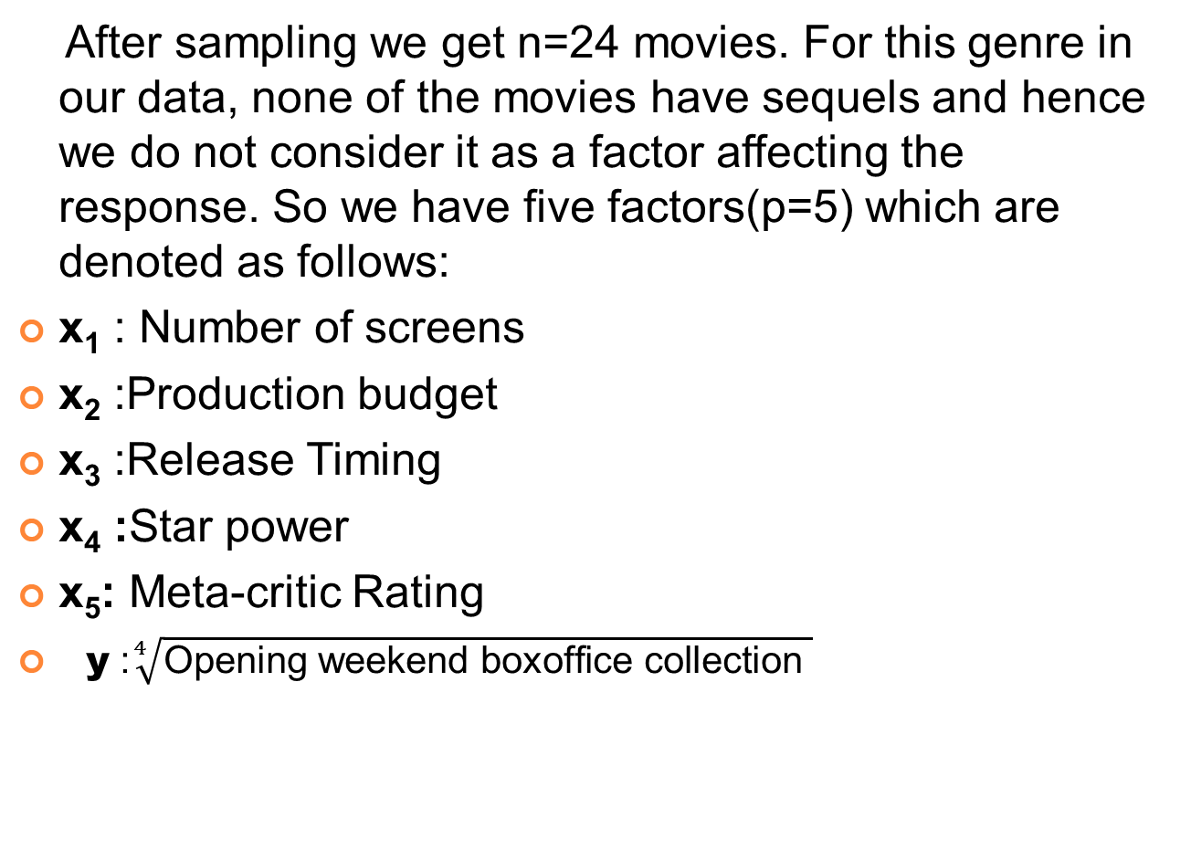
DRAMA
After sampling we get n=24 movies. For this genre in our data, none of the movies have sequels and hence we do not consider it as a factor affecting the response. So we have five factors(p=5) which are denoted as follows:
x₁ : Number of screens
x₂ :Production budget
x₃ :Release Timing
x₄ :Star power
x₅: Meta-critic Rating
y :$\sqrt[4]{\text{Opening} \text{weekend} \text{boxoffice} \text{collection} }$

Slide 26
Here the multiple correlation coefficient is given as
r_{y.12345}= 0.917660
We now test for the significance of the multiple correlation coefficient. So we test
H₀: ρ_{y.12345}=0 vs H₁: not H₀
The test statistic F,under H₀, follows an F distribution with df=(6,18). Its value is 15.9873
We reject H₀ iff F>F_{α;6,18}=2.66130
Here F> F_{α;6,18} ,hence we reject H₀ at 5% level of significance.
i.e. r_{y.12345} is significantly different from zero.
Thus we may conclude that in the light of the given data these factors all taken together have an effect on the response at 5% level of significance.
Now we try to find out those 5 factors which can be used as predictors .

Slide 27
(1)We now calculate the correlation coefficients of the response with the different factors. The values are given below:
r_{y1}= 0.87220; r_{y2}=0.72326; r_{y3}=0.29704; r_{y4}=0.01933; r_{y5}=0.17287
Since ry1 is maximum we test for its significance. So we test
H₀: ρ_{y1}=0 vs H₁: not H₀
We get the value of the test statistic as:
F_{obs}=69.9474;
F_{0.05;1,22} =4.30095
Since F_{obs}>F_{0.05;(1,22)} so we reject H₀ and conclude that x₁ i.e. Number of screens is a significant factor.

Slide 28
(2) Next we calculate the first order partial correlation coefficients between y and the other factors given x₁. The values are given below.
r_{y2.1}=0.45717; r_{y3.1}=0.42012; r_{y4.1}=0.32998; r_{y5.1}=0.12146
Since r_{y2.1} is maximum we test for its significance. So we test
H₀: ρ_{y2.1}=0 vs H₁:not H₀
We get the value of the test statistic as:
F_{obs}=5.54882;
F_{0.05;1,21}=4.32479
Since F_{obs}>F_{0.05;1,21} so we reject H₀ and conclude that x₂ i.e. Production budget is a significant factor.

Slide 29
(3) Now we calculate the 2nd order partial correlation coefficients between the response and the other factors given x₁ and x₂. The values are given:
r_{y3.12}=0.29648; r_{y4.12}=0.22606; r_{y5.12}= -0.04607
Since r_{y3.12} is maximum, we test for its significance. So we test
H₀: ρ_{y3.12}=0 vs H₁: not H₀
We get the value of the test statistic as:
F _{obs}=1.92743
F_{0.05;1,20} =4.35124
Since F_{obs}<F_{0.05;1,20} so we accept H₀ and conclude that release timing is not a significant factor and hence the remaining factors do not affect the response as well. So number of screens and production budget are the only factors that affect the response. We fit a final regression equation treating only these two variables as predictors. We get it as:
The regression equation is given by
y=30+0.104*No of screens+.198*production budget

Slide 30
Conclusion
From our analysis , we find the following genre wise regression model for predicting opening weekend collection. We also predict our response from some random movies taken from the year 2014 and compare them with the original values.
Action
Regression equation:
y=- 19.5 + 0.0240*no of screens + 0.318*critic rating
Animation
Regression equation:
y = 56.8+0.184*production budget

Slide 31
Comedy
Regression equation:
y=6.9 + 0.0158* no of screens
Drama
Regression equation
y = 30.0 + 0.0104*no of screens + 0.198*production budget
Thriller
Regression equation:
y=21.5+ 0.0155* no of screens

Slide 32
Genre | Movie | Predictor 1 | Predictor 2 | Y observed | Y predicted
Action | Need For Speed | No of screens =3115 | Metacritic Rating =40 | 64.9984 | 67.98
Animation | Mr. Peabody & Sherman | Production Budget =145 million | - | 75.3334 | 83.4800
Comedy | Muppet most wanted | No of screens =3194 | - | 64.2163 | 57.3652
Drama | 300:rise of an empire | production budget =110 million | No of screens =3470 | 81.9211 | 87.8680
Thriller | Non stop | No of screens =3090 | - | 73.3049 | 69.3950

