Slide 1


Basic principles of cellular functions: metabolism
Dr. Rocío Mercado
Department of Chemical Engineering, MIT
Interviewing for Assistant Professorship in Data-driven cell and molecular biology
Thursday March 10, 2022
Notes:
Test lecture instructions:
The Recruitment Board would like you to hold a test lecture in English. We want you to plan and deliver the test lecture as if it was the first 15 minutes of a real lecture. The audience in the test lecture will not be the usual student group, but please give the lecture as if this was the case. The test lecture is open to personnel from the Department of Applied Physics, as well as the Recruitment Board.
The title of the test lecture is “Basic principles of cellular functions: metabolism”. The lecture can be considered to be part of SK2532 “Biomedicine for engineers” (https://www.kth.se/student/kurser/ kurs/SK2532?l=en). This is a mandatory course in Master's programme in Engineering Physics (biomedical physics specialisation). Information about the Master's programme can be found here: https://www.kth.se/en/studies/master/engineeringphysics. It is very important to keep to the allocated time. After the lecture, the audience may ask questions (5 minutes).

Slide 2
Intended learning outcomes (ILOs)
SK2532 Biomedicine for Engineers, 7.5 credits
From the syllabus:
The course provides an introduction to biomedicine adapted for students with a background in engineering.
After completing the course, students should be able to:
describe the basic structure and function of molecules, cells, tissues and organs in living organisms
describe mechanisms and structures for the transport of various substances within and between cells
describe basic processes for the cell's energy supply and cell renewal
describe from cellular to organ level the mechanisms that make an organism function as a whole (metabolism, neuronal signaling, immune system, hormonal action)
identify and critically discuss ethical issues that occur in biomedical research
Notes:
Resources used to prepare this lecture:
https://www.anderson.k12.ky.us/Downloads/06_Lecture_Presentation2.pdf
https://www.etsu.edu/uschool/faculty/tadlockd/documents/apbio_chp_8_detaillectout.pdf
https://rwu.pressbooks.pub/bio103/chapter/introduction-to-metabolism-enzymes-and-energy/

Slide 3
Lecture outline
What is metabolism?
Metabolic pathways
Two main classes of metabolic reactions
Task 1 (Jamboard)
Gibbs free energy
Endergonic and exergonic reactions
Enzymes
Task 2 (final poll)

Slide 4
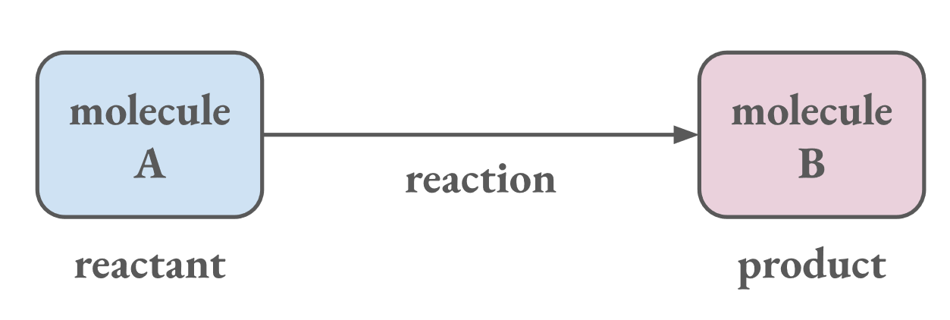
What is metabolism?
Metabolism: the set of all chemical reactions occurring in a living organism.
Metabolism arises from interactions between molecules within a cell.

Slide 5
What is metabolism?
Metabolism is how an organism manages its material and energy resources to run processes.
For example:
Breaking down nutrients
Generating & storing energy
Synthesizing cellular building blocks
Eliminating waste & potentially harmful substances

Slide 6
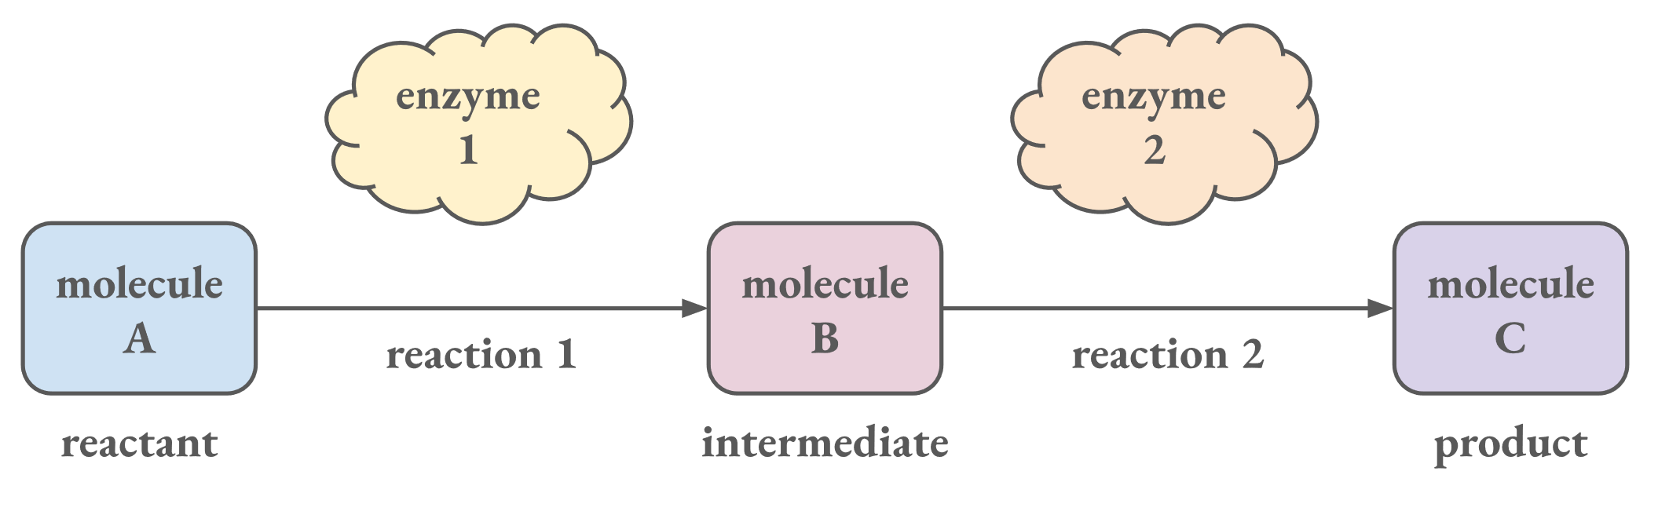
Metabolic pathways
A metabolic pathway begins with a specific molecule and ends with a product.
Each step is catalyzed by a specific enzyme.

Slide 7
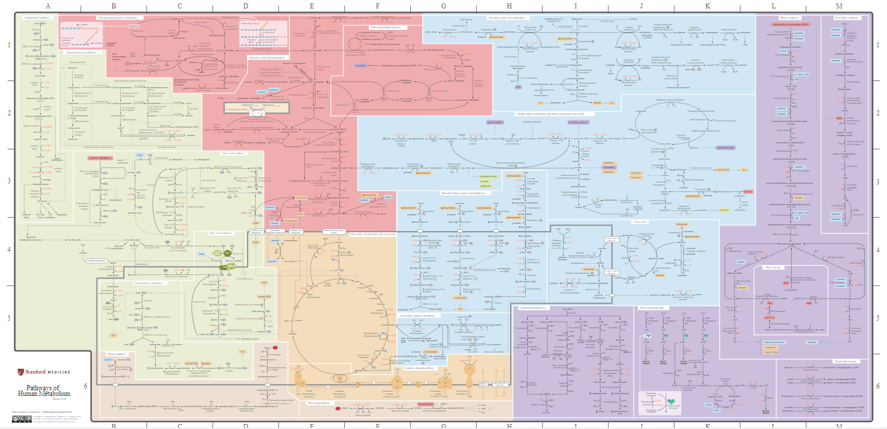
Pathways of Human Metabolism Map
https://interactivepathways.stanford.edu/
https://metabolicpathways.stanford.edu/

Slide 8
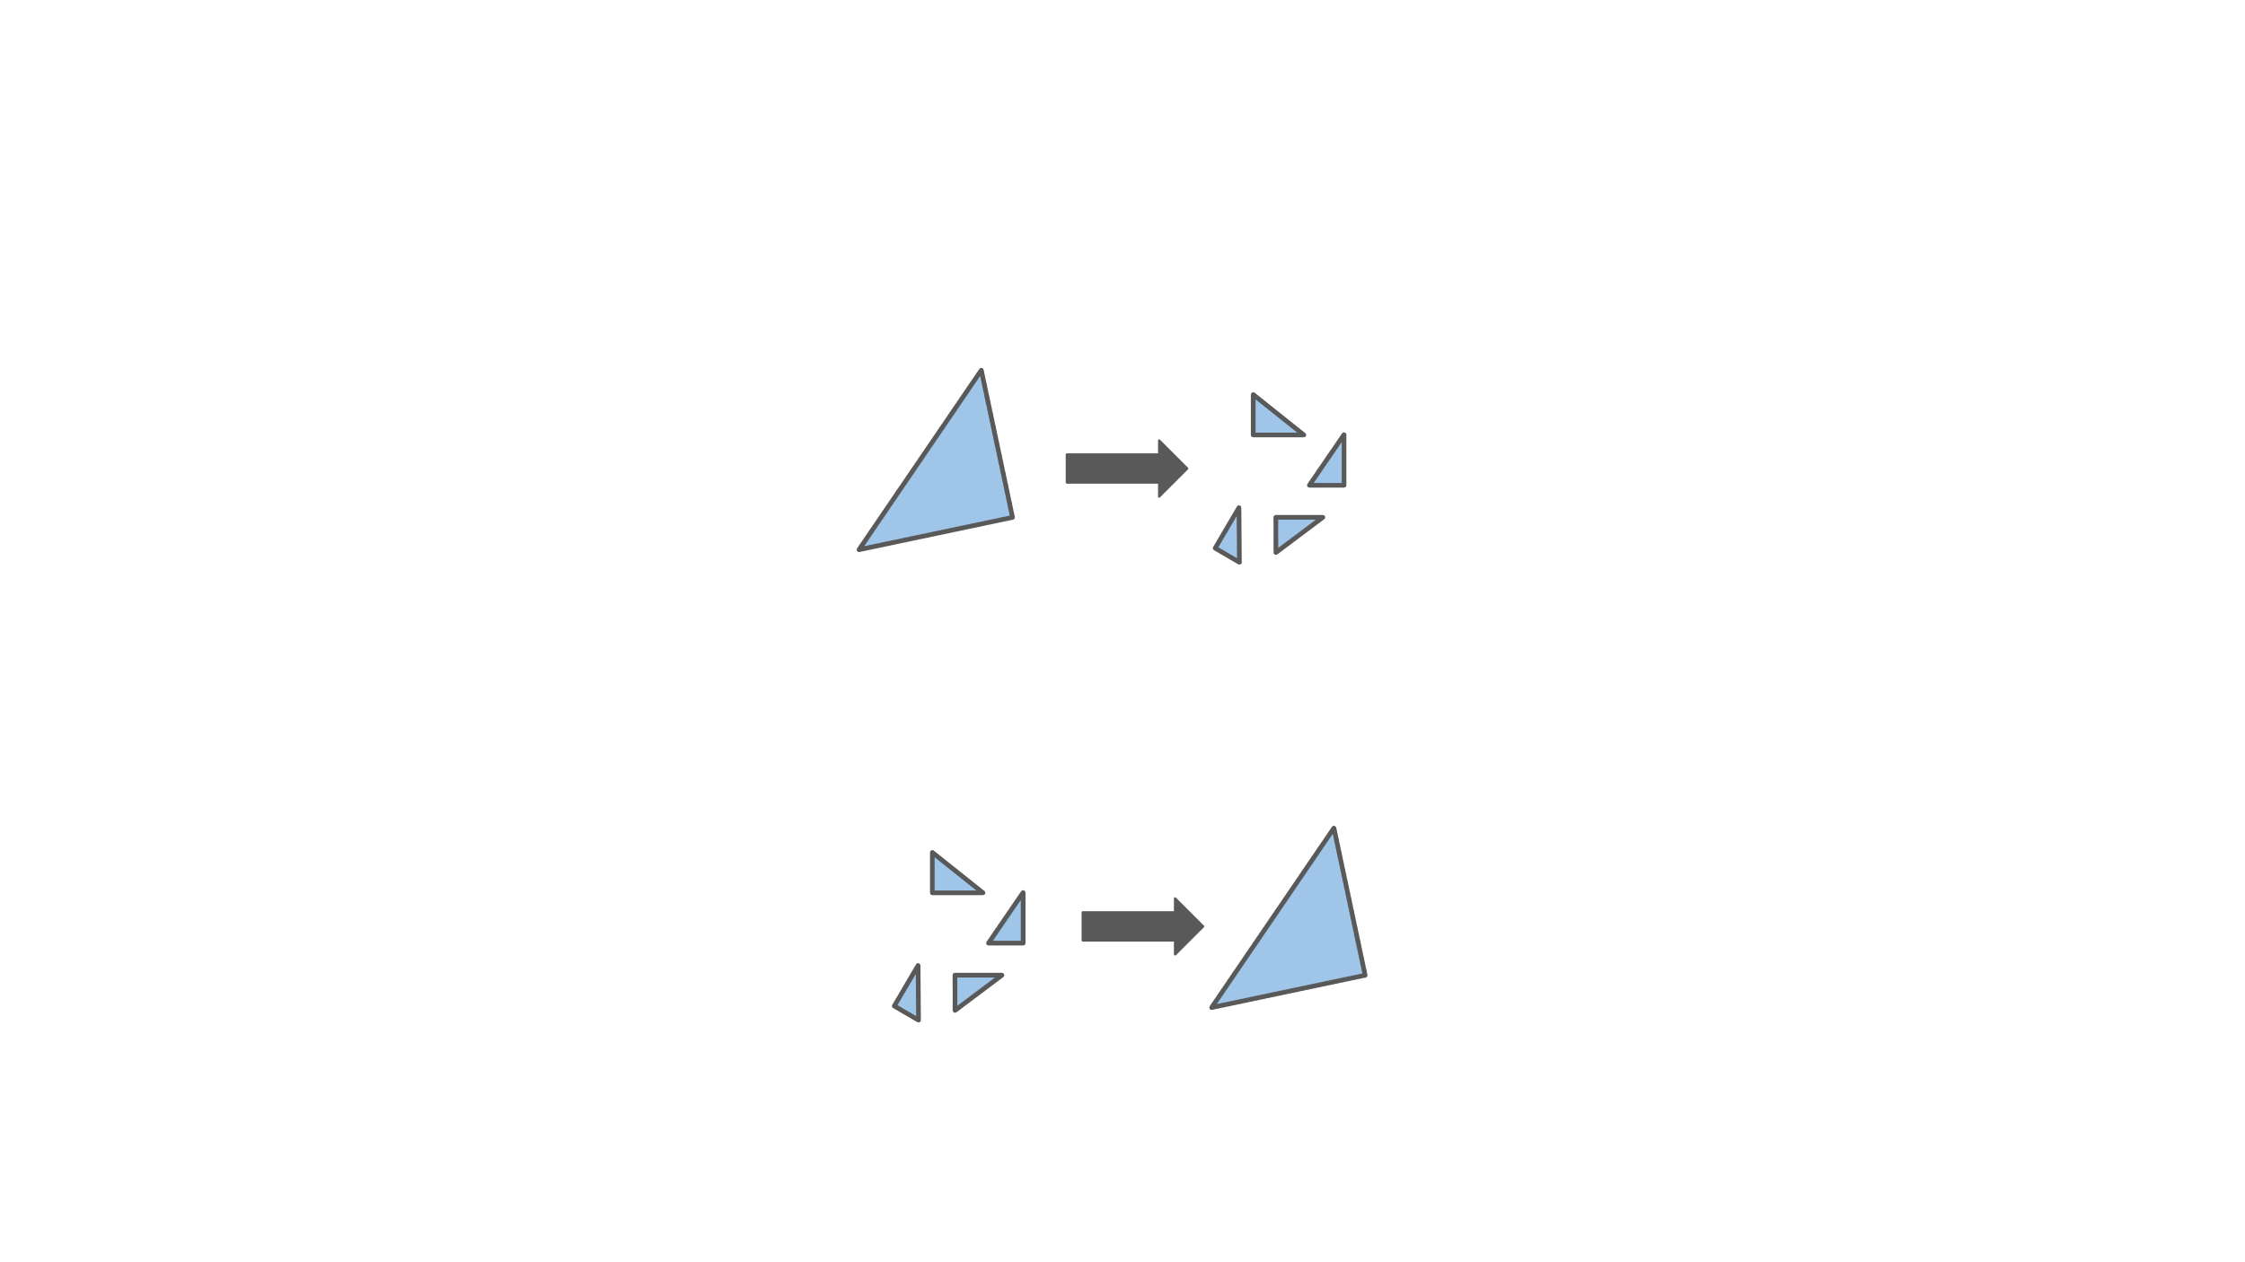
Two main classes of metabolic reactions
Catabolic pathways release energy by breaking down complex molecules into simpler molecules.
C₆H₁₂O₆ + 6 O₂ → 6 CO₂ + 6 H₂O + ATP
Anabolic pathways consume energy to build complex molecules from simpler molecules.
amino acids → proteins
+ energy
mnemonic: "ABCD"
Anabolic → Build
Catabolic → Degrade
energy +

Slide 9

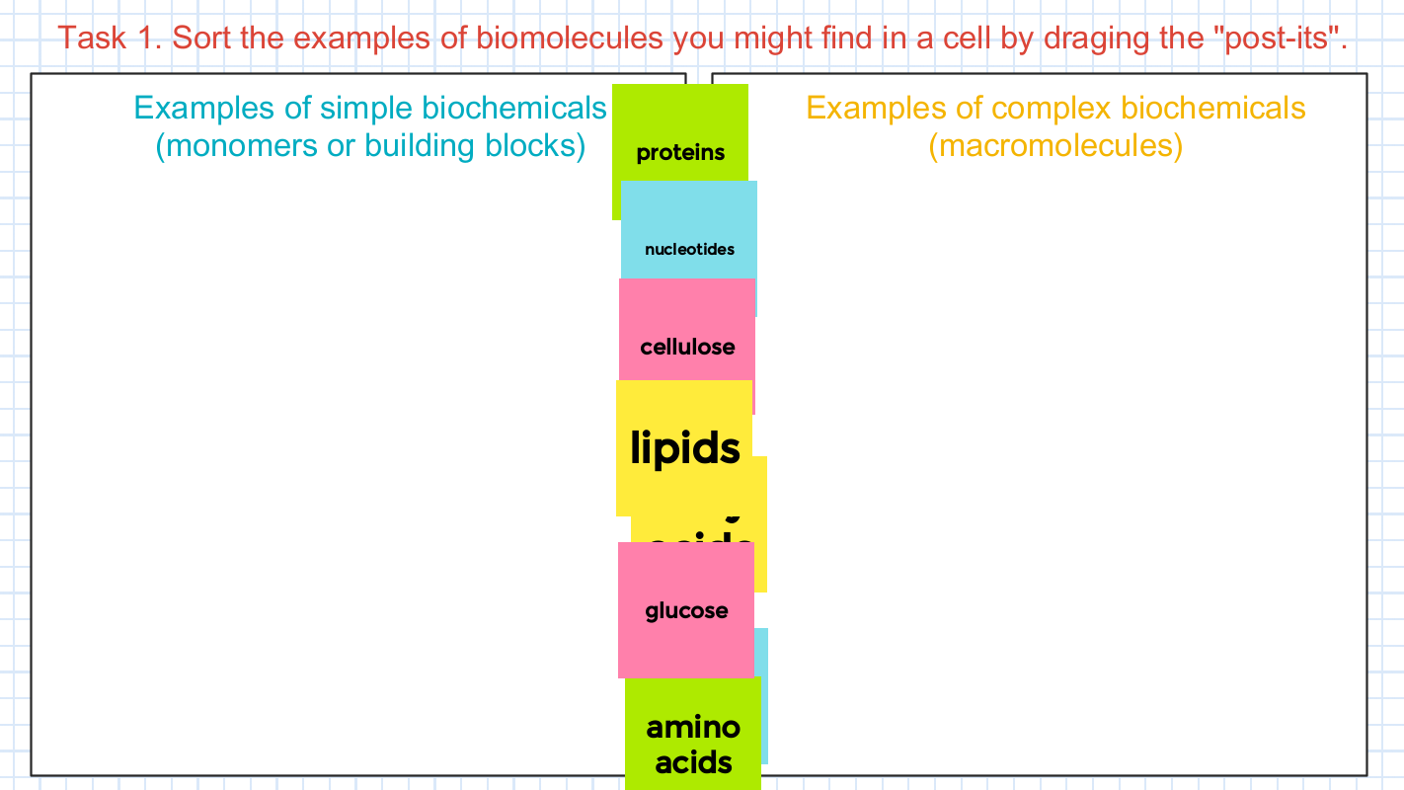
Task 1. Examples of complex and simple biomolecules
Go to this link → bit.ly/SK2532-1
(~2 minutes)
Notes:
bitly link:
bit.ly/SK2532-1
Raw jamboard link:
https://jamboard.google.com/d/1sXpiKTuMjLKjgMebKCo4NeIm4_maK9Mc2-23NuBjd_k/edit?usp=sharing

Slide 10
Task 1. Examples of complex and simple biomolecules
Possible valid responses
Examples of simple biochemicals (building blocks)
Examples of complex biochemicals (macromolecules)
carbon dioxide
proteins
lipids
amino acids
fatty acids
biological membranes
galactose
monosaccharides
polysaccharides
glucose
fructose
starch
cellulose
DNA
nucleotides
glycogen
water
RNA

Slide 11
Two main classes of metabolic reactions
Catabolic pathways release energy by breaking down complex molecules into simpler molecules.
C₆H₁₂O₆ + 6 O₂ → 6 CO₂ + 6 H₂O + ATP
Anabolic pathways consume energy to build complex molecules from simpler molecules.
amino acids → proteins
glucose oxygen carbon dioxide water energy
Notes:
cellular respiration = glycolosis + pyruvate metabolism (https://en.wikipedia.org/wiki/Glycolysis#:~:text=Glycolysis%20is%20the%20metabolic%20pathway,nicotinamide%20adenine%20dinucleotide%20(NADH).)

Slide 12
Gibbs free energy
Gibbs free energy is used to quantify the energy changes associated with chemical reactions.
Gibbs free energy is the energy that is available to do work in a chemical reaction.
∆G = ∆H – T∆S
Notes:
Every chemical reaction involves a change in free energy, called delta G (∆G). The change in free energy can be calculated for any system that undergoes a change, such as a chemical reaction. To calculate ∆G, start with the total energy change of the system, which is called enthalpy, and is denoted as ΔH. Then subtract the amount of energy that is lost to entropy (denoted as ∆S).

Slide 13
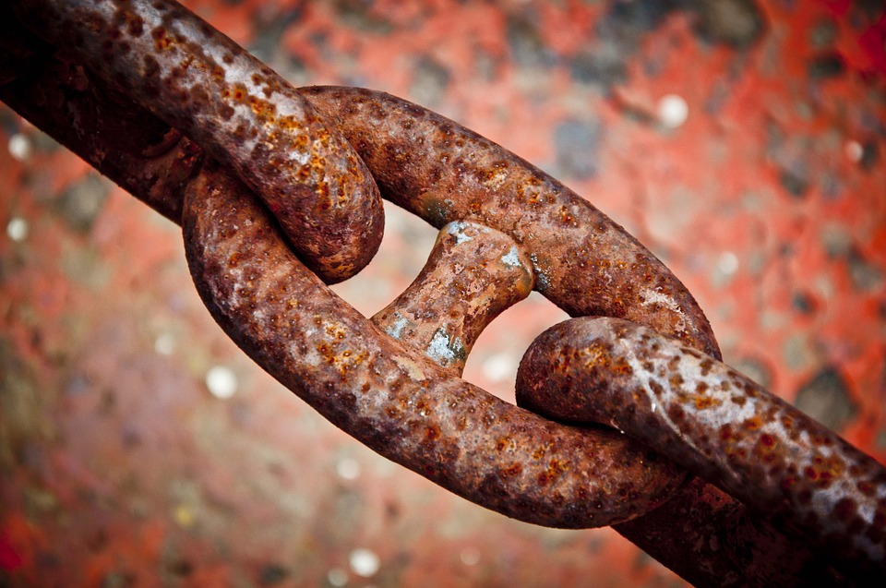
Exergonic and endergonic reactions
Understanding which chemical reactions are spontaneous and release free energy is important because these reactions can be used to perform work inside the cell.
!!! Spontaneous ≠ quick
Picture from https://monroeengineering.com/blog/wp-content/uploads/2017/06/chain11.jpg

Slide 14
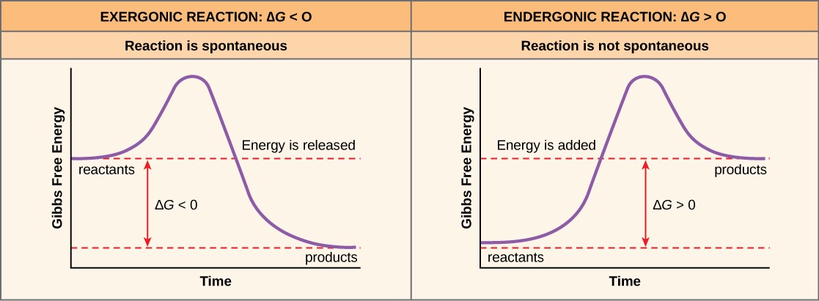
Exergonic and endergonic reactions
+ energy
Figure 10.2 from https://rwu.pressbooks.pub/bio103/chapter/introduction-to-metabolism-enzymes-and-energy/

Slide 15
Exergonic and endergonic reactions
energy +
Figure 10.2 from https://rwu.pressbooks.pub/bio103/chapter/introduction-to-metabolism-enzymes-and-energy/

Slide 16
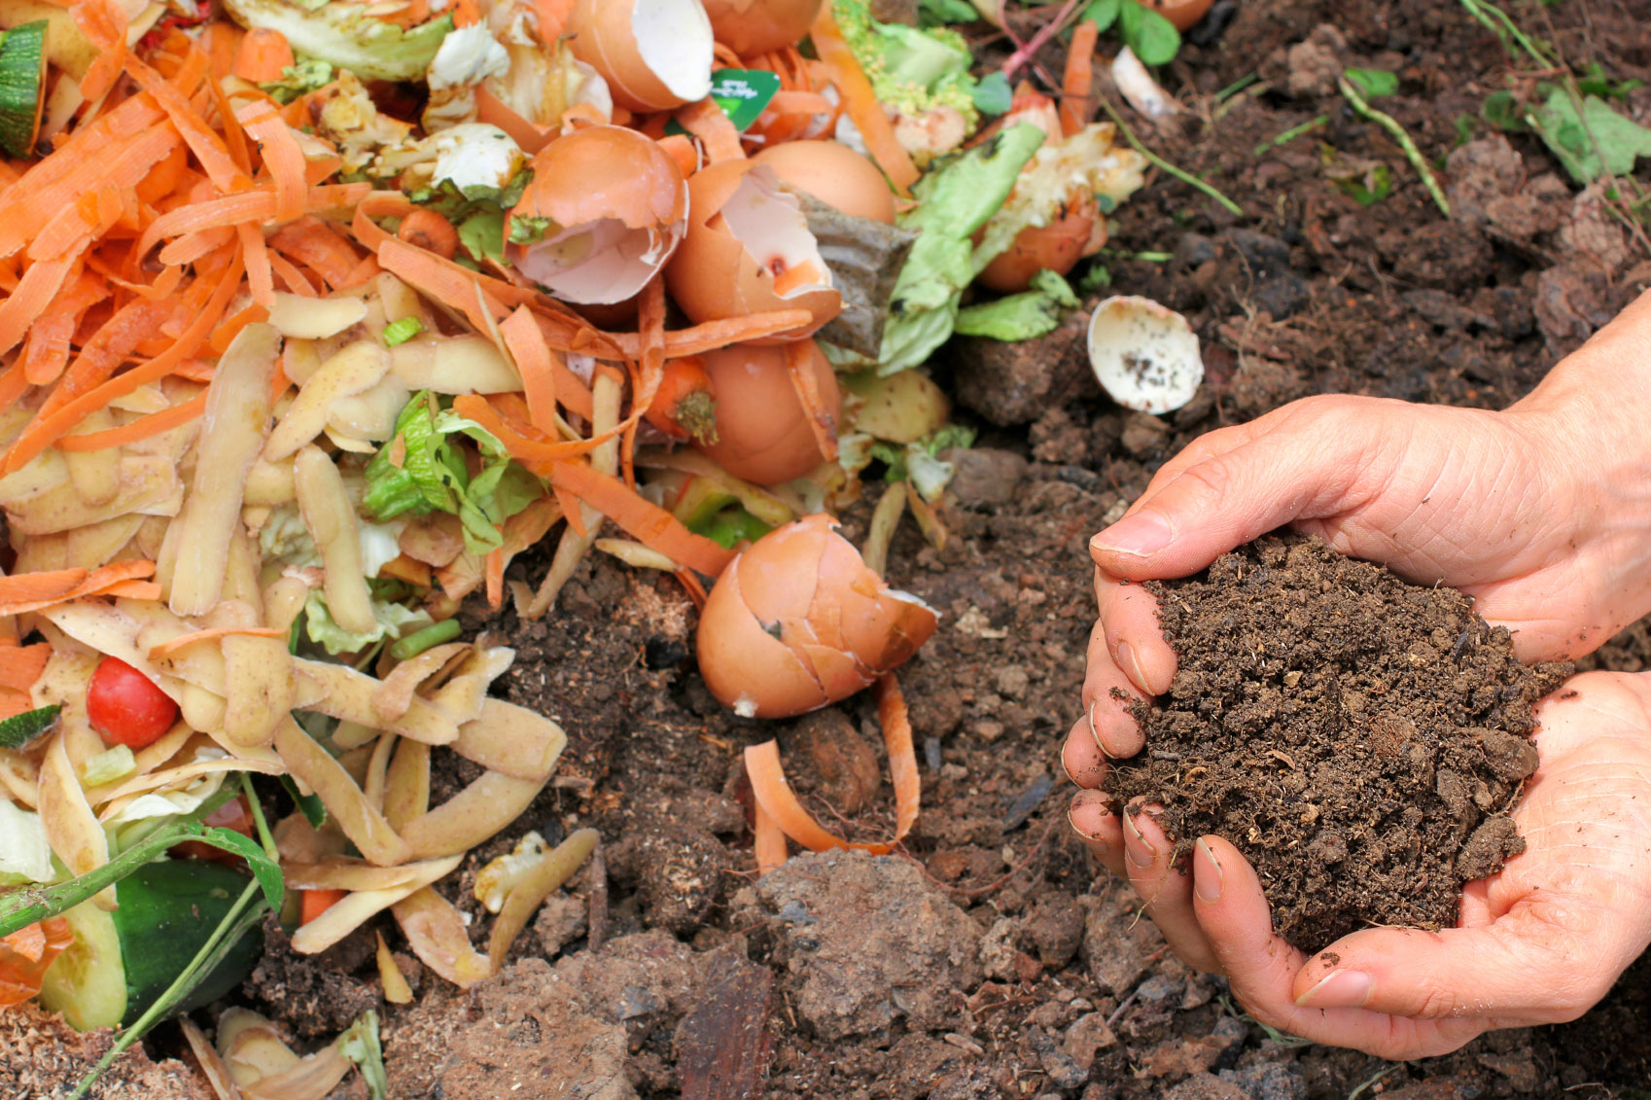
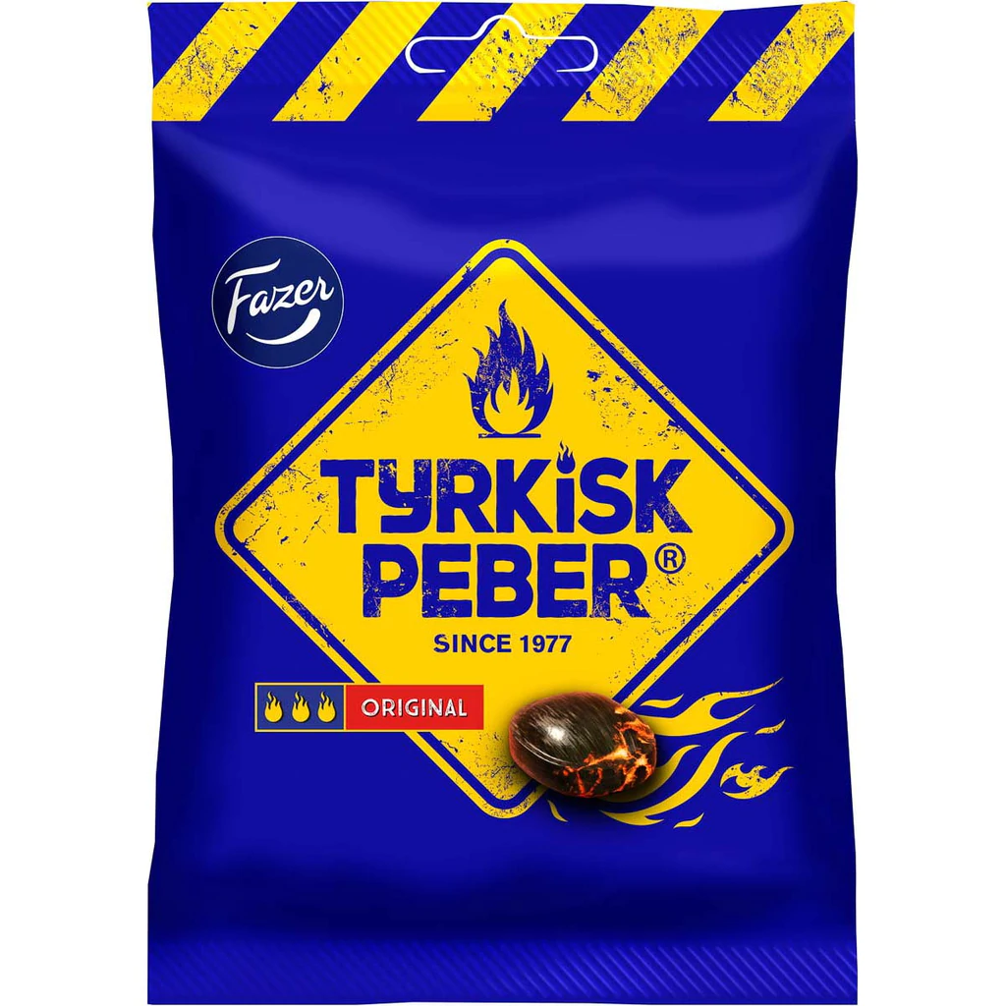
Exergonic and endergonic reactions
Even though the cellular respiration reaction below is exergonic and spontaneous, it does not mean it happens quickly.
Speed of reaction depends on the height of the free energy barrier.
C₆H₁₂O₆ + 6 O₂ → 6 CO₂ + 6 H₂O + ATP
glucose oxygen carbon dioxide water energy
Next time: How to speed up reactions inside the cell?
expose to O₂
does not instantly combust
Compost picture from https://www.gardeningknowhow.com/wp-content/uploads/2014/05/compost-pile.jpg
Turkisk Peber picture from https://cdn.shopify.com/s/files/1/2142/6545/products/FC_Tyrkisk_Peber_Original_150g_402835_HR_SV_1024x1024.jpg?v=1613406264

Slide 17
Next lecture
Enzymes
An enzyme is a macromolecule that acts as a catalyst, a chemical agent that speeds up the rate of a reaction without being consumed by the reaction.

Slide 18
Task 2. Metabolism poll
Quick poll to assess understanding:
Go to this link → bit.ly/SK2532-2
(~1 minute)
Link to view results
Turkisk peber picture from https://cdn.shopify.com/s/files/1/2142/6545/products/FC_Tyrkisk_Peber_Original_150g_402835_HR_SV_1024x1024.jpg?v=1613406264
Notes:
https://bit.ly/SK2532-2
To view the results of the quiz: https://www.mentimeter.com/s/82556ba3a5b4f769de1d4715a79a6a6a/cb2cb2d8d138
To edit the quiz: https://www.mentimeter.com/s/82556ba3a5b4f769de1d4715a79a6a6a/cb2cb2d8d138/edit?

