Slide 1


Introduction to Machine Learning
Dr. Rocío Mercado
Department of Chemical Engineering, MIT
Interviewing for Assistant Professorship in the Area of Machine Learning
Wednesday April 20, 2022
Notes:
Test lecture instructions: Pedagogical lecture, 20 min + 10 minutes for questions. The Faculty Appointment Committee and the recruitment group has chosen the following topic for your lecture:
Topic: An introductory lecture on machine learning Target group: 1st year MSc students in DSAI MSc program
https://www.chalmers.se/en/education/programmes/masters-info/Pages/Data-Science.aspx#second-page
Please note that the lecture should target students even if the real audience will be the members of the Faculty Appointment Committee and the representatives from the departments of Computer Science and Engineering and Biology and Biological Engineering.

Slide 2
Intended learning outcomes (ILOs)
Following this lecture, students should be able to:
define the basic terminology and connections between artificial intelligence, machine learning, and deep learning
describe the three main classes of machine learning methods (supervised learning, unsupervised learning, and reinforcement learning)
describe the impact of machine learning across a range of fields and applications, and give examples of a few applications (e.g. facial recognition, recommendation systems, molecular optimization)
Notes:
Resources used to prepare this lecture:
Chris Bishop's book
https://introduction-to-machine-learning.netlify.app/chapter01
Angrew Ng's CS239 (Stanford)
Stanford CS229 Lecture Notes https://cs229.stanford.edu/lectures-spring2022/master.pdf

Slide 3
Lecture outline
What is machine learning?
The relationship between AI, ML, and DL
Example applications of machine learning
Activity 1 (Survey to assess class interests)
Three main classes of machine learning algorithms
Examples of machine learning methods
Introducing a common notation
Supervised learning
Building a simple regression model
Activity 2 (Quick poll to assess understanding)

Slide 4
What is machine learning?
Machine learning: the field of study that gives computers the ability to learn without being explicitly programmed.¹
¹ Arthur Samuel (1959).

Slide 5
The relationship between AI, ML, and DL
Artificial intelligence
Machine learning
Deep learning
^{AI: artificial intelligence}
^{ML: machine learning}
^{DL: deep learning}

Slide 6
The relationship between AI, ML, and DL
Artificial intelligence: the use of machines to perform intelligent tasks which, until that point, could only be performed by humans.
Machine learning: the use of mathematically well-defined models to make predictions or decisions from data without explicit programming.
Deep learning: a subfield of ML which focuses on neural networks.
Artificial intelligence
Machine learning
Deep learning

Slide 7
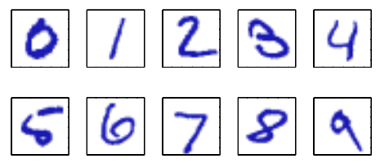
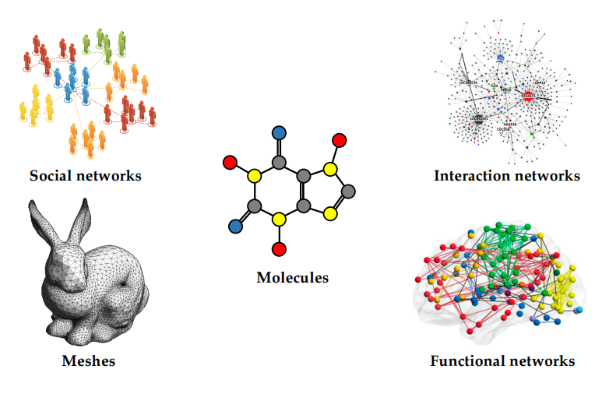
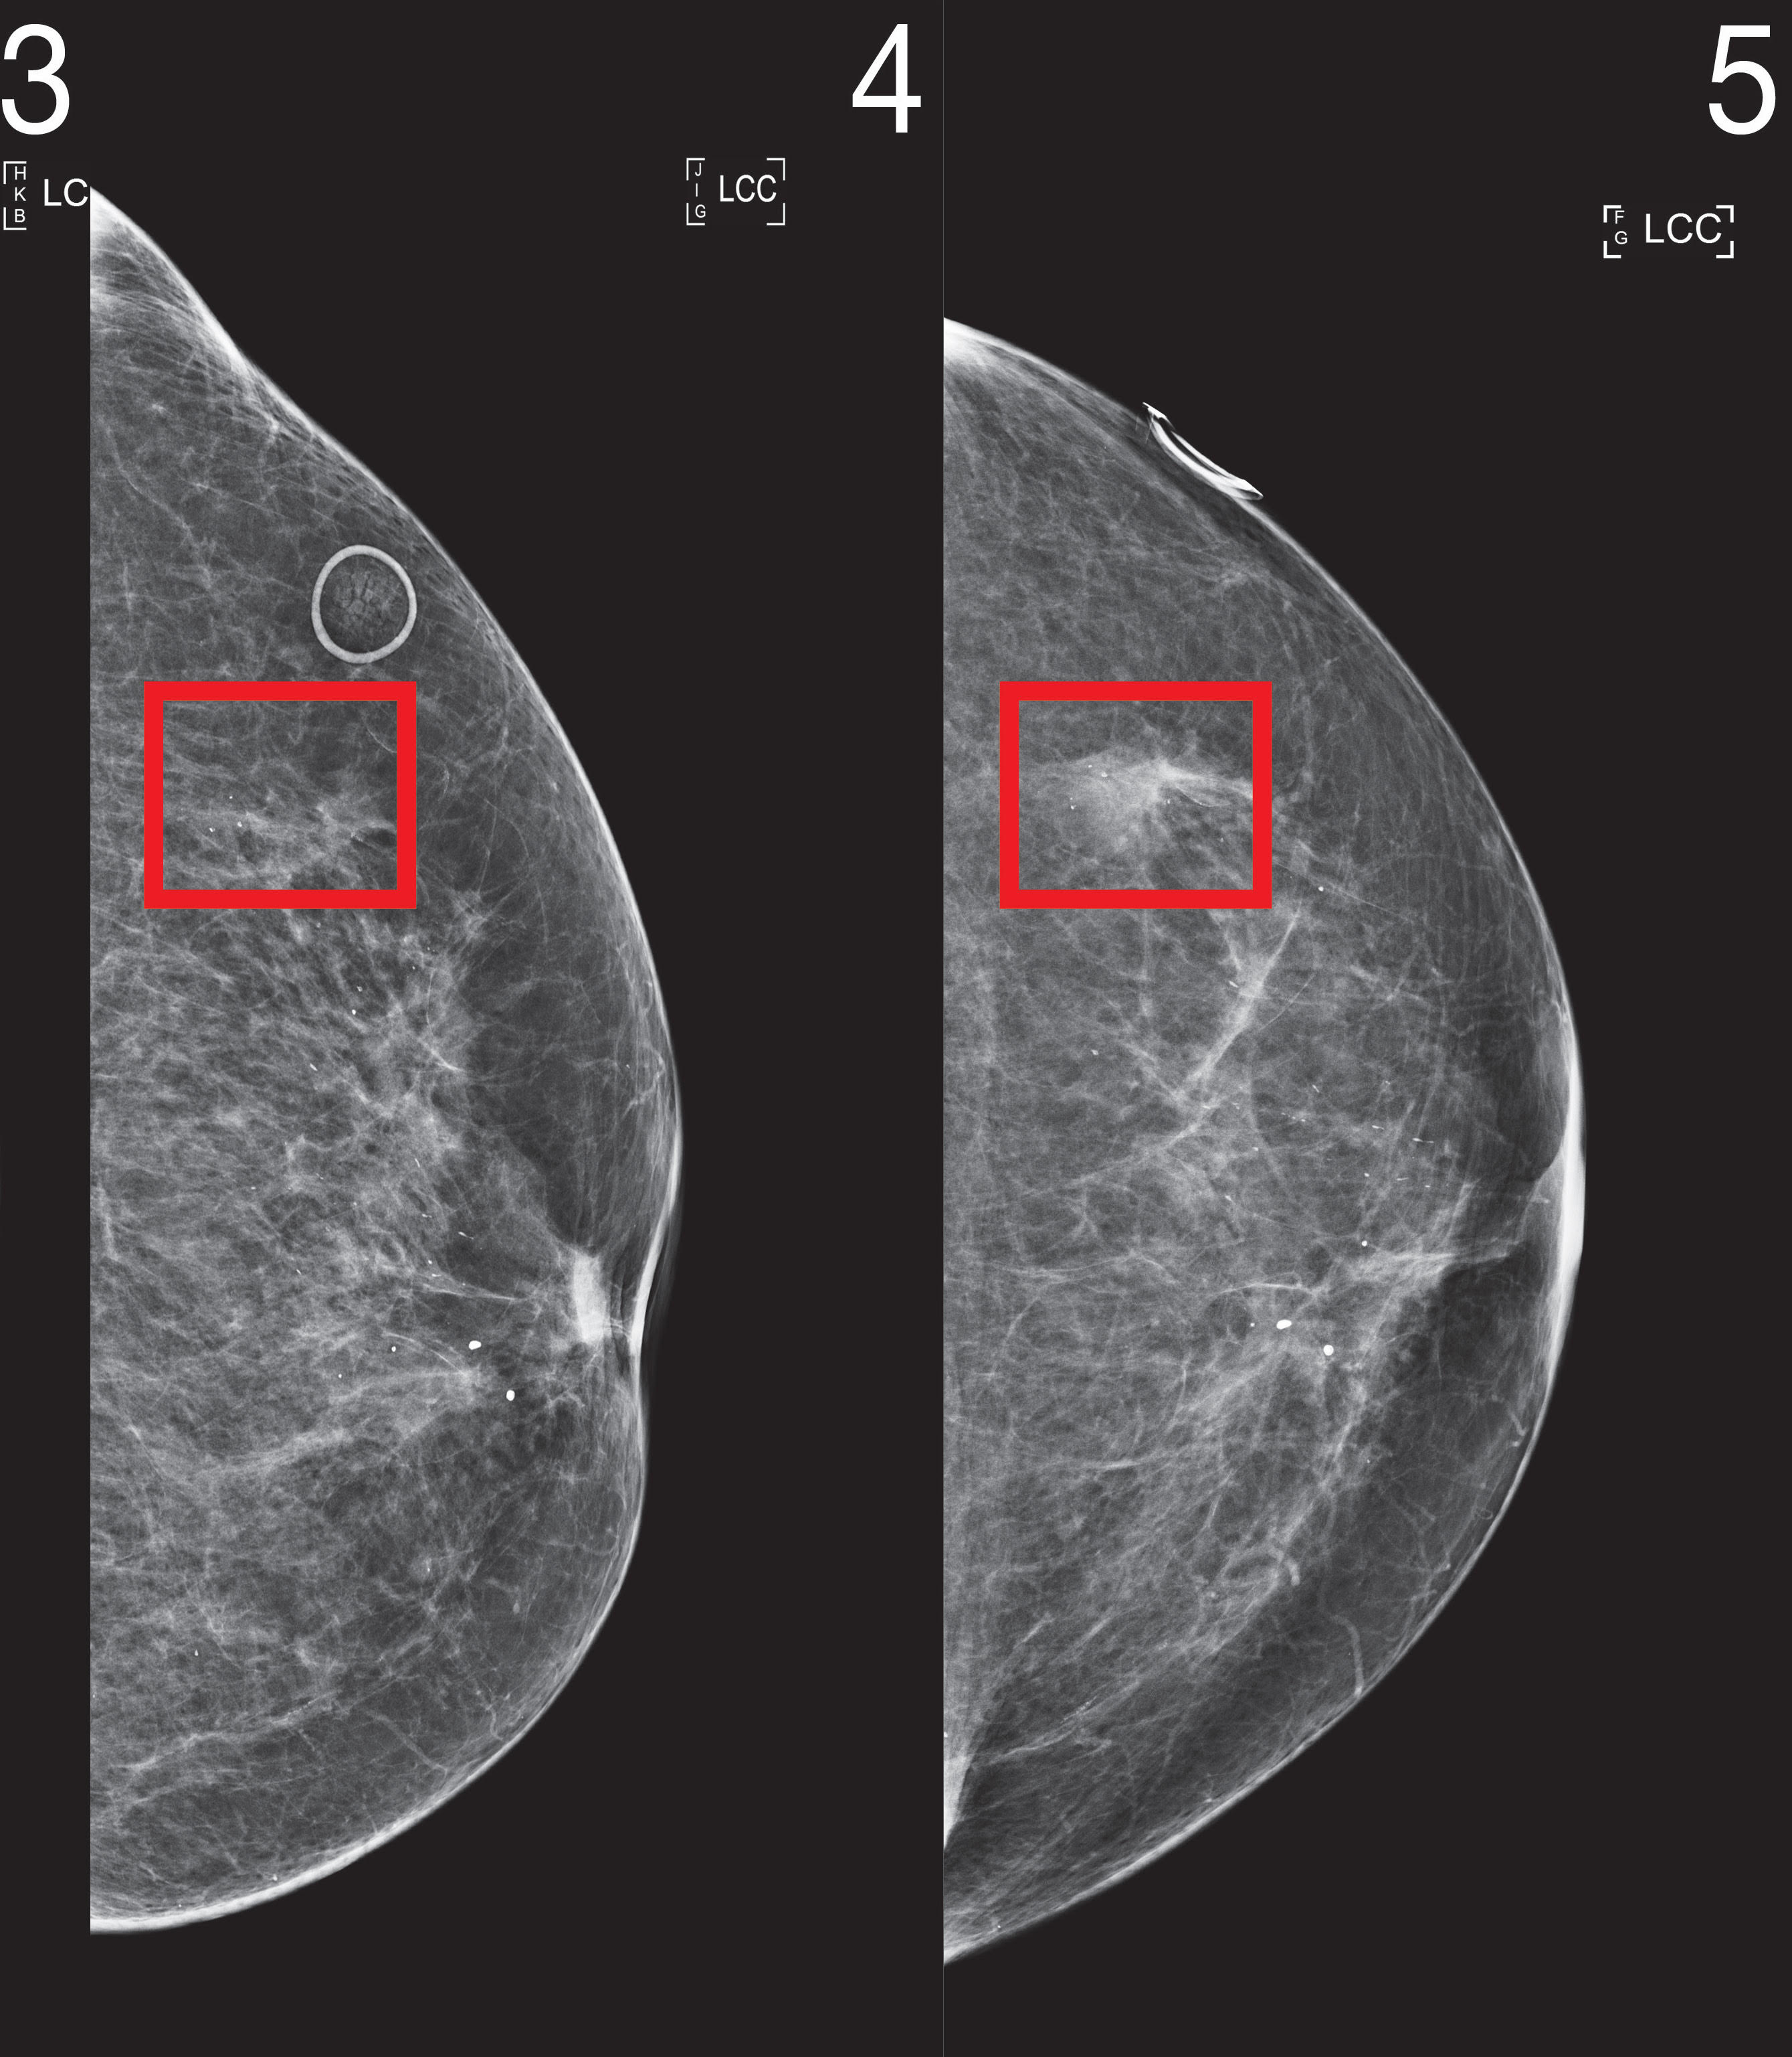
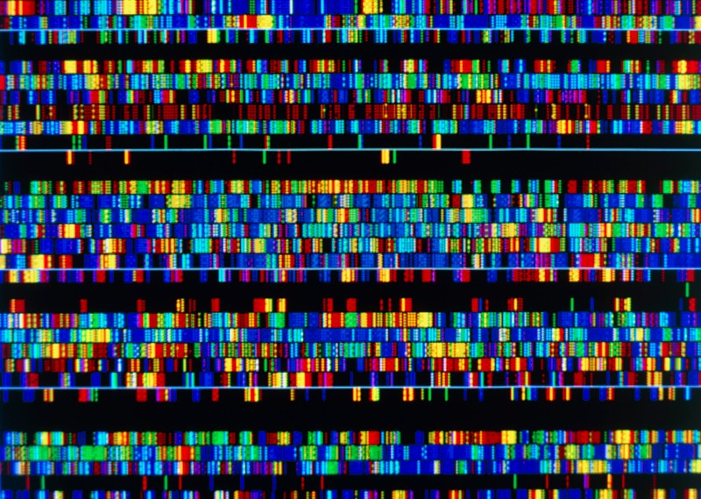
Example applications of machine learning
Example applications
Example data
facial recognition
tumor profiling
optical character recognition
market forcasting
Handwritten digits
molecular property prediction
predicting life expectancy
Biomedical images
robot navigation
recommendation systems
clinical trial design
customer retention
image synthesis
molecular design
DNA sequences
data compression
Figures from Bronstein, M. et al. Geometric Deep Learning, AAMI. 2021., Bishop, C. M. Pattern Recognition and Machine Learning, 2006. csail.mit.edu/news/robust-ai-tools-predict-future-cancer, https://www.nature.com/articles/d41586-021-01506-w.

Slide 8

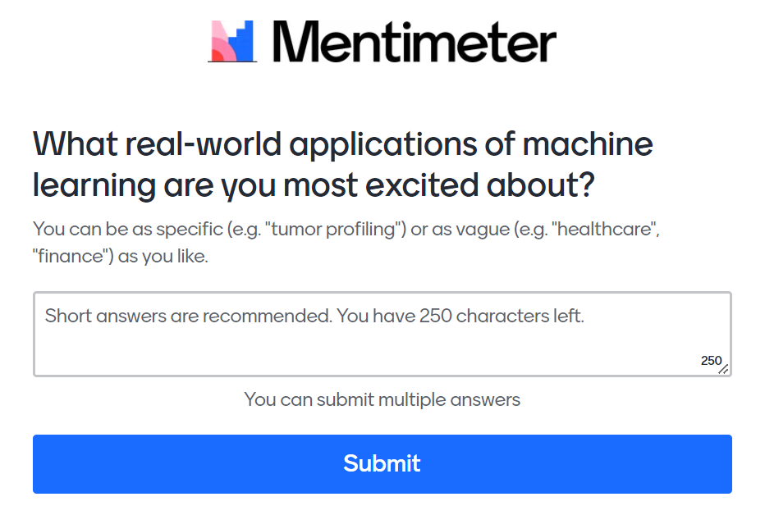
Activity 1. Survey to assess class interests (~2 minutes)
Take a minute to think about other possible applications where you could use machine learning to make predictions/decisions from data.
For example:
climate change
chemistry
healthcare
physics
finance
biology
transportation
…

Slide 9

Activity 1. Survey to assess class interests (~2 minutes)
Go to this link → bit.ly/INTROML1
or scan the QR code
Notes:
bitly link:
bit.ly/INTROML1
link to live results:
https://www.mentimeter.com/s/a8057fb8fff0481695fcdd8539703c3a/7fe146422228

Slide 10
Activity 1. Survey to assess class interests (responses)
(in browser)
Notes:
bitly link:
bit.ly/INTROML1
link to live results:
https://www.mentimeter.com/s/a8057fb8fff0481695fcdd8539703c3a/7fe146422228

Slide 11
Machine learning algorithms can be classified into three main classes
Machine learning
Supervised learning
Unsupervised learning
Reinforcement learning

Slide 12
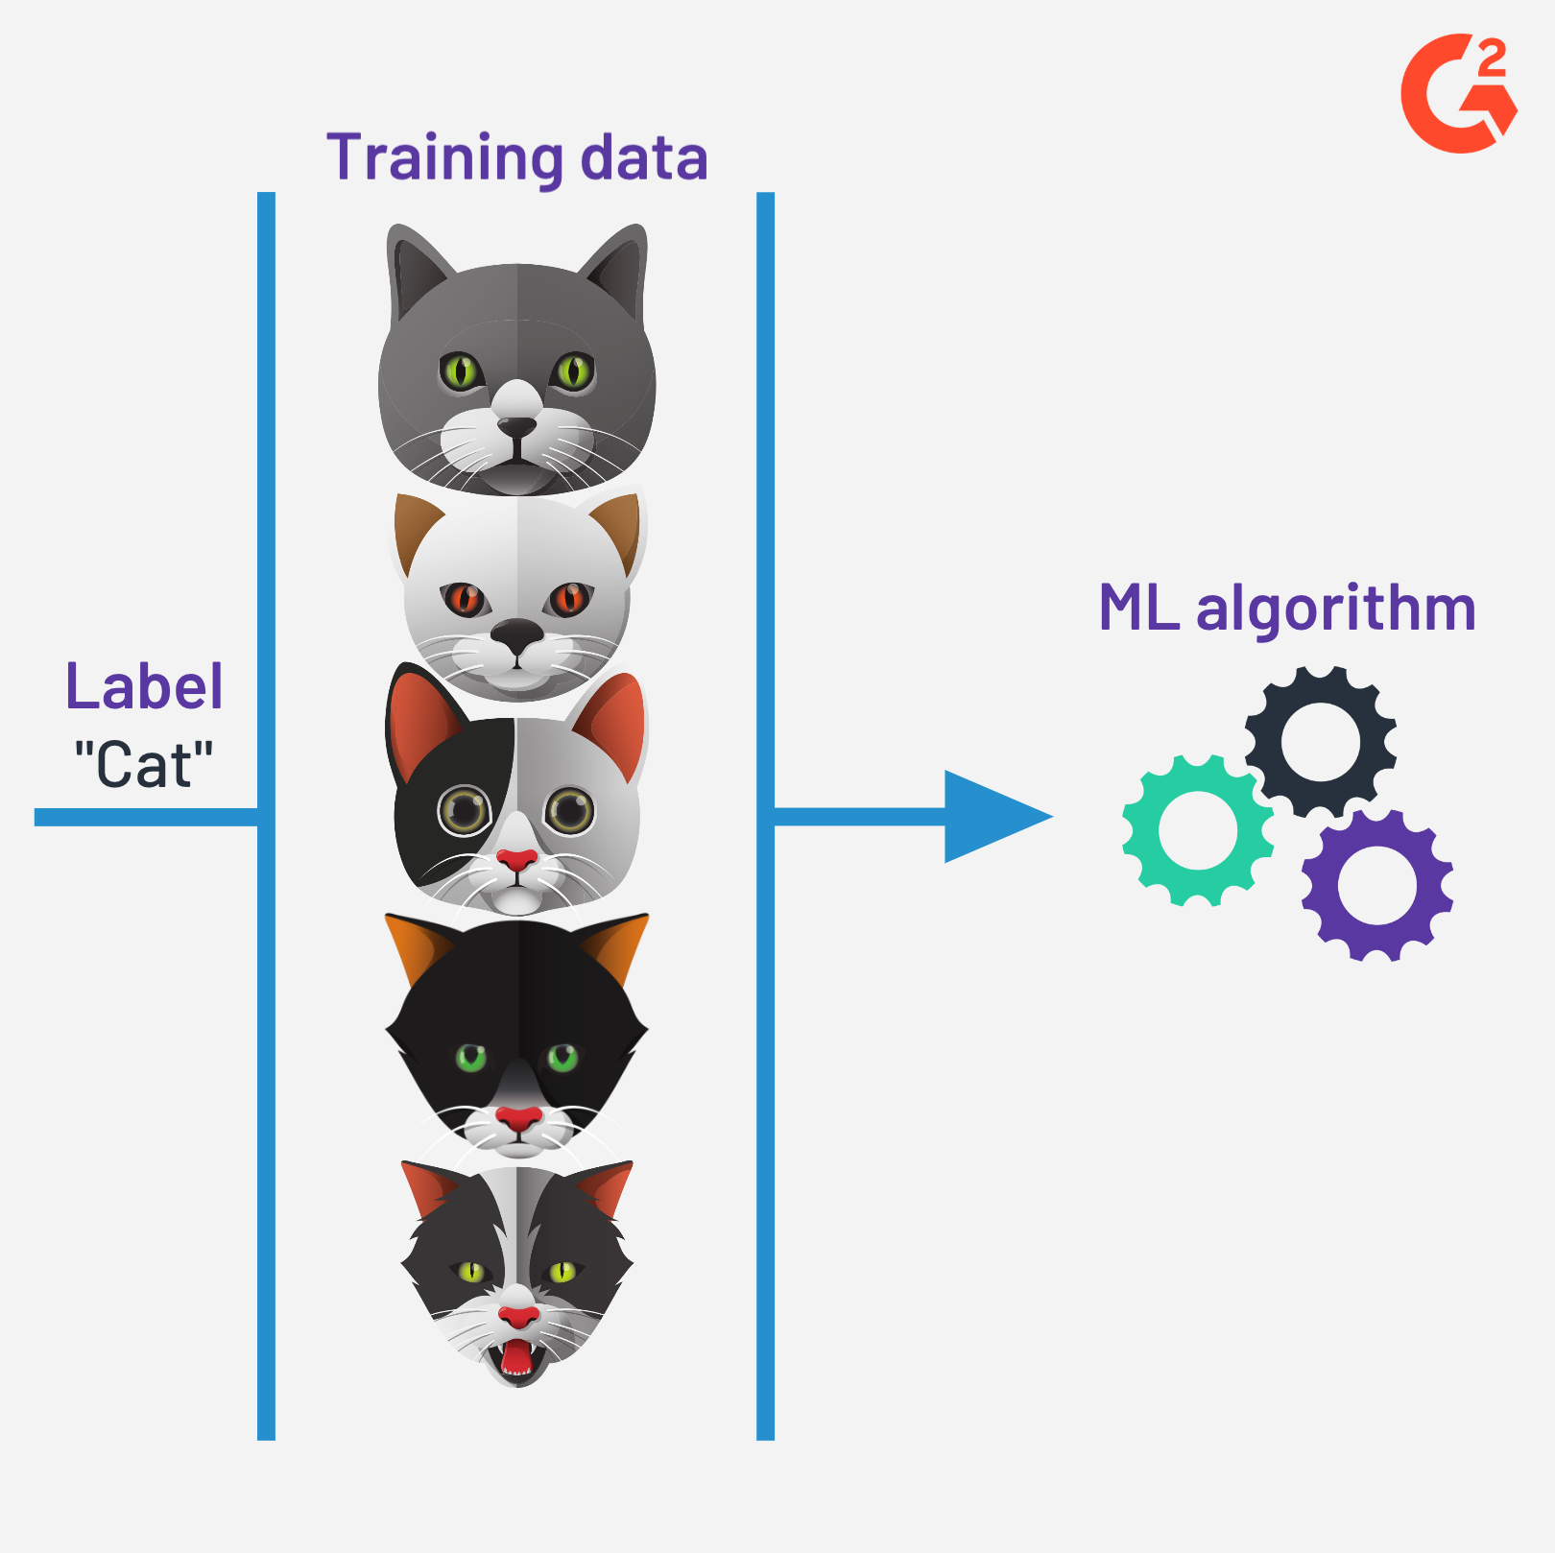
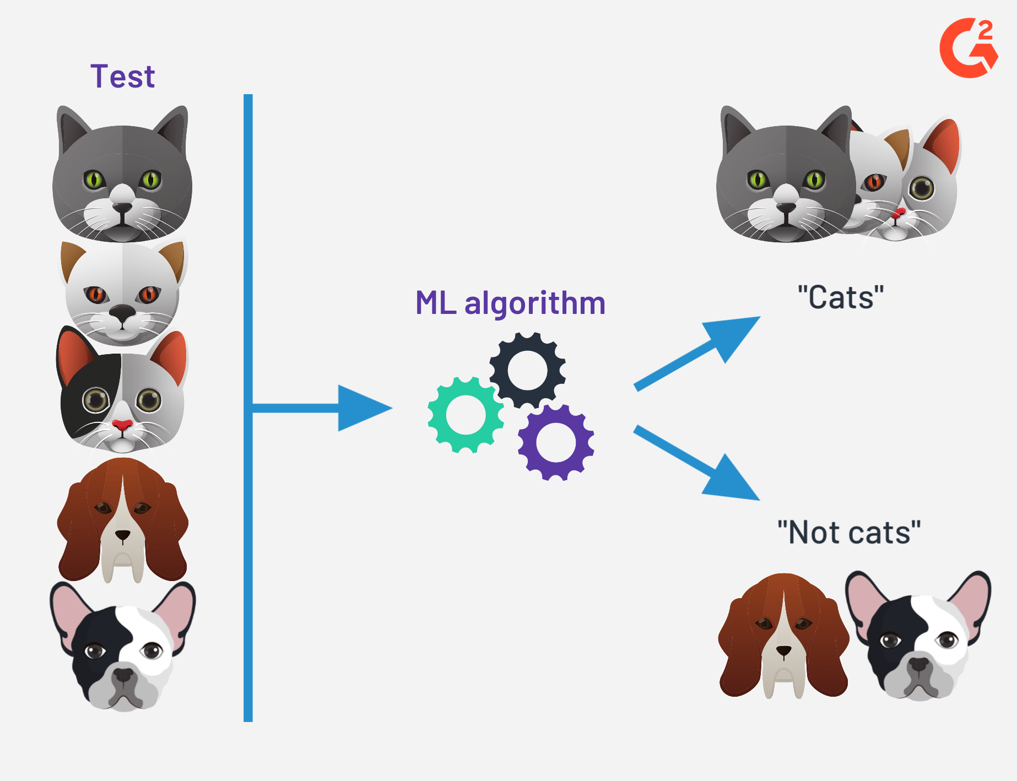
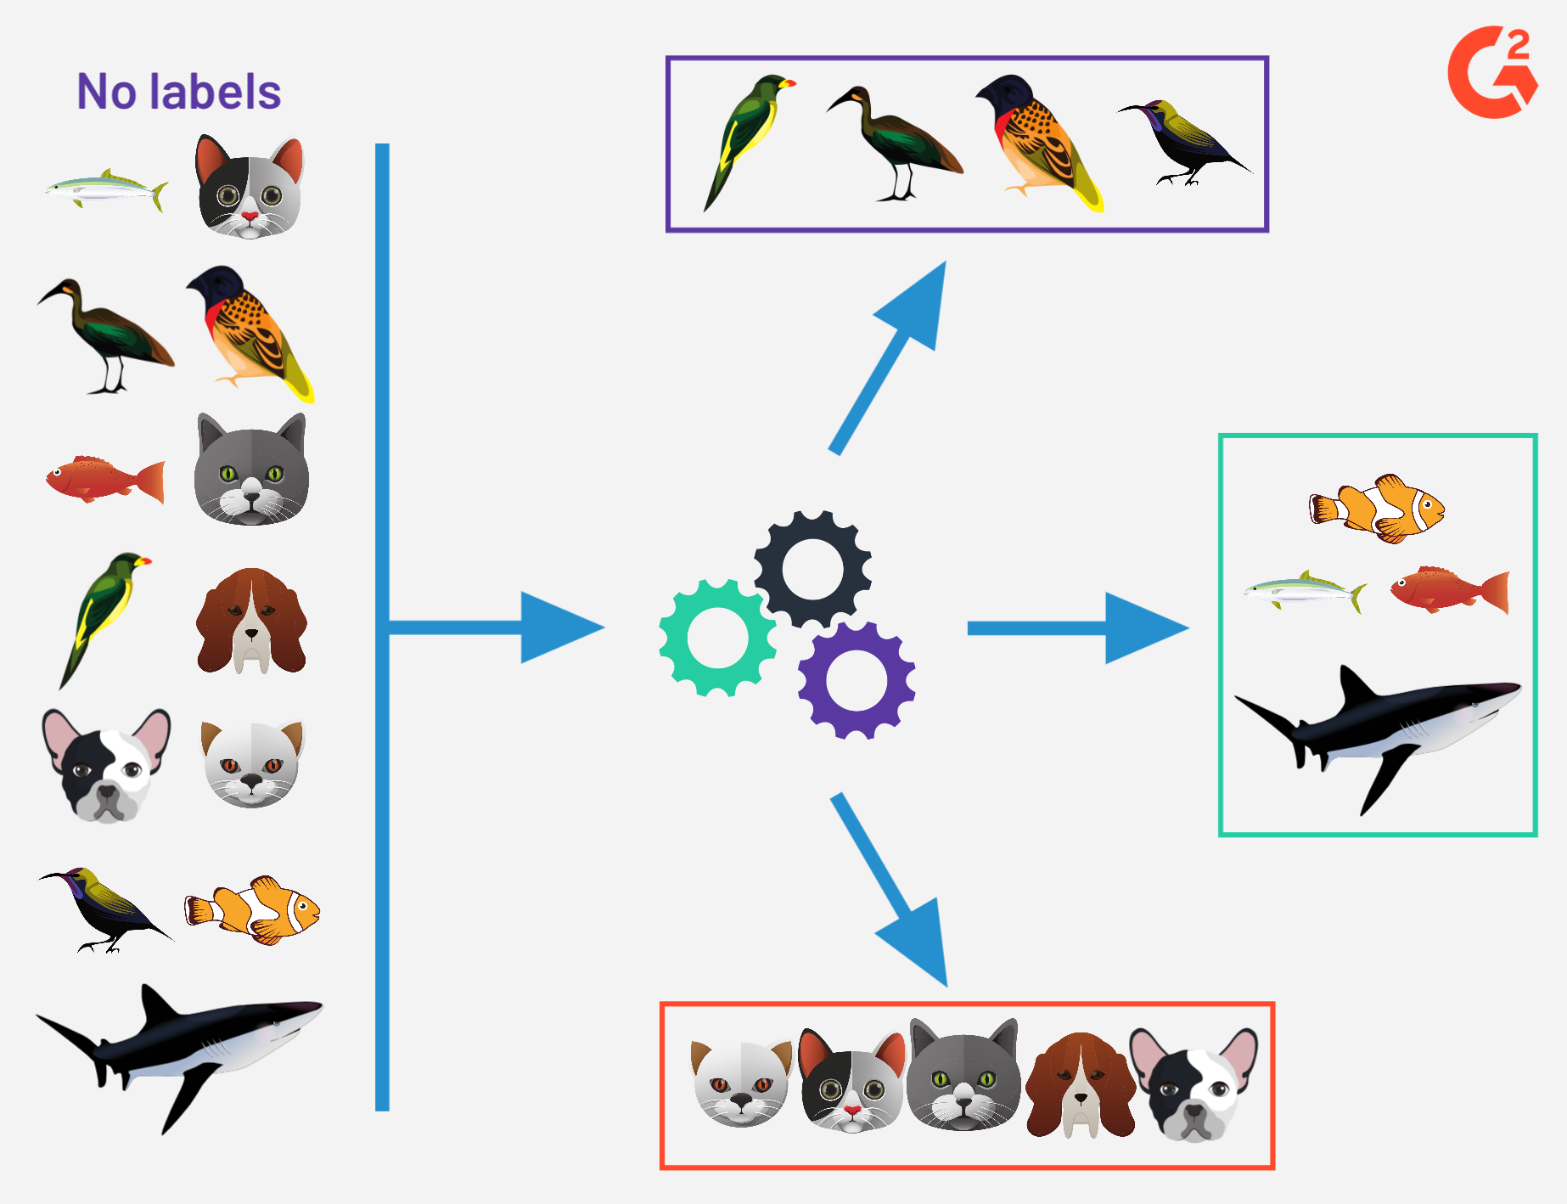

Machine learning algorithms can be classified into three main classes
Supervised learning: Learning patterns from labeled data.
Unsupervised learning: Finding patterns in unlabeled data.
Reinforcement learning: General framework via which an agent learns to select actions which maximize a reward from interacting with an environment.
(like training a dog)
Figures from https://www.g2.com/articles/supervised-vs-unsupervised-learning

Slide 13
Machine learning algorithms can be classified into three main classes
Machine learning
Supervised learning
Unsupervised learning
Reinforcement learning
Regression
Classification
Clustering
Dimensionality reduction
Outlier detection

Slide 14
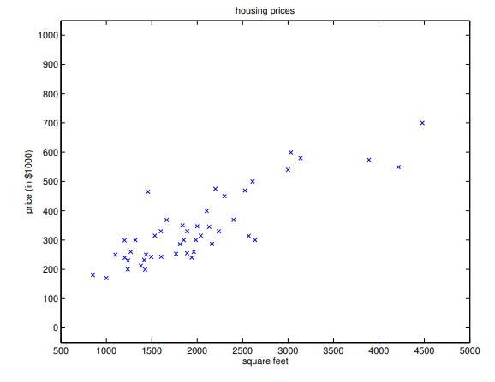
Introducing a common notation
x are the features
e.g. sq. ft., # bedrooms, year built, school district
y are the true labels
e.g. house price
ŷ are the predicted labels
(x^{i}, y^{i}) is a specific datapoint
{(x^{i}, y^{i}); i = 1, …, n} is a dataset
Dataset of 47 house prices from Portland, Oregon, figure taken from https://cs229.stanford.edu/lectures-spring2022/master.pdf

Slide 15
Introducing a common notation
x are the features
e.g. sq. ft., # bedrooms, year built, school district
y are the true labels
e.g. house price
ŷ are the predicted labels
X is the space of input features
Y is the space of output values
Dataset of 47 house prices from Portland, Oregon, figure taken from https://cs229.stanford.edu/lectures-spring2022/master.pdf

Slide 16
Supervised learning
The goal in supervised learning is to learn a function f : X → Y so as to be able to predict ŷ from new x such that:
ŷ = f (x).
If the labels y are continuous, then the task is regression.
If the labels y are discrete, then the task is classification.
→ predicting dwelling price
→ predicting if dwelling is a house or an apartment

Slide 17
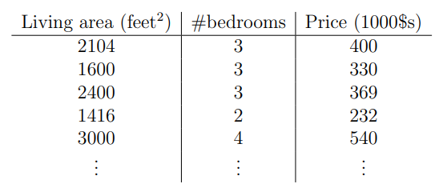
Building a simple regression model: predicting housing prices
Let's say we want to predict a house's price based on the living area and number of bedrooms.
To perform supervised learning, we must decide how we're going to represent f.
x₁
x₂
y
Dataset of 47 house prices from Portland, Oregon, figure taken from https://cs229.stanford.edu/lectures-spring2022/master.pdf

Slide 18
Building a simple regression model: predicting housing prices
As an initial choice, let's say we want to represent ŷ as a linear function of x.
f_{θ}(x) = θ₀ + θ₁x₁ + θ₂x₂
→ θ_{i} are the parameters we want to learn
x₁
x₂
y

Slide 19
Building a simple regression model: predicting housing prices
As an initial choice, let's say we want to represent ŷ as a linear function of x.
We can rewrite this more conveniently as:
f_{θ}(x) = θ₀ + θ₁x₁ + θ₂x₂
→ θ_{i} are the parameters we want to learn
f_{θ}(x) = θ₀x₀ + θ₁x₁ + θ₂x₂ where x₀ = 1
x₀
x₁
x₂
(for a single datapoint)
f_{θ}(x) = θ^{T}x
θ^{T}= θ₀ θ₁ θ₂
x =

Slide 20
Building a simple regression model: predicting housing prices
As an initial choice, let's say we want to represent ŷ as a linear function of x.
We can rewrite this more conveniently as:
f_{θ}(x) = θ₀ + θ₁x₁ + θ₂x₂
→ θ_{i} are the parameters we want to learn
ŷ¹
ŷ² .
⋮
ŷ^{n}
(x¹)^{T}
(x²)^{T}.
⋮
(x^{n})^{T}
(x¹)^{T} = 1 x₀¹ x₀²
for the full dataset:
θ₀
θ₁
θ₂
Ŷ = Xθ
where Ŷ =
X =
θ =

Slide 21
Building a simple regression model: predicting housing prices
How do we find the best parameters, θ*?
Make Ŷ as close to Y as possible for the training examples
Define a cost function ("least squares"):
This is a convex function.
J (θ) = || X θ – Y ||²

Slide 22
Building a simple regression model: predicting housing prices
How do we find the best parameters, θ*?
The best parameters θ* minimize the cost function J:
This has a closed-form solution.
However, for large n, it can be computationally cheaper to find a solution using gradient descent.
J (θ) = || X θ – Y ||²
→ θ* = argmin_{θ} J (θ)

Slide 23
Next lecture
Continue with linear regression
Gradient descent
Solve housing prices model (find θ*) using both closed-form solution and gradient descent.

Slide 24
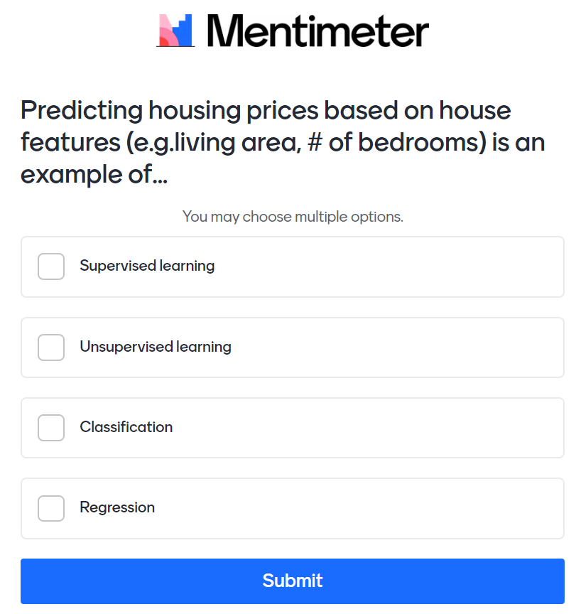

Activity 2. Quick poll to assess understanding (~2 minutes)
Go to this link → bit.ly/INTROML2
or scan the QR code
Notes:
bitly link:
bit.ly/INTROML2
link to live results:
https://www.mentimeter.com/s/f859013cf5993522f5f0d8798103c415/c581cb52dcb9

Slide 25
Activity 2. Quick poll to assess understanding (responses)
(in browser)
Notes:
bitly link:
bit.ly/INTROML2
link to live results:
https://www.mentimeter.com/s/f859013cf5993522f5f0d8798103c415/c581cb52dcb9

