Slide 1

Data-driven molecular design and optimization: graphs as molecular representations
Dr. Rocío Mercado
Department of Chemical Engineering, MIT
Kaufman Teaching Certificate Program Microteaching Session 2
Wednesday April 20, 2022

Slide 2
Intended learning outcomes (ILOs)
Microteaching learning goals
By the end of the 10-minute sessions, students will be able to:
Explain graphs as a data structure
Define two basic elements of a molecular graph representation
an adjacency matrix
a node features matrix
Build a molecular graph for a simple molecule of fewer than 10 heavy atoms

Slide 3
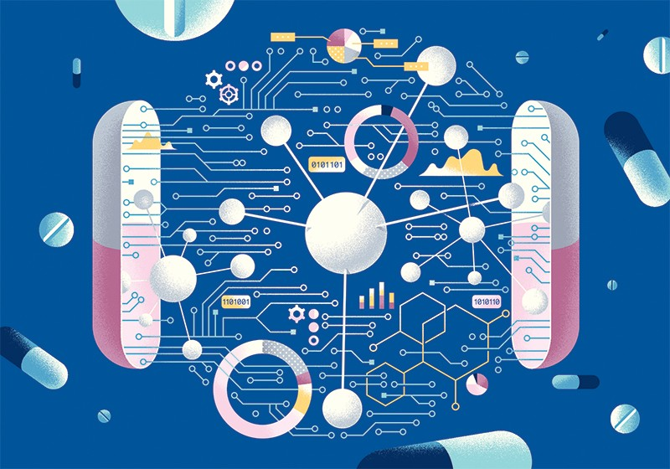
Machine learning (ML) has powerful applications in molecular design.
We discussed how machine learning can be applied to tasks in molecular design and optimization, e.g., pharmaceutical drug design.
Figure from https://media.nature.com/lw800/magazine-assets/d41586-018-05267-x/d41586-018-05267-x_15789480.jpg

Slide 4
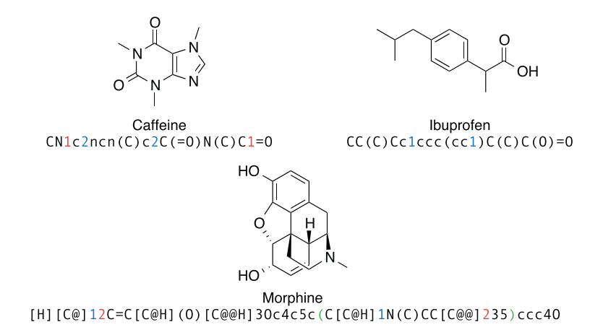
Representing molecules on a computer
How do we represent molecules in ways that a computer can understand?
molecular strings (SMILES)
2D graph depictions
+ many other data structures!
Figure 1 from Segler et al. arXiv:1701.01329. 2017.

Slide 5
Graphs (data structure)
Graphs are by far the most important data structures, as most other molecular representations build upon this one.
A graph is a tuple of nodes and edges. We write this as G = ( V , E ).
( V , E )
V → set of all nodes
E → set of all edges
( ) → indicates tuple
G
G → graph object

Slide 6
Graphs (data structure)
The typical convention is V → atoms and E → bonds, although this is actually arbitrary!
we will use V → atoms and E → bonds for this lecture

Slide 7
Graphs (data structure)
One common way of representing the sets of nodes and edges in a graph data structure is using matrices.
encodes connectivity of nodes
encodes identity of nodes
( , )
X
A
node features matrix
adjacency matrix

Slide 8
A note on sets versus matrices
A set is a collection of objects (e.g. nodes or edges) where the order does not matter.
In a matrix, the order matters.

Slide 9
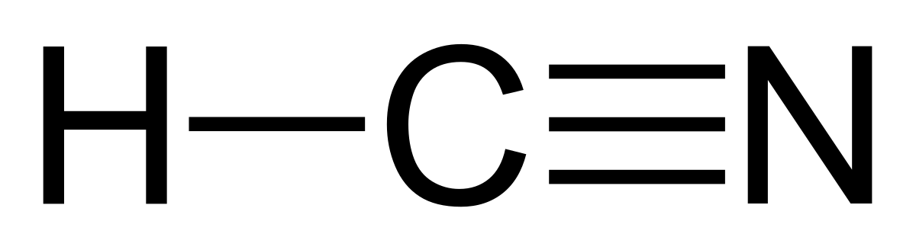
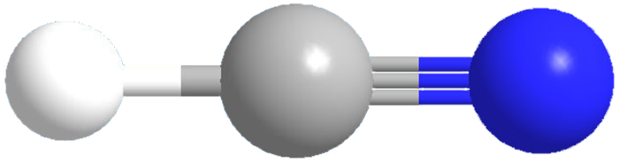
An example molecular graph: hydrogen cyanide
1
2
3
hydrogen cyanide
node features matrix:
adjacency matrix:
 | H | C | N
1 | 1 | 0 | 0
2 | 0 | 1 | 0
3 | 0 | 0 | 1
 | 1 | 2 | 3
1 | 0 | 1 | 0
2 | 1 | 0 | 1
3 | 0 | 1 | 0
X =
A =
encodes identity of nodes
encodes connectivity of nodes
Hydrogen cyanide figure from https://www.acs.org/content/dam/acsorg/molecule/archive-new/h/hydrogen-cyanide-3d.png

Slide 10
An example molecular graph: hydrogen cyanide
1
2
3
hydrogen cyanide
node features matrix:
adjacency matrix:
 | 1 | 0 | 0
 | 0 | 1 | 0
 | 0 | 0 | 1
 | 0 | 1 | 0
 | 1 | 0 | 1
 | 0 | 1 | 0
This is just one way to represent HCN; there are many other ways we can represent it.
X =
A =

Slide 11
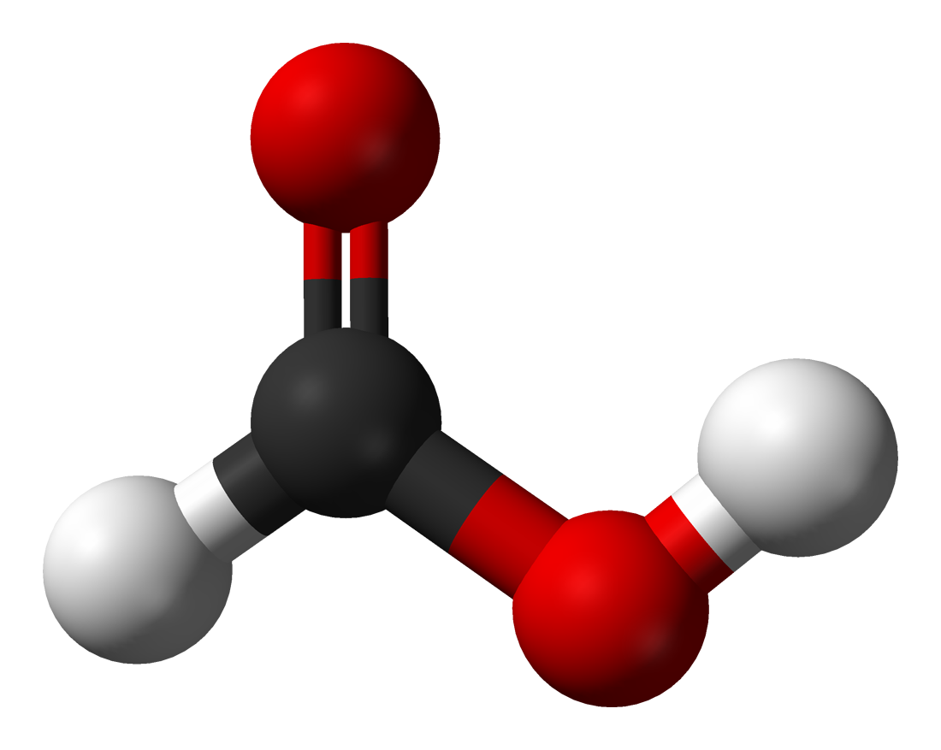
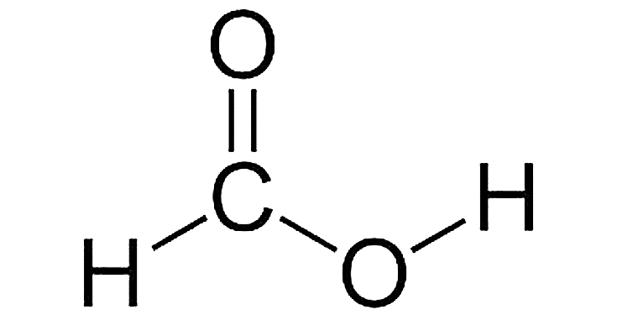
Activity: let's build a graph for a small molecule
3
node features matrix:
5
2
 | 1 | 0 | 0
 | 0 | 1 | 0
 | 0 | 0 | 1
 | 0 | 0 | 1
 | 1 | 0 | 0
 | 0 | 1 | 0
 | 0 | 0 | 1
 | 1 | 0 | 0
 | 0 | 1 | 0
 | 0 | 0 | 1
 | 0 | 0 | 1
 | 1 | 0 | 0
 | H | C | O
1
2
3
4
5
 | 1 | 0 | 0
 | 1 | 0 | 0
 | 0 | 1 | 0
1
4
X =
formic acid
rows: node index
columns: atom type
Formic acid figure from https://upload.wikimedia.org/wikipedia/commons/f/f6/Formic-acid-3D-balls-A.png

Slide 12
Activity: let's build a graph for a small molecule
3
adjacency matrix:
5
2
 | 0 | 1 | 0 | 0 | 0
 | 1 | 0 | 1 | 1 | 0
 | 0 | 1 | 0 | 0 | 0
 | 1 | 2 | 3 | 4 | 5
1
2
3
4
5
 | 0 | 1 | 0 | 0 | 0
 | 1 | 0 | 1 | 1 | 0
 | 0 | 1 | 0 | 0 | 0
 | 0 | 1 | 0 | 0 | 0
 | 1 | 0 | 1 | 1 | 0
 | 0 | 1 | 0 | 0 | 0
 | 0 | 1 | 0 | 0 | 1
 | 0 | 0 | 0 | 1 | 0
 | 0 | 1 | 0 | 0 | 0
 | 1 | 0 | 1 | 1 | 0
 | 0 | 1 | 0 | 0 | 0
 | 0 | 1 | 0 | 0 | 1
1
matrix is symmetric
A^{T} = A
4
A =
formic acid
rows: node index
columns: node index
0 → no bond
1 → bond exists

Slide 13
Activity: let's build a graph for a small molecule
3
5
2
1
4
node features matrix:
adjacency matrix:
 | 1 | 0 | 0
 | 0 | 1 | 0
 | 0 | 0 | 1
 | 0 | 0 | 1
 | 1 | 0 | 0
 | 0 | 1 | 0 | 0 | 0
 | 1 | 0 | 1 | 1 | 0
 | 0 | 1 | 0 | 0 | 0
 | 0 | 1 | 0 | 0 | 1
 | 0 | 0 | 0 | 1 | 0
formic acid
X =
A =

Slide 14
Activity: let's build a graph for a small molecule
3
5
2
1
4
node features matrix:
adjacency matrix:
 | 1 | 0 | 0
 | 0 | 1 | 0
 | 0 | 0 | 1
 | 0 | 0 | 1
 | 1 | 0 | 0
 | 0 | 1 | 0 | 0 | 0
 | 1 | 0 | 1 | 1 | 0
 | 0 | 1 | 0 | 0 | 0
 | 0 | 1 | 0 | 0 | 1
 | 0 | 0 | 0 | 1 | 0
formic acid
X =
A =

Slide 15
Next lecture
How do we encode bond information?
Other ways to encode a graph?

