Slide 1
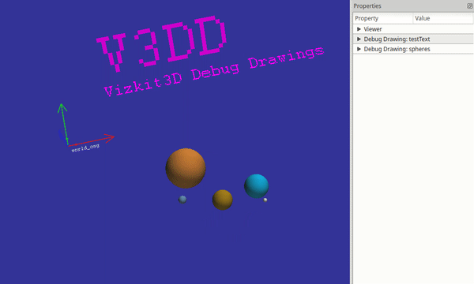
V3DD

Slide 2
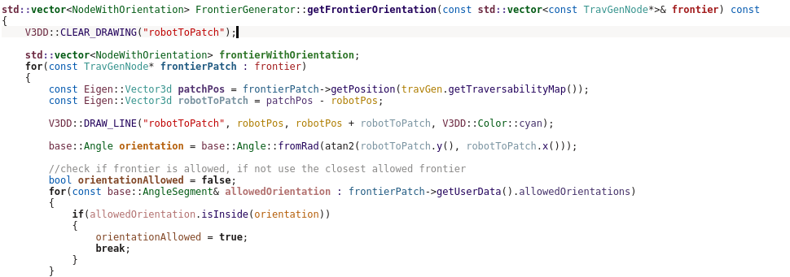
What?
Printf-style debugging, but in 3D!
Draw (and plot) from anywhere inside your code
Zero runtime overhead when disabled
Use with ROCK, or without :-)

Slide 3




How to (simple usecase)
Link vizkit3d_debug_drawings.
Enable debug drawings.
Configure debug drawings at
program startup.
Declare your drawing channels in any cpp file.
This is only required if you want to send debug drawings through ROCK ports. However it is good style to always declare them.
Draw.

Slide 4
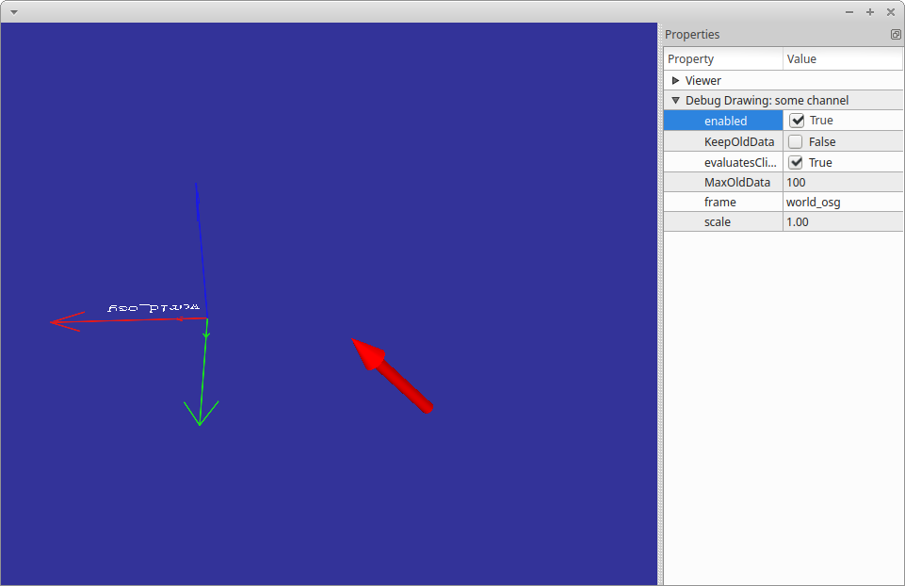
How to (simple usecase)
Result: This window pops up (in a separate thread).

Slide 5
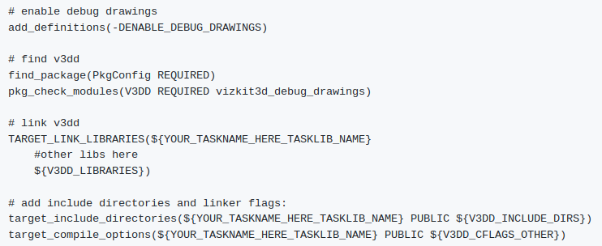


How to use in a ROCK Task
Link V3DD (In CmakeLists.txt)
Load typekit (In *.orogen)
Add dynamic output port (In *.orogen)

Slide 6
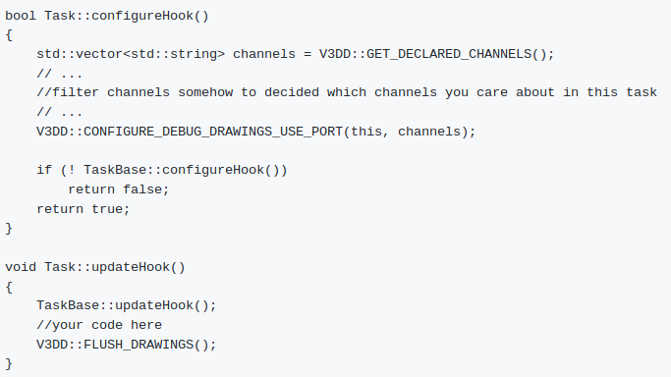
How to use in a ROCK Task
Configure in Task.cpp

Slide 7
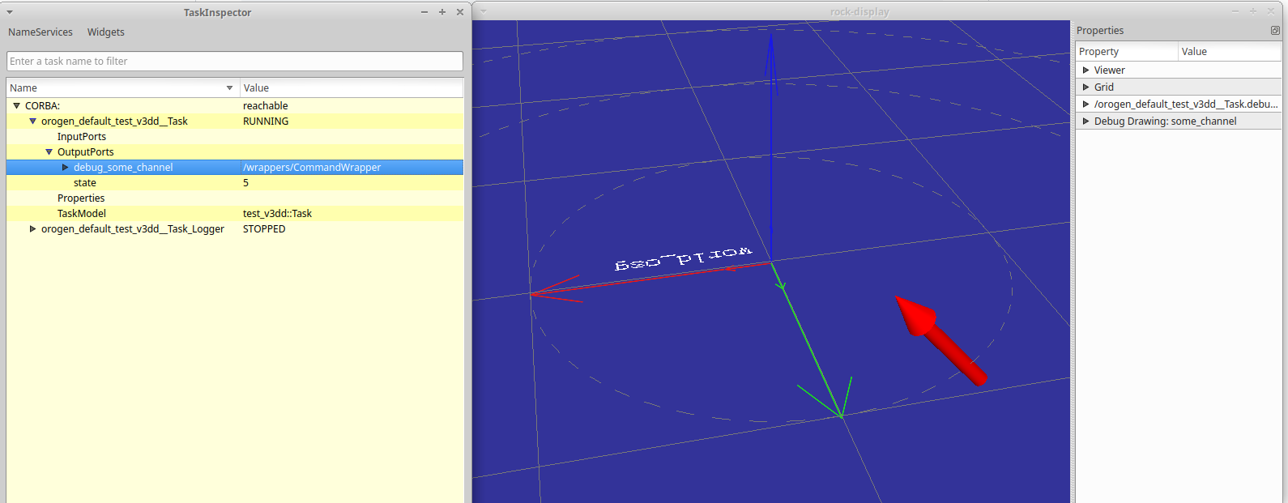
How to use in a ROCK Task
Result: A new port is created for each configured drawing channel.
Visualizing the data on the port displays the drawings.

Slide 8
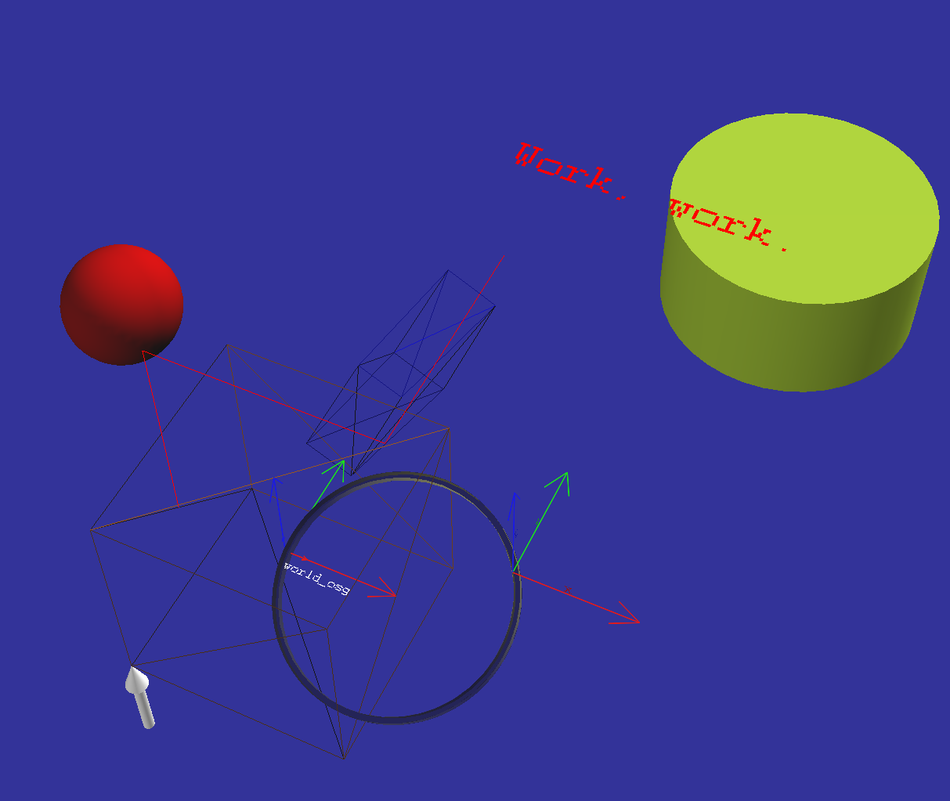
Drawing Primitives
Based on osgViz primitives
Following primitives exist:
  Sphere
  Cylinder
  Ring
  Wireframe Box
  AABB
  Polyline
  Arrow
  Axis
Can be extented using command pattern

Slide 9
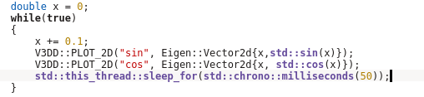
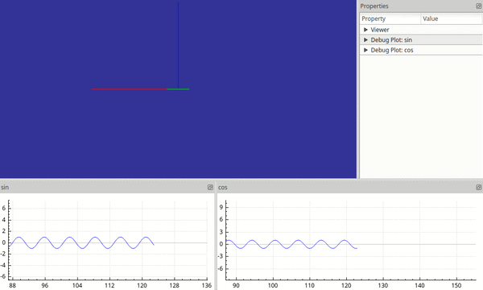
Plotting

Slide 10
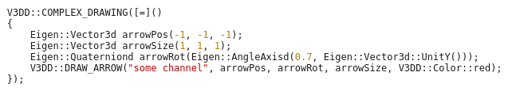
Complex Drawings
When disabled all drawing operations become noops
But what about the boilerplate?
Solution: COMPLEX_DRAWING()

Slide 11
Download and Documentation
https://github.com/rock-gui/gui-vizkit3d_debug_drawings

Slide 12
Complex Drawings
When disabled all drawing operations become noops
But what about the boilerplate?
Solution: COMPLEX_DRAWING()

