Slide 1
Energy-Efficient CPU Scheduling Algorithm
Final Year Project Presentation
Name: Abhishek kumar
Roll No: 50
Registration Number: 12405811

Slide 2
Problem Statement
Traditional CPU scheduling improves performance but ignores power and thermal limits.
This causes faster battery drain and overheating in mobile and embedded systems.

Slide 3
Project Objectives
- Reduce energy consumption using DVFS
- Include thermal-aware scheduling decisions
- Balance performance, fairness, and power efficiency
- Compare baseline and optimized results

Slide 4
Core Concepts
DVFS: Dynamically adjusts CPU frequency and voltage.
Thermal-aware scheduling: reduces speed when temperature is high.
Combined approach saves energy and controls heat.

Slide 5
Proposed Scheduling Logic
1. Read burst, priority, temperature, and base power.
2. Score tasks using priority, short-job bonus, fairness aging, and thermal penalty.
3. Select best task.
4. Choose DVFS level (LOW/MEDIUM/HIGH).
5. Compute power, time, and energy.

Slide 6
DVFS Decision Rules
- If temperature >= 80 C, use LOW.
- If urgent task (priority <= 2 or burst <= 4), use HIGH.
- If moderate heat (>=70 C), use MEDIUM.
- Long tasks prefer LOW for saving power.

Slide 7
C Implementation Highlights
- Implemented in C for process scheduling simulation.
- Accepts user input for process data.
- Computes baseline vs optimized energy.
- Shows scheduling order, DVFS level, execution time, and energy.

Slide 8
Sample Result
Baseline Energy: 640.00 J
Optimized Energy: 512.89 J
Energy Saved: 19.86%
Optimized Order: P2 -> P4 -> P1 -> P3

Slide 9
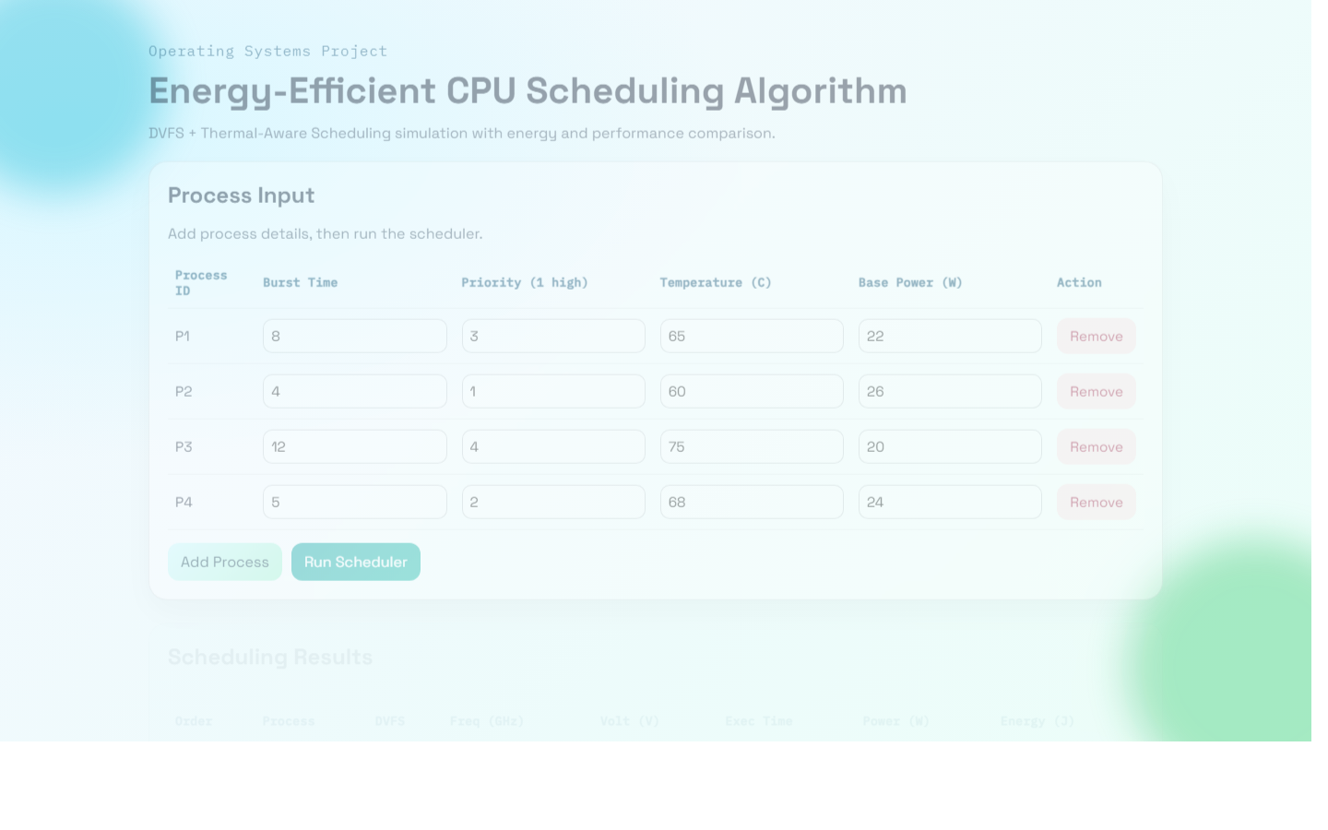
Website Demo Screenshot

Slide 10
Conclusion and Future Work
The proposed scheduler reduces energy while keeping acceptable performance.
Future work: multi-core support, real sensor integration, and ML-based DVFS prediction.

