Slide 1

Web Architecture
Aplicações para a Internet
Engenharia Informática – 2015/2016

Slide 2
Copyright
Based on contents originally created by:
Vítor Caneco (vitorcaneco@gmail.com)
Diogo Lopes (dporem@gmail.com)
Contributors:
Norberto Henriques (norberto.henriques@ipleiria.pt)
Carlos Urbano (carlos.urbano@ipleiria.pt)
Fernando Silva (fernando.silva@ipleiria.pt)
Alexandrino Gonçalves (alex@ipleiria.pt)
Ana Nogueira
João Real
Michael Pinheiro
Revised on: February, 2016
Fernando Silva (fernando.silva@ipleiria.pt)
Notes:
Internet, Base de dados, Email, …

Slide 3
The Internet
In 1969, scientists and researchers of the Department Of Defense of the US government remotely exchanged information. That 1st network was designated ARPANET:
It connected one computer in Utah with three in California.
Later, the DOD allowed the universities to join the network for sharing hardware and software resources
During the 1980s the military network was separated from the civil network. The Internet was born.
Internet => Interconnected Network
Source: http://www.livinginternet.com/i/ii_arpanet.htm
Notes:
Originally with 4 supercomputers, in 1969, scientists and researchers of the defence state department of the United States government remotely exchanged information. That 1st network was designated ARPANET.
During the 1980s the military network was separated from the civil network. The Internet was born.
Internet => Interconnected Network

Slide 4

The Internet
Global system of interconnected computer networks
Uses the standard Internet protocol suite (TCP/IP) to link several billion devices worldwide
It is a network of networks that consists of millions of private, public, academic, business, and government networks of local to global scope, linked by a broad array of electronic, wireless, and optical networking technologies
Source: https://tools.ietf.org/html/rfc1122#page-7

Slide 5
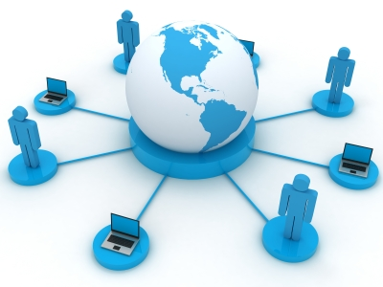
The Internet
Carries an extensive range of information resources and services, each one with its own protocol, such as:
World Wide Web (WWW)
email
ftp
telnet
...

Slide 6
Client/Server Architecture ^{1/2}
Client runs on the computer and makes requests to the services available on the server.
Server is an host that responds to the requests of the clients.
One client can make requests to more than one server.
One server can reply to several clients simultaneously.
There are several types of servers: web, database, e-mail…
Notes:
Internet, Base de dados, Email, …

Slide 7
Client/Server Architecture ^{2/2}
1
Client makes a request to the server
Server replies to the request
2

Slide 8
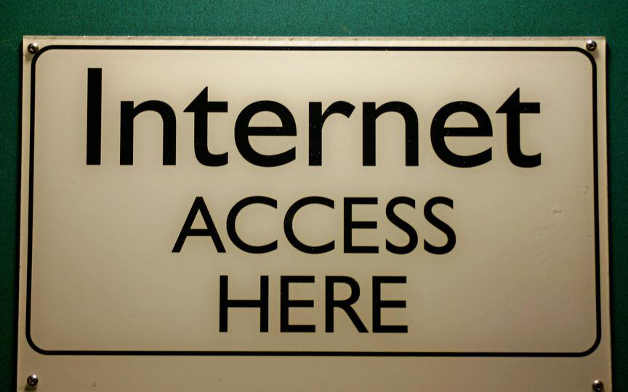
Internet

Slide 9
Internet Architecture ^{1/4}
The Internet is the largest computer network
It uses several protocols for transmitting information between clients and servers
HTTP is the most widely used protocol
Other protocols:
DNS (Domain Name Server)
FTP (File Transfer Protocol)
HTTPS (HTTP Secure)

Slide 10
Internet Architecture ^{2/4}
HTTP - Hypertext Transfer Protocol
It is a Request/Reply protocol that operates between clients and web servers.
It allows sending several different data types from the Server to the Client, including HTML code.
When a client “asks” for a URL address, a HTTP request is sent to the server, which by its turn reply to the client, an HTML file for example.
Other type of data: CSS, JPG, SWF

Slide 11
Internet Architecture ^{3/4}
The Web implements the concept of hypertext (text + links)
Uniform Resource Identifier (URI) is a string of characters used to identify a name or a resource on the web
URIs can be classified as locators (URLs), as names (URNs), or as both.
Uniform Resource Name (URN) defines an item's identity
Uniform Resource Locator (URL) provides a method for finding it

Slide 12
Internet Architecture ^{4/4}
URL - Uniform Resource Locator
It is a string of characters that is used to identify a name or a resource on the web (Internet or Intranet)
It has the following structure:
protocol://machine/path/resource
Example:
http://www.w3.org/Consortium/presskit.html
Notes:
Browsers: Opera, Safari, Chrome

Slide 13
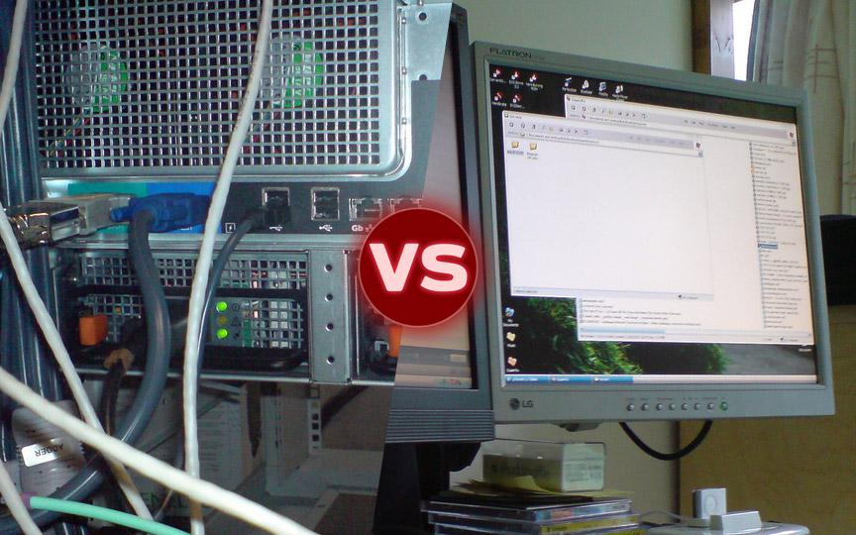
Server VS Client

Slide 14
Server Technologies ^{1/3}
Web servers are also known as HTTP servers, since this is the dominant protocol on the web
Example of web servers:
Apache
Microsoft Internet Information Services (IIS)
…
The relationship between clients and servers is N-to-N. The same client can perform requests to multiple servers; and the same server can reply to several clients

Slide 15
Server Technologies ^{2/3}
PHP is a general-purpose server-side scripting language
Originally designed for Web development to produce dynamic Web pages
Free to use under the PHP License
Alternatives:
ASP.NET (.NET bytecode)
JSP/Servlets (JAVA bytecode)
Ruby on Rails
Perl
...

Slide 16
Server Technologies ^{3/3}
MySQL is a relational database management system used to support PHP
Source code available under the terms of the GNU General Public License
Alternatives:
Microsoft SQL Server
Oracle Database System
PostgreSQL
…

Slide 17
Client Technologies ^{1/4}
Clients are known as browsers:
Firefox
Chrome
Internet Explorer
Safari
Opera
Android
...
http://www.w3schools.com/browsers/browsers_stats.asp

Slide 18
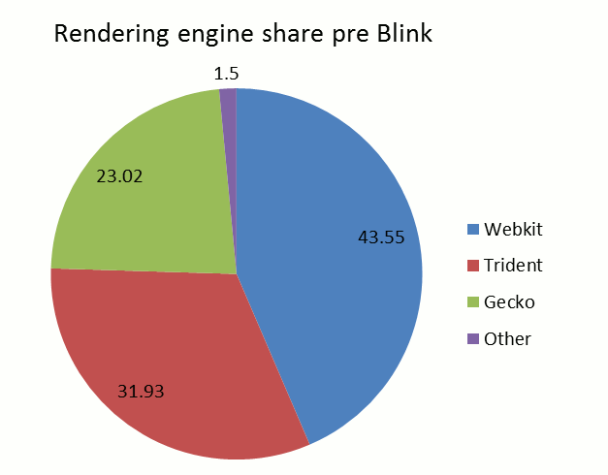
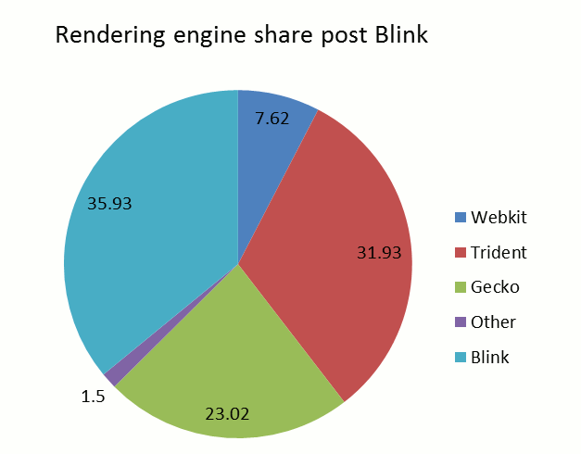
Client Technologies ^{2/4}
Browsers use Layout Engines, such as:
Webkit
Blink
Trident
Gecko
Presto
...
More at: http://gs.statcounter.com
Notes:
Layout engines mais populares vs browsers mais populares:
Blink - for Google Chrome from version 28-present, and Opera, version 15+^{[1]}
Gecko - for Firefox, Netscape
Presto - from Opera 7 to 15
Trident - for Internet Explorer since version 4.0 and embedded WebBrowser controls (such as Internet Explorer shells, Maxthon and some media players)
WebKit - for iOS (including both mobile Safari, WebViews within third-party apps, and web clips), Safari and Google Chrome up to version 27
in: http://en.wikipedia.org/wiki/List_of_layout_engines

Slide 19
Client Technologies ^{3/4}
The technologies must be known and interpreted by the client:
HTML/XHTML
Cascading Style Sheets (CSS)
Javascript
Document Object Model (DOM)
Flash
Java
ActiveX
...

Slide 20
Client Technologies ^{4/4}
Usually require specific support, needing to install a plug-in in the browser
Examples:
Flash
ActiveX
Java
Microsoft Silverlight
...

Slide 21
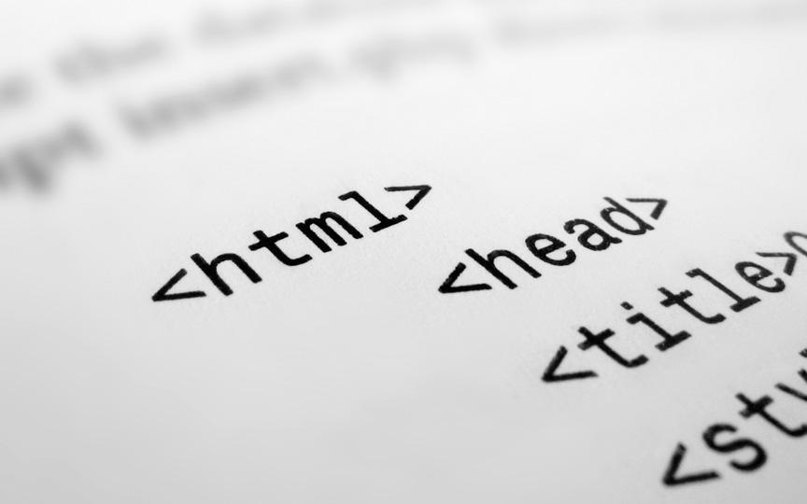
<HTML>

Slide 22
HTML
HTML- Hyper Text Markup Language
Markup language written in SGML (Standard Generalized Markup Language)
SGML is a meta-language which is a system for organizing and tagging elements of a document
SGML was developed and standardized by the International Organization for Standards (ISO) in 1986

Slide 23
HTML
Developed by Tim Berners Lee at CERN (Switzerland) in 1990
HTML is written in the form of HTML elements consisting of tags enclosed in angle brackets
Example: <table>
Current version: HTML5
W3C specification at: http://www.w3.org/TR/html5

Slide 24
HTML VS. XHTML
HTML is a tolerant language to “bad” codification (not standard). This tolerance requires the development of complex parsers to interpret the code, thus making them not suited to be used with limited resources and memory devices.
XHTML is a more strict language, that uses the XML parsers that are low resource demanding to any device/client.
This standardization improves the client/devices (mobile or not) accessibility to web pages.

Slide 25
HTML Document
<!DOCTYPE> | Defines the XHTML version and variant used in the document. This element is important to define the valid HTML syntax for the document validation.
<html> | Indicates the beginning of the HTML document. The client (browser) considerer the forward content as HTML codification.
<head> | Defines the header of the HTML document, where meta-data should be located. For example, it can contain the link to the CSS of the document or the title of the page.
<title> | This tag defines the title of the page. Usually this title appears on the upper left corner of the browser.
<body> | Where the main content of the document must be placed. This is the HTML content that is displayed by the browser.

Slide 26
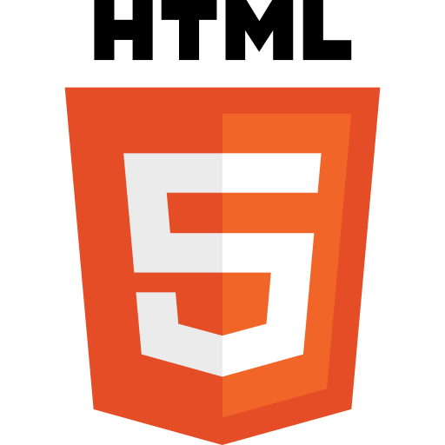
HTML5
It is still under development, but some browsers already implement some of its features
It is an improvement of HTML with, for example, support to multimedia, while keeping it easily readable and consistently understood by computers and devices (browsers, parsers,…)
HTML5 adds many new syntactical and semantic features. These include the new <video>, <audio> and <canvas> elements, as well as the integration of Scalable Vector Graphics (SVG) content

Slide 27
Quirks Mode
When a HTML document misses the DOCTYPE directive, the client assumes that the document don’t apply any norm
By this way it will interpret the document in a “quirks mode”
Quirks mode refers to a technique used by some web browsers for the sake of maintaining backward compatibility with web pages designed for older browsers and older HTML versions
Each client makes its own interpretation of the code, making the sites mismatched
This can be avoided by strictly implement the syntax and define the proper DOCTYPE

Slide 28
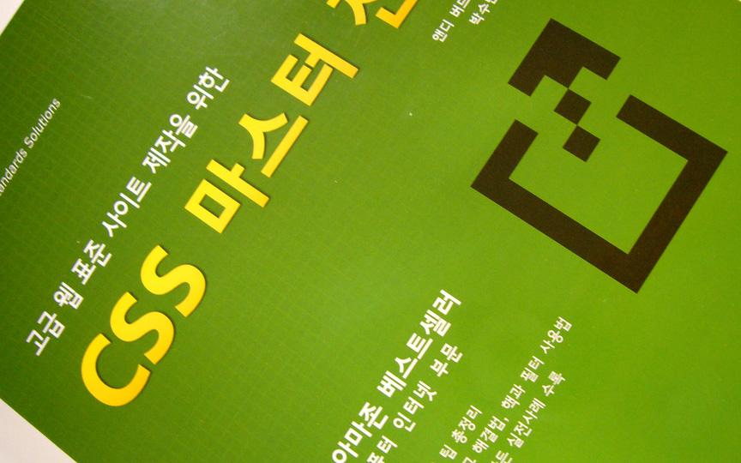
CSS

Slide 29
CSS (Cascading Style Sheet)
All visual layout of the HTML pages should be done using CSSs
Advantages:
Separate the content from appearance
More compact code
Better control over the visual layout
Update the visual appearance of several documents simultaneously

Slide 30
References
http://www.w3.org/TR/uri-clarification/
http://www.w3.org/
http://www.alistapart.com/articles/doctype/
http://www.quirksmode.org/css/quirksmode.html

Slide 31
Questions
?

