Slide 1
Deep Learning & AI
Assignment 1
team # 4
Kears- Conv2D

Slide 2
1. Conv-2D parameters
1.1 Main parameters
•Filters: Integer: the dimensionality of the output space (i.e. the number of output filters in the convolution.
• Kernel_size: An integer or tuple/list of 2 integers, specifying the height and width of the 2D convolution window. Can be a single integer to specify the same value for all spatial dimensions.
• Strides: An integer or tuple/list of 2 integers, specifying the strides of the convolution along the height and width. Can be a single integer to specify the same value for all spatial dimensions.
• Padding: one of "valid" or "same" (case-insensitive). Note that "same" is slightly inconsistent across backends with strides != 1, as described here
• Activation: Activation function to use (see activations). If you don't specify anything, no activation is applied (ie. "linear" activation: a(x) = x).
https://keras.io/layers/convolutional/#conv2d

Slide 3
1. Conv-2D parameters
1.2 Secondary parameters
• Dilation_rate: an integer or tuple/list of 2 integers, specifying the dilation rate to use for dilated convolution.
• Use_bias: Boolean, whether the layer uses a bias vector.
Initializer
• Kernel_initializer: Initializer for the kernel weights matrix (see initializers).
• Bias_initializer: Initializer for the bias vector (see initializers).
Regularizer
• kernel_regularizer: Regularizer function applied to the kernel weights matrix (see regularizer).
• Bias_regularizer: Regularizer function applied to the bias vector (see regularizer).
• Activity_regularizer: Regularizer function applied to the output of the layer (its "activation"). (see regularizer).
• Kernel_constraint, Bias_constraint
https://keras.io/layers/convolutional/#conv2d

Slide 4
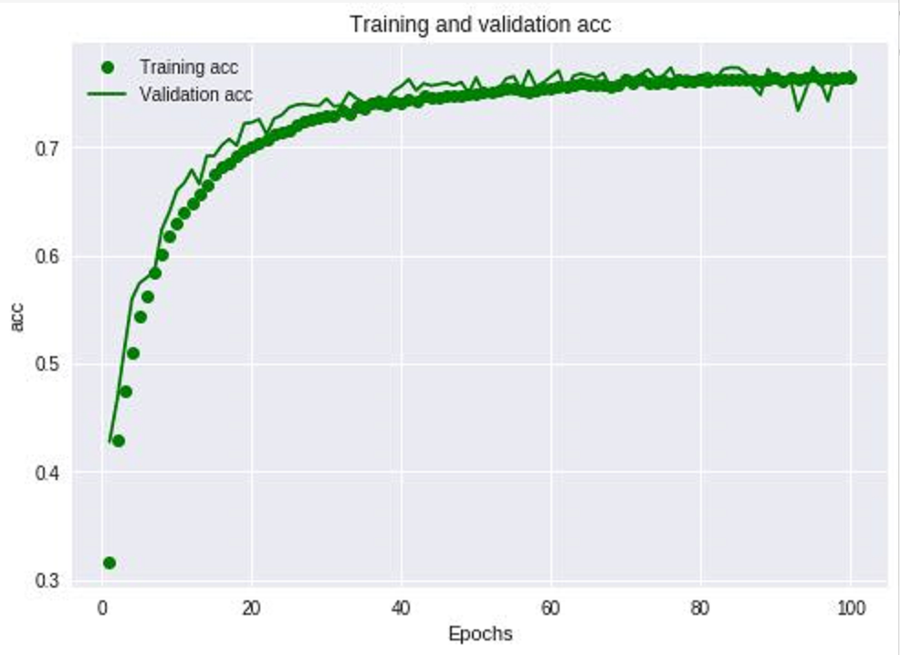
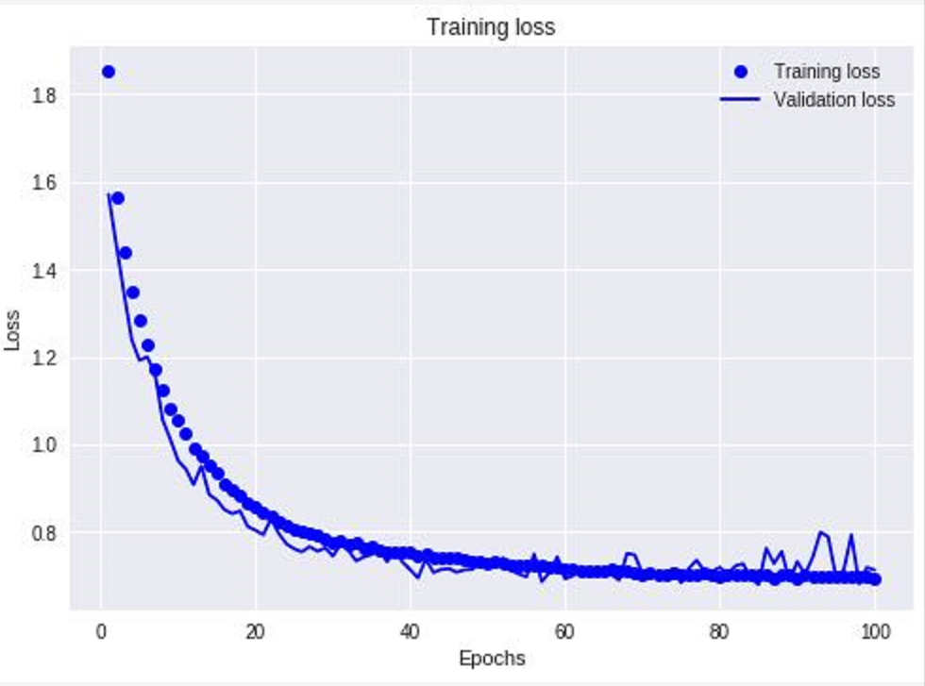
2. Main Parameters
Filters: Integer: • Kernel_size: • Strides: • Padding• Activation
2.1
Set batch_size=512,
Run base model with epochs=100
Use epochs=30, 50 to the following trials.

Slide 5
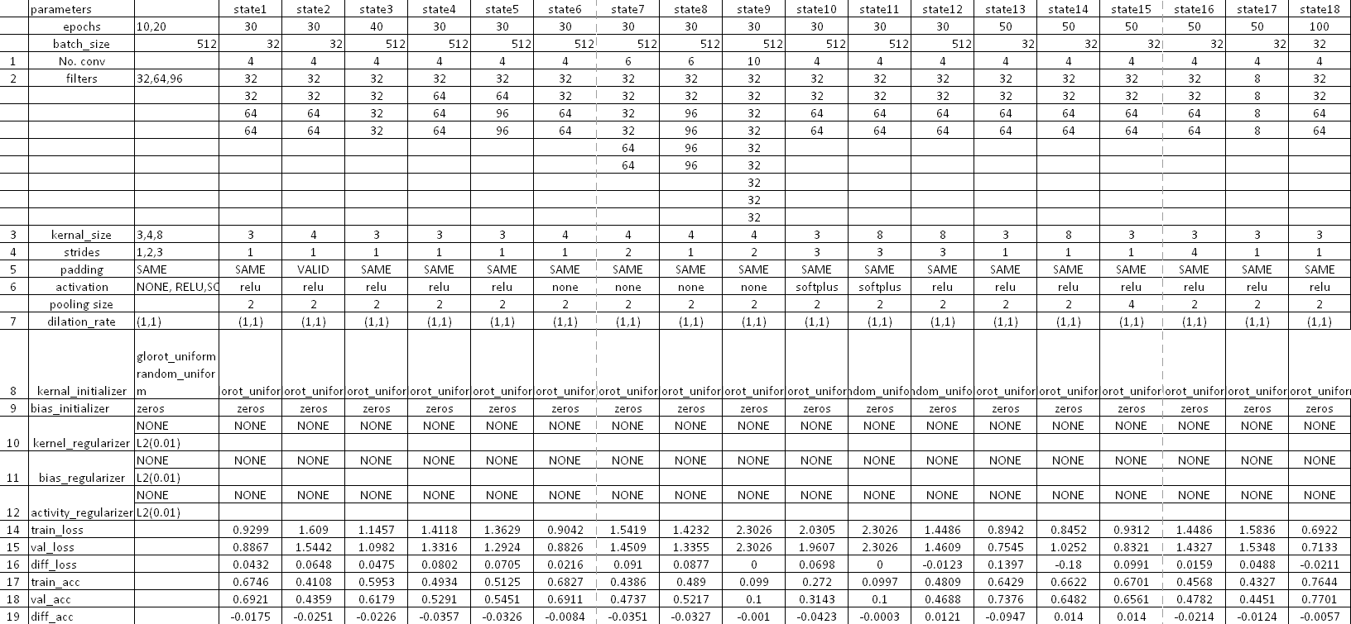
2. Main Parameters
• Set 18 models with modifying parameters
• Alter single parameter or multiple parameters

Slide 6
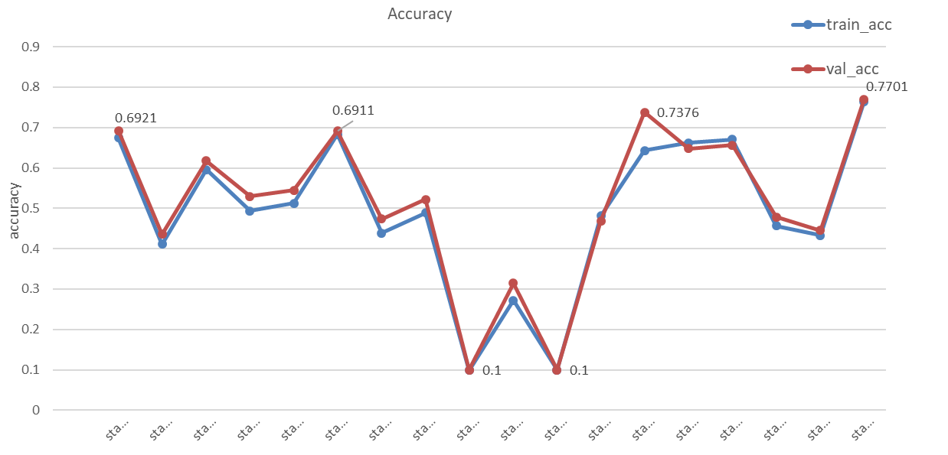
2. Main Parameters
• Set 18 models with modifying parameters
• Alter single parameter or multiple parameters

Slide 7
2. Main Parameters
• Padding:
‘SAME’ to ‘VALID’
Accuracy droped to 0.4359 from 0.6921
• Pooling size：
from‘2*2’ to ‘4*4’
Accuracy droped to 0.6561 from 0.6921
further adjusting pooling size need adjust more parameters
make trade-off

Slide 8
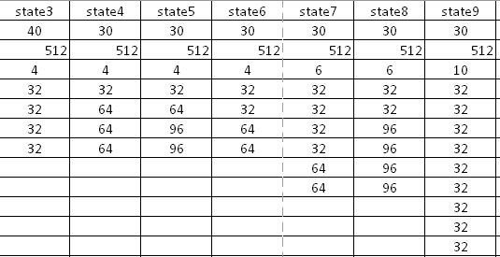
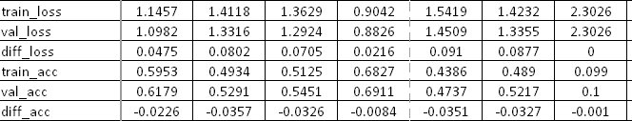
2. Main Parameters
• Filters:
• base model accuracy 0.6921
• lower than base model
• filters with convolutional layers
• make trade-off

Slide 9
2. Main Parameters
• kernel size:
• lower than base model
• make trade-off， (4*4) is better

Slide 10
2. Main Parameters
• epochs:
• not conv2D parameters
• more computing time and more accuracy than epochs=30
• Highest Accuracy:0.7701
Notes:
.

Slide 11
3. Secondary Parameters
• kernel_regularizer• Bias_regularizer• Activity_regularizer:
Avoid overfitting
Did not design out an obvious overfitting model

Slide 12
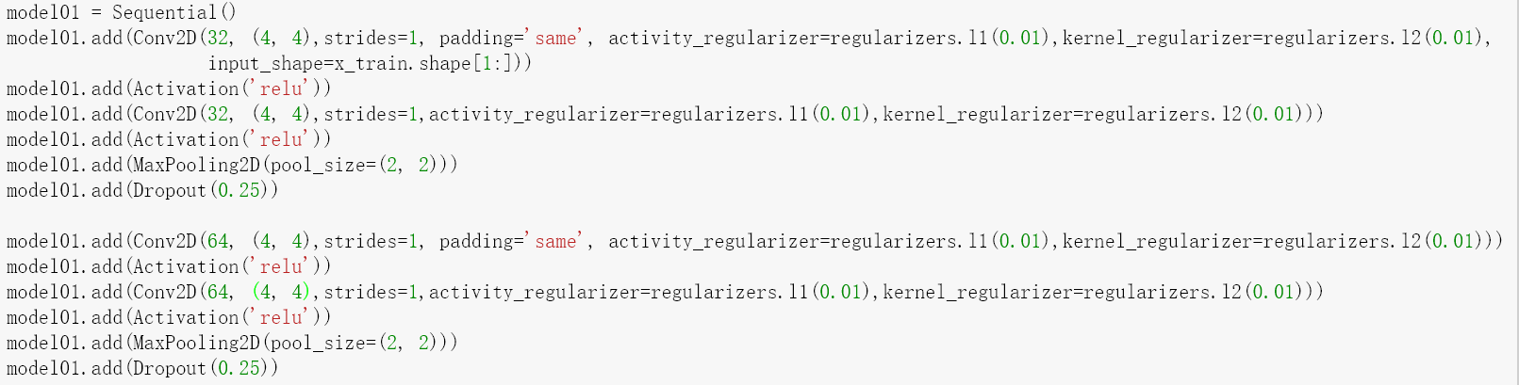
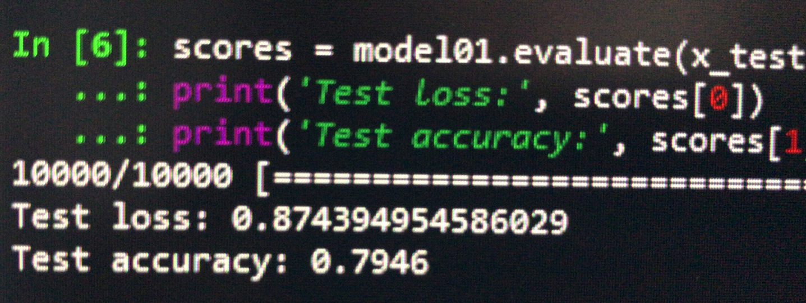
4. Optimal model

