Slide 1
Deep Learning & AI
Assignment 2
team # 4

Slide 2
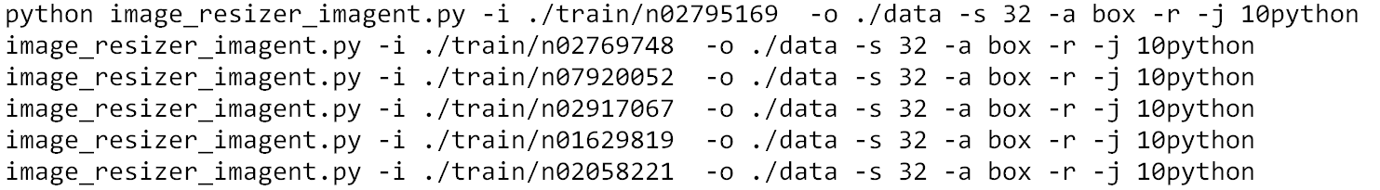
Problem1. Keras -- Tiny ImageNet
Dataset and Implementation
• Downscaled from the original Image dataset size to 32x32 format
• Wrangling data
1. Transform image information to numeric format
2. Set training data, validation data, test data(without label)
3. Ensure the data satisfying the tensor requirements of following models

Slide 3
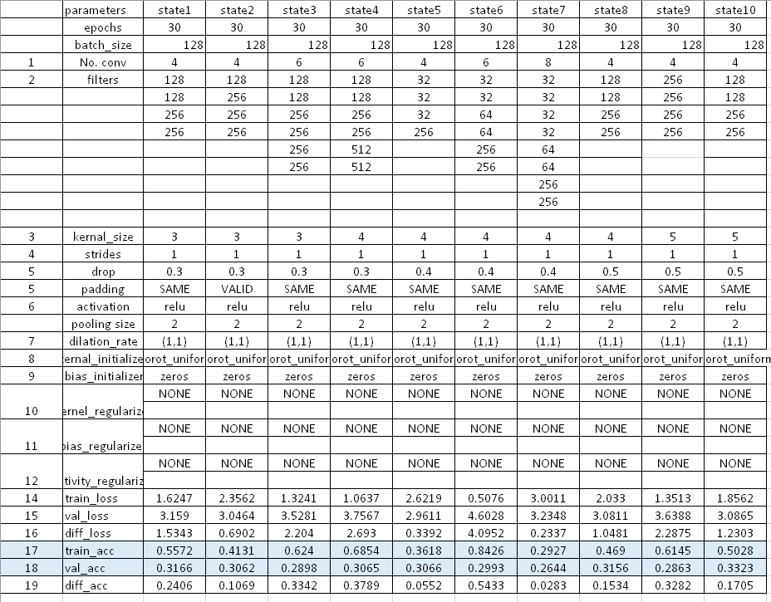
Problem1. Keras -- Tiny ImageNet
2. Train Models & Tune Parameters
Tuning by experience – activation, padding, strides, pooling…
For loop tuning: filters, kernel_size, drop_out

Slide 4
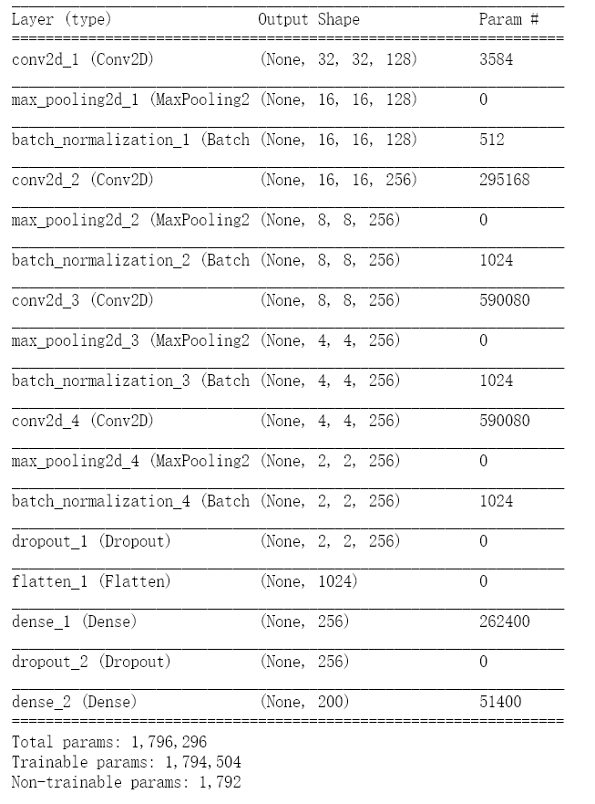
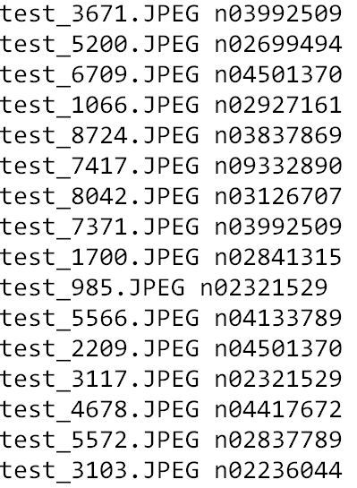
Problem1. Keras -- Tiny ImageNet
Optimal Model
Key parameters:
Conv2D layers: 4
Filters: 128,128,256,256
Dense: 2
Activation: Relu
Kenel_size: (3,3)
Drop_out: 0.3
Test output

Slide 5
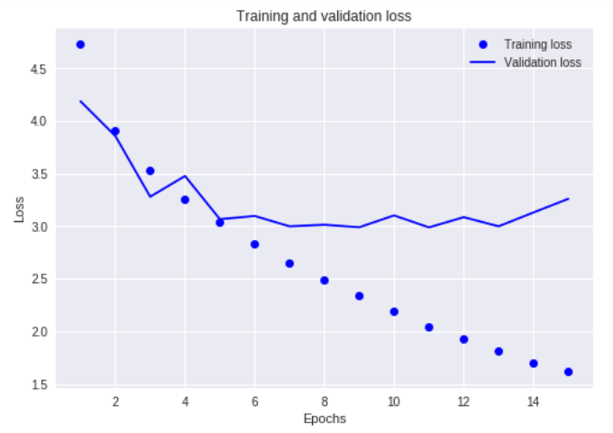
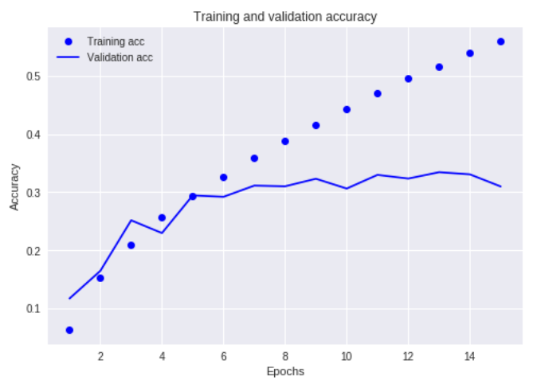
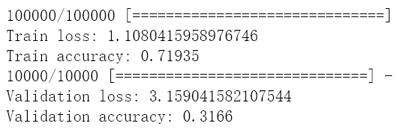
Problem1. Keras -- Tiny ImageNet
Optimal Model
• Epoch=4~7 Val_value keep stabilization.
• Less information for images –100,000.
• No best model, much better, Trade-off

Slide 6
Problem2. AutoKeras -- Tiny ImageNet
Dataset and Implementation
• Use same data as problem 1
• Split data into 5 parts to upload to Colab
2. Set parameters
Tuning by experience with computing time—
• max_no_improvement_num (most consecutive time non-change)
• max_iter_num (most iterations for each model)
• time_limit (most time for training process)
• …
Loop the key parameters to get the optimal ones

Slide 7
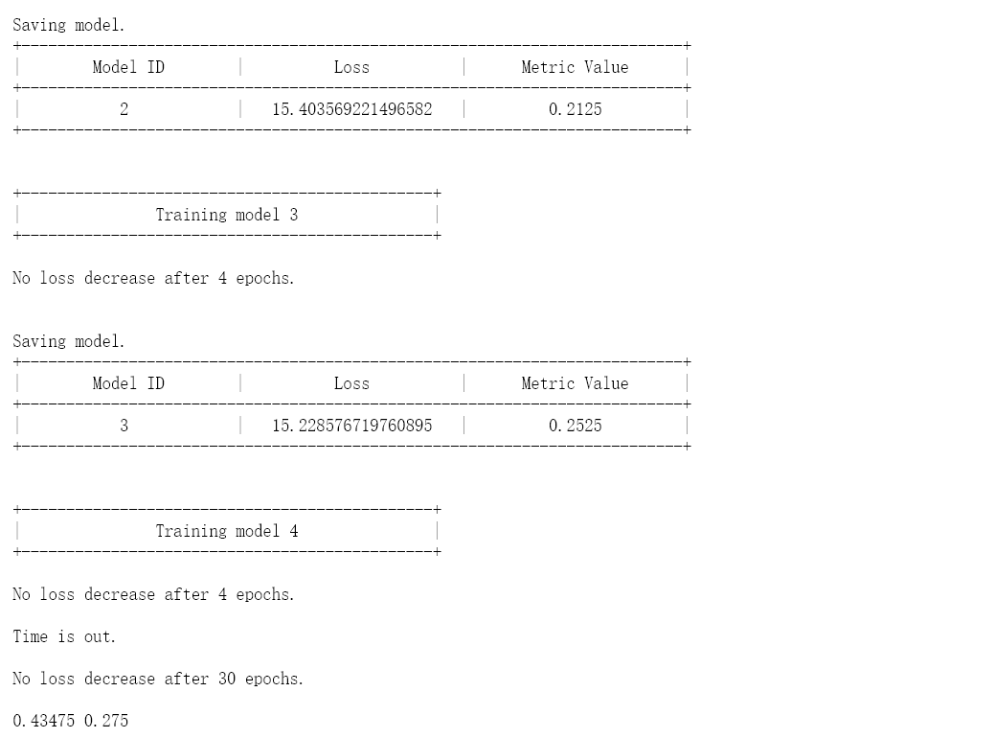
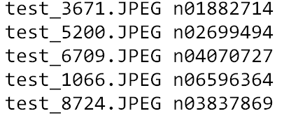
Problem2. AutoKeras -- Tiny ImageNet
Optimal model
• max_no_improvement_num= 4
• max_iter_num= 30
• time_limit= 60*60*6
4. Conclusion
• Not better than problem 1
• More computing time
•“less image information to draw”
• No best, trade-off
Test output

