Slide 1
Social Network focusing on Image Content
Anjan Nepal, Qingqing Cai
Temple University

Slide 2
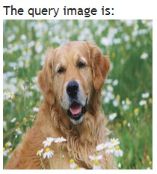
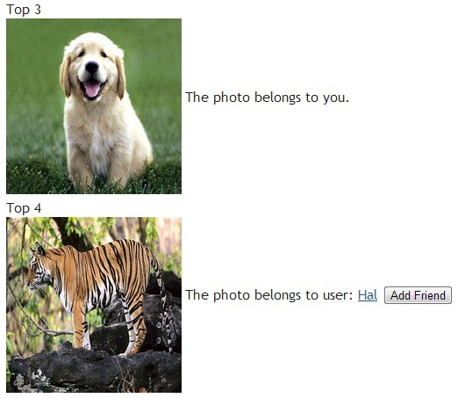
Introduction
Motivation
Social Network & Image Searching
Friends suggestion using image content

Slide 3
Introduction (cont.)
Proposed Functionality
Registration
Photo uploading and browsing
Image searching and clustering
Friend suggestion by image content

Slide 4
Schema
Person (personID, username, password, firstName, lastName, address, birthday, gender, isAcive, imagePath)
Photo (photoID, albumID, caption, featureValue, locationPath, thumbnailPath, isRGB, uploadTime)
Album (albumID, userID, thumbnailPhotoID, albumName, description, visibility)

Slide 5
Schema (cont.)
photoLike (personID, photoID, dataTime, isNotied)
comment (commentID, commenterID, photoID, text, dateTime, isNotied)
friendRequest (senderID, receiverID, dateTime, isNotied)
friendship (userID1, userID2, startDateTime, isNotied)

Slide 6
Image Searching and Clustering
Image Searching
given an image query, find all similar images
Image Clustering
split all images into k clusters
Features
Color auto-correlogram

Slide 7
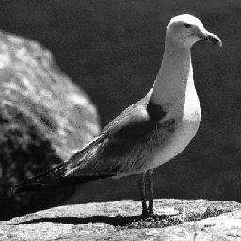
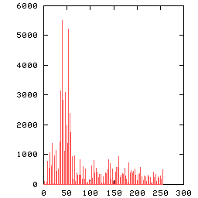
Image Feature
Color Histogram
Compute the distribution of pixel colors in an image

Slide 8
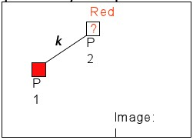
Image Feature (cont.)
Color auto-correlogram
color histogram + spatial information
 | C₁ | C₂ | C₃ | …
D=1 | P₁₁ | … | …
D=3 | … | … | …
D=5 | … | … | …
D=7 | … | … | …
Notes:
Given the pixel with color C1, the probability of finding another pixel of color C1 at a distance D=1;
Pick any pixel p1 of color Ci in the image; At the distance k away from p1, pick another pixel p2; What is the probability that P2 is also of color P1?

Slide 9




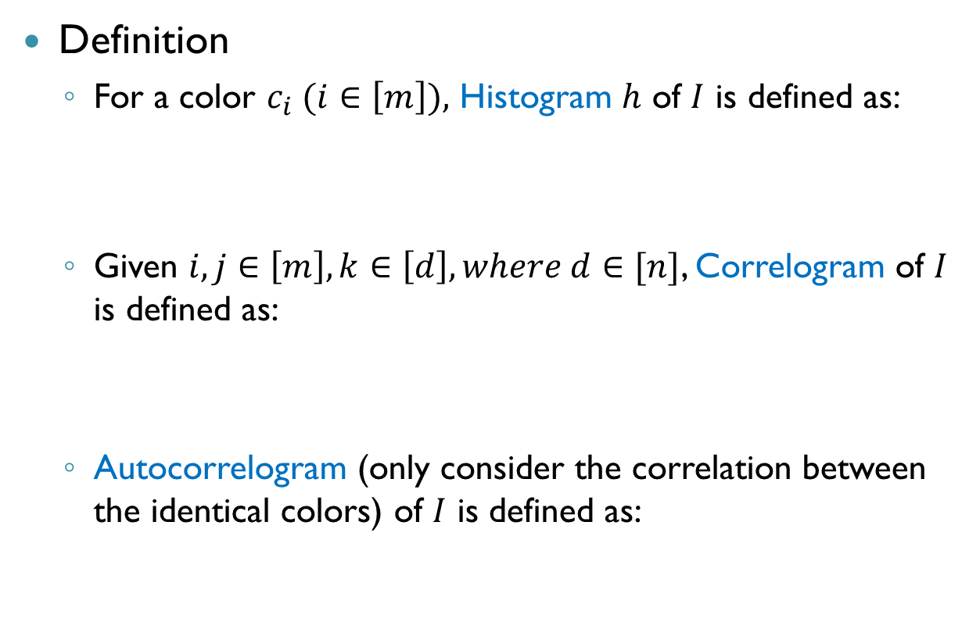

Image Feature (cont.)
Definition
For a color $c_{i} (i∈\left[m\right]),$ Histogram $h$ of $I$ is defined as:
Given $i,j∈\left[m\right], k∈\left[d\right], where d∈[n]$, Correlogram of $I$ is defined as:
Autocorrelogram (only consider the correlation between the identical colors) of $I$ is defined as:
$m:$ number of colors
$I:n×n$ image

Slide 10
Software and Tools
PostgreSQL: multi-user, multi-threaded database management system
PHP: general-purpose scripting language especially suited for web development
Git: concurrency version control
Eclipse: Integrated development environment

Slide 11
Demo
http://ec2-184-73-14-96.compute-1.amazonaws.com/sn/

Slide 12
Thanks! ☺

