Slide 1
Pesterize Your Code!!
Speaker: Me (Jim Arruda)

Slide 2
Agenda
Why are you Pestering me?
Where do I start? What helped me (Jim)
Now what? (Let’s start to write some tests!)
How dare you Mock me!
Putting it all together
Sum it up and Q/A

Slide 3
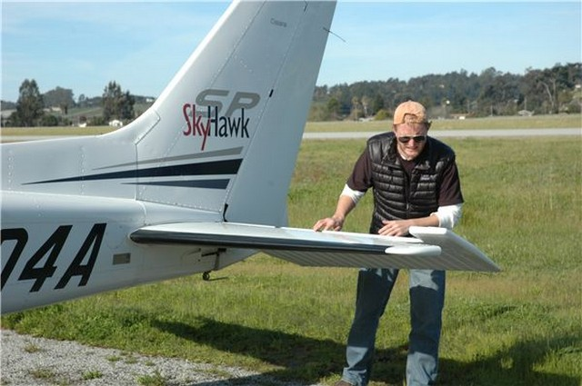
Why are you Pestering me?

Slide 4
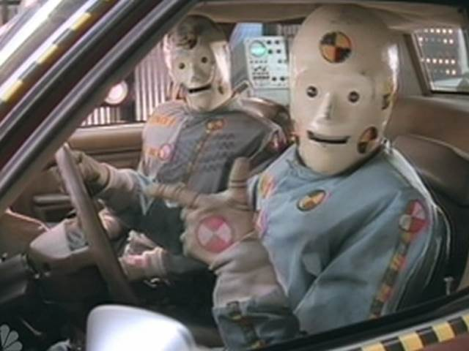
Be a Dummy! Test first!

Slide 5
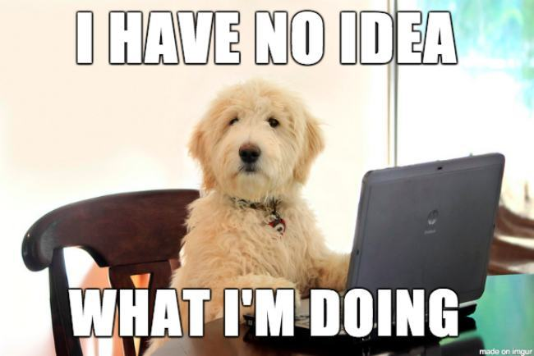
Where do I start?(Things I learned)
Simpler code = simpler tests
Start with what you know
Test the easier things first
Understand what to Mock

Slide 7

In Summary
Simpler Code = Simpler Tests
Start simple
Understand what to Mock
Pester Yourself!!

Slide 8
Contact Info
Twitter - @JimRockArruda
Github - https://github.com/rockarruda/PesterSummitSession

