Slide 1
Design Notes
These slides are hidden, and will not display when presenting.
You’re welcome to delete these slides if you plan to share your deck.

Slide 2
Sharing
You are responsible for sharing your deck, your code, or anything else you like.
You can use Sched.com, or you can use another location. It’s entirely up to you.
We suggest including a shortened URL at the end of the presentation.

Slide 3
Demos
Please modify console, ISE, or VS Code colors to use a high-contrast color scheme.
“Light” themes often work better, especially when combined with bold fonts and dark text colors.
Jack up the font size so your code is legible at the back of the room.

Slide 4
Demos
We strongly recommend the use of VS Code – all attendees can get it, and we’d like them to get used to it
We recommend the Light+ theme
Use the Zoom feature to raise the font size consistently throughout the UI

Slide 5
Copyright
Please do not include graphics or videos you found on the Internet unless you have explicit permission from their owner to use them.
We have had take-down notices in the past and would like to avoid this.
When in doubt, skip the silly picture.

Slide 6
Copyright
We default slides to a Creative Commons attribution, sharealike, noncommercial license
You’re welcome to state a different copyright policy. If you do, please remove the CC logos.

Slide 7
Lastly
Please leave the boilerplate slide at the end of the presentation, and leave it on-screen as you end.
During your “Final Q&A” is a good time to bring that slide up.

Slide 8
Pesterize Your Code!!
Speaker: Me (Jim Arruda)

Slide 9
Agenda
Why are you Pestering me?
Where do I start? What helped me (Jim)
Now what? (Let’s start to write some tests!)
How dare you Mock me!
Putting it all together
Sum it up and Q/A

Slide 10

Why are you Pestering me?

Slide 11

Be a Dummy! Test first!

Slide 12
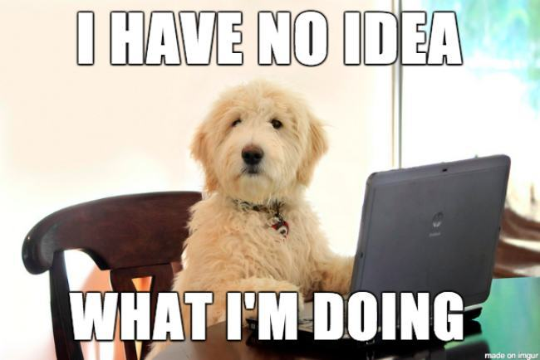
Where do I start?(Things I learned)
Simpler code = simpler tests
Start with what you know
Test the easier things first
Write the first test

