Slide 1
✈ Air Tracker – Flight Analytics
End-to-End Flight Data Analytics using MySQL, Python, Pandas, Plotly & Streamlit
FLIGHTS
300
AIRPORTS
15
AIRCRAFT
44
DELAY RECORDS
45
Air Tracker – Flight Analytics | 1

Slide 2
Project Overview
Purpose and implemented solution
• Relational flight analytics solution built around the flight_analytics MySQL database.
• Python connects to MySQL for database-backed analysis.
• Pandas supports processing and Plotly provides interactive visualizations.
• Streamlit provides KPIs, filters, charts and analytical tables.
• GitHub stores the application, SQL, datasets and documentation.
DATABASE
MySQL
DASHBOARD
Streamlit
ANALYTICS
Pandas
VISUALS
Plotly
SOURCE CONTROL
GitHub
Air Tracker – Flight Analytics | 2

Slide 3
Problem Statement & Objectives
Turning flight records into usable operational insights
PROBLEM STATEMENT
Flight records contain aircraft, airport, route, schedule, status and delay information. The project organizes these records in a relational database and presents analysis through an interactive dashboard.
• Store flight data in normalized MySQL tables.
• Create relationships between flights, airports, aircraft and delay records.
• Execute all 11 required SQL analyses.
• Provide interactive filters and KPI summaries.
• Visualize status, airline activity, routes and delays.
• Maintain reproducible project files in GitHub.
Air Tracker – Flight Analytics | 3

Slide 4
System Architecture & Technology
End-to-end flow
CSV DATA
4 datasets
MYSQL
4 relational tables
PYTHON
mysql.connector + Pandas
STREAMLIT
KPIs + Filters + Charts
PYTHON
Application
MYSQL
Database
PANDAS
Analysis
PLOTLY
Charts
GITHUB
Version
USER FLOW
Select filters → query data → analyze → visualize
Air Tracker – Flight Analytics | 4

Slide 5
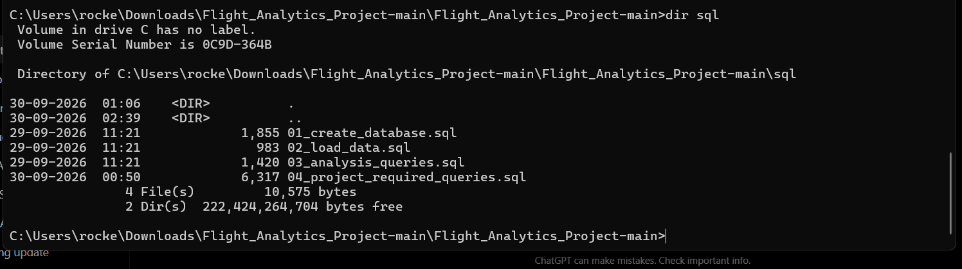
Database Design & Dataset Validation
Verified working MySQL database
Table | Rows | Primary Key | Purpose
aircraft | 44 | aircraft_id | Aircraft master data
airport | 15 | airport_id | Airport master data
flights | 300 | flight_id | Operational flight records
airport_delays | 45 | delay_id | Airport delay statistics
FK
flights → aircraft
FK
flights → airport
FK
delays → airport
Air Tracker – Flight Analytics | 5

Slide 6
Required SQL Analysis
All 11 analytical questions implemented
• 1. Total flights per aircraft model
• 2. Aircraft assigned to >5 flights
• 3. Airports with >5 outbound flights
• 4. Top 3 destination airports by arrivals
• 5. Domestic vs International classification
• 6. Five most recent arrivals at DEL
• 7. Airports with no arriving flights
• 8. Airline counts by status using CASE
• 9. Cancelled flights with aircraft and both airports
• 10. City pairs with >2 aircraft models
• 11. Delayed-arrival percentage by destination
Air Tracker – Flight Analytics | 6

Slide 7
SQL Results – Aircraft, Airports & Destinations
Examples from executed queries
Aircraft Model | Flights
A320-214 | 75
A320-251N | 60
A321-251NX | 50
ATR 72-600 | 46
B737-8 | 33
B737-800 | 17
IATA | Airport | Outbound
DEL | Indira Gandhi International Airport | 56
BOM | Chhatrapati Shivaji Maharaj International Airport | 44
HYD | Rajiv Gandhi International Airport | 34
BLR | Kempegowda International Airport | 29
MAA | Chennai International Airport | 25
TOP DESTINATIONS
DEL 72 • BOM 54 • BLR 30
ROUTE CLASSIFICATION
CASE compares origin.country with destination.country.
Air Tracker – Flight Analytics | 7

Slide 8
Operational SQL Insights
Airline status, recent arrivals and cancelled flights
Airline | Landed | Delayed | Cancelled | Total
6E | 66 | 24 | 5 | 124
AI | 23 | 15 | 4 | 63
IX | 15 | 6 | 3 | 36
QP | 17 | 5 | 2 | 32
9I | 12 | 2 | 0 | 19
SG | 9 | 3 | 2 | 18
UK | 5 | 2 | 0 | 8
RECENT DEL ARRIVALS
QP826, QP6617, IX1446, IX8467 and SG9253 were returned by the five-most-recent-arrivals query.
CANCELLED FLIGHTS
The query returns flight number, aircraft, origin, destination and scheduled departure.
STATUS COUNTS
CASE expressions calculate each airline's status totals.
Air Tracker – Flight Analytics | 8

Slide 9
Route & Delay Analysis
Examples of deeper analytical results
Origin | Destination | Aircraft Models
Hyderabad | Mumbai | 8
Chennai | Mumbai | 7
Kolkata | Delhi | 7
Bengaluru | Chennai | 6
Mumbai | Bengaluru | 6
Ahmedabad | Delhi | 5
Airport | Arrivals | Delayed | %
BBI | 5 | 2 | 40.00
COK | 11 | 4 | 36.36
BLR | 30 | 10 | 33.33
VGA | 6 | 2 | 33.33
BOM | 54 | 13 | 24.07
HYD | 25 | 6 | 24.00
FORMULA
Delayed-arrival percentage = delayed arrivals ÷ total arrivals × 100.
Air Tracker – Flight Analytics | 9

Slide 10
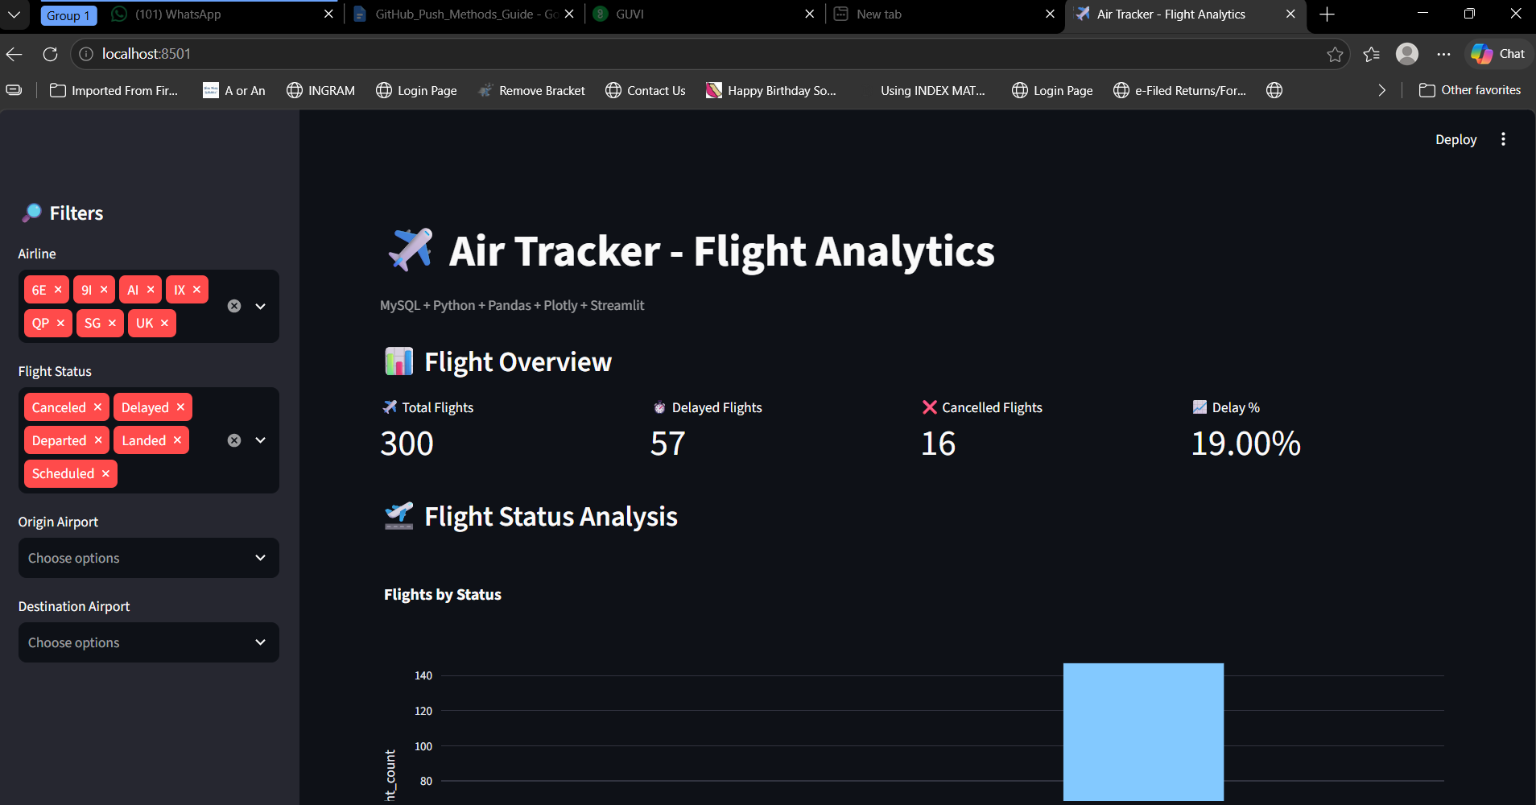
Streamlit Dashboard
Implemented and tested locally
• 300 total flights
• 57 delayed flights
• 16 cancelled flights
• 19.00% delay rate
• Airline and status filters
• Origin and destination filters
• Interactive charts and tables
Air Tracker – Flight Analytics | 10

Slide 11
Testing, GitHub & Deliverables
Final implementation checks
• Git: working tree clean and synchronized with origin/main.
• Python: virtual environment active.
• Packages: requirements.txt installed successfully.
• MySQL: Python connection test returned “MySQL connection successful!”.
• Database: 44 / 15 / 45 / 300 records verified.
• SQL: required analyses executed successfully.
• Streamlit: launched at localhost:8501 and filters tested.
Repository Component | File / Folder
Application | app.py
Database | sql/01_create_database.sql
Analysis | sql/04_project_required_queries.sql
Data | data/*.csv
Documentation | docs/Air_Tracker_Flight_Analytics_Project_Report.docx
Dependencies | requirements.txt
GITHUB
rockeerocky337 / Flight_Analytics_Project
Air Tracker – Flight Analytics | 11

Slide 12
Conclusion
Air Tracker successfully integrates flight datasets, MySQL, SQL analytics, Python and Streamlit into a working flight analytics solution.
Core database, required SQL analysis, GitHub repository and interactive dashboard are completed.
PROJECT VERSION
v1.0.0
Air Tracker – Flight Analytics | 12

