Slide 1

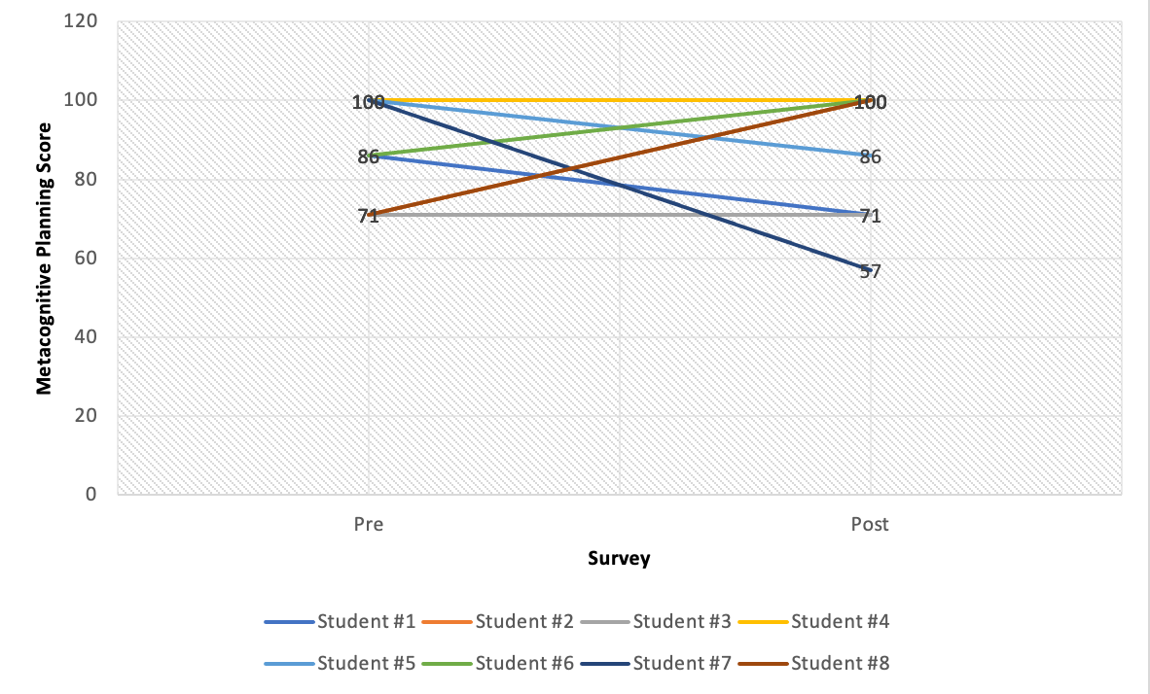
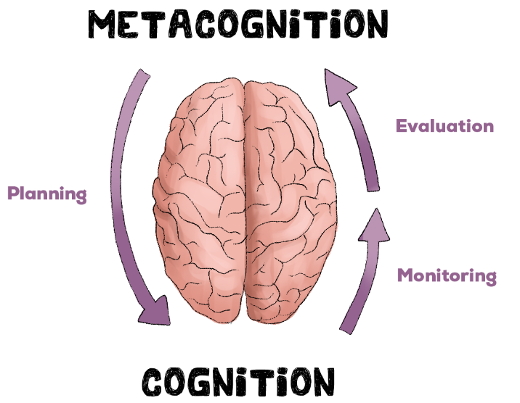
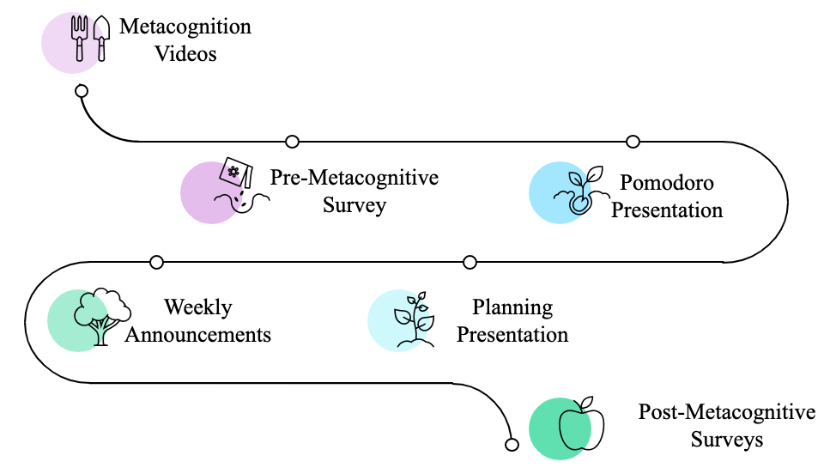
Developing Metacognitive Planning Skills to Improve Student Performance in Virtual University Level Mathematics Classes
Jessica Gonzalez
Learning Assistant
jgonzalez18
Kenneth Jenkins
Learning Assistant
kjenkins39
Introduction In recent years, the COVID-19 pandemic has necessitated a shift towards online learning, making it more critical than ever for students to possess effective metacognitive skills. Metacognition, or the ability to monitor and control one's own cognitive processes, has been shown to be a crucial factor in academic success, particularly in virtual classrooms [1].
However, it is often found that first-year college students lack proper metacognitive habits. To address this issue, we did a preliminary study in a Math Modeling class to examine the impact of developing metacognitive planning skills on student success in online math classes, recognizing that a student's prior knowledge can either support or hinder their learning process [2].
As Learning Assistants for virtual math classes, we have seen the value of reflective questions and study techniques in supporting students in constructing new knowledge. By contributing to the growing research on metacognition in virtual learning environments, this study's findings may aid educators and students in developing effective metacognitive strategies for success in online learning.
Results
Discussion
In conclusion, the results of our study suggest that the hypothesis that students who receive metacognitive interventions perform better on their class assignments was not supported.
We attribute this to the small sample size, which may have resulted in our statistical test being not normally distributed. Additionally, it is possible that other factors, such as students' ability to evaluate their own performance, could have influenced these results.
To obtain more reliable findings, future studies should use a larger sample size and more focused metacognitive surveys.
Furthermore, comparing intervention presentations to a controlled group would also provide a more comprehensive understanding of the impact of metacognitive interventions on academic performance.
Overall, our findings suggest that further research is needed to fully explore the relationship between metacognitive interventions and academic performance in students.
Objective
The objective of this study is to examine the impact of developing metacognitive planning skills on student success in online math classes.
Figure 1. The slope graph above compares the scores of online math student’s pre vs. post metacognitive invention survey planning skills.
Methods
Statistical Analysis Summary:
The metacognitive survey data were not normally distributed (Shapiro-Wilk test, W = 0.813, p = 0.039).
Non-parametric test, the growth of planning skills after a metacognitive intervention were not significantly different from the planning skills before the metacognitive intervention (Wilcoxon rank-sum test W=10.5 P=1)
Students 6 & 8 had an increase in their metacognitive skills.
Students 3 & 4 showed no change in their metacognitive skills.
Students 1,2,5, & 7 showed a decline in their metacognitive skills.
Due to challenges in obtaining student participation, a limited amount of data was collected for this study.
how a certain process
References
[1] Education, J.,et.al. Devaraj School of Information Technology. A learning assessment applying Pomodoro technique as a productivity tool for online learning: 2021 13th International Conference on Education Technology and computers. ACM Other conferences. Retrieved February 7, 2023, from https://dl.acm.org/doi/pdf/10.1145/3498765.3498844
[2] Ambrose, S. A., Bridges, M. W., DiPietro, M., Lovett, M. C., & Norman, M. K. (2010). How learning works 7 research-based principles for smart teaching. Jossey-Bass.
to show
works.
Acknowledgments:
We would like to express our gratitude to the following faculty guides who have provided their valuable support and guidance in developing and conducting our research: Dr. Stephen Burnett, Dr. Barbara Musoff, Dr. Tomás Merchan-Rodriguez, Dr. Christopher Raridan, Dr. Ann Showalter, and Prof. Jelinda Spotorno.

