Slide 1
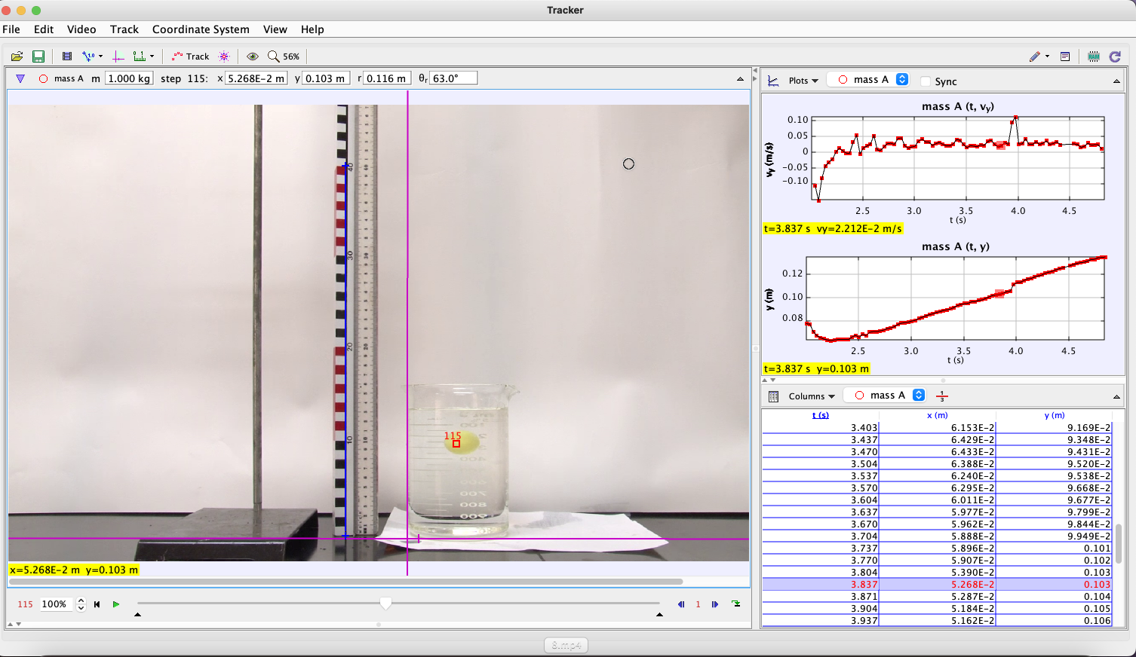
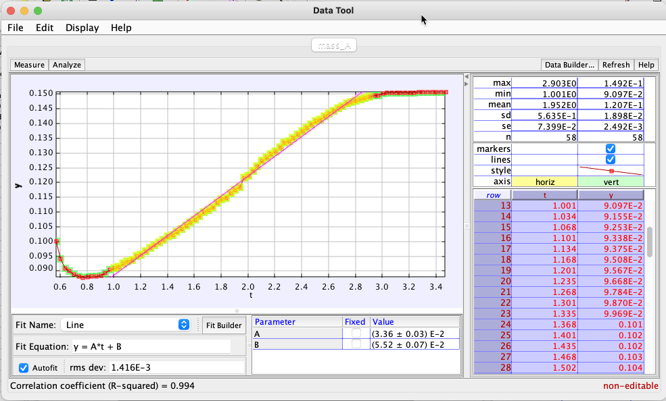
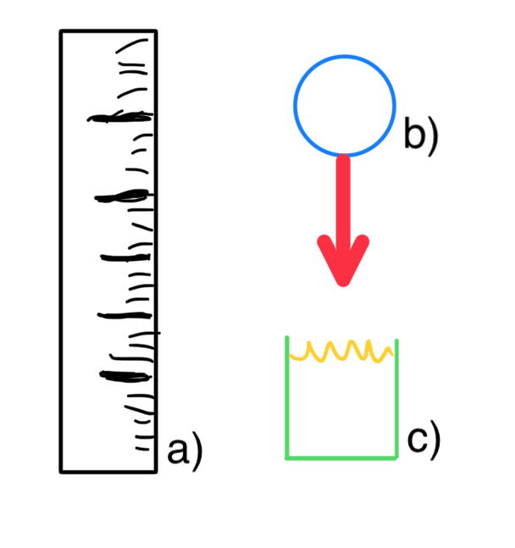
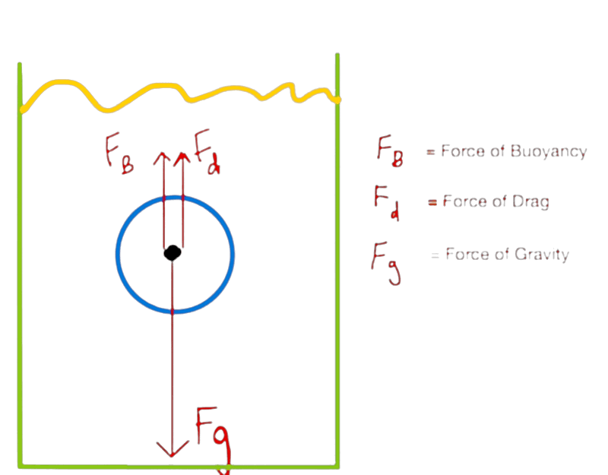
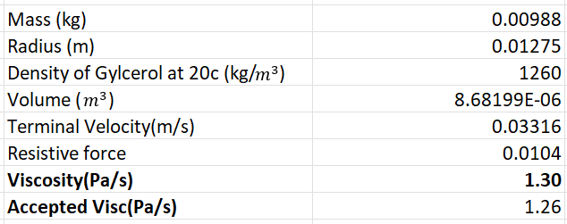
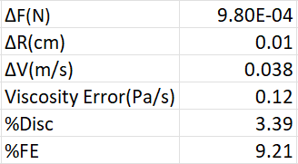
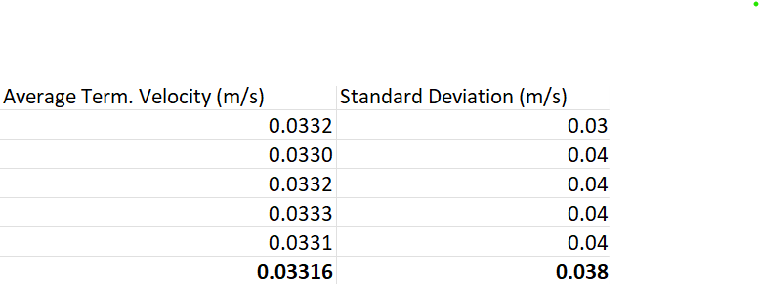
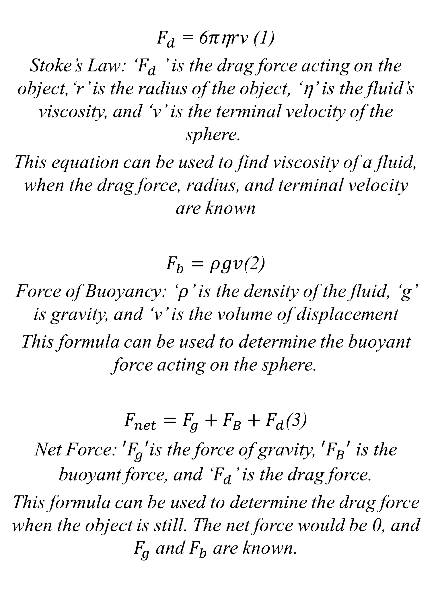
Abstract
The aim of the study was to determine the viscosity of a fluid using Tracker open-source video analysis software and Stokes law. The viscosity of a fluid is a crucial property that determines its flow behavior and is essential in many industrial and biomedical applications.
To achieve this objective, a video was recorded of a small metal ball falling through a known volume of the fluid. The ball's motion was then tracked and its velocity as a function of time was calculated using Tracker software. The accuracy of the tracking was validated by comparing the results with theoretical predictions.
Next, Stokes law was used to relate the velocity of the ball to the viscosity of the fluid. The law states that the drag force experienced by a falling object is proportional to its velocity and the viscosity of the fluid. The experimental data was fitted to the Stokes law equation to determine the viscosity of the fluid.
The results demonstrate that Tracker open-source video analysis software can be an effective and inexpensive tool for measuring the viscosity of fluids. A viscosity value was obtained that was consistent with the expected value for the fluid, indicating the accuracy and reliability of the technique.
In conclusion, the combination of Tracker software and Stokes law provides a powerful and accessible method for measuring fluid viscosity. The approach has the potential to be applied in a range of research and industrial settings to enhance the understanding and control of fluid behavior.
Falling Into Viscosity: Using the Stokes Equation to Analyze Liquid Properties
Conclusion
This study has successfully demonstrated the use of Tracker open-source video analysis software and Stokes law in determining the viscosity of a fluid. The accuracy and reliability of the technique were validated by comparing the results with theoretical predictions. This study found the viscosity of the fluid to be 1.30 Pa/s with the assumption that the fluid is glycerol at room temperature. The known viscosity of the fluid is known to be 1.26 Pa/s [1]. This difference indicated a fractional error of 9.32%. and a percent discrepancy of 3.39% It is possible in the video that was observed that the fluid may have been at a lower temperature and therefore had been more viscous, resulting in this fractional error. Despite this, the experiment was found to have low overall error, with a very low error in viscosity of 0.12 Pa/s. This approach provides an effective, inexpensive, and accessible method for measuring fluid viscosity, which can be applied in various research and industrial settings to enhance the understanding and control of fluid behavior. Overall, this study highlights the potential of combining software tools and physical principles to advance the field of fluid mechanics. this approach can be used to investigate the behavior of complex fluids such as emulsions, suspensions, and polymers. These fluids often exhibit non-Newtonian behavior, meaning that their viscosity changes with shear rate or stress. The combination of Tracker software and other analytical tools can provide insight into the rheological properties of such fluids. This can help researchers to develop models for predicting the flow behavior of these fluids, which is important in the design of industrial processes such as the production of cosmetics and pharmaceuticals.
Kenneth Jenkins
kjenkins39
Joshua Chung
jchung2
Experimental Setup
Figure 3 – Experiment Diagram
Figure 1 – Tracker Setup Screen
Figure 2 – Tracker’s Data Analysis Tool
This experiment aims to measure the viscosity of an unknown liquid using the Stokes equation. The experimental setup consists of a meter stick and a spherical ball that is dropped into the liquid. The experimental setup is shown schematically in Figure 3.
First, the meter stick (Figure 3a) and the ball (Figure 3b) are dropped into the unknown liquid (Figure 3c). The terminal velocity of the ball is measured using high-speed video analysis software, such as Tracker. A point mass is set on the ball inside Tracker, and the scale is set on the meter stick. The axis is set inside the meter stick to provide accurate measurements of the ball's velocity.
The diameter and mass of the ball are known, which allows for the calculation of the ball's radius. Using the measured terminal velocity of the ball, the drag force can be determined. The drag force is proportional to the radius of the ball, its velocity, and the viscosity of the fluid. With this information, the Stokes equation can be used to calculate the viscosity of the unknown liquid.
Figure 4 - Free body Diagram
Outcomes
Using the Stokes equation to determine the viscosity of an unknown liquid by measuring the terminal velocity of a ball in the liquid, providing insight into the physical properties of the fluid.
Theory
$F_{d}$ = 6$π\text{η}r$v (1)
Stoke’s Law: ‘$F_{d}$ ’ is the drag force acting on the object,‘r’ is the radius of the object, ‘$\text{η}$’ is the fluid’s viscosity, and ‘v’ is the terminal velocity of the sphere.
This equation can be used to find viscosity of a fluid, when the drag force, radius, and terminal velocity are known
$F_{b}=ρgv$(2)
Force of Buoyancy: ‘$ρ$’ is the density of the fluid, ‘g’ is gravity, and ‘v’ is the volume of displacement
This formula can be used to determine the buoyant force acting on the sphere.
$F_{net}=F_{g}+F_{B}+F_{d}$(3)
Net Force: ${′F}_{g}′$is the force of gravity, ${′F}_{B}′$ is the buoyant force, and ‘$F_{d}$’ is the drag force.
This formula can be used to determine the drag force when the object is still. The net force would be 0, and $F_{g}$ and $F_{b}$ are known.
Introduction
The Stokes equation, developed by mathematician George Gabriel Stokes in 1851, helps scientists and engineers calculate the viscosity of fluids, which is essential in various fields such as mechanical and chemical engineering. It determines the drag force experienced by a spherical object, such as a ball, moving through a fluid, and this drag force is proportional to the ball's radius, velocity, and the fluid's viscosity. This project aims to use the Stokes equation to determine the viscosity of an unknown liquid by measuring the diameter and mass of the ball, as well as its terminal velocity through the fluid. High-speed video analysis software like Tracker can be used to analyze the ball's motion accurately and provide precise velocity measurements, enabling researchers to calculate the viscosity more accurately. This type of analysis can also aid in understanding other fluid dynamics problems, including flow around obstacles, turbulence, and fluid interactions in complex systems.
Results
References
[1] Dourmashkin, P. (n.d.). Drag Forces in Fluids. In Classical Mechanics. LibreTexts. Retrieved April 21, 2023, from https://phys.libretexts.org/Bookshelves/Classical_Mechanics/Classical_Mechanics_(Dourmashkin)/08%3A_Applications_of_Newtons_Second_Law/8.06%3A_Drag_Forces_in_Fluids
Acknowledgements
Dr. Tatiana Krivosheev, our esteemed physics professor and advisor, for her invaluable guidance, unwavering support, and insightful feedback throughout the course of our poster project.

