Slide 1
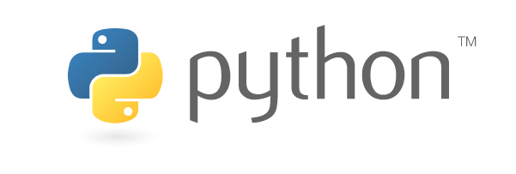
https://www.python.org

Slide 2
Modules and Packages
“modules” are files that contain Python code, class definitions, functions, variables etc.. and can be executed and imported.
Modules: Helps organizing, maintaining the Python code we develop and Using it
with other Code
Modular programming is a software design technique to split your code into separate parts: called Modules

