Slide 1
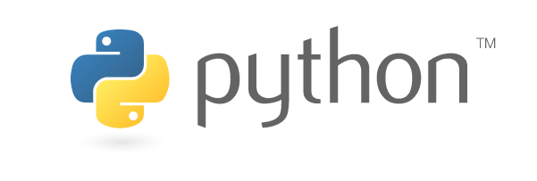
https://www.python.org

Slide 2
Modules and Packages
Modular programming is a software design technique to split your code into separate parts: called Modules
“modules” are files that contain Python code, class definitions, functions, variables etc.. and can be executed and imported.
Modules: Helps organizing, maintaining the Python code we develop and Using it
with other Code
Modules code can be executed after they are imported
import os
import sys
from collections import Counter

