Slide 1

Spring Boot

Slide 2
What is Spring Boot
Spring Boot makes it easy to create stand-alone, production-grade Spring-based Applications that you can run.
It a tool which let you create and bootstrap a spring application from the scratch
Spring : - Spring framework which let you write Enterprise Java Applications.
Boot : - Bootstrap or quickly startup the spring application.

Slide 3
Spring Boot Features
Spring boot make decision on your behalf (manual configuration is exception).
Convention over configuration
Scan the code in order to determine the feature that is require for spring platform and work accordingly.
Automatic configuration
Maven and Gradle for dependency management and it favors Executable jars
Starter Dependency Build tool integration
Spring Boot provide application server functionality by embedding a servlet container
Embedded containers
(Tomcat, Jetty or Undertow)

Slide 4
Developing a very simple Hello World web application with Spring
A project complete structure with a Maven or Gradle build file including required dependencies.
Spring MVC and the Servlet API.
A web.xml file/WebApplicationInitializer implementation that declares Spring’s DispatcherServlet.
A Spring configuration that enables Spring MVC.
A controller class that will respond to HTTP requests with “Hello World”.
A web application server, such as Tomcat, to deploy the application to.

Slide 5
org.springframework:spring-core
org.springframework:spring-web
org.springframework:spring-webmvc
com.fasterxml.jackson.core:jackson-databind
org.hibernate:hibernate-validator
org.apache.tomcat.embed:tomcat-embed-core
org.apache.tomcat.embed:tomcat-embed-el
org.apache.tomcat.embed:tomcat-embed-logging-juli
Dependencies

Slide 6
Spring Boot Application Project Structure

Slide 7
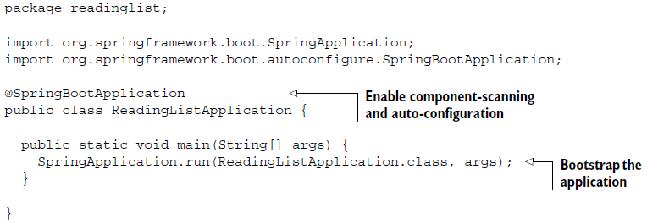
What happen when we started spring boot
ReadingListApplication.java (bootstrap class):
Bootstrapping : Spring Application Context
Configuration
?

Slide 8
Configuration (@SpringBootApplication)
Designates a class as a configuration class that can have one or more bean and Sets up default Configuration
@ComponentScan
@Configuration
Performs class path scan so that the web controller classes and other components will be automatically discovered and registered as beans.
Spring Boot
It attempting to guess and configure beans that application are likely to need. tomat-embedded.jar TomcatEmbeddedServletContainerFactory
@EnableAutoConfiguration

Slide 9
Thank You

