Slide 1

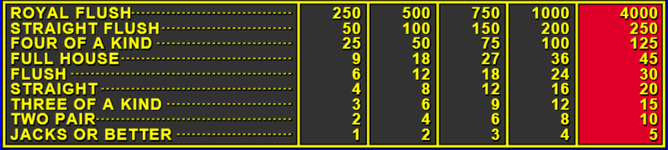
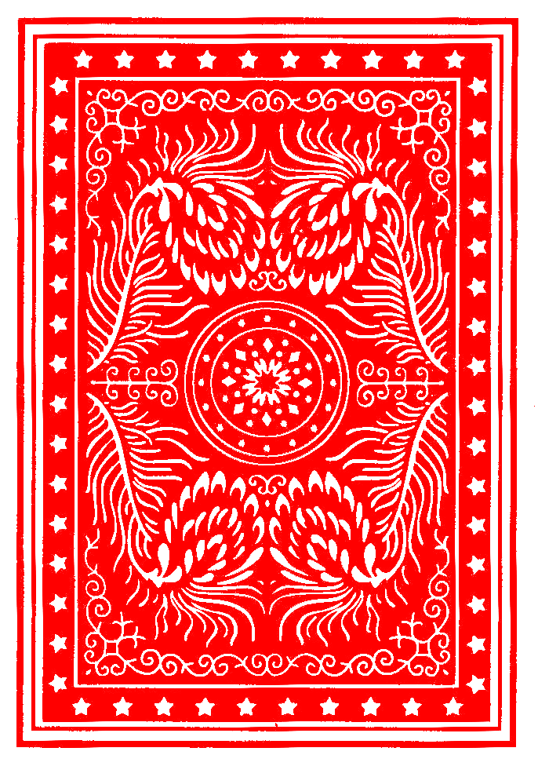
projectTitle
LEGEND
Main game elements
Local elements
gameContainer
bettingTableRef
imgTable
Game Status message appears here
msgResult
cardStatusContainer
Card Status | Card Status | Card Status | Card Status | Card Status
cardsContainer
CREDIT: 100
BET: 100
creditContainer
betContainer
dealDrawBtn
↑
DEAL/SUBMIT
↓
bottomContainer
betAmtElement
betDownBtn
betUpBtn

