Slide 1
Facebook Clients – Android Group 3 Nghiem Viet Cuong Cao Xuan Ngoc Vu Tung Son Instructor: Tran Giang Son

Slide 2
Introduction
Facebook Client :
There is an official Facebook Client for Android devices but the official client has many limitations. It is often being complained for taking too much memory and power which makes the devices slower and low on battery.

Slide 3
Facebook Client for Android
Objective: To develop an alternative app that provides facebook account interactions with simple use.

Slide 4
Prerequisites
Android Studio
Android SDK
Genymotion

Slide 5
App Architecture
Presentation Layer (User Interface)
Application Layer(LoginRadius SDK For Android )
Storage Layer(Retrieve Data via LoginRadius)

Slide 6
Activities
Main Activity: Responsible for connecting to Facebook server.
Pager Activity: Responsible for presenting views.

Slide 7
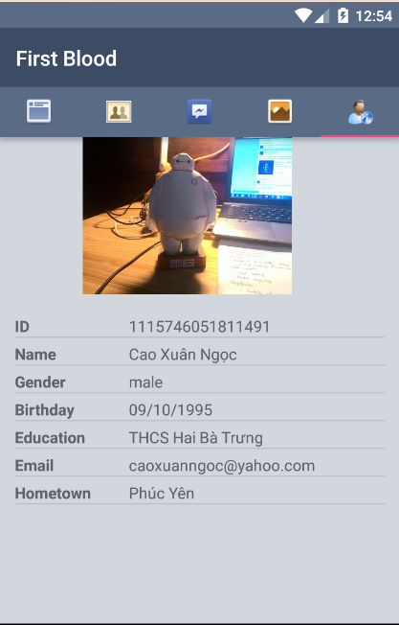
Fragments
User Info Fragments: Show the User info of logined in Facebook account.

Slide 8
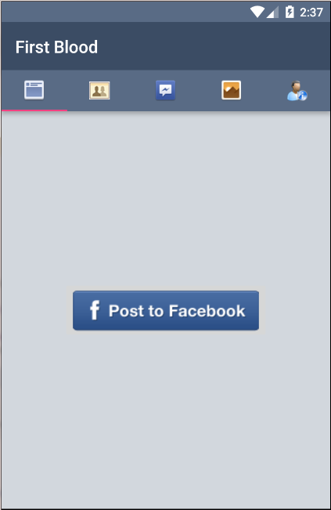
Fragments
Newsfeed Fragments: Posting status

Slide 9
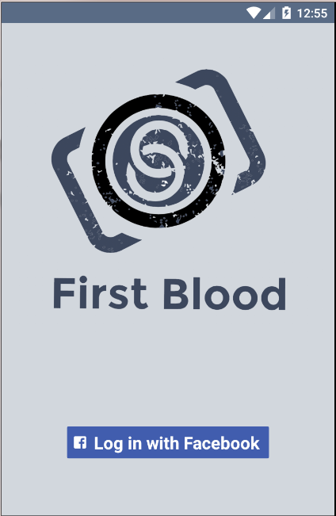
Login Interface

Slide 10
Thank you!

