Slide 1
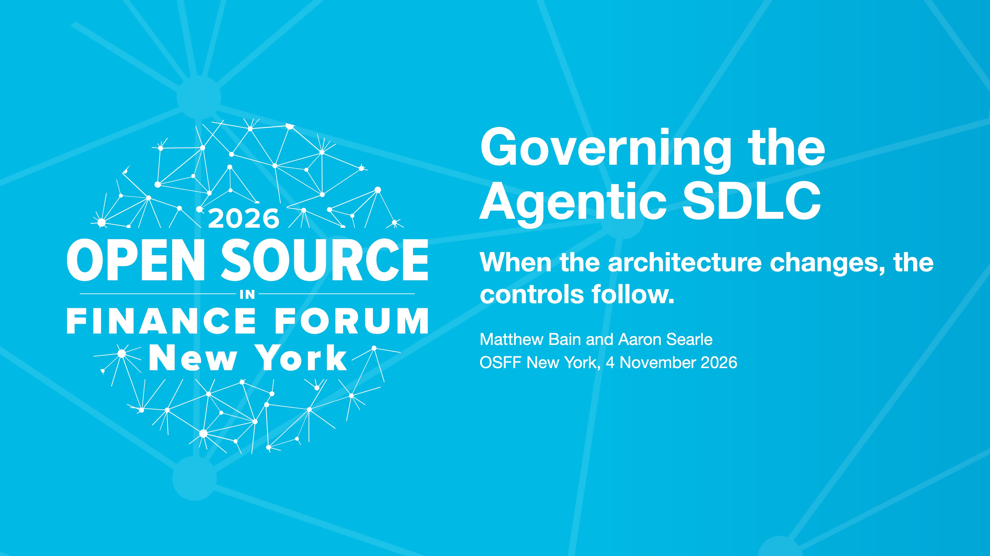
Notes:
Aaron.
Two parts about how two finos projects can work together
First talking about our SDLC common controls catalog
Second part is how Calm can be used to gate and evidence those controls
In a way that both agents can use as well as humans

Slide 2
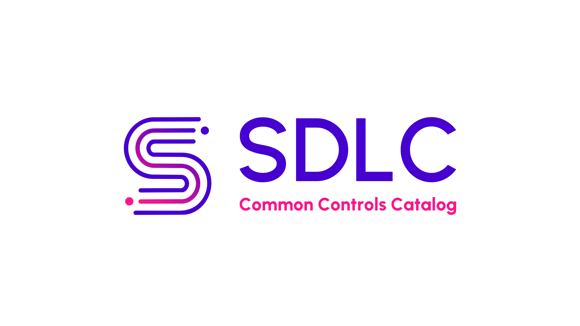
Notes:
Aaron.
Catalog
Accross the industry
Reduce toil
Fragmentation
Duplication
All doing the same thing, same rules, risks

Slide 3
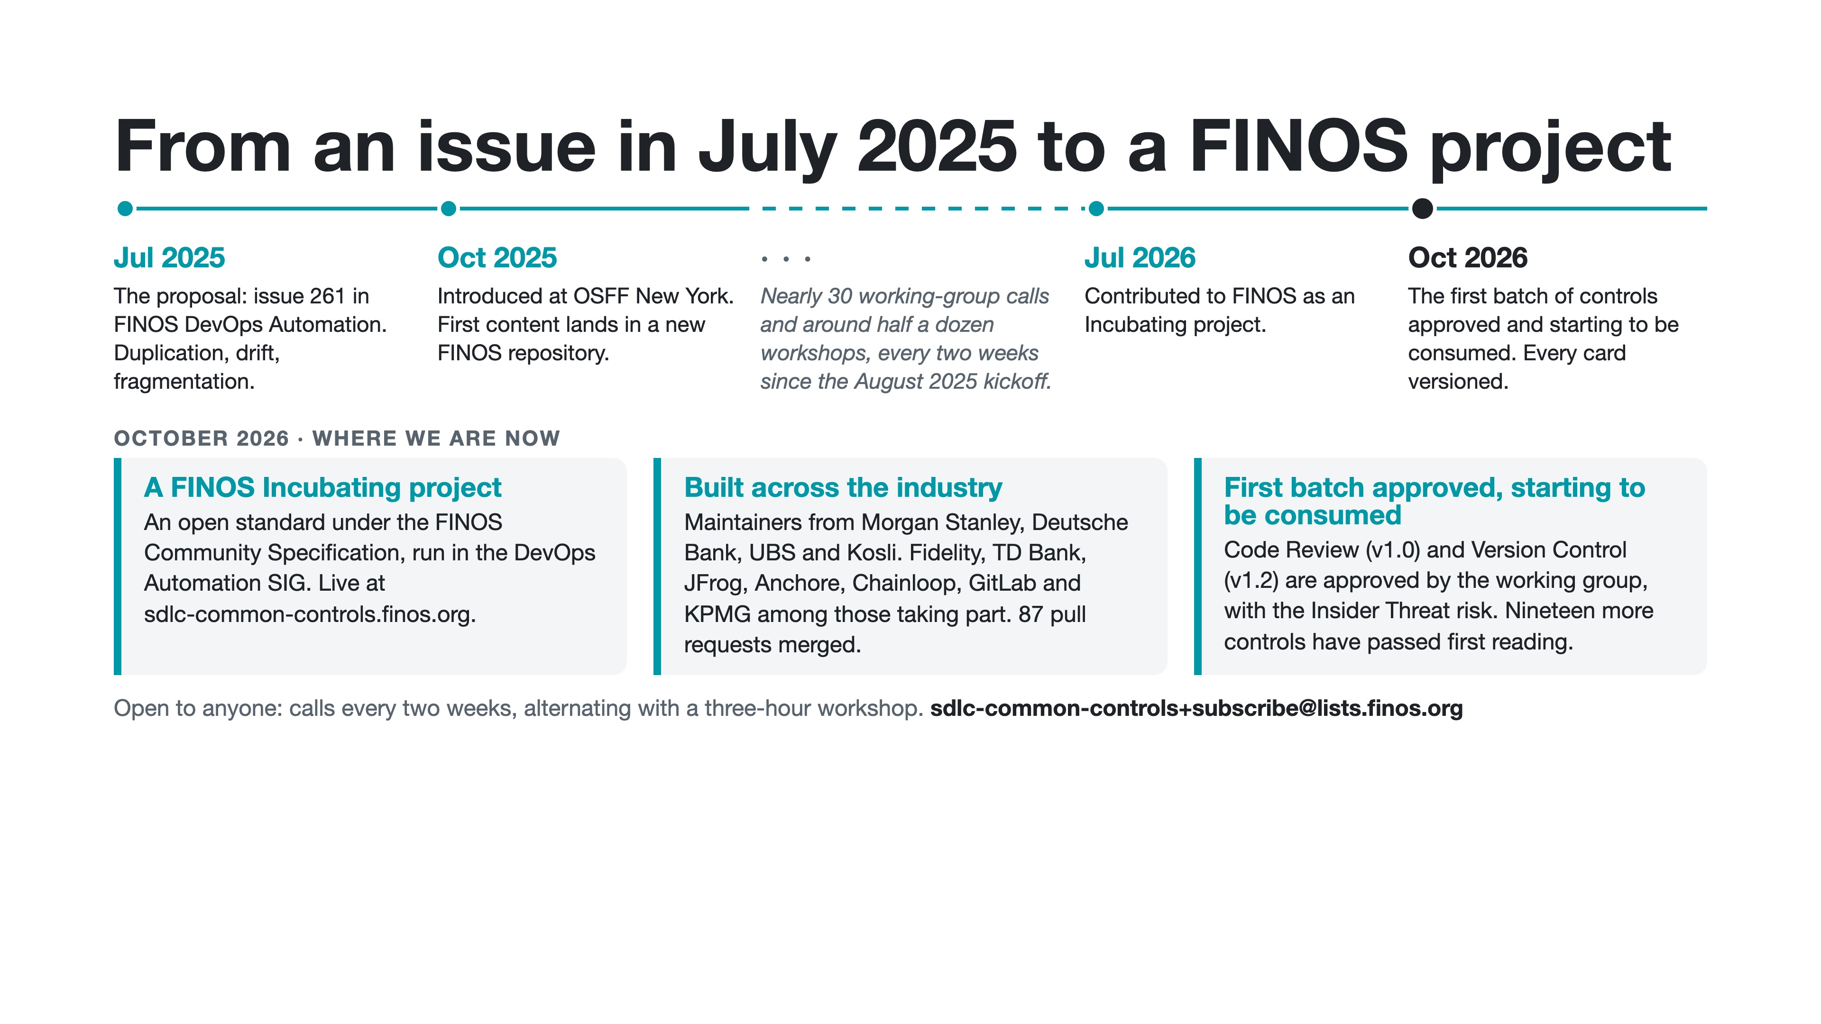
Notes:
Aaron.
It has been over a year since we have started
Range of contributors, Toby Weston, Mike & Alex Kosli
Morgan Stanley, Deutsche Bank, UBS and Kosli, banks like Fidelity and TD alongside vendors like JFrog, Anchore, Chainloop and GitLab
Incubating which was announce a few months ago
A set of controls that are ready for you to consume
TODO: add more you know this

Slide 4
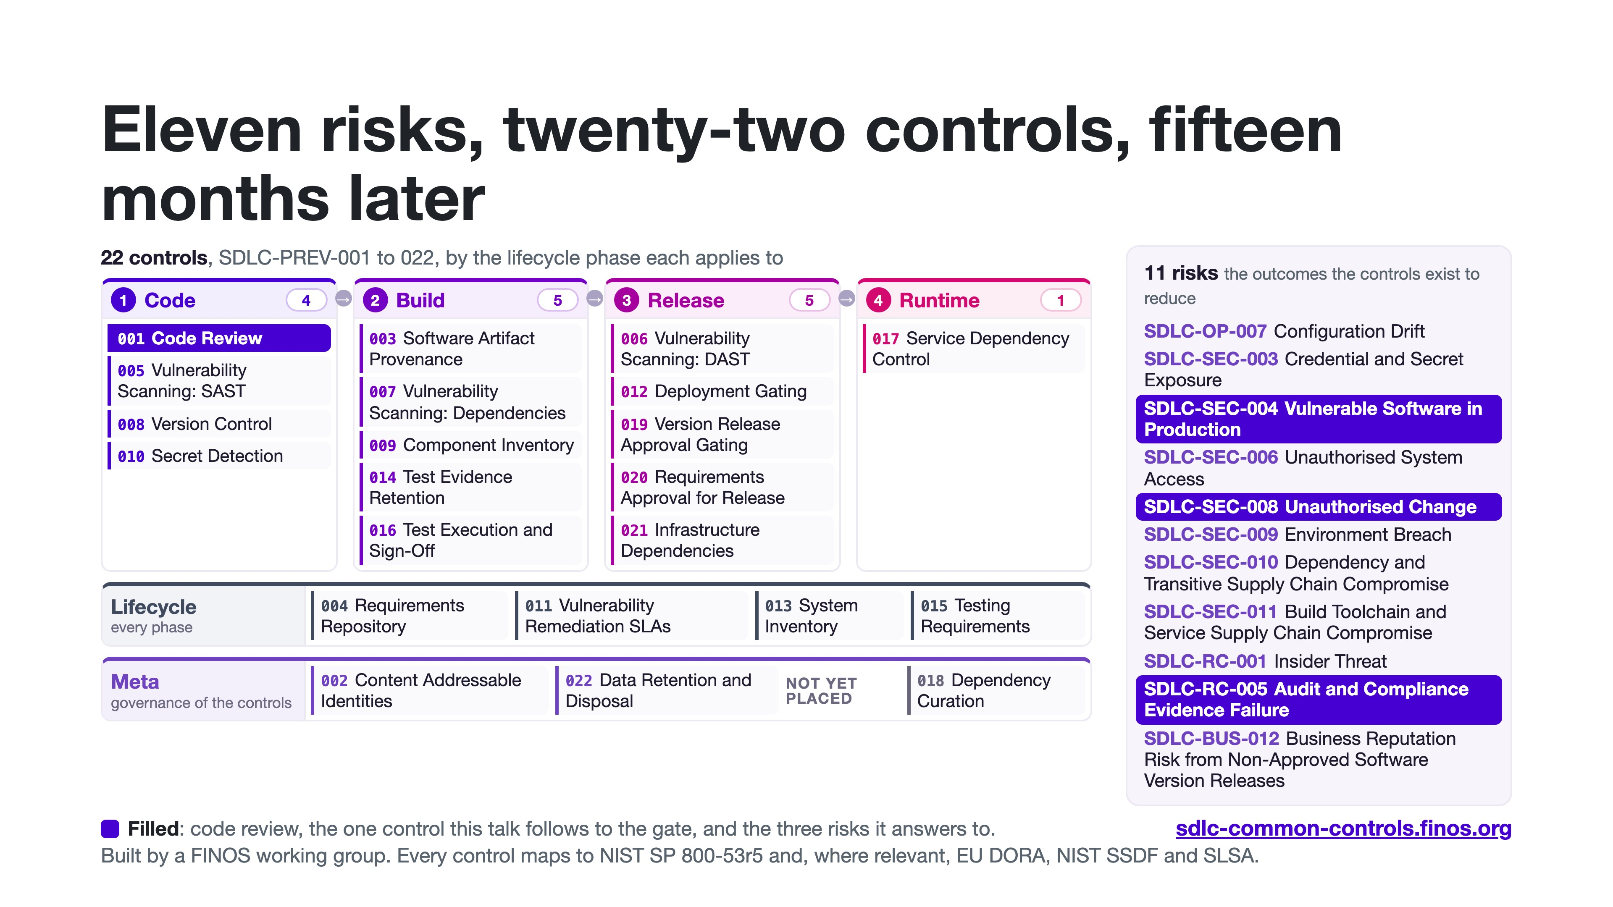
Notes:
Aaron.
And here we have our catalog
Obviously there is alot of changing going on but we have tried to keep that in mind an incorporate it
Agentic development was in our mind when they were written
Meeting every two weeks for workshops and discussions, progress is slow but steady.
Already out of date...
... new agentic aligned additions
Code review - and mapped risks...

Slide 5
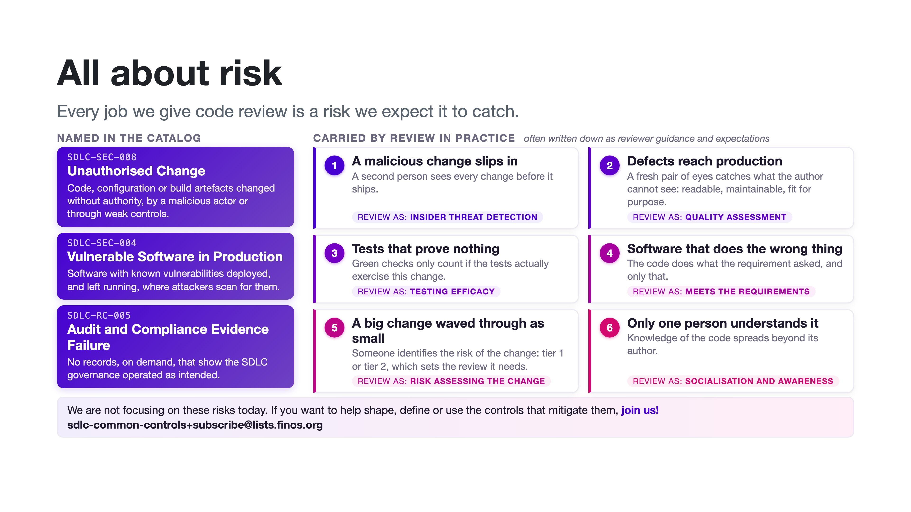
Notes:
Aaron.
Why do we define controls?
To demonstrate mitigation to risks...here are some
Testing, Quality, Requirements met, Insider threat, Risk assessment
My least favourite control. Overloaded
Digression. But if you want to talk or hear more on that come join us!

Slide 6
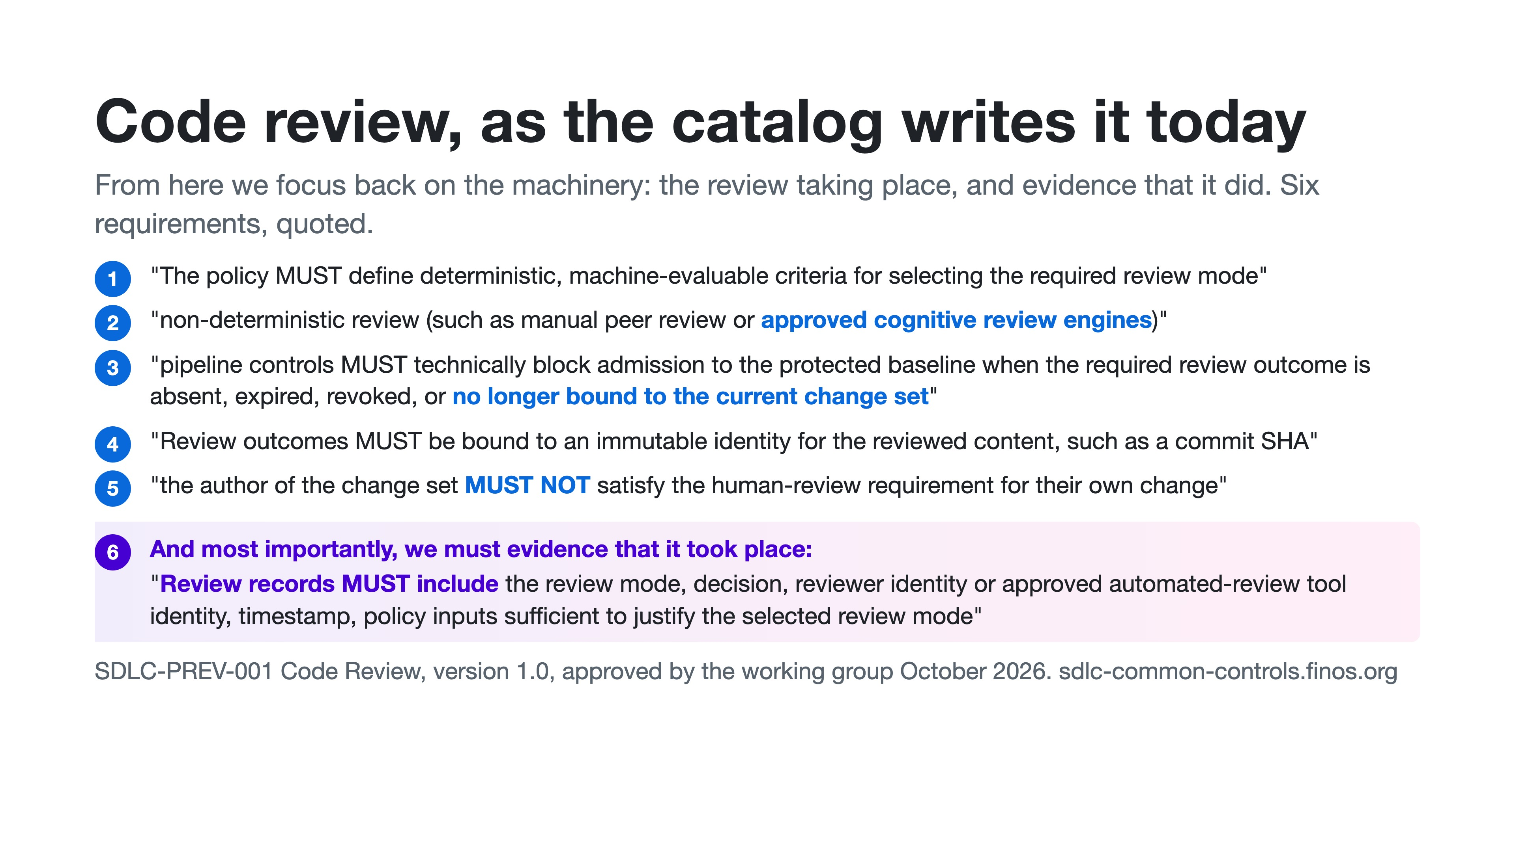
Notes:
Aaron.
This is it is written in the catalog
it seems broadly fine but something fundamental is missing
How to enforce it, and how to evidence that it happened? For an agent
How to explose those requirements to the agent or person
Pipeline must block if a check hasn't been performed
Evidence must be collected and attributed, was it performed by a person, agent or deterministic logic?

Slide 7
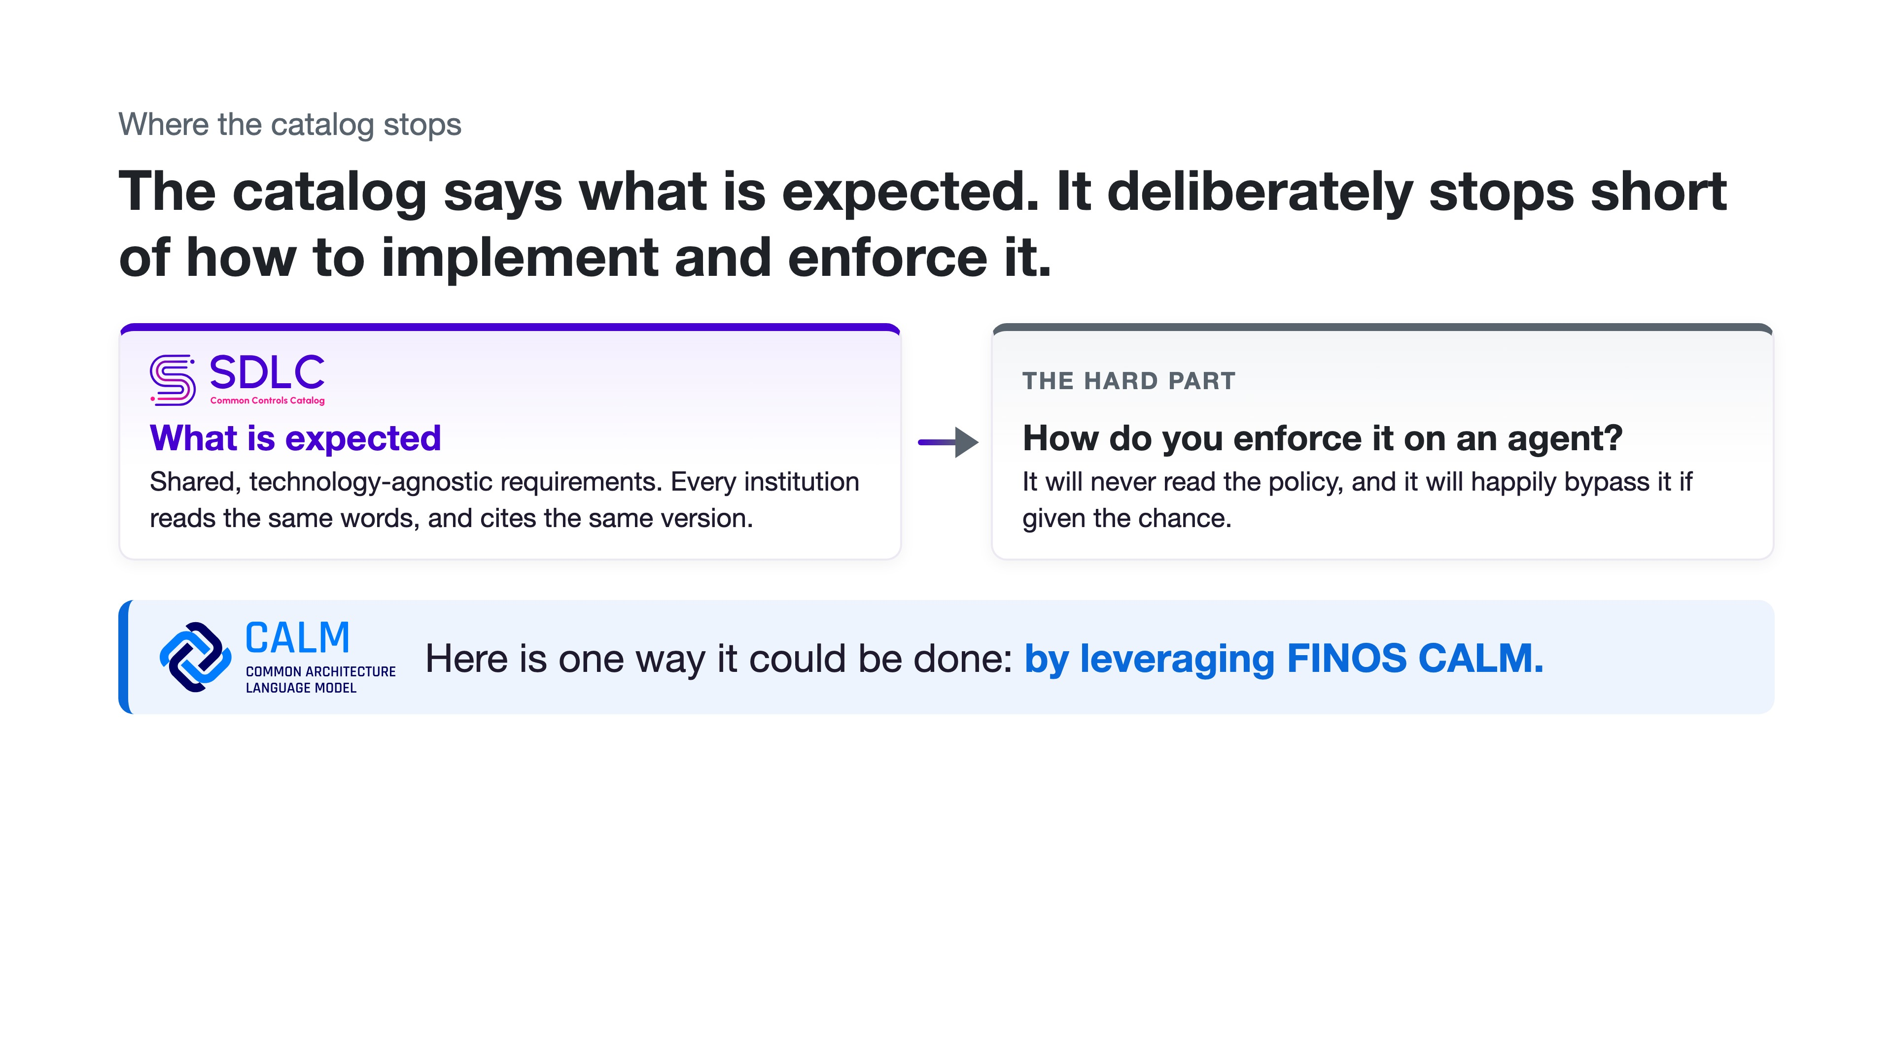
Notes:
Aaron.
Where the catalog stops. It sets expectations, it doesn't say how.
There would be too many
Matt is going to explain how we can leverage CALM
To create these gates, inform them and provide evidence
So Matt, how are you going to do this?

Slide 8
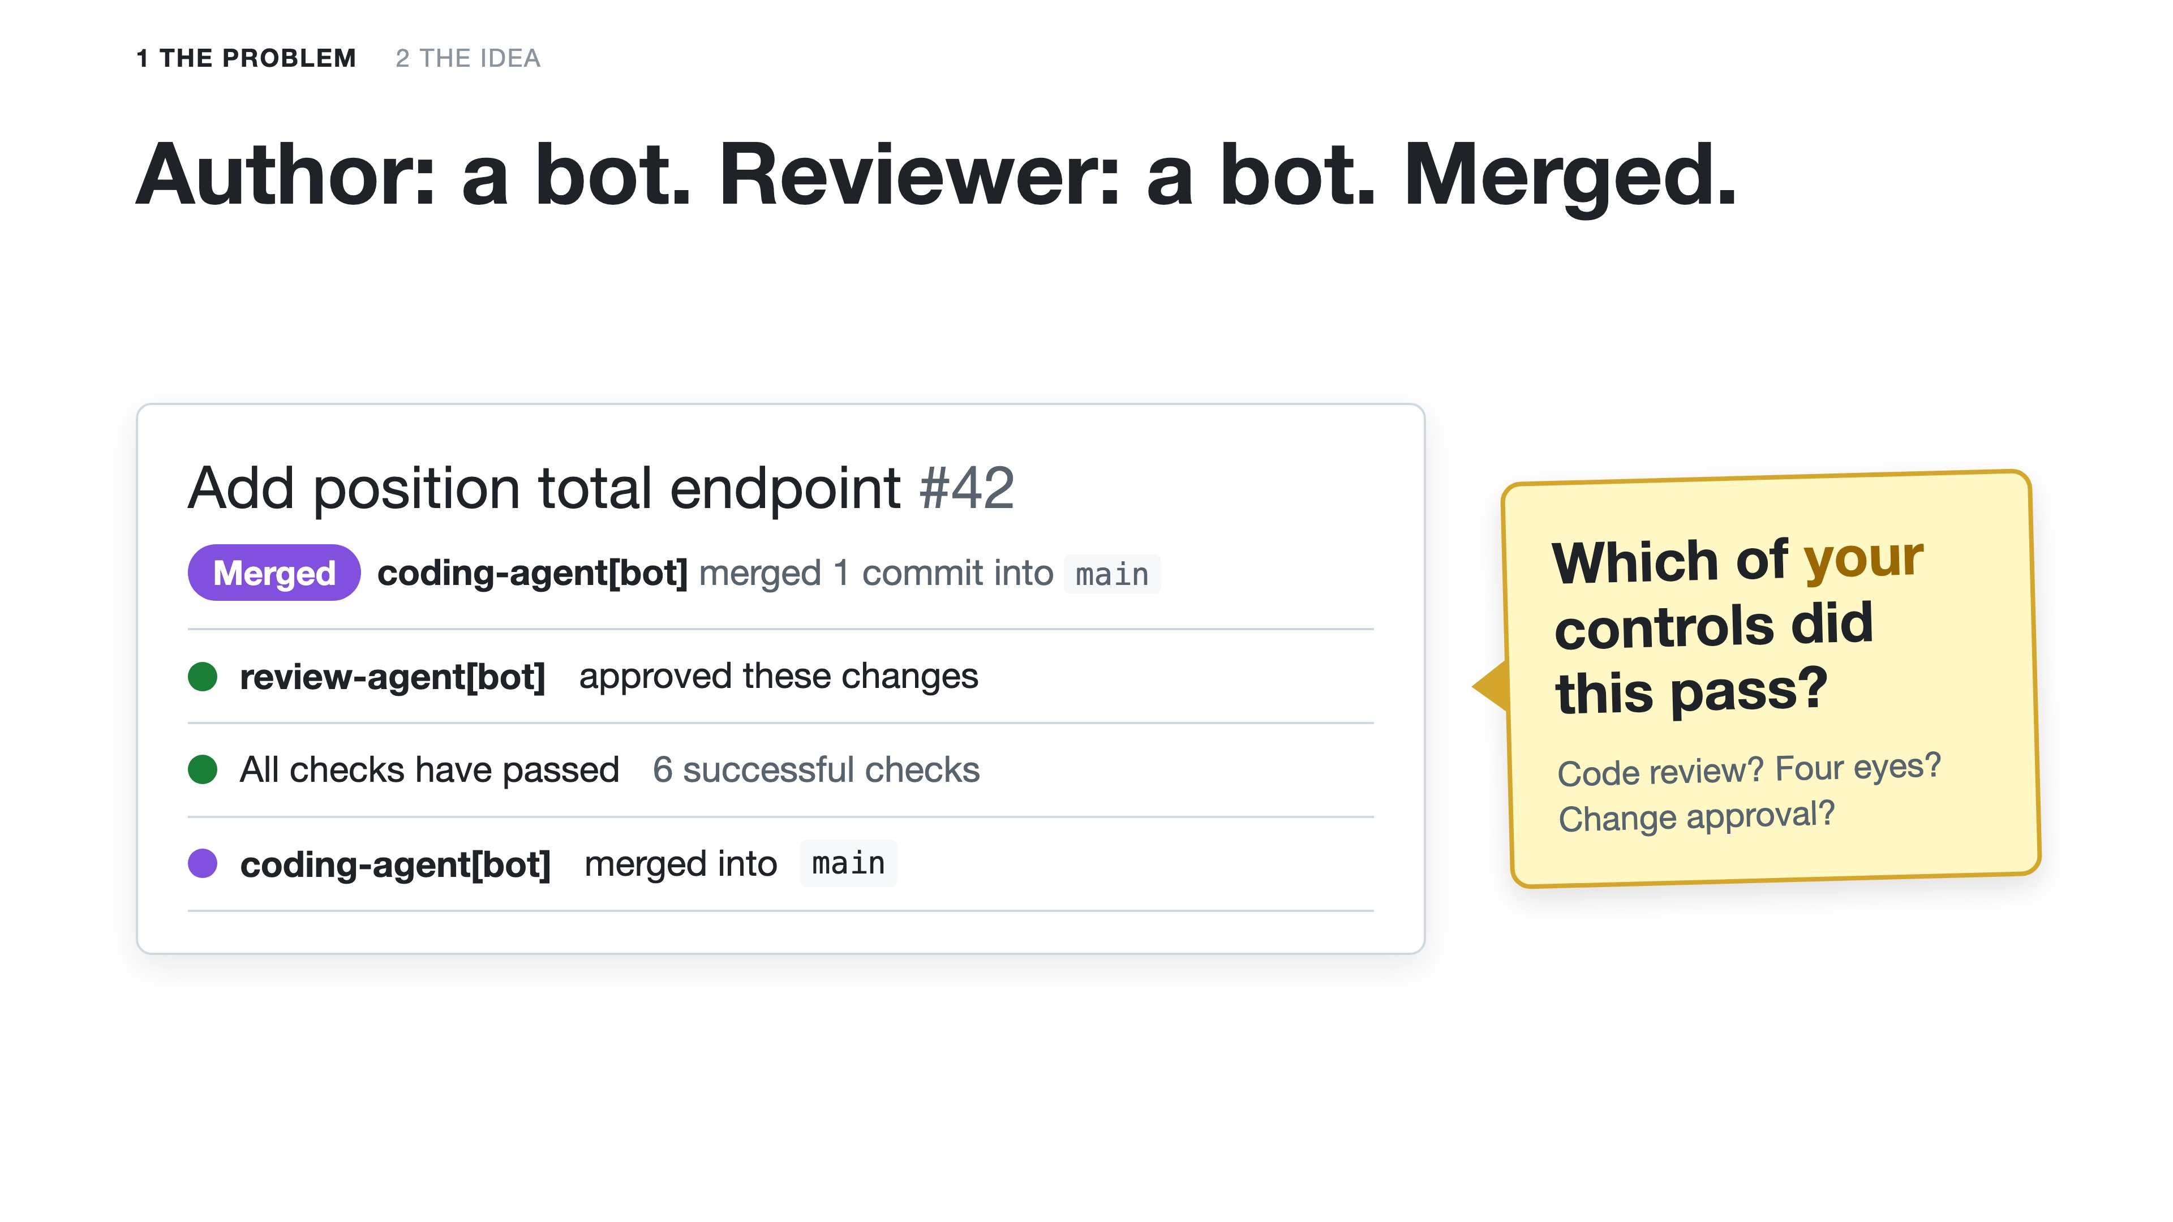
Notes:
Matthew. A pull request like this merged somewhere this week. Written by an agent, reviewed by an agent, every check green. Ask the room: which of your controls did this pass? Code review: a reviewer approved it. Four eyes: two parties, author and reviewer. Every check green. On paper, most of them. And nobody looked at it. Was that OK? Did it need a person? You can't tell from this screen, and that's the problem: to know, you'd need to know what that code talks to, and which rules apply to it.

Slide 9
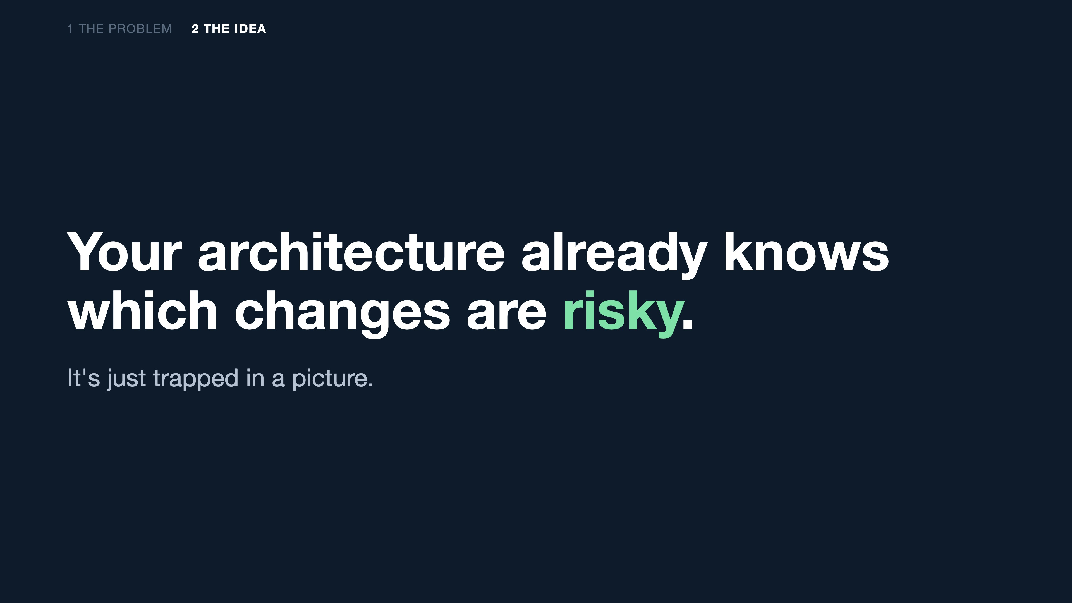
Notes:
Matthew. Here's the idea. Your architecture already knows which changes are risky: it knows which services write to the client ledger, the bank's book of record. The trouble is that it's trapped in a picture on a wiki, and a picture can't check anything. So write it down as data. FINOS CALM is architecture as code: every box and every line in a file a machine can read, versioned in git next to the code. And once it's data, every pull request can be checked against it.

Slide 10
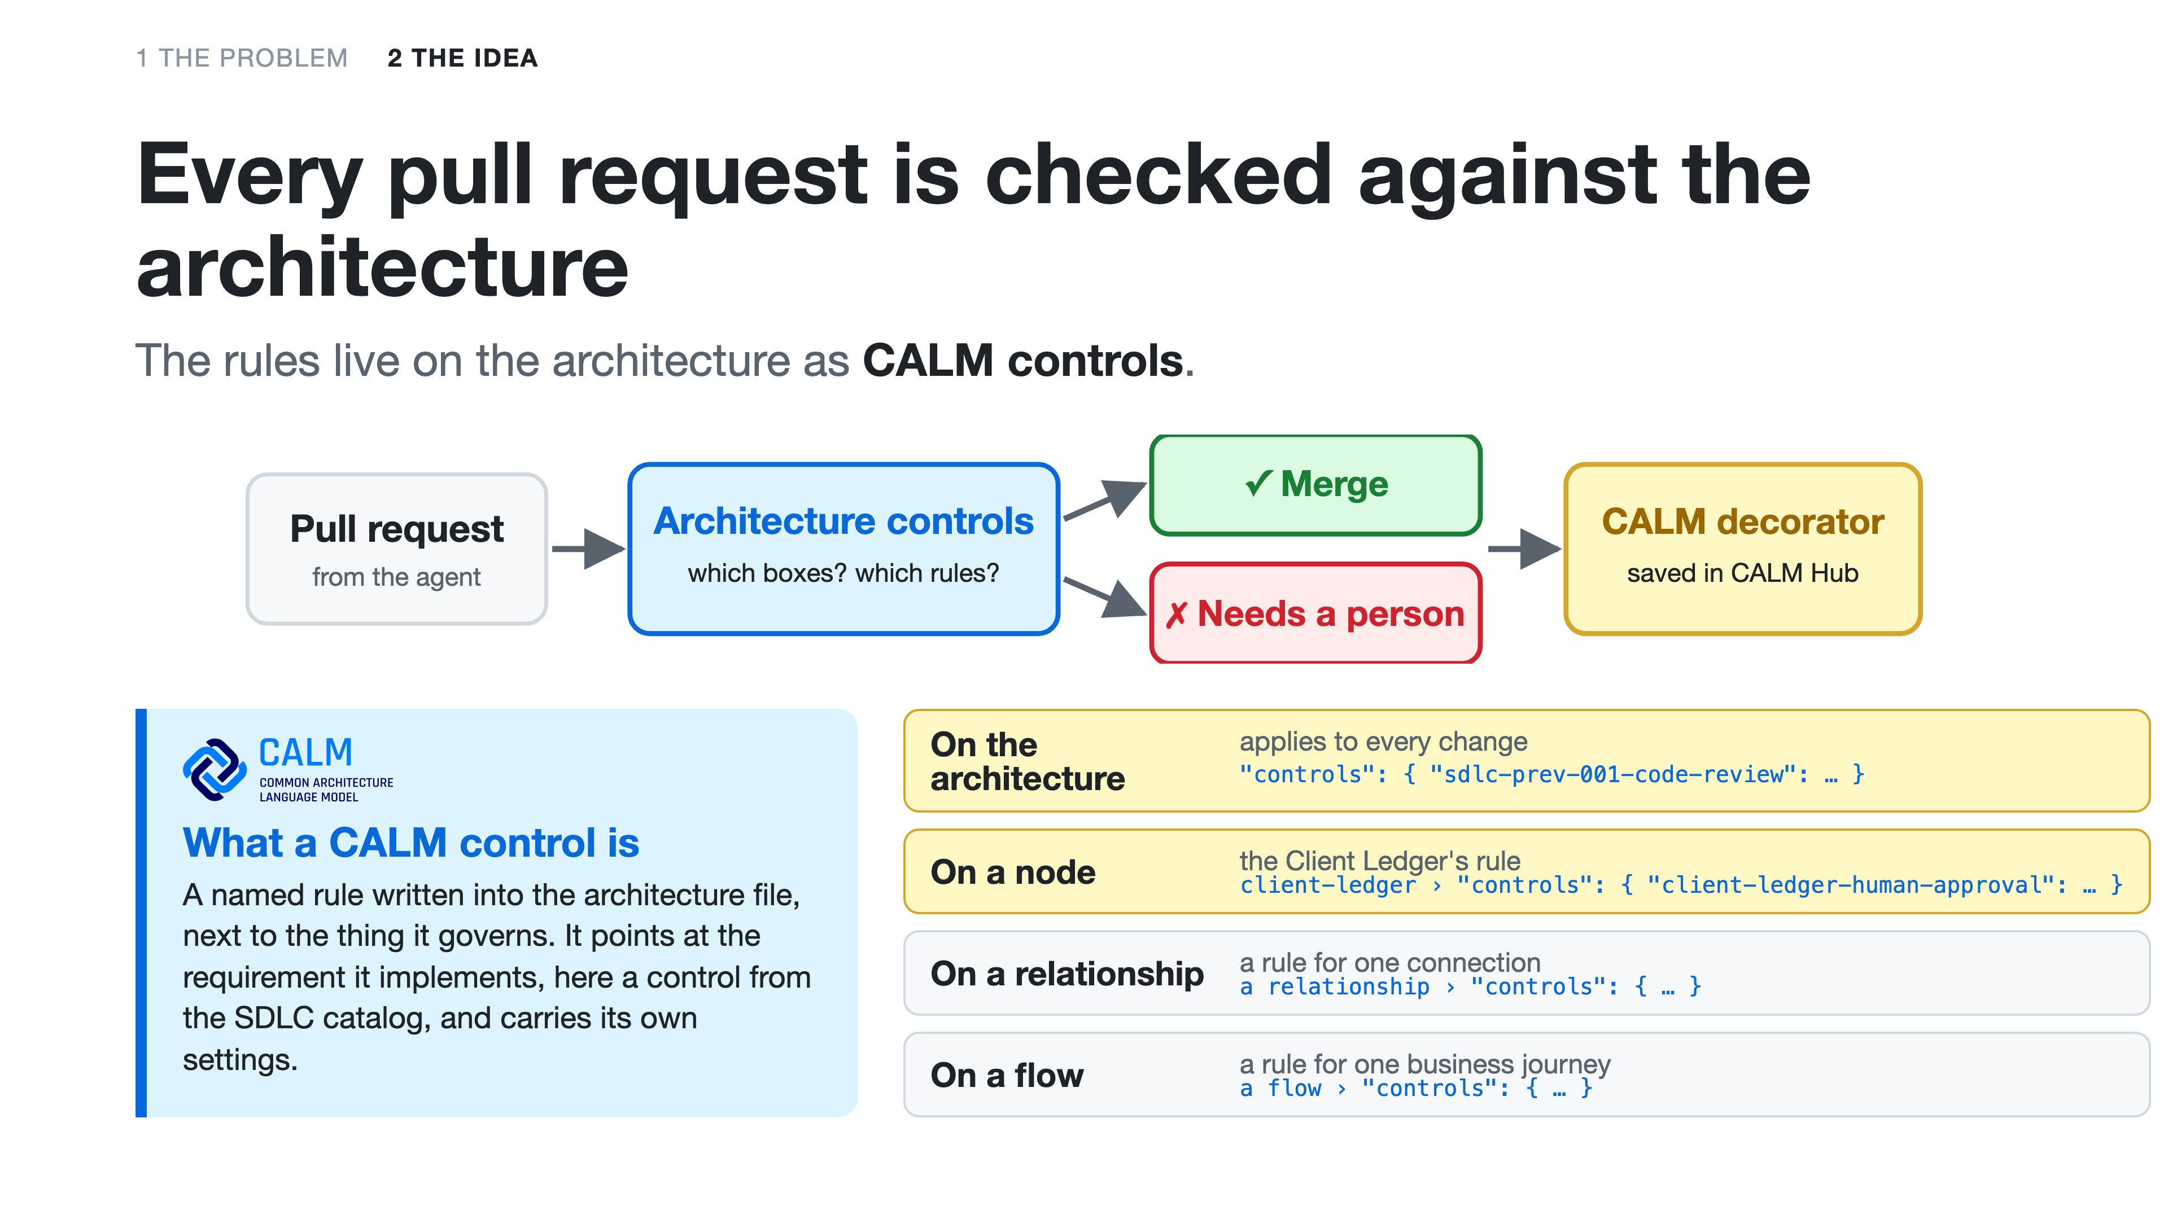
Notes:
Matthew. So every pull request is checked against the architecture. A check called Architecture controls works out which boxes the change touches and which rules are on them. Nothing needs a person: green, merge. Something does: blocked until a person approves, and it says why. Each decision is saved back onto the architecture in CALM Hub as a CALM decorator. The rules are CALM controls. A control is a named rule written into the architecture file, next to the thing it governs, pointing at the requirement it implements, here a control from Aaron's catalog, with its own settings. You can put one on the whole architecture, so it applies to every change, like code review; on a node, like our rule on the Client Ledger, the bank's book of record: any change to a service that connects to it needs a human approver; on a relationship, a rule for one connection; or on a flow, a rule for one business journey through the system, like trade capture end to end. Notice the ledger rule never names a service. It names a relationship, so when the architecture changes, what the rule applies to changes with it. Remember that.

Slide 11
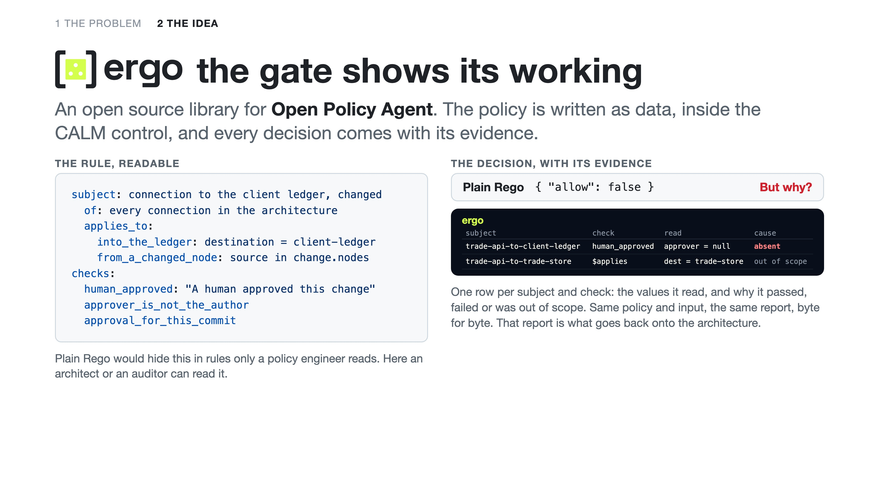
Notes:
Matthew. How does the check decide? With ergo, an open source project, and it does two things for us. First, the policy is readable. ergo is a library for Open Policy Agent, the engine most of you already run for policy as code. Instead of Rego that only a policy engineer can read, the rule is written as data: what you're judging, what's in scope and what must hold. And it lives inside the CALM control on the Client Ledger. The subject is every connection in the architecture; in scope are connections into the Client Ledger from a box this change touches; the checks are that a human approved it, that the approver didn't write it, and that the approval is for this exact commit. Second, evidence. Rego on its own says allow false. ergo says why: one row per subject and check, the value it actually read, and the cause: here, no approver, so absent. Even the connections it ruled out of scope are recorded. Nothing disappears. Same policy and same input give the same report, byte for byte, so you can hash it and store it. A decision nobody can inspect isn't evidence. Rego says no; ergo says why. And that report is exactly what we save back onto the architecture.

Slide 12
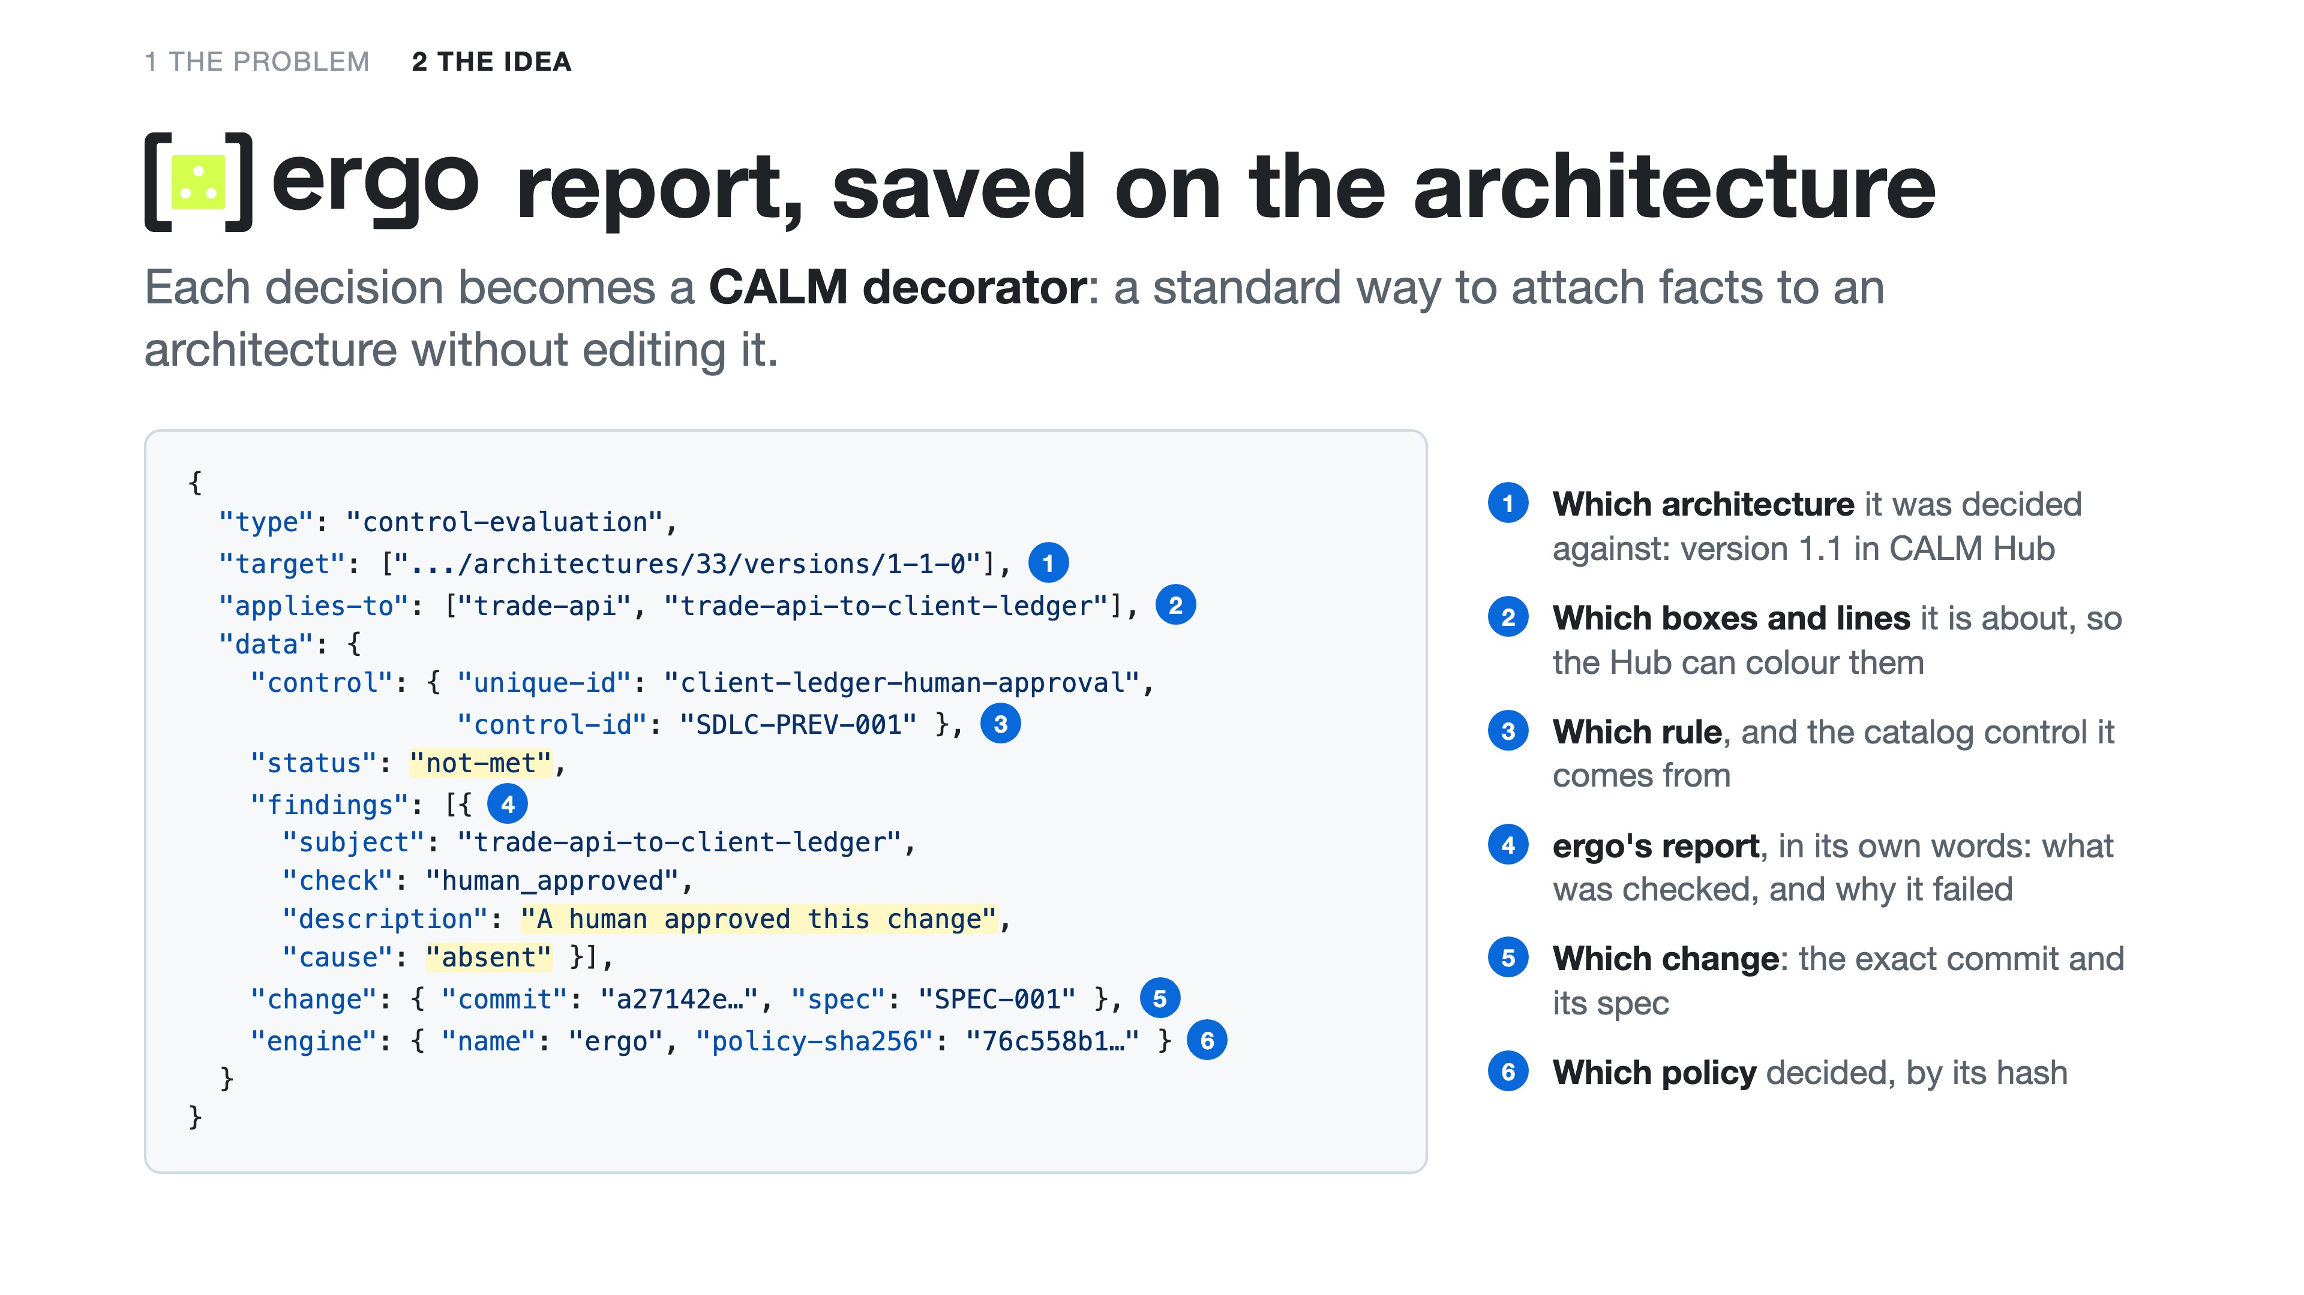
Notes:
Matthew. And this is what goes back onto the architecture. ergo's report for a pull request you'll see in a moment, saved as a CALM decorator: a standard way to attach facts to an architecture without editing it, so the architecture file stays the architecture. It says which version of the architecture it was decided against, which boxes and lines it's about, which rule and which catalog control, ergo's own finding in plain words, the exact commit, and the hash of the policy that decided. One per rule, per decision. It's a draft CALM Standard we're proposing, so any tool can write one and any tool can read one, and CALM Hub draws them on the diagram. Let's see it.

Slide 13
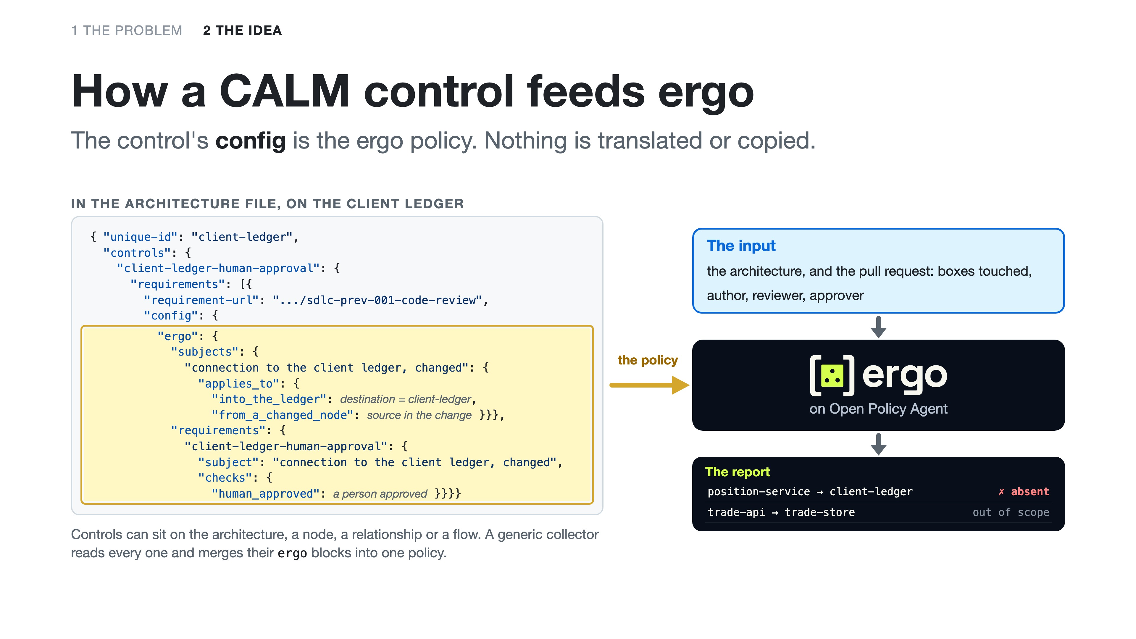
Notes:
Matthew. So how does a control on the architecture become a decision? This is the Client Ledger in the architecture file. It carries one CALM control, client-ledger-human-approval. Its requirement points at the catalog control it implements, SDLC-PREV-001, and its config holds the rule, written for ergo. The subject: connections into the Client Ledger from a box the pull request changes. The check: a person approved it. That block, highlighted, is the ergo policy. We don't translate it or copy it anywhere. Controls can sit on the whole architecture, on a node, on a relationship or on a flow; a small generic collector walks all of them and merges their ergo blocks into one policy. ergo, running on Open Policy Agent, evaluates that policy against the input: the architecture itself, and the facts of the pull request, which boxes it touched, who wrote it, who reviewed it, who approved it. Out comes the report: the Position Service's connection into the ledger is in scope and nobody approved, so absent; the Trade API's connection to the trade store is out of scope. Change the architecture and the policy changes with it, because the policy is the architecture. That's what you'll see in the demo.

Slide 14
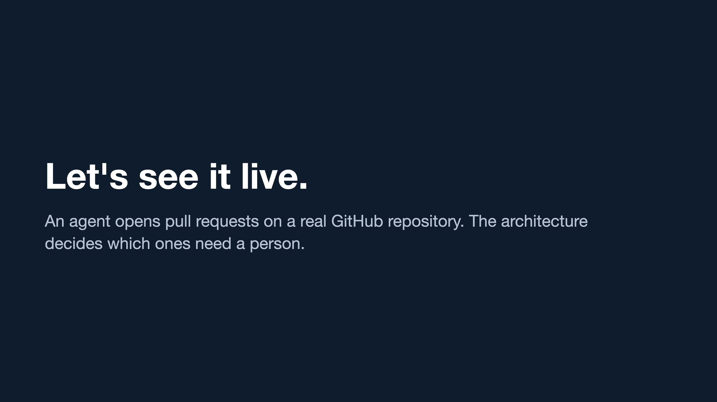
Notes:
Matthew. Switch to the browser on the repository's pull requests; npm run demo:github drives it, Enter for each moment. One. CALM Hub opens on the system, with the Client Ledger and its rule in the details pane: traders send trades to the Trade API, which stores them and asks the Position Service to update positions; the Position Service writes to the Client Ledger, and the rule sits on the ledger. The cast: the agent, a GitHub App that writes code and opens pull requests; a review bot that reviews every commit; the check, Architecture controls, which reads the architecture; Aaron, who approves when a person is needed; and me, the architect. Two. "Account summary endpoint on trade-api": reviewed, every control met, green, merge; CALM Hub shows it on the Trade API box. This is the fast lane. Three. "Position total endpoint on position-service": same kind of change, red, because the Position Service connects to the Client Ledger; the check names who can approve. Nobody wrote "Position Service is risky" anywhere: the architecture did that. Four, Aaron: open it on your laptop, read the real diff, approve with GitHub's own button; green in a few seconds, merge; CALM Hub shows who approved which commit. Five. The shortcut: the Trade API reads the ledger's file directly. Red: that connection is not in the architecture, so it does not exist. If the business really needs it, the fix is an architect, not a cleverer agent. Six. As the architect, I add one relationship to the architecture: the Trade API writes end-of-day snapshots to the Client Ledger. Changing the architecture is changing the rules, so Aaron approves; merge; CALM Hub moves to version 1.1. Seven. "Trade count endpoint on trade-api", the kind of change that went straight through at the start. Red: the Trade API now connects to the Client Ledger. Then say it plainly: nobody touched the pipeline, the rule or a list of services. The architect changed the architecture, and the rule followed it. When the architecture changes, the controls follow.

Slide 15
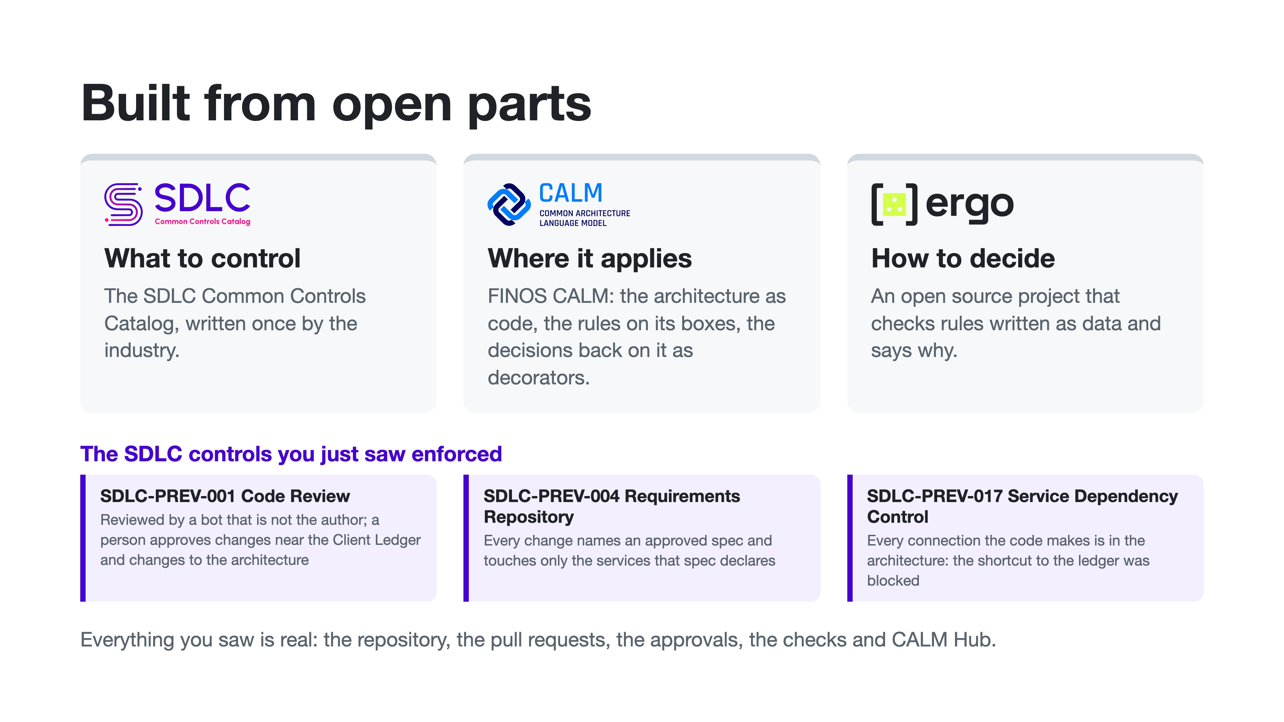
Notes:
Aaron. Three controls from the catalog were enforced live in that demo. Code review: every change reviewed by someone other than its author, and a person approving anything near the Client Ledger or any change to the architecture. Requirements: every change names an approved spec and stays inside the services it declares. Service dependency: every connection in the code exists in the architecture, which is why the shortcut was blocked. Why should you care? Developers get a fast lane: most changes fly through, and a blocked one says why. Architects get a diagram that can't go stale, because every change is checked against it. And risk and audit get the evidence as a by-product: regulators treat unsubstantiated controls as absent controls. And none of this is a product. The catalog says what to control. CALM says where it applies, and holds the decisions. ergo, an open source project, decides and explains. Everything you saw was real: a real repository, real pull requests, real approvals.

Slide 16
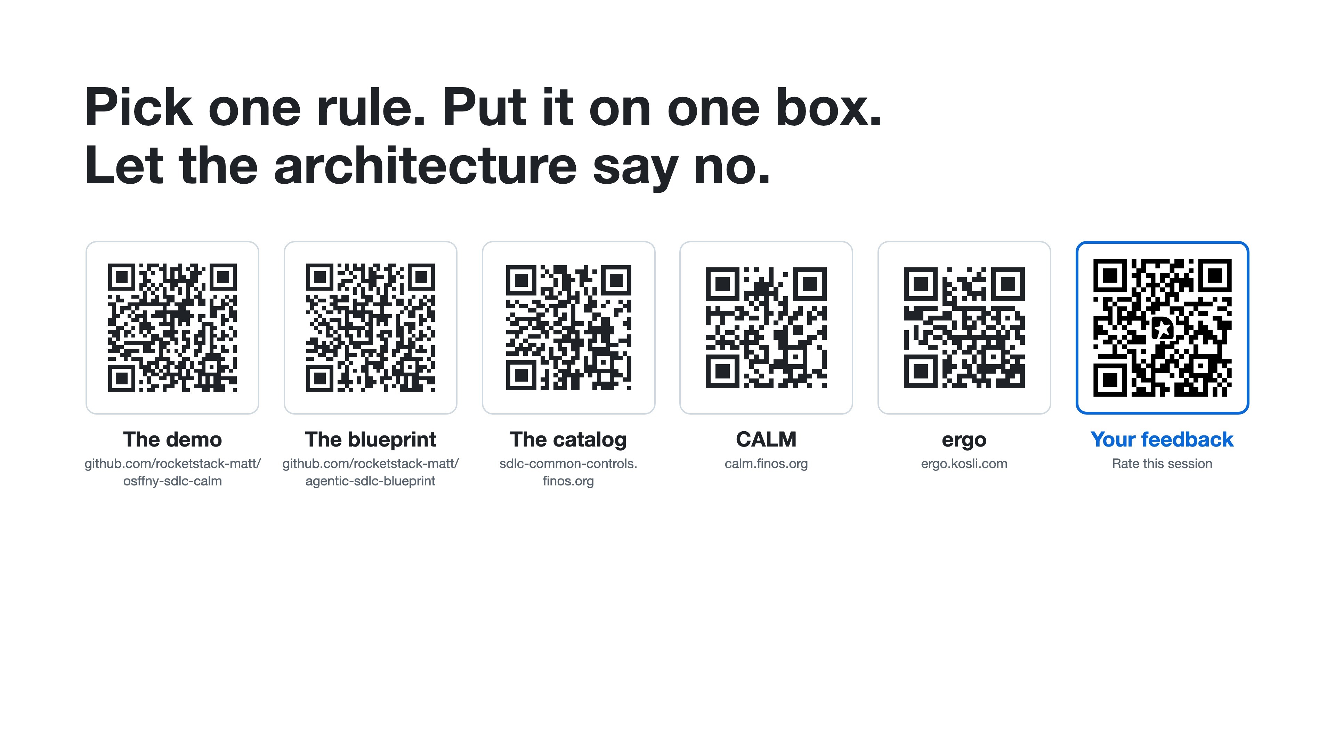
Notes:
Both. One ask. Pick one rule you already have. Put it on one box in your architecture. Let the architecture say no. Scan any of these: the demo repository, the code behind it, the catalog, CALM and ergo are all open. And the last one, on the right: please tell us what you thought of the session. Bring what you learn back to FINOS. Thank you. Leave this slide on screen for questions.

