Slide 1

Lecture 06: Constraint Satisfaction
Artificial Intelligence (CS 131)

Slide 2
Constraint Satisfaction Problems
In a search problem, a state is often a “black box”
Any data structure can be used
Even heuristic search does not pay generally pay attention to the relationships between different states and their structures beyond the basic heuristic values
Constraint satisfaction problem (CSP):
State is a set of variables X₁,…,X_{n}
Each variable X_{i} has a domain D_{i} of possible values
Goal test: a set of constraints C₁,…,C_{m}
(restrictions on possible values of the variables)
Solution: a complete assignment—each variable is assigned a possible value, without violating any constraint

Slide 3
Example 1: Map Coloring
Image source: Russell & Norvig (2021)
Variables: WA, NT, Q, NSW, V, SA, T
Domains: D_{i} = {R, G, B}
Constraints: adjacent areas must have different colors, e.g.:
(WA,NT) ∈ { (R,G), (R,B), (G,R), (G,B), (B,R), (B,G) }
WA ≠ NT

Slide 4

Example 1: Map Coloring
NT
Q
WA
SA
NSW
V
T
Solution: a complete and consistent assignment
e.g., WA = R, NT = G, Q = R, NSW = G, V = R, SA = B, T = G

Slide 5
Constraint Graphs
NT
Q
WA
SA
NSW
V
T
Binary CSP: each constraint involves n ≤ 2 variables
Constraint graph represents the problem:
Nodes are variables
Edges connect variables that occur together in any constraint; each such edge stores the necessary constraint information

Slide 6
Reducing to Binary Constraints
Every CSP can be written to only involve constraints on exactly two variables
Example: consider 3-ary constraint:
Create new variable AB with domain consisting of pairs from domains of A and B, and replace 3-ary version with:
(A, B, C) ∈ { (1, 1, 0), (1, 2, 1) }
(A, AB) ∈ { (1, (1, 1)), (1, (1, 2)) }
(B, AB) ∈ { (1, (1, 1)), (2, (1, 2)) }
(AB, C) ∈ { ((1, 1), 0), ((1, 2), 1) }

Slide 7
Reducing to Binary Constraints, cont’d.
Now consider 4-ary constraint:
Again, create new variable AB & replace constraint with:
Now, the last 3-ary constraint can be replaced using the procedure seen before
(A, B, C, D) ∈ { (1, 1, 0, 3), (1, 2, 1, 2) }
(A, AB) ∈ { (1, (1, 1)), (1, (1, 2)) }
(B, AB) ∈ { (1, (1, 1)), (2, (1, 2)) }
(AB, C, D) ∈ { ((1, 1), 0, 3), ((1, 2), 1, 2) }

Slide 8
Reducing to Binary Constraints, cont’d.
Inductively, any n-ary constraint can be made (n – 1)-ary
When all that is left are binary and unary, we can eliminate the unary ones entirely by domain reduction
For example, if we have a variable X_{i} with:
Simply replace the domain with the constraint itself:
Domain: D_{i} = {1, 2, 3, 4}
Constraint: X_{i} ∈ {1, 3}
Domain: D_{i} = {1, 3}

Slide 9
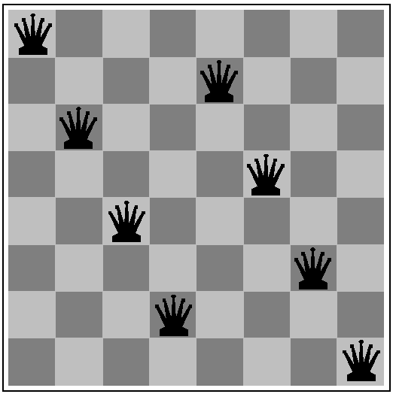
Example 2: n-Queens
What are the variables? Domains? Constraints?

Slide 10
Example 2: 8-Queens
8 variables, one per Queen, Q_{i} ( i = 1,…,8 )
Domain for each is a possible position: {1,2,…,8}
Constraints are as follows for all pairs ( i, j ) such that i ≠ j :
Q_{i} ≠ Q_{j}
|X^{i} – X^{j}| ≠ |i – j|

Slide 11
Example 3: Task Scheduling
T₁
T₁ must be done during T₃
T₂ must be achieved before T₁ starts
T₂ must overlap with T₃
T₄ must start after T₁ is complete
T₂
T₄
T₃
The variables here are task start/end times
What about the domains and constraints? How can we express something like constraint #4, above, in terms of pairs of values for the end of T₁ and the start of T₄?

Slide 12
Finite vs. Infinite Domains
Finite: n-Queens, matching mates, job assignment
Constraints can, if we wish, be listed explicitly, in terms of all the possible pairs of values between constrained variables
Infinite: job scheduling
Cannot usually just enumerate all the possibilities
We need a constraint language to express things concisely:
Start-Job₁ + 5 ≤ Start-Job₂
The choice of this language affects the complexity of checking constraint satisfaction
Programs may need significant computation to check whether or not some assignment satisfies all constraints

Slide 13
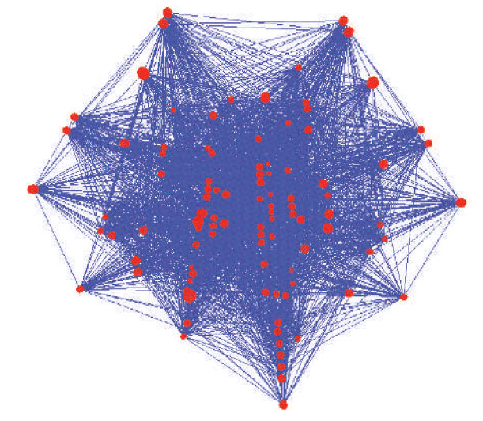
Real-World CSPs
Assignment problems
e.g., who teaches what class
Timetabling problems
e.g., which class is offered when and where?
Transportation scheduling
Factory scheduling

Slide 14

Bad Solution 1: Generate and Test
A naïve algorithm:
Generate all possible combinations of values (nested loops)
Test each one to see if it satisfies constraints
Terminate on first satisfying assignment or fail when all checked
The complexity of this is far too high; if we have:
A set of n variables
A range of d possible domain values (e.g. values 1, 2, 3,…,d )
d^{n} possible value combinations
n² possible binary constraints

Slide 15
Bad Solution 2: Naïve Search
Simple search in a tree of (partial/complete) solutions:
Initial start state is set of unassigned variables
Each branch chooses one unassigned variable and some value for it that does not cause a constraint failure
Depth-First search, where each leaf is a complete or failed assignment
Again, complexity of this is far too high, since we have:
(n × d) choices for (variable, value) choices at first level
((n – 1) × d) choices at level 2, ((n – 2) × d) choices at level 3, etc.
n!d^{n} possible paths down to leaves that must be explored

Slide 16
Solving CSPs: What else is needed?
We need more than a successor function and a goal test:
Way to propagate constraints: checking how changes to values of one variable affect those that can be placed on all the others
Early failure test, so we don’t explore dead ends in our search
Thus, we need:
Precise way to represent constraints
Algorithms to check constraint conflict, agreement, and satisfaction

Slide 17
One Improvement: Using Commutativity
Naïve search ignores commutativity of CSPs
Whether a solution exists does not depend upon the order in which we assign variables, since all we care about is a final solution that is consistent
Backtracking Search: a basic CSP solution algorithm
Exploit commutative structure by only changing single variable at each level (X₁ at first search level, X₂ at second, etc.)
This reduces total number of search paths: n!d^{n} ⇒ d^{n}
Allow search to back up by removing a variable assignment when failure occurs, rather than starting all over again

Slide 18
Backtracking Search
Image source: Russell & Norvig (2021)
For any value chosen, we recurse, moving onto next variable in our ordering.
Failure test checks any result returned from lower levels.
A simple recursive version of back-tracking
Even in this limited version, can solve n-Queens for n ≤ 25

Slide 19
Backtracking Search
Image source: Russell & Norvig (2021)
If a solution is not consistent, then the latest assignment is removed from the current set.
The algorithm repeats until either we succeed, or all values are used up and we fail.

Slide 20
Backtracking example
Image source: Russell & Norvig (2021)
Any search from this point on will fail, so this branch will back up to the parent node above it as necessary.

Slide 21
Improving Backtracking
Depending upon how we answer the following questions, our search can go in a number of different ways:
Which variable should be assigned next and in what order should the values be tried?
What results does the current variable assignments have on other variables?
How to detect dead-ends early?
When a path fails, can we avoid repeating this failure in later search paths?

Slide 22
Improving Performance of Backtracking
By varying the order in which we select variables and values, we may improve algorithm efficiency dramatically

Slide 23
Backtracking Search
Image source: Russell & Norvig (2021)
In simplest possible version, this step does nothing (and can be deleted).
More complex versions will do some computation to enforce certain other properties on an assignment (to be covered next lecture).

