Slide 1
Announcements for day 23
Get started on Project C
Leaderboard due Fri 12/18 11:59pm AoE
Report due Mon 12/21 11:59pm AoE
Assignments ahead:
HW5 due on Wed 12/2
Last chance to use your late days
Quiz 5 next Wed 12/9
Will cover Unit 5 (Kernels) and PCA
Class ahead:
Wed 12/2: Rec Sys
Mon 12/7: More Ethics + ML / Unit 5 Practice Quiz
Wed 12/9: Last class!
Ask me anything + Work time for Project C

Slide 2
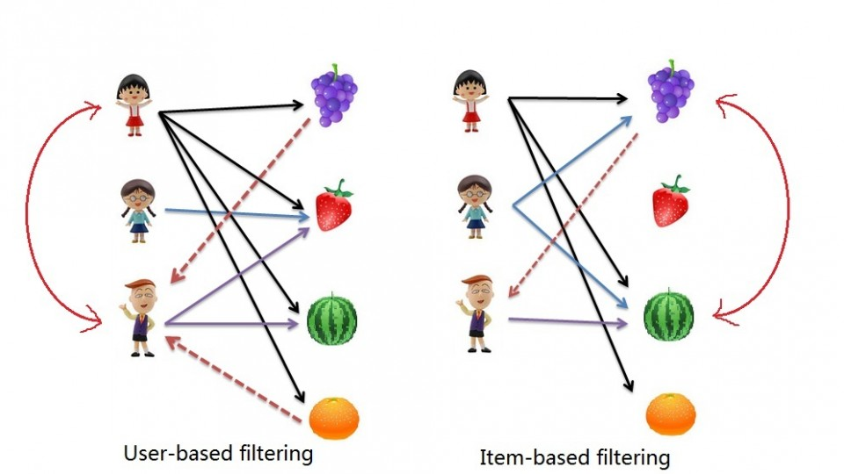

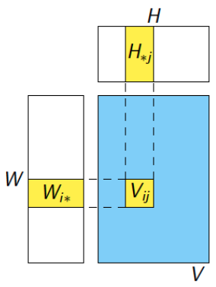
Matrix Factorization for Recommendation Systems
Tufts COMP 135: Introduction to Machine Learning
https://www.cs.tufts.edu/comp/135/2020f/
Prof. Mike Hughes
Many ideas/slides attributable to:
Liping Liu (Tufts), Emily Fox (UW)
Matt Gormley (CMU)

Slide 3
Matrix Factorization Objectives (day 23)
New Task: Recommendation
Many “users”, many “items”
Predict which users will like each item
Collaborative filtering
Unsupervised learning problem
Latent Factor model (Reading: Koren et al)
Training algorithm: Stochastic gradient descent (SGD)
How to do gradients: Automatic differentiation
Python package: autograd

Slide 4
Recommendation Task: Which users will like which items?

Slide 5










Need recommendation everywhere

Slide 6
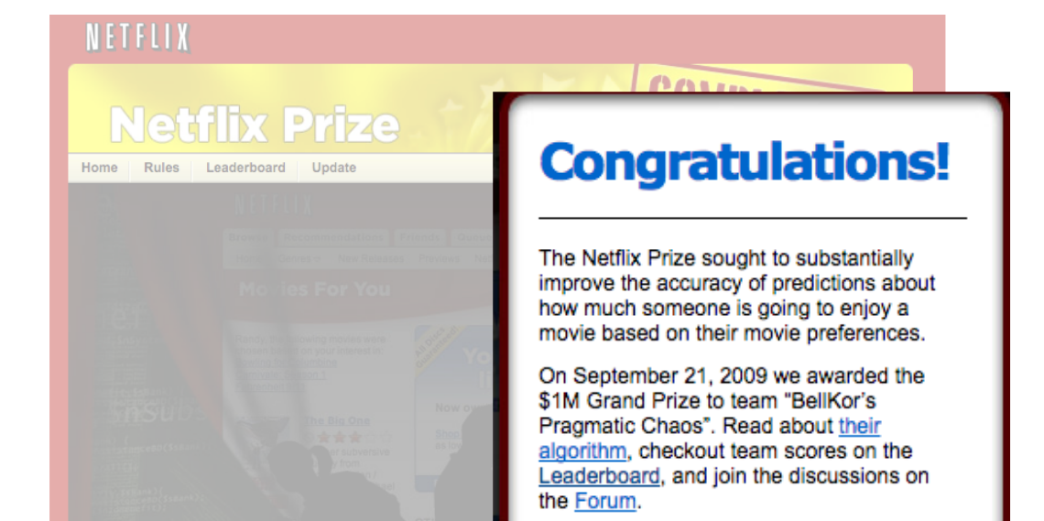
Motivation: Netflix Prize

Slide 7
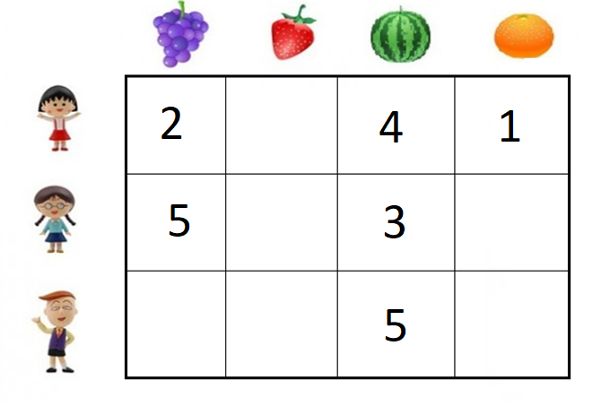
Observed data
The “value”, “utility”, or “rating” of items to users
In practice, very sparse, many entries unknown
2
4

Slide 8
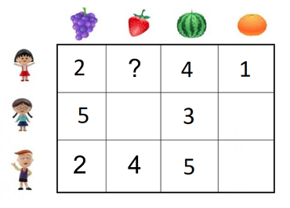
Task: Recommendation
Supervised
Learning
Content filtering
Unsupervised Learning
Collaborative filtering
Reinforcement Learning

Slide 9
Collaborative filtering via Latent Factor Models

Slide 10
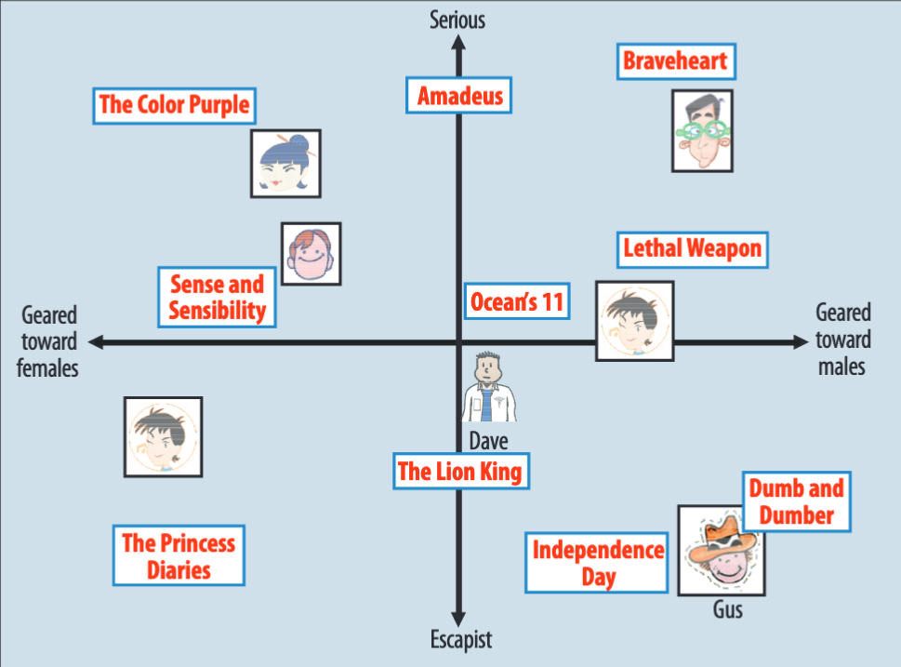
Latent Factor Methods for Collaborative Filtering
Assumption:
Both movies and users can be explained via a low-dimensional space
Latent Factor Recommendation
To find new movies to recommend to Joe
Find Joe’s embedding vector in the learned “factor” space
Recommend movies with similar embedding vectors
Factor 2
Stereotypically
Stereotypically
Factor 1
Fig. Credit: Koren et al. ’09

Slide 11
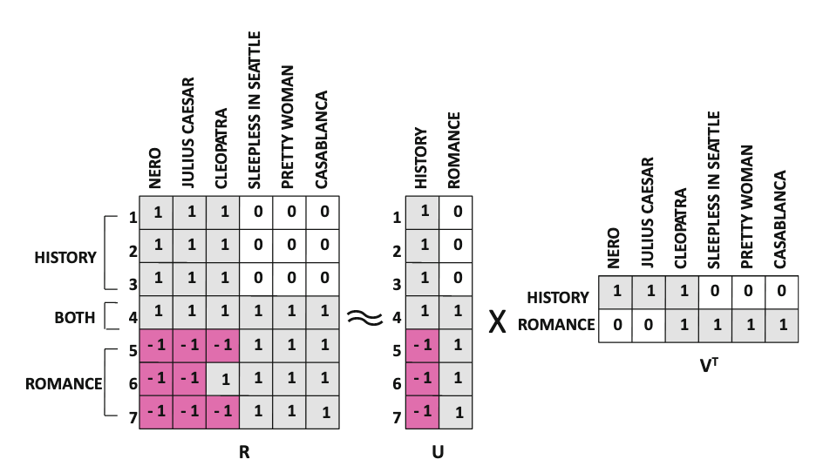
Cartoon View of Matrix Factorization with 2 latent factors
movies
users
Fig. Credit: Aggarwal 2016
By way of M. Gormley

Slide 12
Recall: PCA as Matrix Factorization
Compared to PCA, Latent Factor models (LF) for recommendation are
Similar
Use a K-dimensional latent space
Use linear inner products to do ”prediction”
Measure reconstruction cost with mean-squared error
Different
PCA required orthogonality constraints on W, while LF is less strict
LF interprets each column of data as an “item”, not a “feature dimension”
PCA requires fully observed data, the LF models we’ll develop can handle realistic missingness patterns

Slide 13

Latent Factor Model: Prediction
Assume a known number of factors K
User $i$ represented by vector
Item $j$ represented by vector
We predict the rating y for
user-item pair (i,j) as:
Intuition:
Two items with similar v vectors
get similar ratings from the same user;
Two users with similar u vectors
give similar ratings to the same item
Inner product of:
User vector
Item vector

Slide 14
Latent Factor Model: Training
Find parameters that minimize squared error
How to optimize?
Stochastic gradient descent
Use random minibatch of user-item pairs
Squared error between
True rating
Predicted rating
Which pairs do we use?

Slide 15
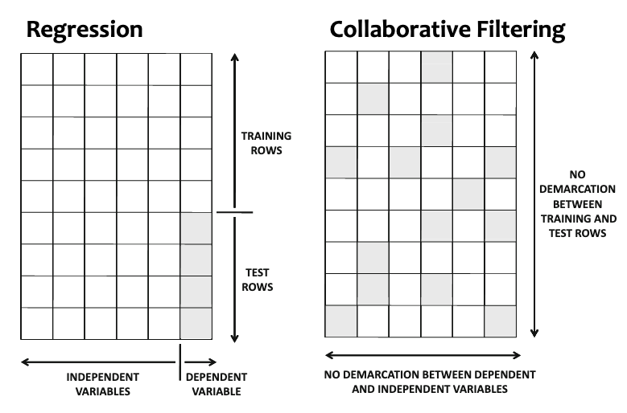
Supervised Learning vs Unsupervised Matrix Completion
x₁
x₅
y
Fig. Credit: Aggarwal 2016
By way of M. Gormley

Slide 16
Setting up Collaborative Filtering task
Real data will have known and unknown entries

Slide 17
Setting up Collaborative Filtering task
Real data will have known and unknown entries
Divide known user-item pairs at random into:
Training
Validation
Test
Assumption (for Project C): We only care about predictions among known sets of users and items.
Do not worry about any new users or new items. (Obviously, in real world need to handle new users/items)

Slide 18
Latent Factor Model: Training
Find parameters that minimize squared error
How to optimize?
Stochastic gradient descent
Use random minibatch of user-item pairs
Squared error between
True rating
Predicted rating
Which pairs do we use?
Only the blue squares in the matrix Y

Slide 19
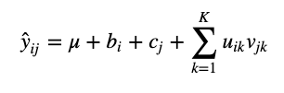
Improvement: Include intercept parameters!
Overall “average rating”
Per-user scalar
Per-item scalar
Why include these? Improve accuracy
Some items just more popular
Some users just more positive

Slide 20




Project C
Goal: Latent factor models for MovieLens100k dataset
943 users, 1683 movies
Problems 1, 2, and 3 develop increasingly interesting models:
M1
M2
M3
We’ll use SGD to fit them all! With gradients from autograd.

Slide 21
Matrix Factorization Objectives (day 23)
Explain Recommendation Task
Predict which users will like each item
Collaborative filtering
Unsupervised learning problem
Latent Factor model (Reading: Koren et al)
Training algorithm: Stochastic gradient descent (SGD)
How to do gradients: Automatic differentiation
Python package: autograd

Slide 22





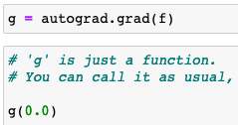
autograd : Univariate functions

Slide 23



autograd : Multivariate functions
TODO use ag_np.square and other ag_np calls

Slide 24
Breakout: Lab on autograd

Slide 25
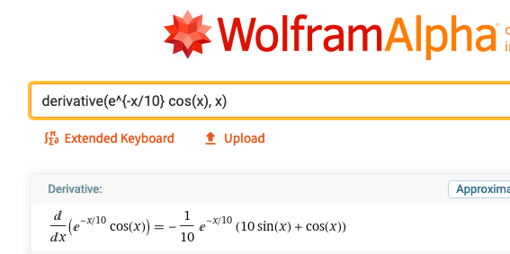
Automatic differentiation
What it is NOT
Symbolic differentiation
Symbolic systems know how to do algebra, simplify, etc
Like asking Wolfram Alpha
Numeric differentiation
Perturb input by 0.0001 and estimate the change in function value

Slide 26
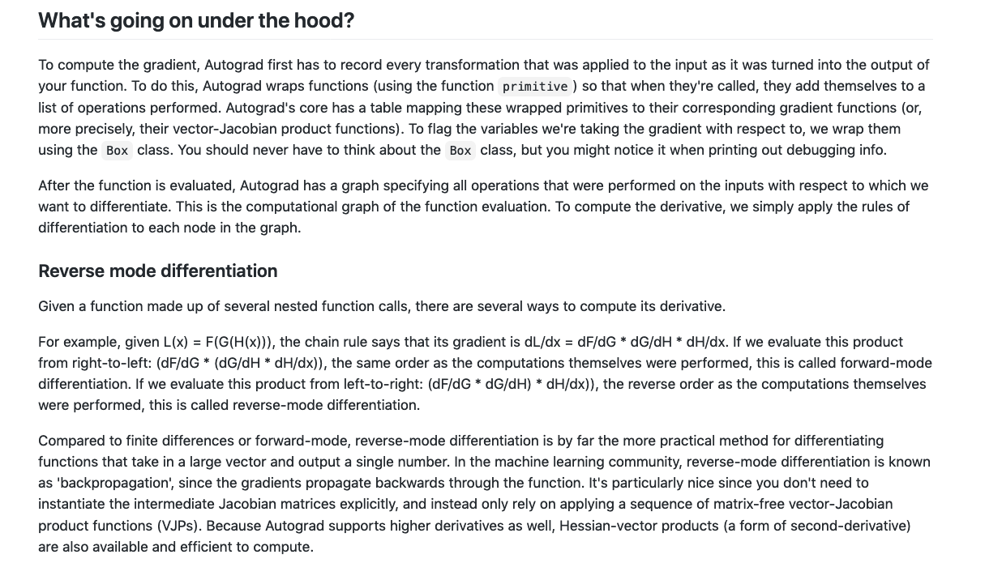
Automatic differentiation
What it is: back propagation
For more demos and info:
https://github.com/HIPS/autograd

Slide 27
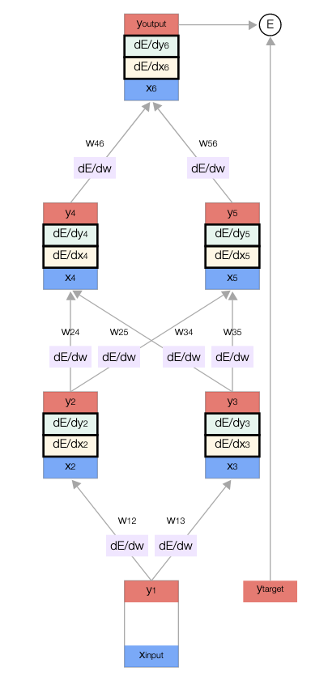
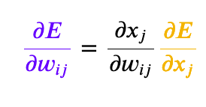
Recall: Backprop (from Unit 3)
Assume: Computation graph with known ordering
0. Do forward pass
1. Update each non-terminal node in reverse order
2. Update each edge’s gradient wrt weights
Chain rule update
Each term either:
- simple derivative of known function
- looked up as computation of previous step

Slide 28
Backprop for autograd
Computation graph and ordering discovered by monitoring the Python interpreter
0. Do forward pass
1. Update each non-terminal node in reverse order
2. Update each input parameter’s gradient
Chain rule update involving several terms
Each term either:
- simple derivative of known function
- looked up as result of previous step
As long as we can compute each elementary operation’s derivative, we can do this!

