Slide 1

Class #05: Linear Classification with the Perceptron
Machine Learning (COMP 135)

Slide 2
Review: The General Learning Problem
We want to learn functions from inputs to outputs, where each input has n features:
The type of learning problem we are solving really depends upon the type of the output domain, Y
If (i.e., is real-valued), this is regression
If Y is a finite discrete set, this is classification

Slide 3
Decisions to Make
When collecting our training example pairs, (x, f(x)), we still have some decisions to make
Example: Medical Informatics
We have some genetic information about patients
Some get sick with a disease and some don’t
Patients live for a number of years (sick or not)
Question: what do we want to learn from this data?
Depending upon what we decide, we may use:
Different models of the data
Different machine learning approaches
Different measurements of successful learning

Slide 4
One Approach: Regression
We decide that we want to try to learn to predict how long patients will live
We base this upon information about the degree to which they express a specific gene
A regression problem: the function we learn is the “best (linear) fit” to the data we have
x
x
x
x
survival (years)
x
x
x
x
x
x
x
x
x
x
x
x
x
x
x
x
x
x
x
x
x
x
x
x
x
x
x
x
x
x
x
x
x
x
x
x
x
x
x
gene X expression

Slide 5
Another Approach: Classification
We decide instead that we simply want to decide whether a patient will get the disease or not
We base this upon information about expression of two genes
A classification problem: function separates data into two different groups (binary classes)
x Healthy
o Disease
o
o
o
o
o
o
o
o
o
o
o
gene Y expression
o
o
o
o
o
o
x
o
x
o
o
o
o
x
o
o
x
o
o
x
o
o
x
x
o
x
x
o
o
x
x
o
x
o
x
x
x
x
o
o
x
x
x
x
x
x
x
x
x
x
x
x
x
x
gene X expression

Slide 6
Which is the Correct Approach?
x Healthy
o Disease
x
x
o
o
o
x
x
o
o
o
o
o
o
survival (years)
o
o
x
x
x
x
gene Y expression
o
o
o
o
o
o
x
x
o
x
x
x
x
x
x
x
o
o
o
o
x
x
x
o
o
x
x
x
x
x
o
o
x
o
o
x
x
o
x
x
x
x
x
x
x
o
o
x
x
x
o
x
o
x
x
x
x
x
x
x
x
o
o
x
x
x
x
x
x
x
x
x
x
x
x
x
x
x
x
x
x
x
x
x
x
x
x
x
x
gene X expression
gene X expression
The approach we use depends upon what we want to achieve, and what works best based upon the data we have
Much machine learning involves investigating different approaches

Slide 7
From Regression to Classification
x
Suppose we have two classes of data, defined by a single attribute x
We seek a decision boundary that splits the data in two
When such a boundary can be defined using a linear function, it is called a linear separator

Slide 8
Threshold Functions
We have data-points with n features:
We have a linear function defined by n+1 weights:
We can write this linear function as:
We can then find the linear boundary, where:
And use it to define our threshold between classes:
Outputs 1 and 0 here are arbitrary labels for one of two possible classes

Slide 9
From Regression to Classification
x
Data is linearly separable if it can be divided into classes using a linear boundary:
Such a boundary, in 1-dimensional space, is a threshold value

Slide 10
From Regression to Classification
Data is linearly separable if it can be divided into classes using a linear boundary:
Such a boundary, in 2-dimensional space, is a line

Slide 11
From Regression to Classification
o
x
o
x
x
o
x
o
o
o
o
o
x
x
o
o
o
x
o
o
x
x
x
o
x
o
o
x
x
o
o
x
o
x
o
Data is linearly separable if it can be divided into classes using a linear boundary:
Such a boundary, in 3-dimensional space, is a plane
In higher dimensions, it is a hyper-plane

Slide 12
The Geometry of Linear Boundaries
x₂
Suppose we have 2-dimensional inputs
The “real” weights
define a vector
The boundary where our linear function is zero,
is an orthogonal line,
parallel to
Its offset from origin is determined by w₀ (which is called the bias weight)
x₁

Slide 13
The Geometry of Linear Boundaries
x₂
For example, with “real” weights:
we get the vector shown
as a green arrow
Then, for a bias weight
the boundary where our
linear function is zero,
is the line shown in red,
crossing origin at (2,0) & (0,1)
2.0
1.5
1.0
0.5
0.0
x₁
0.0
0.5
1.0
1.5
2.0

Slide 14
The Geometry of Linear Boundaries
x₂
Once we have our linear boundary, data points are classified according to our threshold function
x₁

Slide 15
Zero-One Loss
x₂
For a training set made up of input/output pairs,
we could define the
zero/one loss
Summed for the entire set, this is simply the count of examples that we get wrong
x₁
In this example, if data-points marked should be in class 0 (below the line) and those marked should be in class 1 (above the line) the loss would be equal to 3

Slide 16
Minimizing Zero/One Loss
Sadly, it is not easy to compute weights that minimize zero/one loss
It is a piece-wise constant function of weights
It is not continuous, however, and gradient descent won’t work
E.g., for the following one-dimensional data, we get loss shown below:
x₁
0
1
2
3
4
5
6
7
Loss
2
1
0
x₁
0
1
2
3
4
5
6
7

Slide 17
Perceptron Loss
Instead, we define the perceptron loss on a training item:
For example, suppose we have a 2-dimensional element in our training set for which the correct output is 0, but our threshold function says 1:
The difference between what output should be, and what our weights make it
Sum of input attributes (1 is the “dummy”
attribute that is multiplied by bias weight w₀)

Slide 18
Perceptron Learning
To minimize perceptron loss we can start from initial weights—perhaps chosen uniformly from interval [-1,1]—and then:
Choose an input x_{i} from our data set that is wrongly classified.
Update vector of weights, , as follows:
Repeat until no classification errors remain.
The update equation means that:
If correct output should be below the boundary (y_{i} = 0) but our threshold has placed it above (h_{w}(x_{i}) = 1) then we subtract each feature (x_{i,j}) from the corresponding weight (w_{i})
If correct output should be above the boundary (y_{i} = 1) but our threshold has placed it below (h_{w}(x_{i}) = 0) then we add each feature (x_{i,j}) to the corresponding weight (w_{i})

Slide 19
Perceptron Updates
The perceptron update rule shifts the weight vector positively or negatively, trying to get all data on the right side of the linear decision boundary
Again, supposing we have an error as before, with weights as given below:
This means we add the value of each attribute to its matching weight (assuming again that “dummy” x_{i,0} = 1, and that parameter 𝛼 = 1):
After adjusting weights, our function is now correct on this input

Slide 20
Progress of Perceptron Learning
x₂
For an example like this, we:
Choose a mis-classified item (marked in green)
Compute the weight updates, based on the “distance” away from the boundary (so weights shift more based upon errors in boundary placement that are more extreme)
Here, this adds to each weight, changing the decision boundary
x₁
In this example, data-points marked should be in class 0 (below the line) and those marked should be in class 1 (above the line)

Slide 21
Progress of Perceptron Learning
x₂
Once we get a new boundary, we repeat the process
Choose a mis-classified item (marked in green)
Compute the weight updates, based on the “distance” away from the boundary (so weights shift more based upon errors in boundary placement that are more extreme)
Here, this subtracts from each weight, changing the decision boundary in the other direction
x₁
In this example, data-points marked should be in class 0 (below the line) and those marked should be in class 1 (above the line)

Slide 22
Linear Separability
x₂
The process of adjusting weights stops when there is no classification error left
A data-set is linearly separable if a linear separator exists for which there will be no error
It is possible that there are multiple linear boundaries that achieve this
It is also possible that there is no such boundary!
x₁

Slide 23
Linearly Inseparable Data
x₂
Some data can’t be separated using a linear classifier
Any line drawn will always leave some error
The perceptron update method is guaranteed to eventually converge to an error-free boundary if such a boundary really exists
If it doesn’t exist, then the most basic version of the algorithm will never terminate
x₁

Slide 24
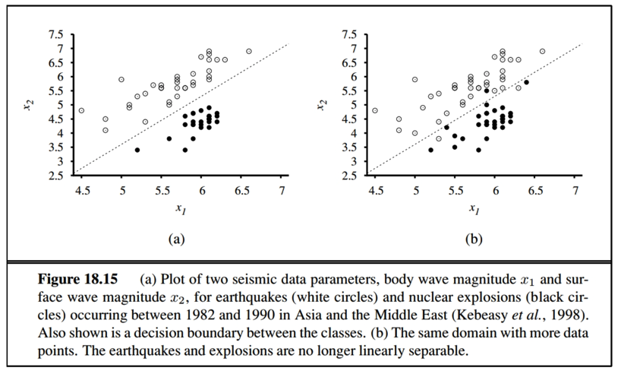
Linearly Inseparable Data
Image source: Russel & Norvig, AI: A Modern Approach (Prentice Hal, 2010)
Unfortunately, data that can’t be separated linearly is very common…

Slide 25
Modifying Perceptron Learning
To minimize error, we can modify the algorithm slightly:
Choose an input x_{i} from our data set that is wrongly classified.
Update vector of weights, , as follows:
Repeat until no classification errors remain.
Repeat until weights no longer change; modify learning parameter 𝛼 over time to guarantee this.
If we make 𝛼 smaller and smaller over time, then as , the weights will quit changing, and the algorithm converges
To get down to a least-error possible final separator, we do this slowly, e.g., setting , where t is the current iteration of the update algorithm

Slide 26
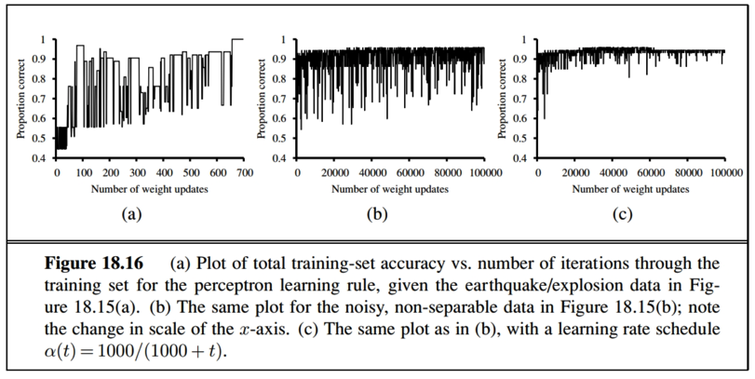
Modifying Perceptron Learning
Image source: Russel & Norvig, AI: A Modern Approach (Prentice Hal, 2010)

