Slide 1

Class #08: Logistic Regression
Machine Learning (COMP 135)

Slide 2
Reminder: Threshold Functions
We have data-points with n features:
We have a linear function defined by n+1 weights:
We can write this linear function as:
We can then find the linear boundary, where:
And use it to define our threshold between classes:
Outputs 1 and 0 here are arbitrary labels for one of two possible classes

Slide 3
Hard Thresholds are Hard!
The hard threshold function used by the perceptron algorithm (among others) produces some conceptual and mathematical challenges
Gives a yes/no answer everywhere, which can be tricky when our data isn’t linearly separable
Function is discontinuous (non-differentiable) at x = 0

Slide 4
The Logistic Function
We can generate a smooth curve by instead using the logistic function as a threshold
We can treat this value as a probability of belonging to one class or another
Probability function is 0.5 at x = 0

Slide 5
Using the Logistic for Classification
Treated as a probability, the logistic can still be used to classify data, where the class is the one that has highest probability overall, while also supplying a probability for that outcome
A “coin flip” where we have x = 0

Slide 6
Issues with Linear Classification
BP
Consider data about heart-attack risk, based upon body mass index (BMI) and blood pressure (BP)
Even assuming linearly separable training data, linear classification gives a hard cut-off that may not be appropriate
BMI
heart attack
no heart attack

Slide 7
Issues with Linear Classification
BP
Given that multiple possible lines can separate this data, how do we classify a new instance when it lies in the region between the training instances?
BMI
heart attack
don’t know?
no heart attack

Slide 8
Issues with Linear Classification
BP
Even if we did settle on some fixed line, what do we do with something that is very close to the separator?
BMI
heart attack
don’t know?
no heart attack

Slide 9
Using Probabilistic Classification
BP
Logistic regression also generates a linear separator (where the weight-function = 0), but now it is giving us an empirical distribution over the data-set
A new data point close to the line still has some positive probability of being in the class on the other side of it
more likely
less likely
BMI
heart attack
don’t know?
no heart attack

Slide 10
Properties of the Logistic Function
Also known as the Sigmoid, from the shape of its plot
It always has a value in range:
0 ≤ x ≤ 1
The function is everywhere differentiable, and has a derivative that is easy to calculate, which turns out to be useful for learning:

Slide 11
Logistic Regression
In perceptron learning we update the weight vector in each case based upon a mis-classified instance, using the equation:
For the logistic, using the same loss function (squared error), we would do the same, but add an extra term:
The difference between what output should be, and what our weights make it
The jth feature-value
The derivative of the logistic

Slide 12
Gradient Descent for Logistic Regression, I
We could then use the same approach as for linear classification, starting with some random (or uniform) weights and then:
Choose an input x_{i} from our data set that is wrongly classified.
Update vector of weights, :
Repeat until weights no longer change; modify learning parameter 𝛼 over time to guarantee this.
Again, we make 𝛼 smaller and smaller over time, and the algorithm converges as

Slide 13
A Problem: Local Minima
While this sort of weight update does drive the error down, it has a flaw: squared-error loss for logistic regression is not convex
Gradient descent can get stuck in locally optimal solutions that aren’t ideal
Solution: change the error function!

Slide 14
Gradient Descent for Logistic Regression, II
We change the weight-update in our gradient descent approach:
Choose an input x_{i} from our data set that is wrongly classified.
Update vector of weights, :
Repeat until weights no longer change; modify learning parameter 𝛼 over time to guarantee this.
Note: the update looks like the update for linear regression, but:
It only uses a single incorrect data-point, not the sum of all errors
The hypothesis h is an application of the logistic function
The reason we can do this update is that we don’t use the squared-error loss, but use a different loss function: logistic loss

Slide 15
Gradient Descent for Logistic Regression
The logistic update equation, via gradient descent, minimizes the log-loss (also known as logistic loss or binary cross entropy):
For these purposes, we treat the output of the logistic as the probability we are interested in:
Over time, we drive the loss towards 0

Slide 16
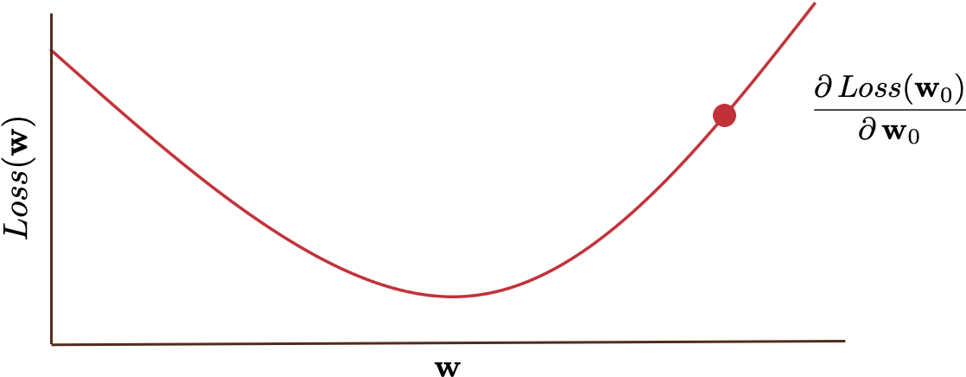
Gradient Descent for Logistic Regression
The log-loss is a convex function
Like the losses used in linear regression and the perceptron
This means that the gradient descent process (with suitable values of 𝛼) will converge upon a near-optimal solution

Slide 17
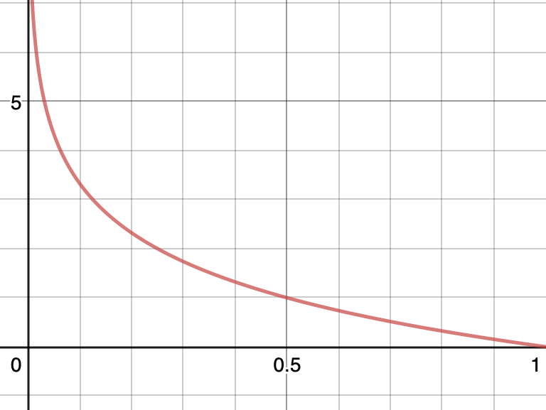
Logarithmic Loss vs. Thresholded Error
For an individual data element, the log loss is an upper bound on a threshold-based (1/0) loss:
log
This graph assumes:
True label is 1
Threshold used is 0.5 (i.e., h_{w} = 1 if probability assigned is p ≥ 0.5)
Log base 2 is used
1/0

Slide 18
Linear vs. Logistic Regression
Linear Regression | Logistic Regression
A value x ∈ ℝ | A value 0 ≤ x ≤ 1
Output value of an arbitrary function | Probability of belonging to a certain class
Tries to find line that best fits to the data | Tries to find separator that best divides the classes

Slide 19
Linear vs. Logistic Regression in Mathematical Terms
Linear
Loss function
Weight-update equation
Logistic
Loss function
Weight-update equation

Slide 20
Another Approach: ADALINE classifiers
Rather than a perceptron or logistic approach, what if we tried to use linear regression itself to build a classifier?
For two classes, we could:
Label data using two class-labels, y 𝜖 {+1, –1}
Fit a linear regression to this data using squared loss (now measured as the difference between the linear value and the class-label, not some other real number) and the same weight-updates as before
Classify data based upon whether the resulting linear function is ≥ 0 (in which case it is assigned +1) or not (–1)
This is known as a least-squares or ADALINE (Adaptive Linear Neuron) classifier

Slide 21
Treatment of Outliers in Data
x₂
x₂
logistic
ADALINE
x₁
x₁
Logistic regression (solid line) and ADALINE (dashed) give similar results on some data
The ADALINE is skewed by outliers, however, as loss function sees them as “too correct”

