Slide 1

Class #09: Support Vector Machines (SVMs) and Kernel Functions
Machine Learning (COMP 135)

Slide 2
Data Separation
x₂
x₂
x₁
x₁
Linear classification with a perceptron or logistic function looks for a dividing line in the data (or a plane, or other linearly defined structure)
Often multiple lines are possible
Essentially, the algorithms are indifferent: they don’t care which line we pick

Slide 3
“Fragile” Separation
x₂
x₂
New data
x₁
x₁
As more data comes in, these classifiers may start to fail
A separator that is too close to one cluster or the other now makes mistakes
May happen even if new data follows same distribution seen in the training set

Slide 4
“Robust” Separation
x₂
x₂
x₁
x₁
What we want is a large margin separator: a separation that has the largest distance possible from each part of our data-set
This will often give much better performance when used on new data

Slide 5
Large Margin Separation
x₂
This is sometimes called the “widest road” approach
A support vector machine (SVM) is a technique that finds this road
The points that define the edges of the road are knows as the support vectors
x₁
A new learning problem: find the separator with the largest margin
This will be measured from the data points, on opposite sides, that are closest together

Slide 6
Linear Classifiers and SVMs
Linear
Weight equation
Threshold function
SVM
Weight equation
Threshold function

Slide 7
Large Margin Separation
x₂
+1
A key difference: the SVM is going to do this without learning and remembering weight vector w.
Instead, it will use features of the data-items themselves.
–1
x₁
Like a linear classifier, the SVM separates at the line where its learned vector of weights is zero

Slide 8
Mathematics of SVMs
x₂
x⁺
x–
x₁
It turns out that the weight-vector w for the largest margin separator has some important properties relative to the closest data-points on each side (x⁺ and x–)

Slide 9
Mathematics of SVMs
Through the magic of mathematics (Lagrangian multipliers, to be specific), we can derive a quadratic programming problem
We start with our data-set:
We then solve a constrained optimization problem:
The goal: based on known values ( ) find the values we don’t know (𝛼_{i} ) that:
Will maximize value of margin W(𝛼)
Satisfy the two numerical constraints

Slide 10
Mathematics of SVMs
Although complex, a constrained optimization problem like this can be algorithmically solved to get the 𝛼_{i} values we want:
Once done, we can find the weight-vector and bias term if we want:
A note about notation: these equations involve two different, necessary products:
The usual application of weights to points:
Products of points and other points:

Slide 11
The Dual Formulation
It turns out that we don’t need to use the weights at all
Instead, we can simply use the 𝛼_{i} values directly:
What we usually look for in a parametric method: the weights, w, and offset, b, defining the classifier
What we can use instead: we compute an equivalent result based upon the 𝛼 parameters, the outputs y, and products between data-points themselves (along with the standard offset)

Slide 12
The Dual Formulation
Now, if we had to sum over every data-point as on the right-hand side of this equation, this would look very bad for a large data-set
It turns out that these 𝛼_{i} values have a special property, however, that makes it feasible to use them as part of our classification function…

Slide 13
Sparseness of SVMs
x₂
So, when we do the calculation:
We only have to sum over points x_{j} that are in the set of support vectors, ignoring all others, since the related 𝛼 values are all 0.
Thus, an SVM need only remember and use the values for a few support vectors, not those for all the rest of the data.
𝛼_{i} = 0
𝛼⁺
𝛼–
x₁
The 𝛼_{i} values are 0 everywhere except at the support vectors (the points closest to the separator)

Slide 14
Hard and Soft Margins
We have slightly simplified one detail of how most SVMs actually work
It is not always true that the support vectors lie on the margins, with nothing else in between them
This is only true in the hard margin case
SVMs can have soft margins, instead (and usually do) to deal with noisier data
We weaken the requirement that no points lie between the margins
All points within the margins then become the support vectors for classification

Slide 15
Hard and Soft Margins
In upcoming exercises, we see how to vary margin strength in sklearn
SVM models come with a regularization parameter (C, as in the case of classifiers) that can be:
Increased to enforce a harder margin
Decreased to allow a softer margin

Slide 16
Another Nice Trick
x₂
Using a kernel“trick”, we can find a function that transforms the data into another form, where it is actually possible to separate it in a linear manner
x₁
The dual formulation uses dot-products of data-points with each other (instead of with weights)
Combining this with the idea of a kernel will allow us to deal with data that is not linearly separable

Slide 17
Transforming Non-Separable Data
x₂
A transformation function:
maps data-vectors to new vectors, of either the same dimensionality (m = n) or a different one (m ≠ n)
x₁
If data that is not linearly separable, we can transform it
We change features used to represent our data
As usual, we don’t care what the data feature are, so long as we can get classification to work

Slide 18
Transforming Non-Separable Data
x₂
x₂
x₁
x₁

Slide 19
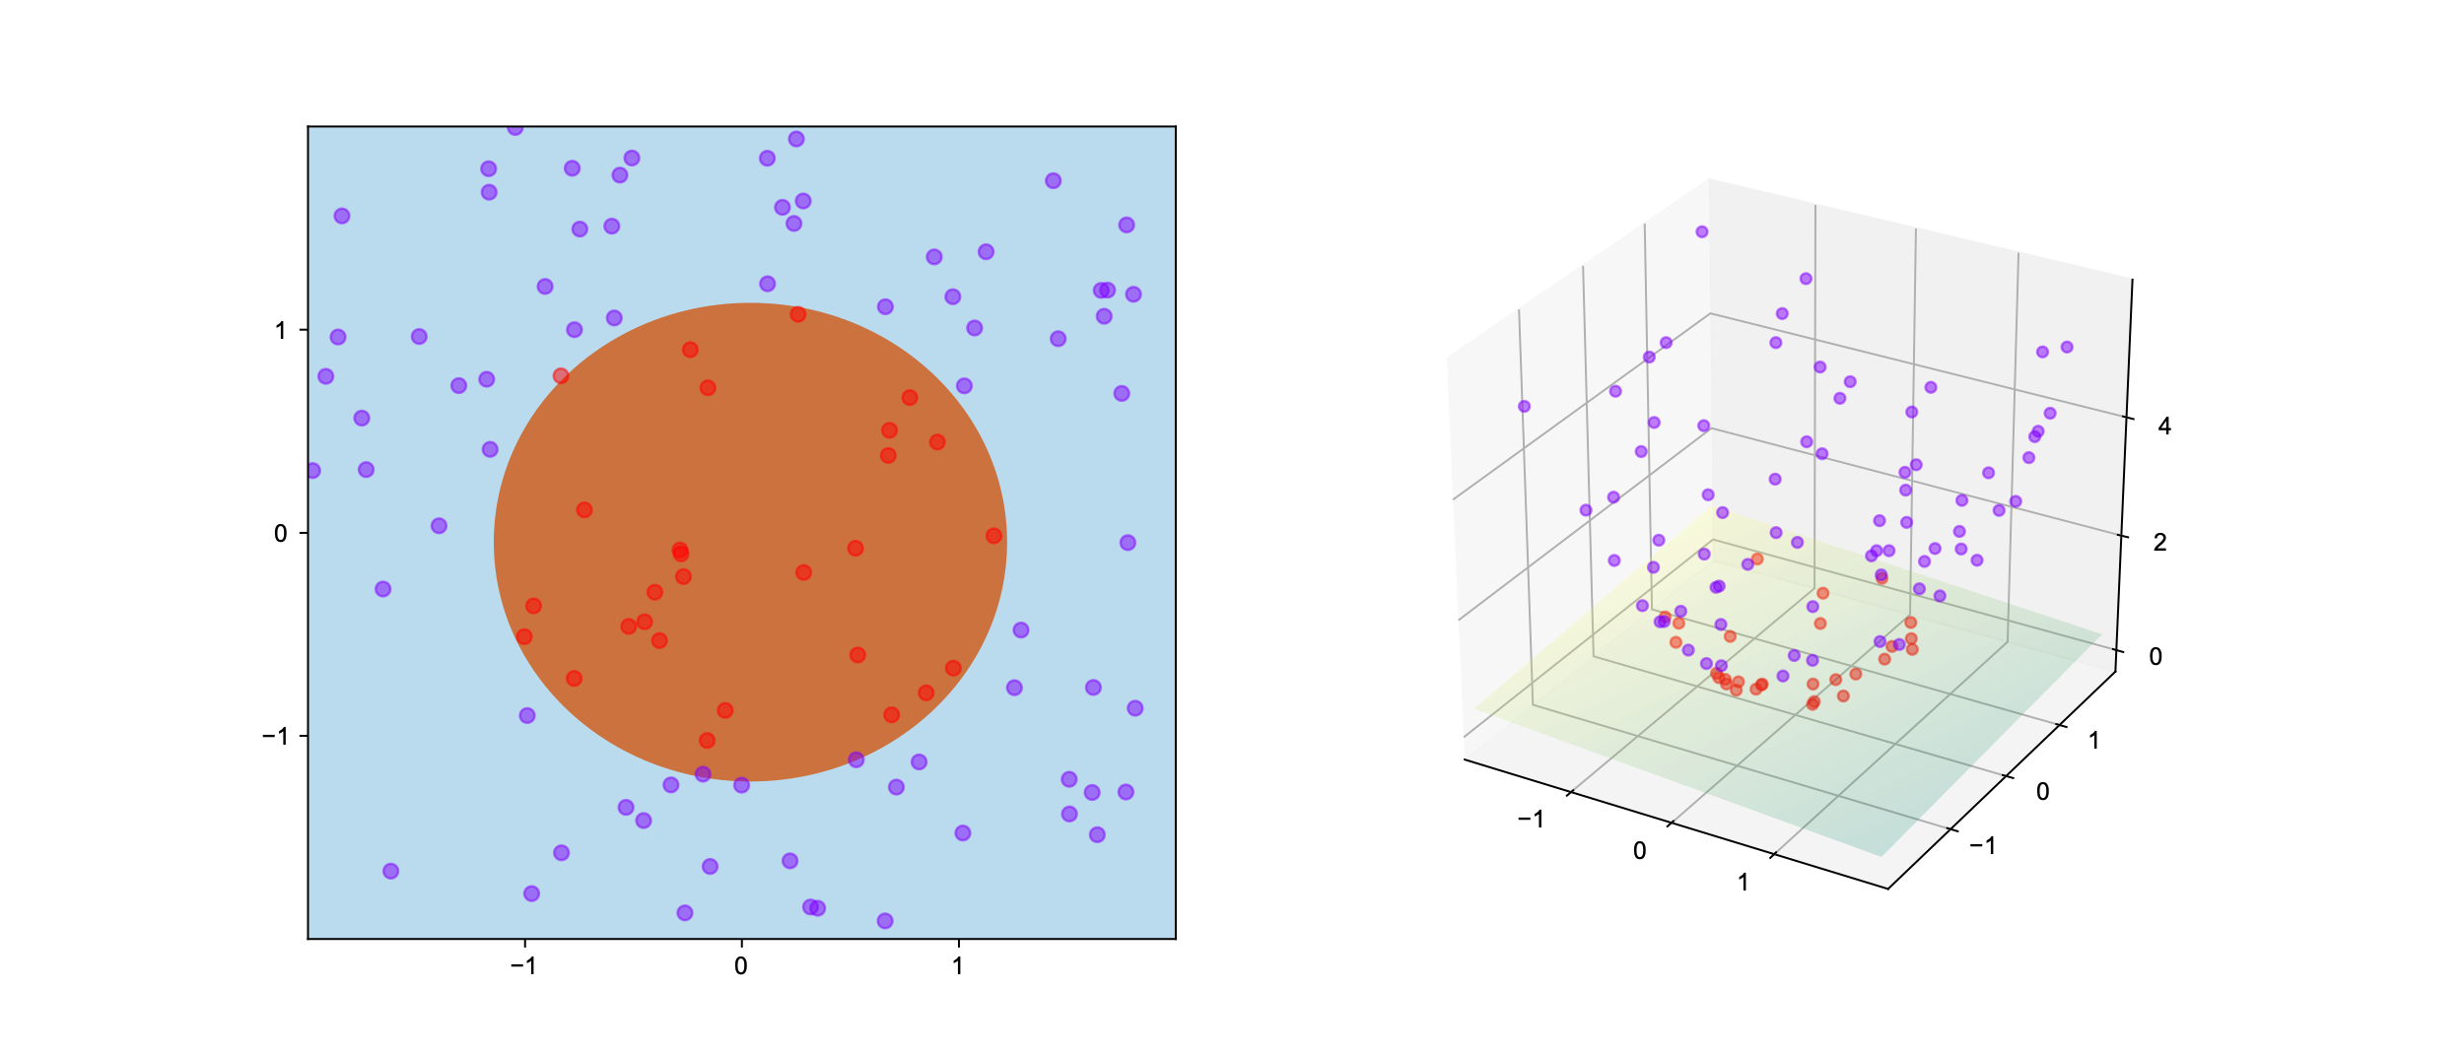
The “Kernel Trick”
Image by: By Shiyu Ji
CC BY-SA 4.0

Slide 20
Simplifying the Transformation Function
We can derive a simpler (2-dimensional) equation, equivalent to the cross-product needed when doing SVM computations in the transformed (3-dimensional) space:
Needed
10 multiplications
2 additions
3 multiplications
1 addition
Used instead

Slide 21
The Kernel Function
This final function (right side) is what the SVM will actually use to compute dot-products in its equations
This is called the kernel function
To make SVMs really useful we look for a kernel that:
Separates the data usefully
Is relatively efficient to calculate

Slide 22
Another Reason to Use Kernel Functions
The SVM formulation generally uses dot-products of data-points (perhaps run through some kernel) rather than the standard product of features and weights
We have cases where the kernel-data approach is possible, but the weights-based one is not
Some useful kernels, that are easy to compute, correspond to weight-equations applied to very high dimensional transforms of the original data
In some common cases, equivalent weight-data vectors are infinite-dimensional, and simply cannot be used in computation

