Slide 1

Class #01: Types of Learning; Linear Methods
Machine Learning (COMP 135)

Slide 2
Defining a Learning Problem
Suppose we have three basic components:
Set of tasks, T
A performance measure, P
Data describing some experience, E
Cover image: McGraw Hill,
1997 [link]
A computer program learns if its performance at tasks in T, as measured by P, improves based on E.
From: Tom M. Mitchell, Machine Learning (1997)

Slide 3
An Example Problem
Suppose we want to build a system, like Siri or Alexa, that responds to voice commands
What are our components?
Tasks, T
Performance measure, P
Experience, E
Task:
Take system actions,
based upon speech
Performance:
How often correct action
is taken during testing
For many domains, deriving the experience used by the system is the biggest real challenge:
The evidence it uses.
How it uses that evidence.
Experience?
This is the tricky part!

Slide 4
The Expert Systems Approach
One (older) approach used expert-generated rules:
Find someone with advanced knowledge of linguistics
Get them to devise the structural rules of language’s grammar and semantics
Encode those rules in program for parsing written language
Build another program to translate speech into written language, and tie that to another program for taking actions based upon the parsing
Photo of Noam Chomsky: Rich Beauchesne, AP (2001)

Slide 5
Another Approach: Supervised Learning
In supervised learning, we:
Provide a set of correct answers to a problem
Use algorithms to find (mostly) correct answers to similar problems
We can still use experts, but their job is different:
Don’t need to devise complex rules for understanding speech
Instead, they just have to be able to tell what the correct results of understanding look like

Slide 6
Another Approach: Supervised Learning
Collect a large set of sample things a set of test users say to our system
For each, map it to a correct outcome action the system should take
“Call my wife”
“Set an alarm for 4:00 AM”
“Play Pod Save America”
…
call(555-123-4567)
alarm_set(04:00)
podcast_play(“Pod Save America”)
…
A large set of such (speech, action) pairs can be created
This can then form the experience, E, the system needs

Slide 7
Inductive Learning
In its simplest form, induction is the task of learning a function on some inputs from examples of its outputs
For a function, f, that we want to learn, each of these training examples is a pair
(x, f(x))
We assume that we do not yet know the actual form of the function f (if we did, we don’t need to learn)
Learning problem: find a hypothesis function, h, such that h(x) = f(x) (at least most of the time), based on a training set of example input-output pairs

Slide 8
Example:1-Dimensional Data Analysis
x
What are our components?
Tasks, T
Performance measure, P
Experience, E
x
x
y
x
x
x
x
x
x
x
Task:
Predict the output, f(x) = y, for points we haven’t seen yet
x
Experience?
Here, this is the easy part: we are provided with an existing data-set of (input, output) points (x, y)
[i.e., f(x) = y]
Performance:
Seek to reduce overall error of the predictions for known points

Slide 9
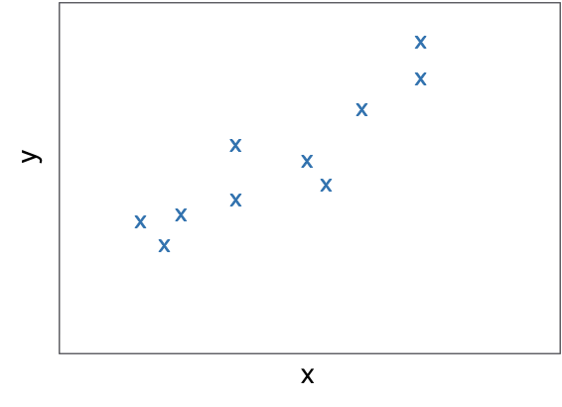
Linear Regression
In general, we want to learn a hypothesis function h that minimizes our error relative to the actual output function f
Often, we will assume that this function h is linear, so the problem becomes finding a set of weights that minimize the error between f and our function:

Slide 10
An Error Function: Least Squared Error
For a chosen set of weights, w, we can define an error function as the squared residual between what the hypothesis function predicts and the actual output, summed over all N test-cases:
Learning is then the process of finding a weight-sequence that minimizes this loss:
Note: Other loss-functions are commonly used (but the basic learning problem remains the same)

Slide 11
An Example
For the data given, the best fit for a simple linear function of x is as follows:

Slide 12
Finding Minimal-Error Weights (Analytically)
We can in principle solve for the weight with least error analytically
Create data matrix with one training input example per row, one feature per column, and output vector of all training outputs
Solve for the minimal weights using linear algebra (for large data, requires optimized routines for finding matrix inverses, doing multiplications, etc., as well as for certain matrix properties to hold, which are not universal):

Slide 13
Finding Minimal-Error Weights (Iteratively)
Weights that minimize error can instead be found (or at least approximated) using gradient descent:
Loop repeatedly over all weights w_{i}, updating them based on their “contribution” to the overall error:
Stop on convergence, when maximum update on any weight (Δ) drops below some threshold (Θ); alternatively, stop when change in error/loss grows small enough
Learning rate: multiplying parameter for weight adjustments
Feature: normalized value of feature i of training input j
Overall Error: difference between current and correct outputs for case j

Slide 14
Updating Weights
For each value i, the update equation takes into account:
The current weight-value, w_{i}
The difference (positive or negative) between the current hypothesis for input j and the known output:
The i-th feature of the data, x_{j,i}
When doing this update, we must remember that for n data features, we have (n + 1) weights, including the bias, w₀
It is presumed that the related “feature” x_{j,0} = 1 in every case, and so the update for the bias weight becomes:

Slide 15
Gradient Descent
The loss function forms a contour (here shown for one-dimensional data)
For any initial set of weights (w₀) we are at some point on this contour

Slide 16
Gradient Descent
The derivate of the loss function at the given weight settings “points uphill” along the slope of the function (note: this is true for this point, not every point)
The gradient descent update moves along the function in the opposite direction toward the direction that decreases loss most significantly

Slide 17
Practical Use of Linear Regression
Ad sales vs. media expenditure (1000’s of units). From: James et al., Intro. to Statistical Learning (Springer, 2017)
A linear model can often radically simplify a data-set, isolating a relatively straightforward relationship between data-features and outcomes

