Slide 1

Class #02: Linear & Polynomial Regression; Error and Over-fitting
Machine Learning (COMP 135)

Slide 2
Practical Use of Linear Regression
Ad sales vs. media expenditure (1000’s of units). From: James et al., Intro. to Statistical Learning (Springer, 2017)
A linear model can often radically simplify a data-set, isolating a relatively straightforward relationship between data-features and outcomes

Slide 3
Accuracy of the Hypothesis Function
x
x
x
x
x
x
x
x
x
recurrence (months)
x
x
x
x
x
x
x
x
x
x
x
x
x
x
x
x
x
x
x
x
x
x
x
x
x
x
x
x
x
x
x
x
x
x
tumor radius (mm)
Although we can generally find the best set of weights efficiently, the exact form of the equation, in terms of the degree of the polynomial used in that equation, can limit our accuracy
Example: if we try to predict time to tumor recurrence based on a simple linear function of its radius, this is likely to be very inaccurate

Slide 4
Higher Order Polynomial Regression
Since not every data-set is best represented as a simple linear function, we will in general want to explore higher-order hypothesis functions
We can still keep these functions quasi-linear, in terms of a sum of weights over terms, but we will allow those terms to take more complex polynomial forms, like:

Slide 5
Higher Order Polynomial Regression
Note: the hypothesis function here is still linear, in terms of a sum of coefficients, each multiplied by a single feature
The same algorithms can find the coefficients that minimize error, just as before
What is different, however, are the features themselves
A feature transformation is a common ML technique
In order to best solve a problem, we generally don’t care what features we use
We will often experiment with modifying features to get better results from existing algorithms

Slide 6
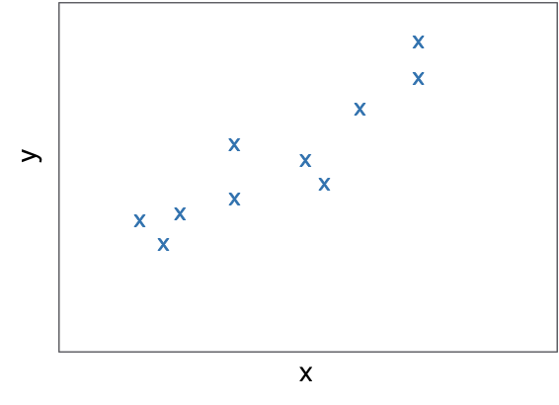
Higher-Order Regression Solutions
With an order-2 function, we can fit our data somewhat better than with the original, order-1 version

Slide 7
Higher-Order Regression Solutions
It is important to note that the “curves” we get are still linear
These are the result of projecting a linear structure in a higher dimensional space back into the dimensions of the original data

Slide 8
Higher-Order Fitting
Order-3 Solution
Order-4 Solution

Slide 9
Even Higher-Order Fitting
Order-5 Solution
Order-6 Solution
Order-7 Solution
Order-8 Solution

Slide 10
The Risk of Overfitting
An order-9 solution hits all the data points exactly, but is very “wild” at points that are not given in the data, with high variance
This is a general problem for learning: if we over-train, we can end up with a function that is very precise on the training data, but is not accurate on new examples

Slide 11
Defining Overfitting
To precisely understand overfitting, we distinguish between two types of error:
True error: the actual error between the hypothesis and the true function that we want to learn
Training error: the error observed on our training set of examples, during the learning process
Overfitting is when:
We have a choice between hypotheses, h₁ & h₂
We choose h₁ because it has lowest training error
Choosing h₂ would actually be better, since it will have lowest true error, even if training error is worse
In general we do not know true error (would essentially need to already know function we are trying to learn)
How then can we estimate the true error?

Slide 12
Model Complexity and Error
Overfitting often occurs as our models get more complex
Higher- and higher-order polynomials for regression
Tweaking of parameters to finer and finer degrees of precision
Error
True/Testing Error
Training Error
Model Complexity
Underfitting
(neither error
minimized)
Overfitting
(Training error
minimized, but not
true/test error)
Region of
best complexity

Slide 13
Cross-Validation
We can estimate our true error by checking how well our function does (on average) when we leave out some training data, and use it only to test instead
Leave-one-out cross-validation:
For each degree d and k items, we train k different models (a total of k * d tests).
For each of the k tests, we take out one example from the input set, and train on all the rest.
For each trained model, we test on the one example we left out, and measure the error.
We choose the degree d that gives us the lowest mean error on the k tests.

Slide 14
An Example of Error Estimation
For data-set of 10 (input, output) pairs, we estimate error using 10 tests:

Slide 15
An Example of Error Estimation
By comparing all possible degrees of our function (1–8), we can see that we get the optimal estimated function at degree 2, with overfitting seen at all degrees higher than that:
Optimal degree: minimizes the estimated error over new examples
Over-fitting: we have minimized the error over training data, but have larger estimated error over new examples

Slide 16
More General Cross-Validation
Leave-one-out validation can be quite costly with large input sets, and so we often test machine learning algorithms in more approximate ways
k-fold cross-validation is a more granular approach:
Divide the input into k different test sets.
On each run, remove one of the test sets.
Train on the remainder and test on the test set.
Average the k results to estimate true error.

