Slide 1

Class #04: Regression with Regularization
Machine Learning (COMP 135)

Slide 2
Review: Squared Error in Linear Regression
For a chosen set of weights, w, we can define an error function as the squared residual between what the hypothesis function predicts and the actual output, summed over all N test-cases:
Learning is then the process of finding a weight-sequence that minimizes this loss:
Note: Other loss-functions are commonly used (but the basic learning problem remains the same)

Slide 3
Review: Finding Weights Analytically
We can in principle solve for the weight with least error analytically
Create data matrix with one training input example per row, one feature per column, and output vector of all training outputs
Solve for the minimal weights using linear algebra (for large data, requires optimized routines for finding matrix inverses, doing multiplications, etc., as well as for certain matrix properties to hold, which are not universal):

Slide 4
When is the Analytic Solution Possible?
Linear regression using squared error is special: in many cases, we can generate an exact closed-form solution to the minimal-weights problem
Other ML techniques will use different error functions
For many of these functions, we do not have a closed form solution (or it is at least very hard to solve)
Gradient descent is thus a general-purpose method for finding the required weights iteratively

Slide 5
When is the Analytic Solution Possible?
Even for linear regression with squared error, it is not always possible to use the linear algebra method directly
Depends upon the relationship between number of data-points (N) and number of features (F)
N > F: More examples than features (over-determined)
In many cases, can be solved (unless X^{T}X is rank-deficient)
Resulting solution likely still has error on training set
N = F: Same number of examples and features
In many cases, can be solved (unless X^{T}X is rank-deficient)
Resulting solution optimal, with 0 error on training set
N < F: More features than examples (or rank-deficient matrix)
Infinitely many 0-error solutions exist
X^{T}X will not be invertible, and analytic methods will generally fail

Slide 6
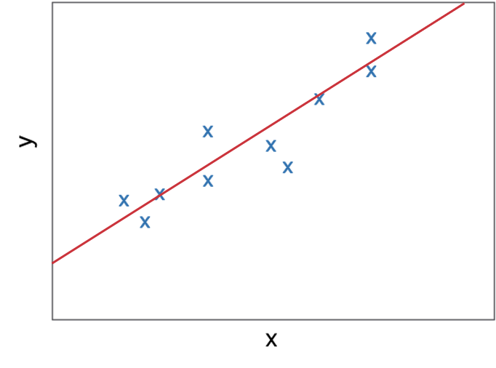
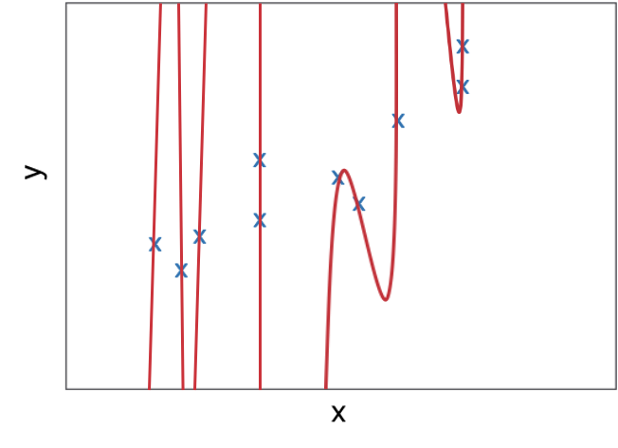
Review: Polynomial Regression & Overfitting
When training a model, we sometimes need to make it more complex to fit data
Here, we can see that a simple linear regression doesn’t fit data very well
At the same time, the higher-order polynomial solution hits all our training data perfectly, but appears very overfit
Order-1 Solution
Order-9 Solution

Slide 7
Overfitting, Weights, and Possible Solutions
Overfitting often comes from complex models with high magnitude weights
Large positive/negative coefficients
Some features treated as far more important than others (and perhaps more important than they should be)
One solution: work on making the models simpler
Another: keep the model, but “discourage” large weights
Instead of working to minimize model error alone, we seek to minimize a combination of error and complexity

Slide 8
Regularizing Model Weights
We often want to be able to control the amount of emphasis we place upon model complexity
We can thus add a weighting parameter to the model complexity measure itself:
If complexity is proportional to the magnitudes of the weights, this is known as regularization
Minimizing loss will involve reducing these magnitudes towards 0
The control λ controls how much we stress this: the higher λ is, the more we emphasize reducing weights over reducing error
At high enough values of λ, we can sacrifice accuracy for simplicity

Slide 9
Measuring Complexity of Weights
Regularization can use the concept of a vector norm
Given our weight vector:
The p-norm (or Lp norm), for p = 1, 2, …, is:
NB: omits bias term w₀,
as in general we seek to minimize feature-weights

Slide 10
Lp Norms of Weights
The basic L1 norm of the weights is simply a sum of their magnitudes (absolute values):
The L2 norm is probably most common in many domains, and is sometimes just called “the norm” or “magnitude”:
The definition can be extended to any positive value p:

Slide 11
Regression with Regularization
To use Lp norms directly in linear regression, we can add them to the loss, and have our model minimize the combination of model error and the weight norm:
In practice, we sometimes use modifications of the norm
Depending upon the version of the norm we use, we can get different results

Slide 12
Basic Effects of Regularization
We can use the same analytical (closed-form) or iterative (gradient descent) techniques to find the weights that minimize our combined loss function
We can experiment with both the value of p we use for the norm, and the weight factor λ that is applied to it
Setting (λ = 0) means we are just doing linear regression without any regularization
Setting (λ > 0) can cause final weights to be closer to 0
As usual, we would explore both, using validation methods, to try to find most robust settings, avoiding likely overfitting

Slide 13
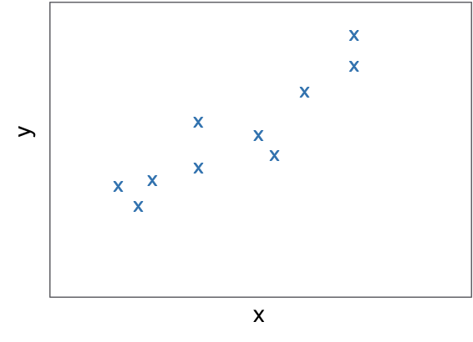
Levels of Regularization
(λ = 0): No regularization
(λ >> 0): Heavy regularization
For a given value of p, we can explore higher or lower values of control parameter λ
Very low values may generate overfitting
Very high values may generate underfitting

Slide 14
Regularization and Bias/Variance
(λ = 0): No regularization
(λ >> 0): Heavy regularization
An overfit model often has low bias but high variance
Training data is captured precisely, but so is noise, and result fits other data poorly
An underfit model often has high bias but low variance
Simple, less-noisy models that do not capture our data very well

Slide 15
Basic Effects of Regularization
(λ = “just right”): Moderate regularization
An ideal solution seeks values of λ that lead to overall best performance across training/testing data, balancing bias and variance trade-offs
Allows for more complex models, responding to subtle combinations of features
Helps avoid models that perform highly in training but are awful on new data

Slide 16
L1 & L2: Common Types of Regularization
Most common regularized models use versions of the L1 and L2 norms
L1 regression (aka the Lasso): seeks to minimize the summed magnitudes of the weights in the loss:
L2 regression (aka ridge regression): seeks to minimize the summed squared magnitudes of the weights:
NB: uses square of the L2 norm (omitting square root operation)

Slide 17
L2: Ridge Regression
L2 regression was proposed by Hoerl & Kennard (1970)
Has the effect of adding constant parameter λ to the diagonal entries in the matrix X^{T}X (hence the name “ridge”)
By adding in a penalty in terms of the summed squares of weights, minimizing loss discourages large magnitudes
Weights are driven towards zero
In general, most will tend to be smaller non-zero values (for reasonable settings of λ > 0)

Slide 18
L1 Regression: The Lasso
L1 regression first examined deeply by Tibshirani (1996)
The “least absolute shrinkage and selection operator” or lasso
Using summed absolute weights also drives them smaller
Weights are driven towards zero
Unlike how ridge tends to perform, large enough values of λ often means that many weights are zero exactly
Lasso thus serves as a way of doing feature selection: since zero-weight features play no part in the hypothesis, they are effectively pruned out and ignored

Slide 19
L1 vs. L2: Which to Choose?
Neither form of regression/regularization is always best
Sometimes, if we know something about our data, we may have reason to prefer one over the other
Other times, we may just want to explore both
There are other techniques, too, like elastic net regularization, which combines the L1 and L2 ideas
If you know that the data has a lot of features, only some of which are important, but you’re not sure which: you might prefer L1, since it can “prune out” unimportant ones by setting their weights to zero
If you know that the patterns in your data are affected by subtle combinations of many small features: you might prefer L2, since it usually won’t prune out any

