Slide 1
Which is the Best Overall Cache Simulator?
Tufts EECE 0193
Morgan Rockett

Slide 2
Project Description
Evaluate the use of non-volatile memories for in-memory computing applications using NeuroSim
Compare your results with a traditional accelerator architecture (e.g. NVDLA+NVSim)
(https://github.com/neurosim/MLP_NeuroSim_V3.0)
Notes:
compare accuracy - based on papers as baseline

Slide 3
Main Goal of Project
Compare state-of-the-art cache simulators
NVSim, Cacti, Neurosim
Accuracy
Runtime
eNVM technologies
STTRAM
RRAM
SRAM

Slide 4

Background & Motivation
Wide adoption vs promising alternatives
Worth the ramp up to learn
a new technology?
Password cracking contest
Tufts Research HPC Clusters
Nvidia P100, A100 GPUs
Intel Xeon Server Chips

Slide 5
Proposed Resources and Deliverables
All configuration settings and design strategy
Will create a script to create parallel batch job files
Will write another script to launch all jobs to Nvidia P100 / A100 GPU’s and save output data to logs
Cronjob to email the progress updates
Run time for each experiment on each simulator
Graphs comparing eNVM cells for power, R/W energy, latency; paper with results
Notes:
2 paper column format including references
Overleaf
https://www.overleaf.com/

Slide 6
Expected Outcomes
Expect that Neurosim will be more accurate than NVSim and Cacti
Predict Neurosim will be slower given initial simulation results
Is Neurosim practical for the average user?
Diminishing returns or worth the [predicted] overhead?

Slide 7
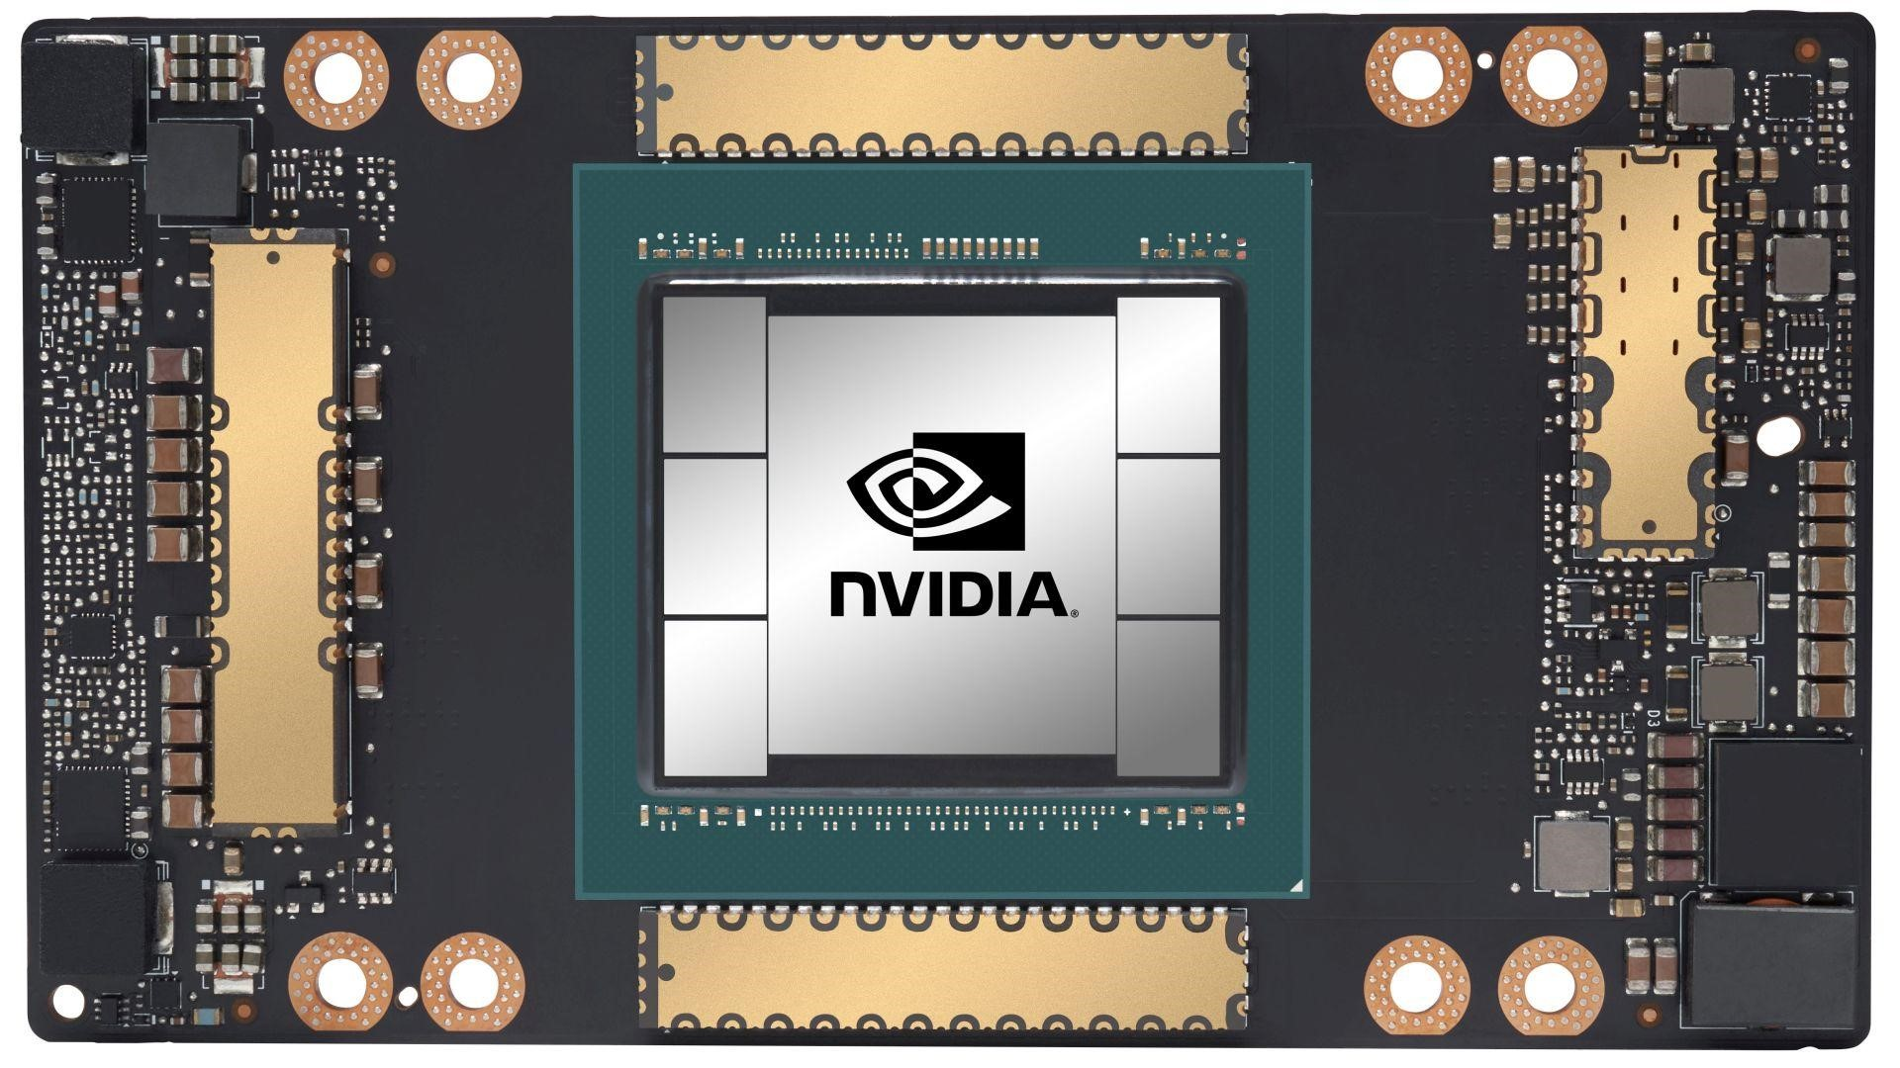

Questions?
Notes:
destiny similator - consider
NVM architectures
destiny simiulates 3D memories
results latency energy etc
nvsim vs destiny in standard 2D
extend evaulation to 3D memories
runtime difference not likely

