Slide 1
Rocketzera
Webflux
Apresentado por Danilo Mendes

Slide 2

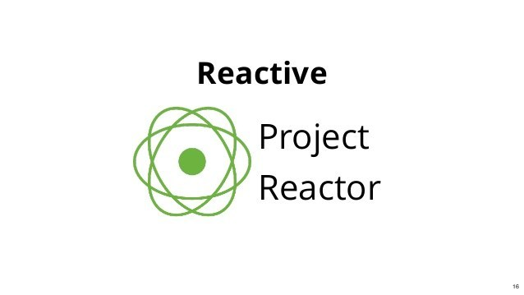
REACTOR
WEBFLUX

Slide 3

BACKPRESSURE
WEBFLUX

Slide 4
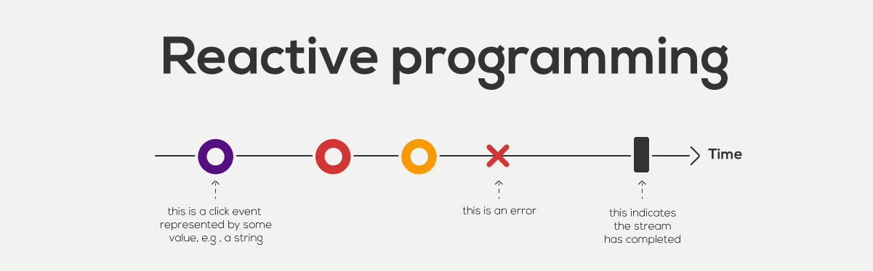
E NO DIA A DIA?
WEBFLUX

Slide 5
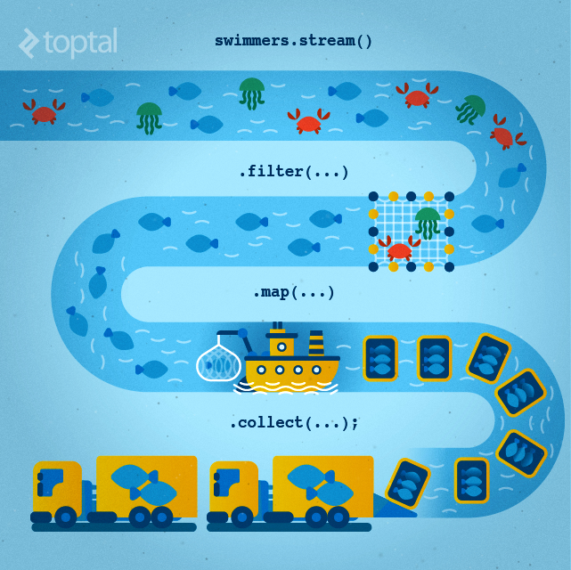

Reactive Streams
HAPPY CUSTOMERS
Our
Top Priority
“Mobile social media refers to the combination of mobile devices and social media. This is a group of mobile marketing applications”

Slide 6
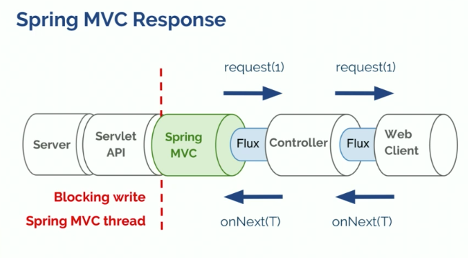
Arquitetura Tradicional
HAPPY CUSTOMERS
Our
Top Priority
“Mobile social media refers to the combination of mobile devices and social media. This is a group of mobile marketing applications”

Slide 7
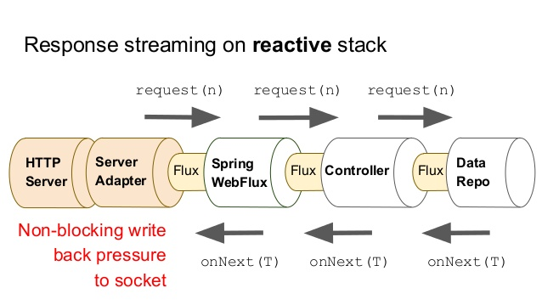
Arquitetura Reativa
HAPPY CUSTOMERS
Our
Top Priority
“Mobile social media refers to the combination of mobile devices and social media. This is a group of mobile marketing applications”

Slide 8
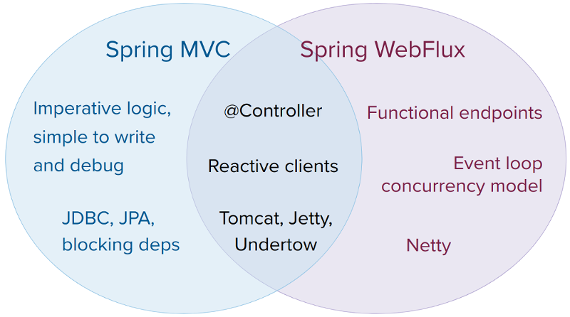
WEBFLUX

Slide 9
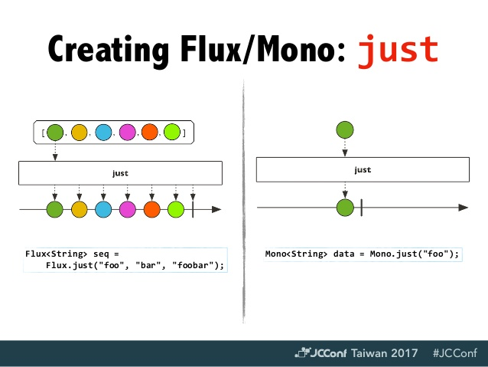
WEBFLUX

Slide 10
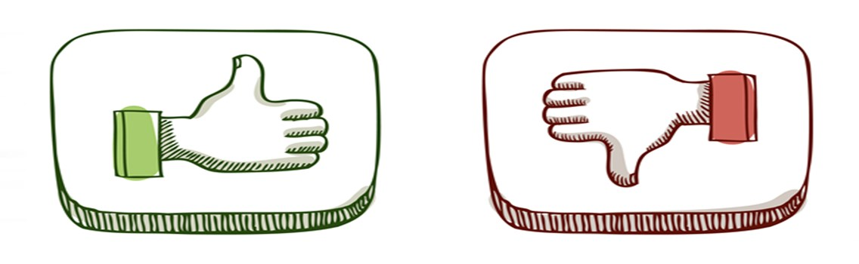
Pros
Delegação total da execução do código para o Spring
Foco do Desenvolvedor nas regras de negócio
Pools de Thread Separadas
Perfeita sinergia com bancos NoSQL

Slide 11

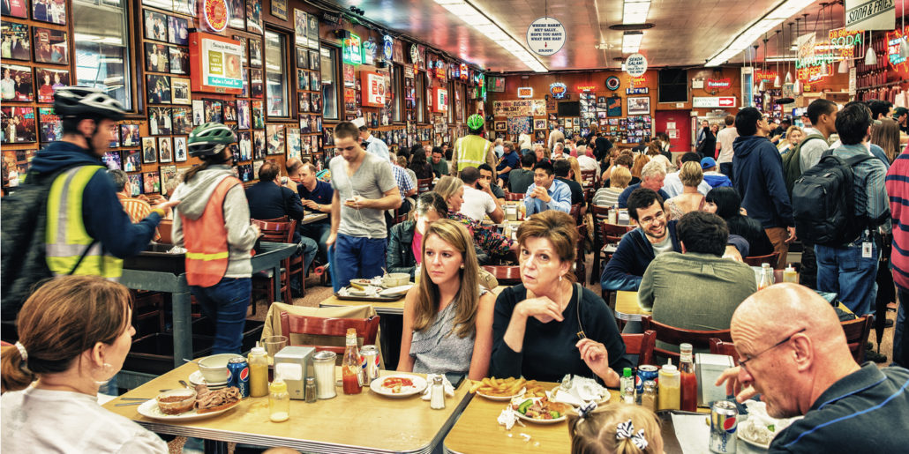
Analogia:
Escalar mais com o menor custo
HAPPY CUSTOMERS
Our
Top Priority
“Mobile social media refers to the combination of mobile devices and social media. This is a group of mobile marketing applications”

Slide 12
Contra
Modelo de programação diferente
Driver JDBC blocante
Debug mais complicado
Perda de contexto transacional

Slide 13


