Slide 1

Analysis of
Premier League
Evolution
Presented By - Mithilesh Kumar
m.mit.kr@gmail.com

Slide 2


Mithilesh Kumar
Presented By
Executive Program in Data Science & AI IIT-G
Follow Me :
Email :
m.mit.kr@gmail.com
Linked-in
linkedin.com/in/mithileshdotorg
Technical Architect
Business Intelligence Architect
BI Analysts
Sr App Developer
Sr Web Developer
Python
Java
Kotlin
Php

Slide 3
Let’s Start
EDA Process
We will discuss 9 step process
Dataset, Tools and Application Used
Generating Graph and Reports
Premier League Reports
HomeTeam vs AwayTeam or Drow
Team comparison in terms of goal
Avg goals in terms of season
Winning teams of the season
Conclusion

Slide 4



EDA Process
Intro
Installing & Importing Libraries
Data Pre-Profiling
Data Post- Profiling
Conclusion
The 9 Step Framework
Problem Statement
Data Acquisition & Description
Data Pre-Processing
Exploratory Data Analysis
Numpy
Pandas
Pandas Profiling
Matplotlib
Seaborn
Tools, Application & Create Graph

Slide 5
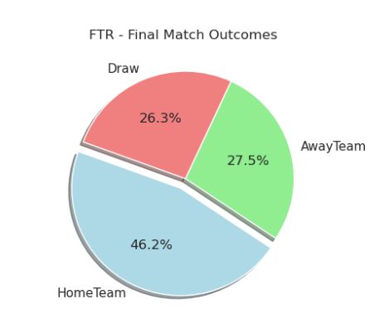
Premier League Reports
Report 1 : Final Match Outcome

Slide 6
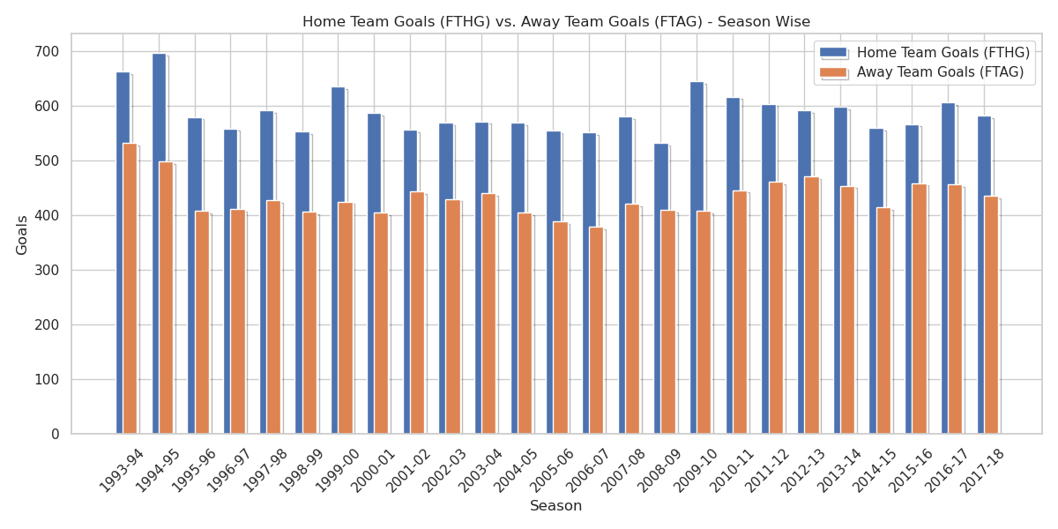
Premier League Reports
Report 2: Season Wise Final Result Goals HomeTeam vs AwayTeam

Slide 7
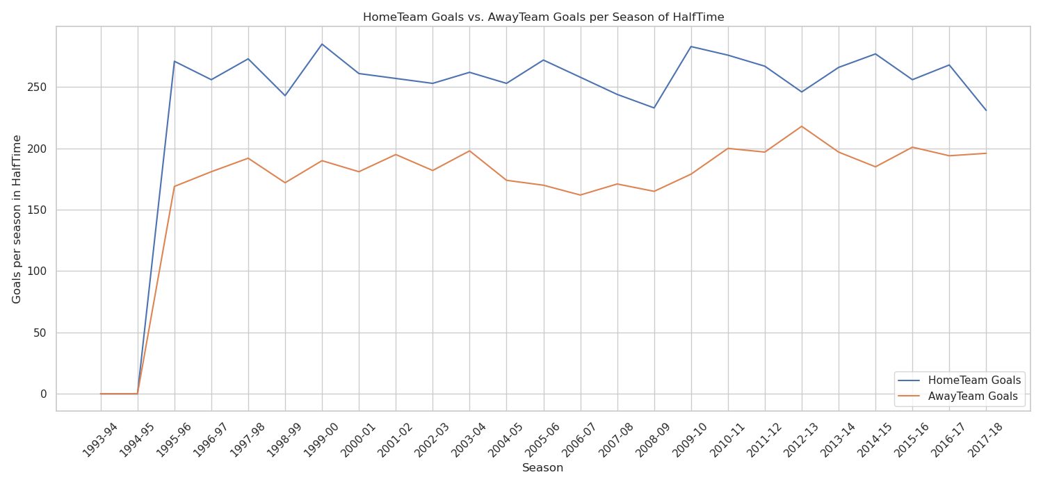
Premier League Reports
Report 3: Season Wise half Time Goals HomeTeam and AwayTeam

Slide 8
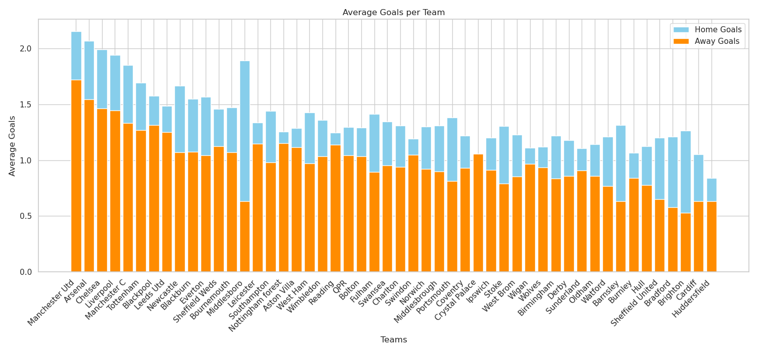
Premier League Reports
Report 4: Average Goal Per Team

Slide 9
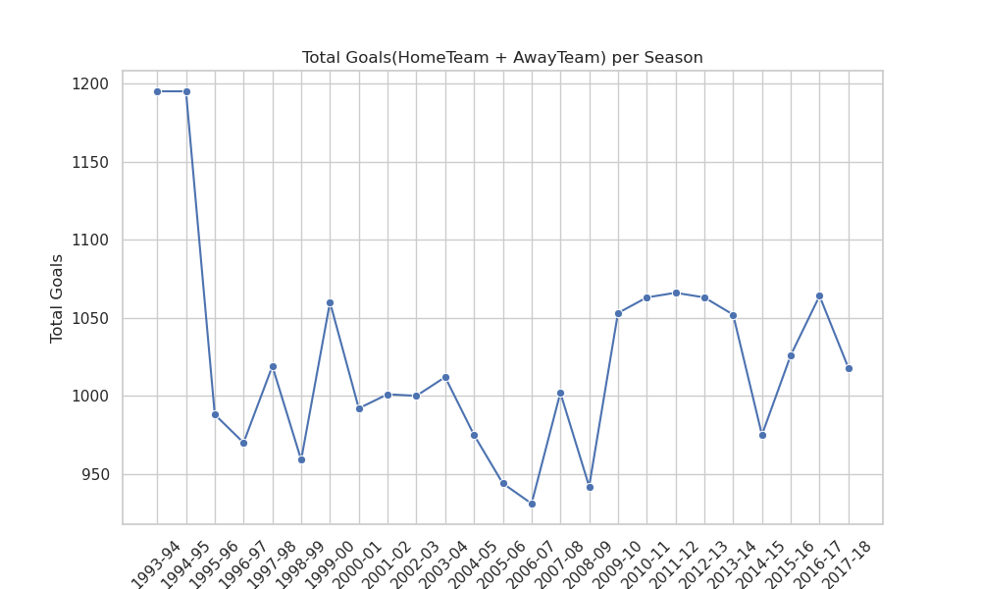
Premier League Reports
Report 5: Total Goals per Season

Slide 10
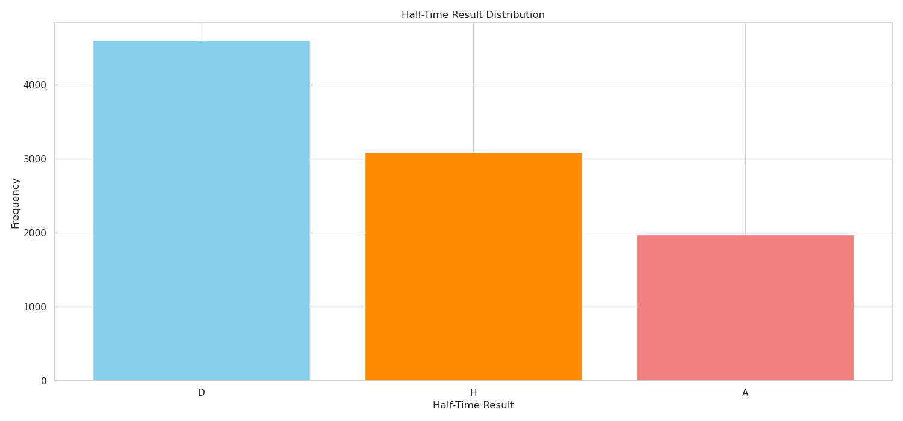
Premier League Reports
D - Draw
H - HomeTeam
A - AwayTeam
Report 6: Half-Time Result Distribution

Slide 11
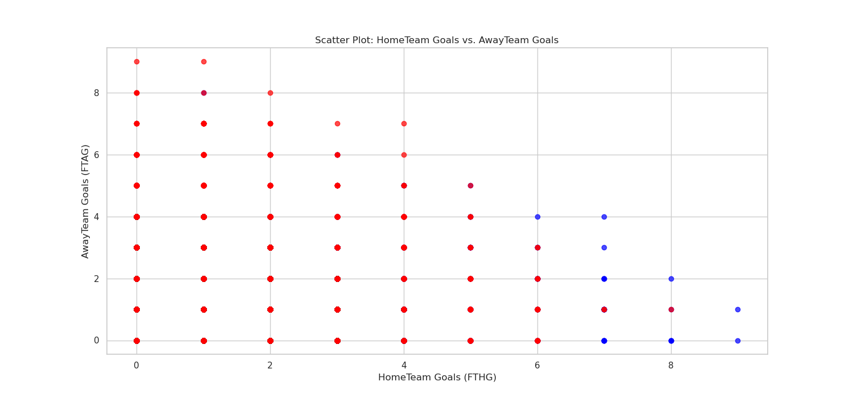
Premier League Reports
Report 7: HomeTeam Goals vs. AwayTeam Goals in terms of total Goals

Slide 12
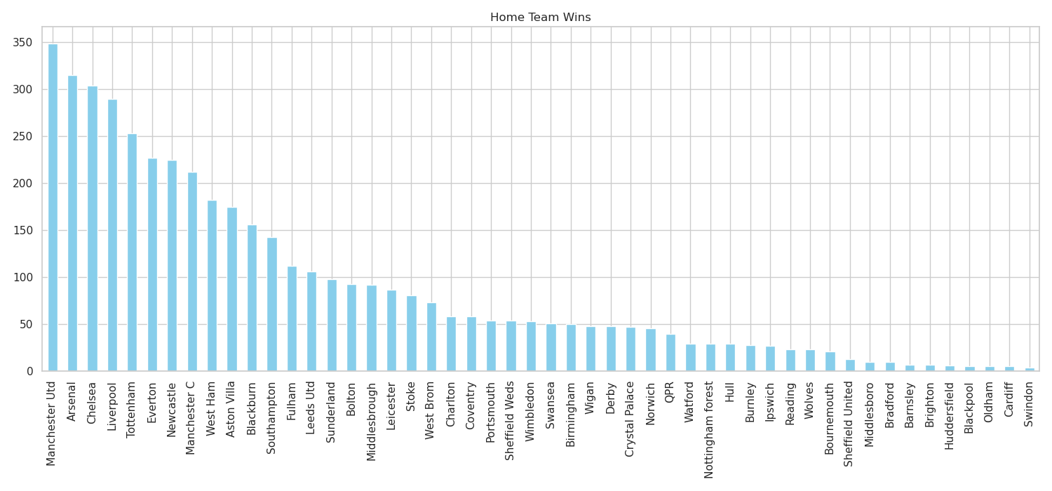
Premier League Reports
Report 8.1: Team Win and Draw

Slide 13
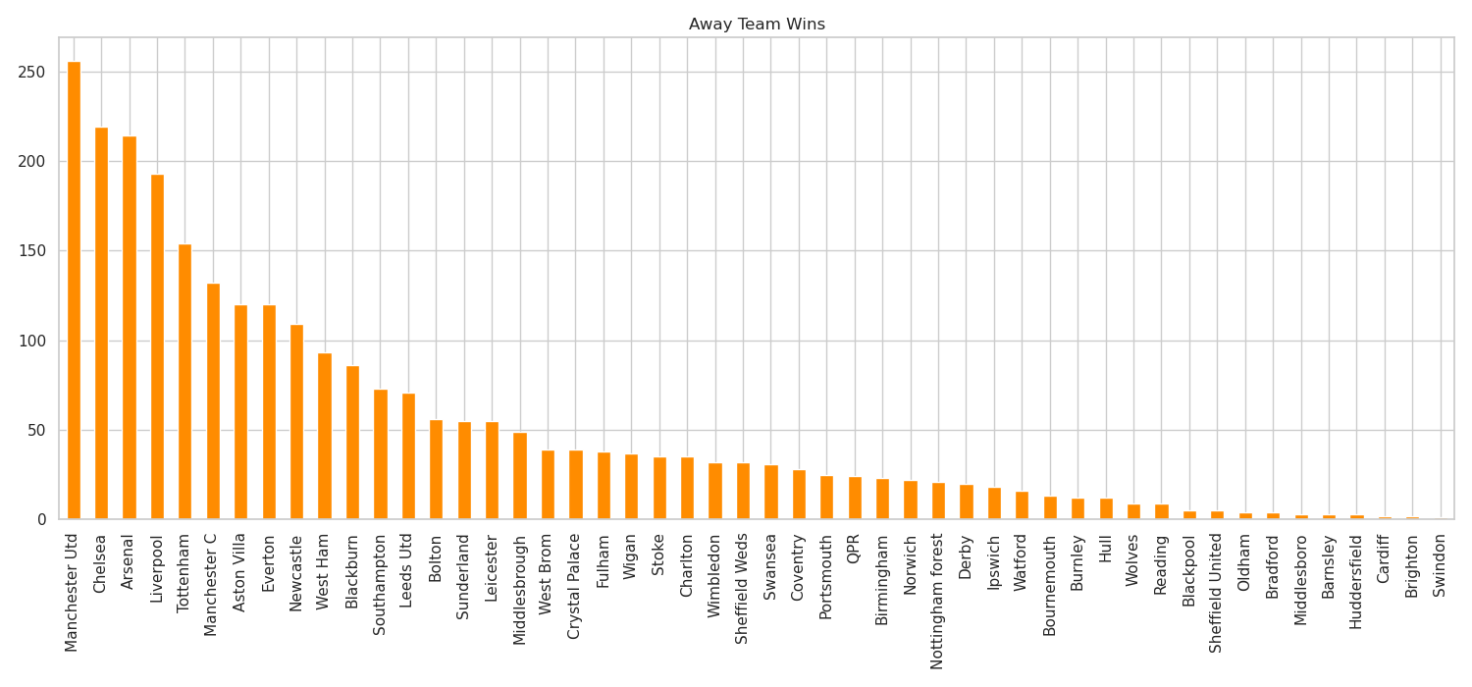
Premier League Reports
Report 8.2: Team Win and Draw

Slide 14
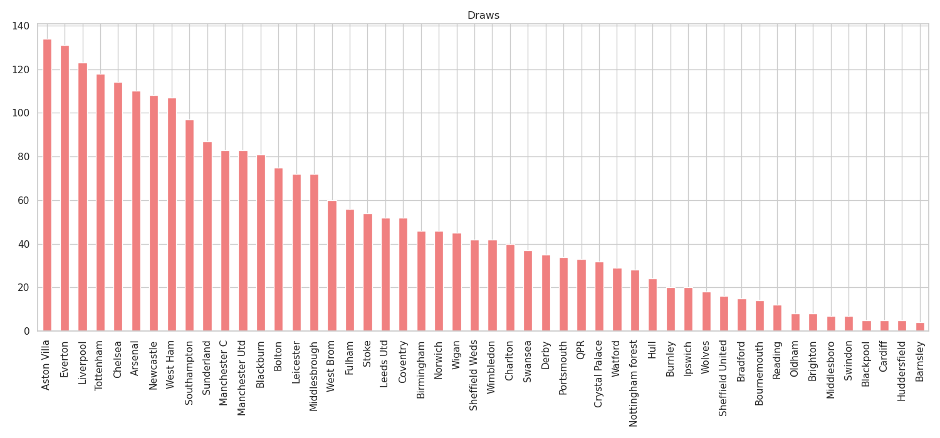
Premier League Reports
Report 8.3: Team Win and Draw

Slide 15
Conclusion
As pe the Data that matches tend to have an average of around 1-2 goals per team, and most matches have at least one goal scored by either team. The halftime scores indicate that home teams tend to have a slight advantage, scoring more goals on average compared to the away teams. However, further analysis of individual matches, teams, and seasons would be needed to gain more insights into specific trends or patterns in the data

Slide 16
Thank You

