Slide 1

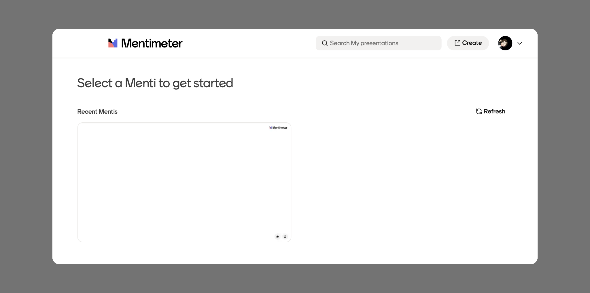
Mentimeter for PowerPoint

Slide 2

Relaunch the add-in
Mentimeter for PowerPoint
After you install the add-in, you can launch it by choosing the add-in button on the Home tab
On the Home tab
Home
Add-ins
Need more help?
Return to your internet browser or copy this link into your browser:
https://pages.store.office.com/addinsinstallpage.aspx?rs=en-US&assetid=WA104379261&isWac=True&ui=en-US&ad=US

