Slide 1
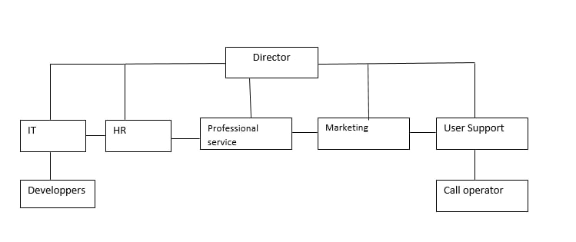
Hire Compagny

Slide 2
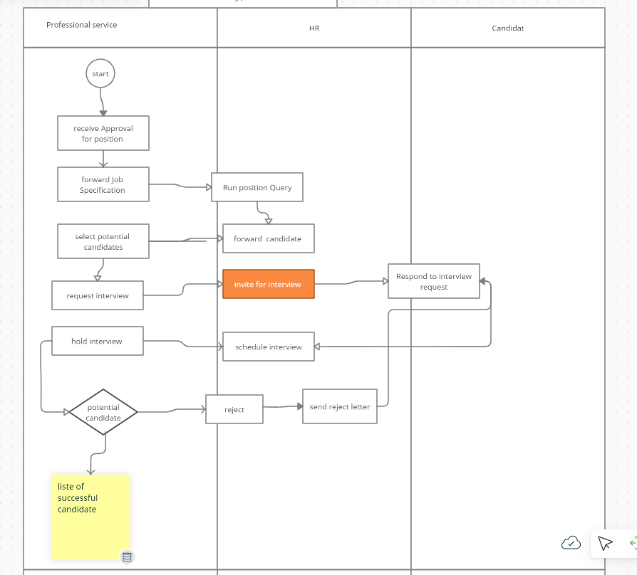
Business proccess

Slide 3
Passport of business process
Hire employers
Professional service
HR
Candidate
Business process requirements | KPI
Hire good candidate | 10
Profile requirement | 8
Filter | 9
solution | 10
Requirement for the business process result
Adaptability to technology evolution

Slide 4
Technology Map
Activity | Role | output
Finial decision | Project manager | 10
Choice of the best profile | Project Manager | 5
Publication of job advertisement | HR | 10
Interview | Manager | 10

Slide 5
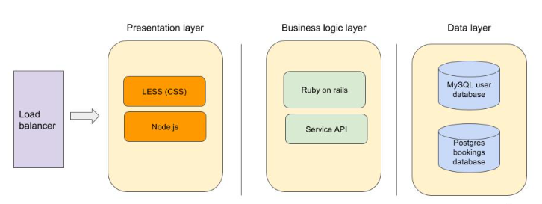
Technical architecture

Slide 6
Enterprise architecture analysis
 | What | How | Where | Who | When | Why
Director | Charter, documentation | Management control | management department | Director | Individual plan | Supervision, profit making
Candidate | Apply | Analysis, consideration | Office, web | candidate | Individual plan | Getting Services
HR | Hire management | email | Office,web | HR | Individual plan | Profit, career
IT | Development | development, testing | office | Developer | As directed | Profit, career
Marketing | Development | development, testing | office | Marketing | As directed | Profit, career
Professional service | Treaty | Analysis, consideration | Client department | Professional service | Individual plan | Profit, career
Technical architecture

Slide 7
opportunities | Zachman model | Model Gartner | MethodologyMETA Group | TOGAF methodology | EAP method
Hierarchical approach, connection with the business strategy​ | +​ | +​ | +​ | -​ | +​
Support of different levels​ | +​ | +​ | +​ | +​ | +​
Formal language and notation system​ | -​ | -​ | -​ | +​ | -​
Description of the architecture development process​ | +​ | +​ | +​ | +​ | +​
Recommendations for the management of architecture​ | -​ | +​ | +​ | +​ | +​
- Help to analyse more clearly
-Give us a good visualization
Zachman model

