Slide 1
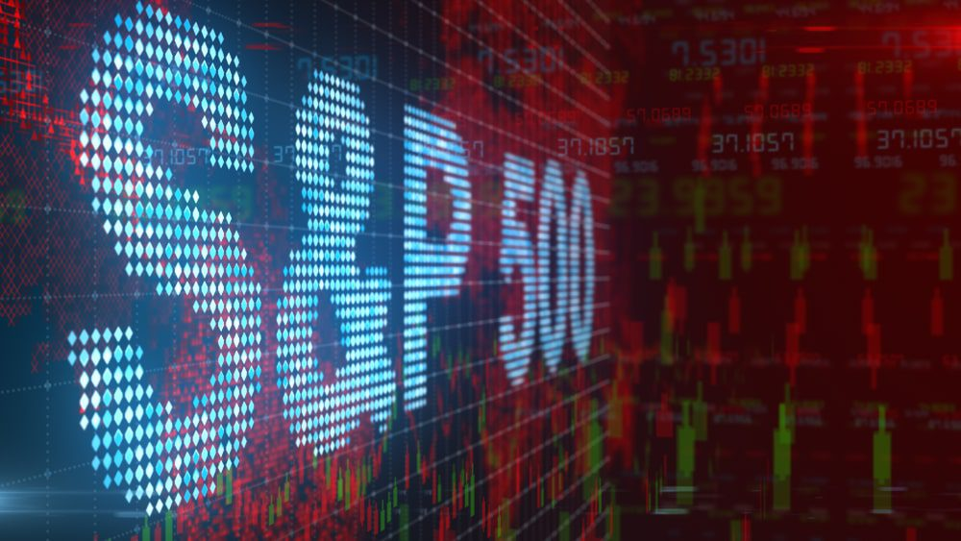
Analysing
S&P500 Stock Index
and the performance of its Economic Sectors
Jonathan Martinez
Mylene Marsden
Christian Torres
Cindy Wong

Slide 2
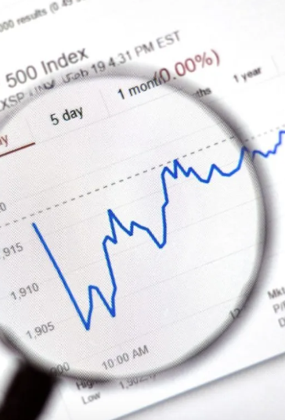
INTRODUCTION
What is the S&P500 and why it is important in the US stock market?
The S&P 500 Index, or Standard & Poor's 500 Index, is a market-capitalization-weighted index of 500 leading publicly traded companies in the U.S. It covers approximately 80% of available market capitalisation. In other words, S&P500 tracks the stock performance of 500 large companies listed on stock exchanges in the United States and it is one of the most commonly followed equity indices.
The S&P 500 index is the most commonly used benchmark for determining the state of the overall economy. Many investors also use the S&P 500 as a benchmark for their individual portfolios. The key advantage of using the S&P 500 as a benchmark is the wide market breadth of the large-cap companies included in the index. The index can provide a broad view of the economic health of the U.S.
It represents the stock market's performance by reporting the risks and returns of the biggest companies. Investors usually look at the S&P 500 to assess how the overall stock market is doing. This index is considered a leading U.S. economic indicator.
Reference: https://www.investopedia.com/terms/s/sp500.asp https://www.thebalancemoney.com/what-is-the-sandp-500-3305888 https://www.spglobal.com/spdji/en/indices/equity/sp-500/#data https://www.spglobal.com/spdji/en/indices/equity/sp-500/#overview

Slide 3
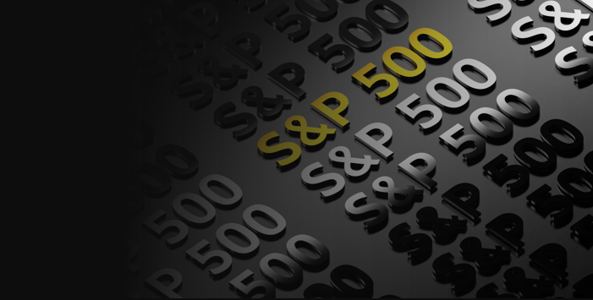


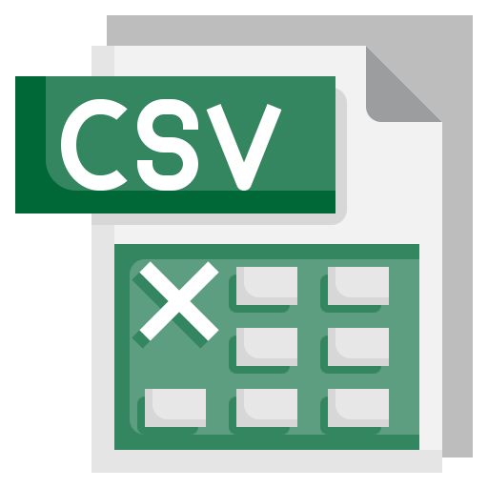



DATA COLLECTION
Sources
Financial data for every need.
Types of data files
Access stocks, forex and other financial assets
Stock Market Quotes & Financial News

Slide 4
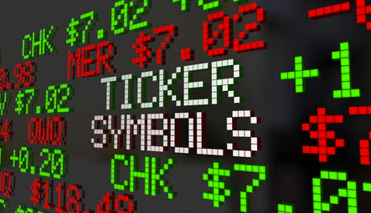
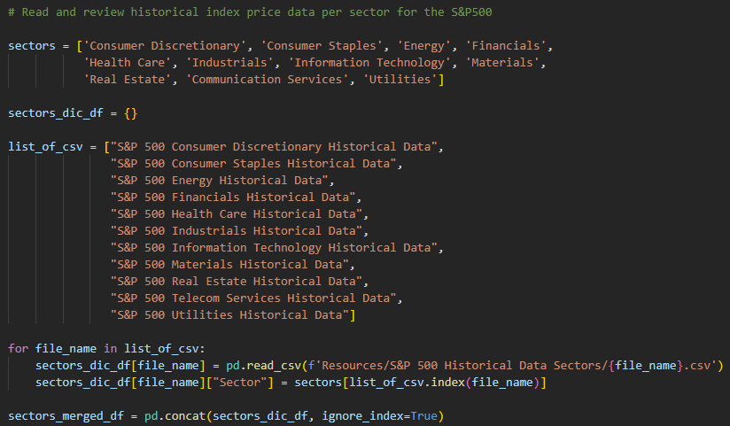
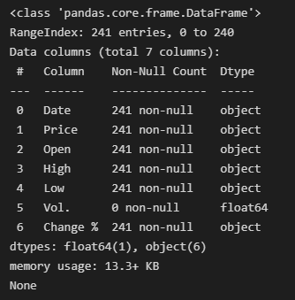
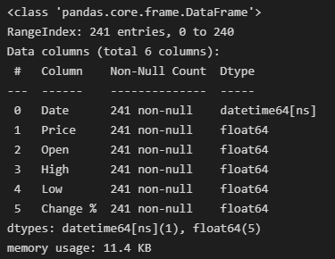
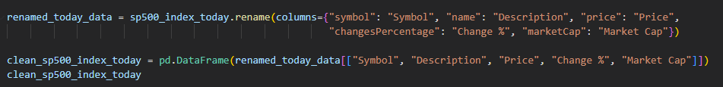
DATA CLEANING
Adjust datatypes
Merge DataFrames
Rename columns and filter DataFrames

Slide 5
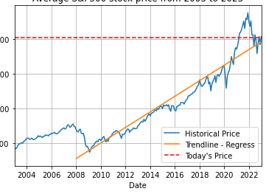
TREND OF S&P 500, CURRENT PRICE AND PREDICTION
Today’s S&P500 stock price from
Historical S&P500 stock price from

Slide 6

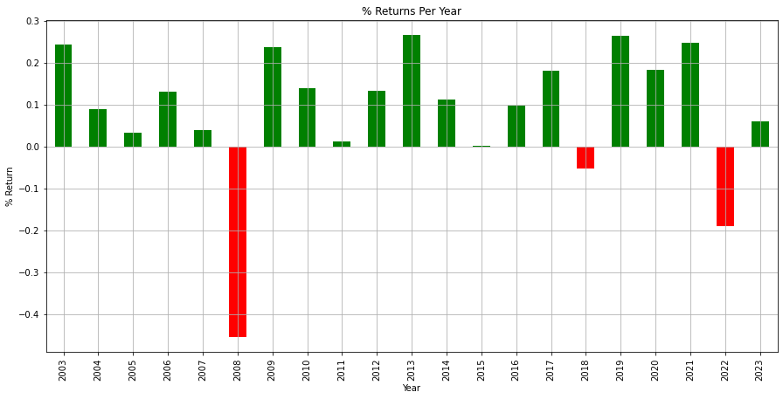
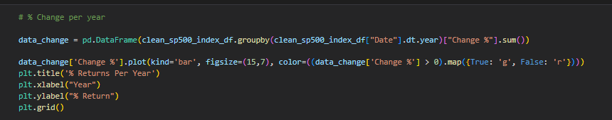
% of RETURN of S&P 500 over the last 20 YEARS (2003 to 2023)
Since 2003, S&P 500 has only fallen 3 times.
2008 was the year with the lowest return, followed by 2018 and then 2022!
Every five-year period following one of the worst years in the stock market saw positive returns!
Notes:
The S&P 500 bottomed out in 2008 was in tandem with other stock markets across the globe, which was known as the Great Recession.

Slide 7
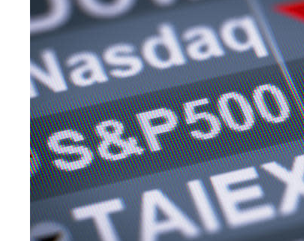
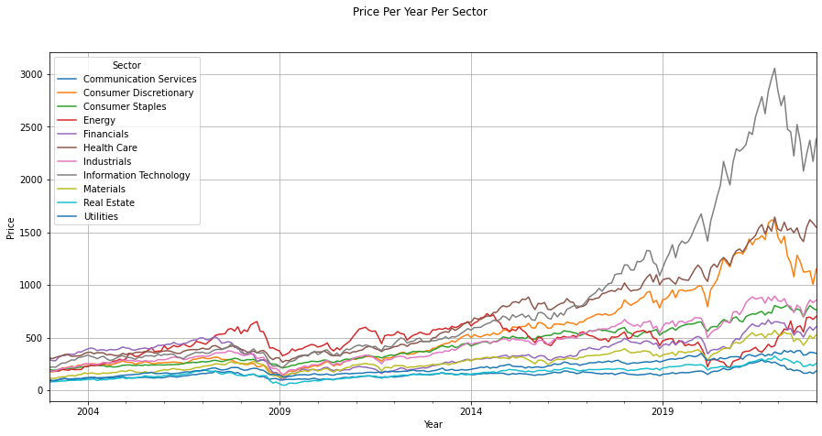
Performance of each SECTOR of the S&P 500 based on AVERAGE PRICE
between 2003 to 2023
TOP 3 out-performing sectors!
Technology
Health Care
Consumer Discretionary

Slide 8
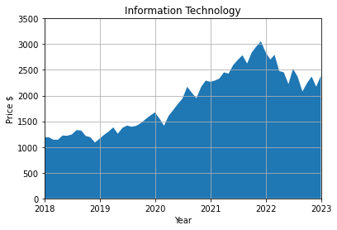
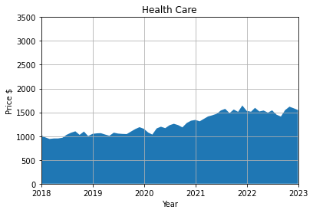
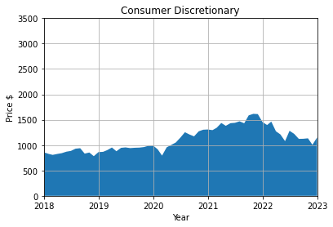
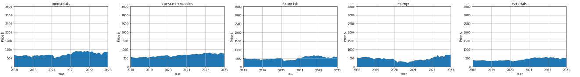
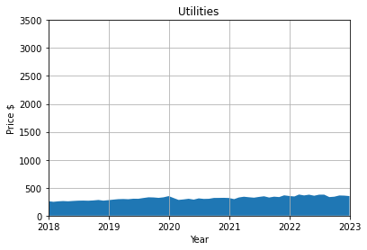
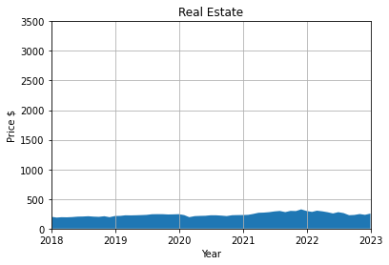
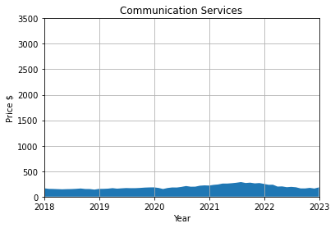
Performance of each SECTOR of the S&P 500 based on AVERAGE PRICE
TOP 3 out-performing sectors!
Technology
Health Care
Consumer Discretionary
TOP 3 under-performing sectors!
Utilities
Real Estate
Telecom Services
Notes:
The Standard and Poor's 500, or simply the S&P 500, is a stock market index tracking the stock performance of 500 large companies listed on stock exchanges in the United States. It is one of the most commonly followed equity indices. As of December 31, 2020, more than $5.4 trillion was invested in assets tied to the performance of the index. The S&P 500 index is a free-float weighted/capitalization-weighted index. As of August 31, 2022, the nine largest companies on the list of S&P 500 companies accounted for 27.8% of the market capitalization of the index and were, in order of highest to lowest weighting: Apple, Microsoft, Alphabet, Amazon.com, Tesla, Berkshire Hathaway, UnitedHealth Group, Johnson & Johnson and ExxonMobil.

Slide 9
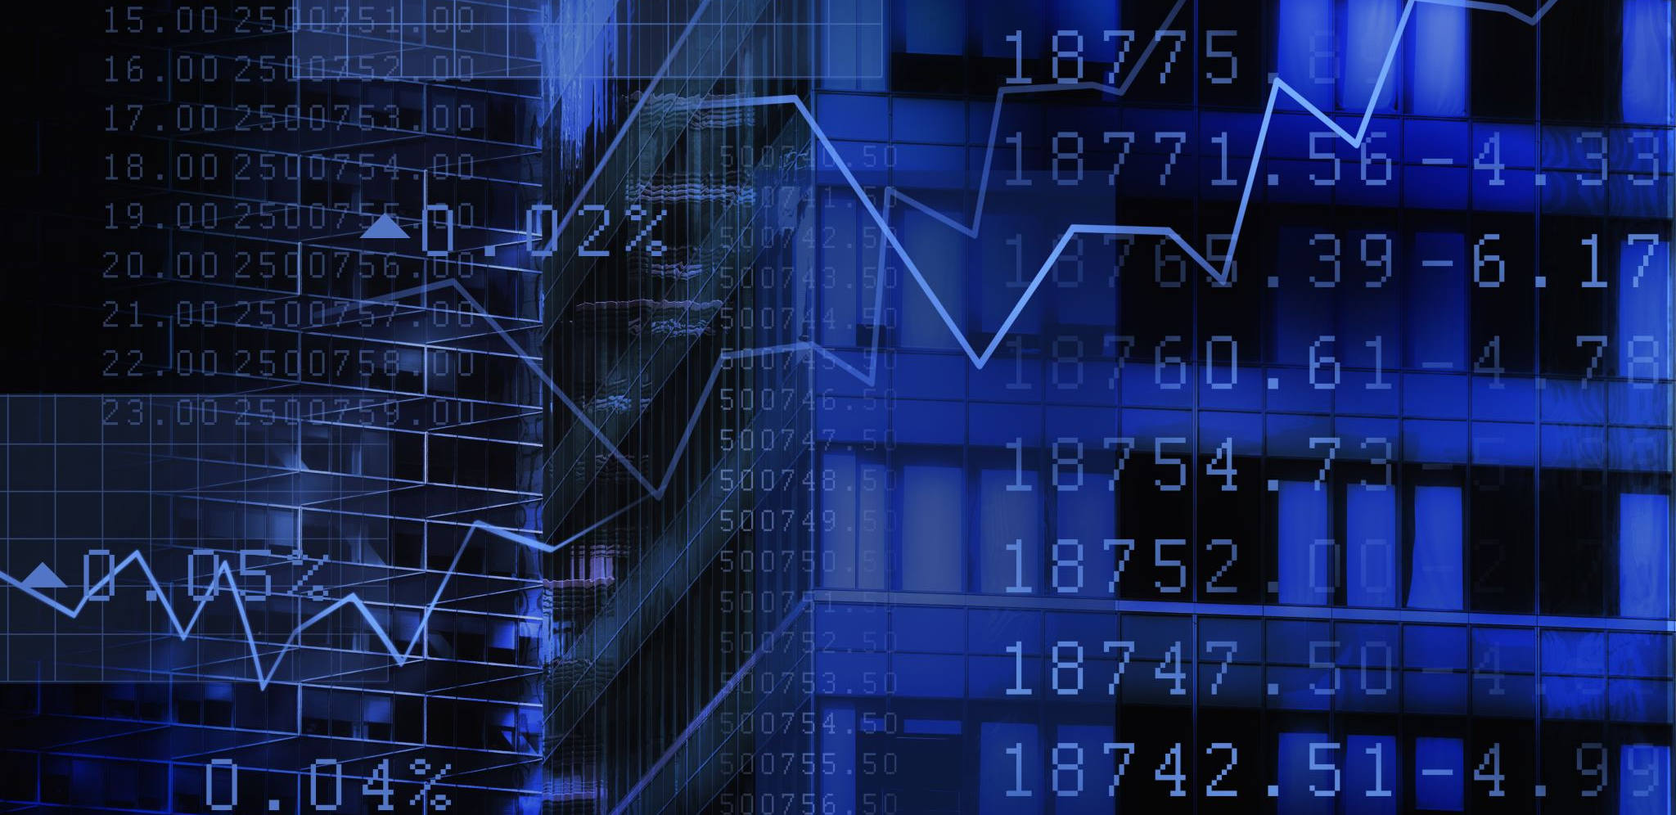
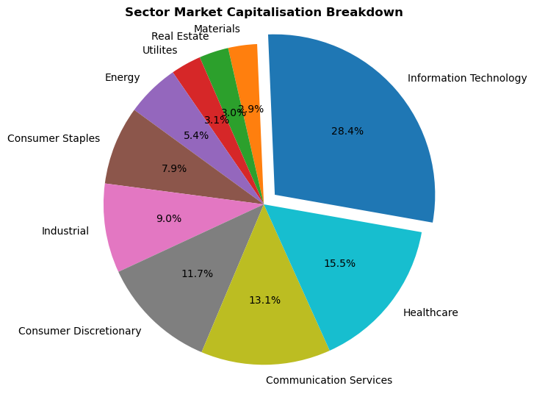
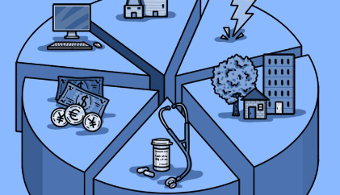
% Participation of each S&P 500 SECTOR between 2003 to 2023

Slide 10

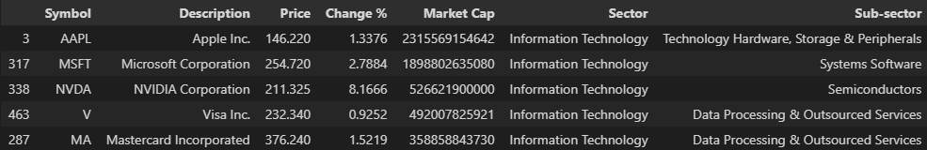
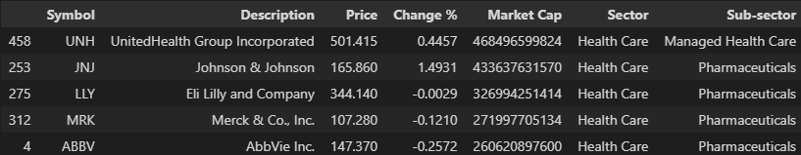
Top 5 Performing S&P 500 Sectors between 2003 to 2023
Information Technolgy
Health Care

Slide 11


