Slide 1

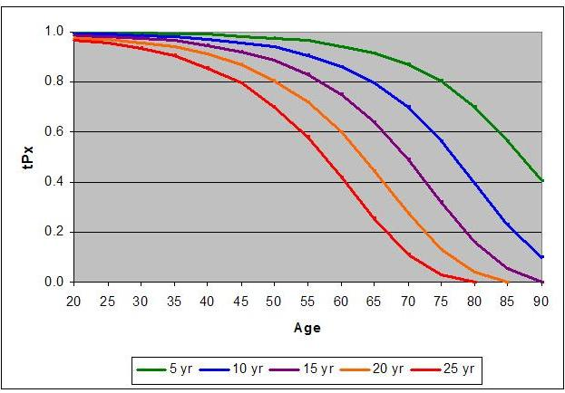

Actuarial Science with Julia
Presented by: Rock Pereira

Slide 2



What Is Insurance?
Risk
Premium

Slide 3
Contents
Present Value, Types of Policies
Force of Morality, Life Tables
Modeling a Term Life Policy
Modeling a Whole Life Policy
Simulation Analysis of MANY Policies
Effect of Risk Factors on Premiums

Slide 4
Section 1: Present Value
1.1 Annuity Immediate
Year | 0 | 1 | 2 | 3 | 4 | ... | n-1 | n
Premium | P
Claim |  | C | C | C | C | C | C | C
PV Premiums = P
PV Claims = C / (1+i)¹ + C / (1+i)² + … C / (1+i)^{n}
Discount v = 1 / (1+i)

Slide 5
1: Present Value
1.2 Annuity Deferred
Year | 0 | 1 | 2 | ... | 10 | 11 | 12 | ... | n
Premium | P | P | P | P
Claim |  |  |  |  |  | C | C | C | C
|–--------Savings Phase--------|
|–--------Income Phase--------|
PV Premiums = P + P * v¹ + P * v² + … + P * v⁹
PV Claims = C * v¹¹ + C * v¹² + … + C * v^{n}

Slide 6
1: Present Value
1.3 Term Life Insurance
Year | 0 | 1 | 2 | ... | Death |  |  | n-1 | n
Premium | P | P | P | P | P
Claim |  |  |  |  |  | C
1.4 Whole Life Insurance
Age | 40 | 41 | 42 | ... | Death |  |  | 99 | Maturity
Premium | P | P | P | P | P
Claim |  |  |  |  |  | C

Slide 7
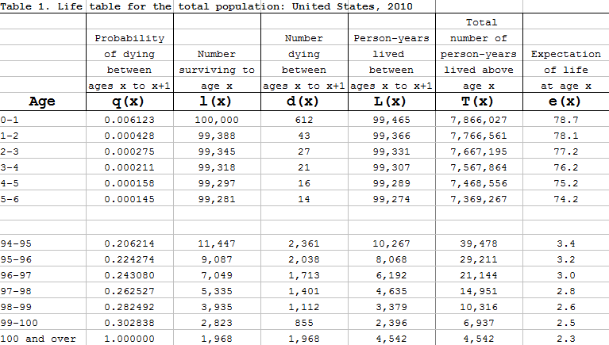
Section 2: Life Tables

Slide 8
7: Sources
Life Tables (All 18 Tables)
ftp://ftp.cdc.gov/pub/Health_Statistics/NCHS/Publications/NVSR/63_07/

