Slide 1
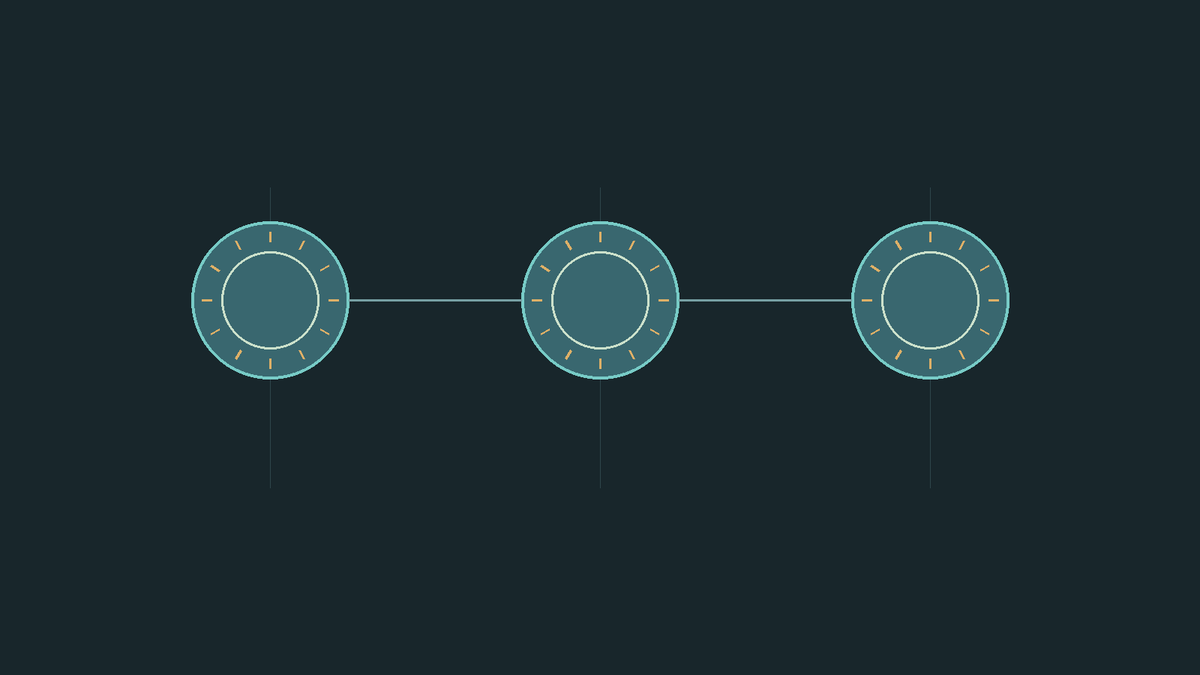

让每一个重点，都被看见
01 / 感知
从环境中捕捉有效信号
Notes:
Original LUMA scene. Native picture-circle Intersect, editable 3-stop triangular simulated beam, real original GLB above beam; Morph across focus states. Source BV1pa4y117yV 59-131s. Not volumetric lighting. Beam angle=-57.752119750207626; apex=(16.94, 14.35).

Slide 2
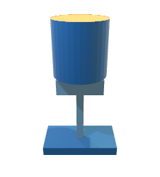
让每一个重点，都被看见
02 / 判断
让多个信号形成清楚判断
Notes:
Original LUMA scene. Native picture-circle Intersect, editable 3-stop triangular simulated beam, real original GLB above beam; Morph across focus states. Source BV1pa4y117yV 59-131s. Not volumetric lighting. Beam angle=0.0; apex=(16.94, 14.35).

Slide 3

让每一个重点，都被看见
03 / 响应
把判断落实为及时行动
Notes:
Original LUMA scene. Native picture-circle Intersect, editable 3-stop triangular simulated beam, real original GLB above beam; Morph across focus states. Source BV1pa4y117yV 59-131s. Not volumetric lighting. Beam angle=57.724355685422374; apex=(16.94, 14.35).

