Slide 1
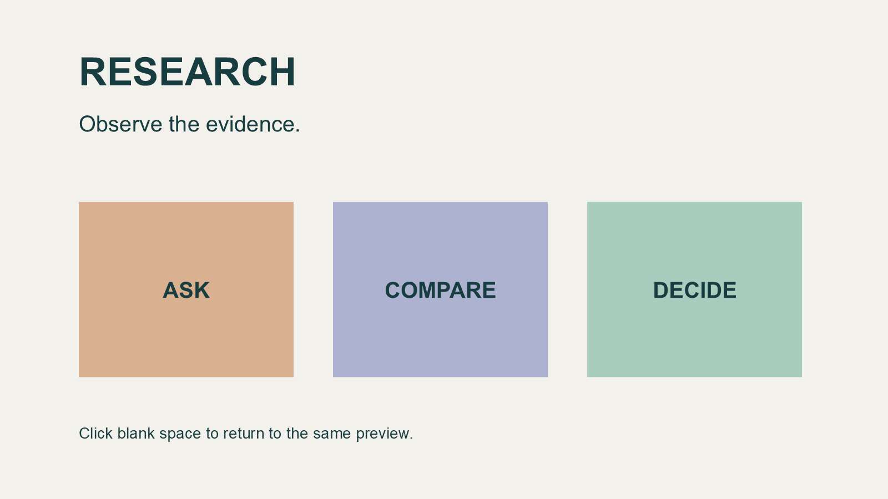
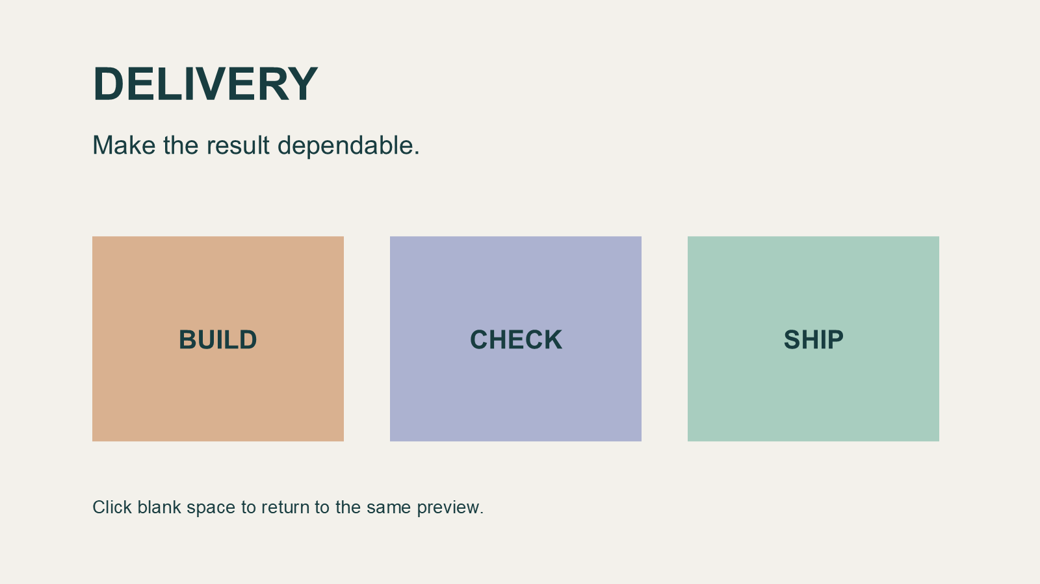
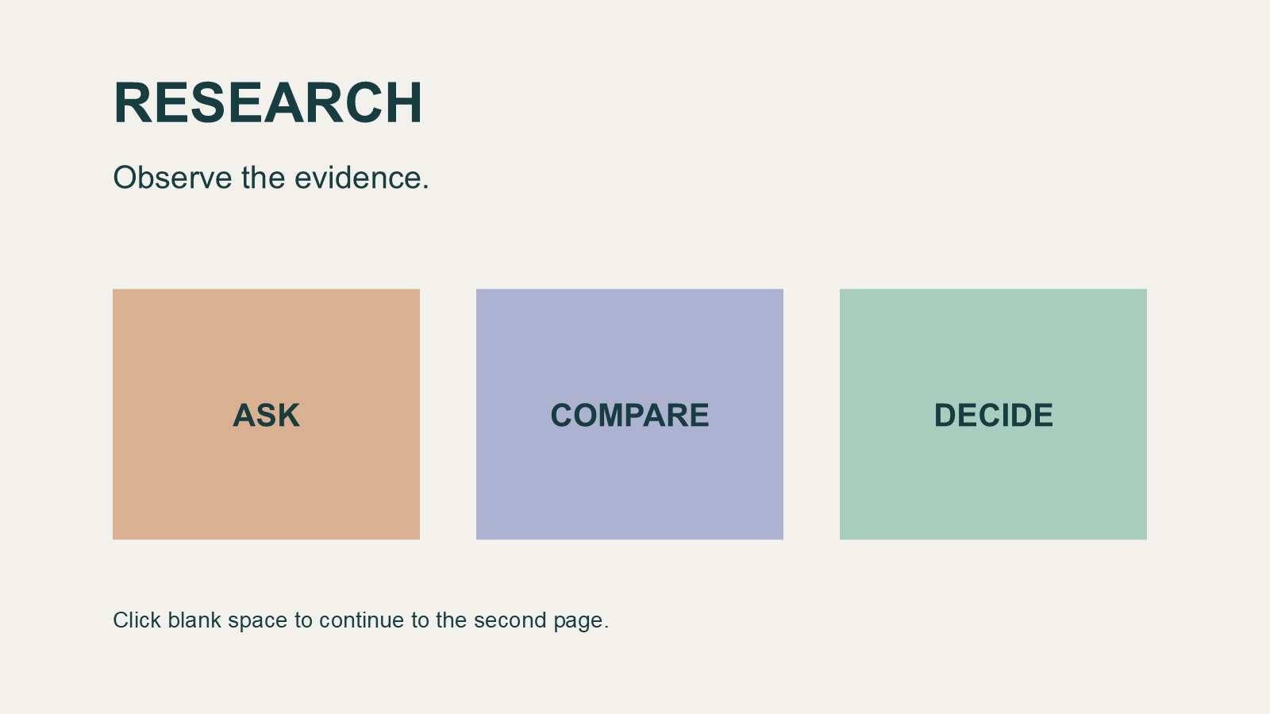

TWO WAYS TO MAKE PROGRESS
Hover to preview. Explore both pages, then return.
A
B
RESEARCH
DELIVERY

Slide 2
TWO WAYS TO MAKE PROGRESS
Hover to preview. Explore both pages, then return.
A
B
RESEARCH
DELIVERY

Slide 3
TWO WAYS TO MAKE PROGRESS
Hover to preview. Explore both pages, then return.
B
A
DELIVERY
RESEARCH

Slide 4
RESEARCH
Observe the evidence.
ASK
COMPARE
DECIDE
Click blank space to continue to the second page.

Slide 5
FROM OBSERVATION TO DECISION
Turn evidence into a clear next step.
ASK
COMPARE
DECIDE
Chapter complete / click blank space to return to the preview.

Slide 6
DELIVERY
Make the result dependable.
BUILD
CHECK
SHIP
Click blank space to continue to the second page.

Slide 7
MAKE DELIVERY REPEATABLE
Keep the result editable and easy to maintain.
BUILD
CHECK
SHIP
Chapter complete / click blank space to return to the preview.

