Slide 1
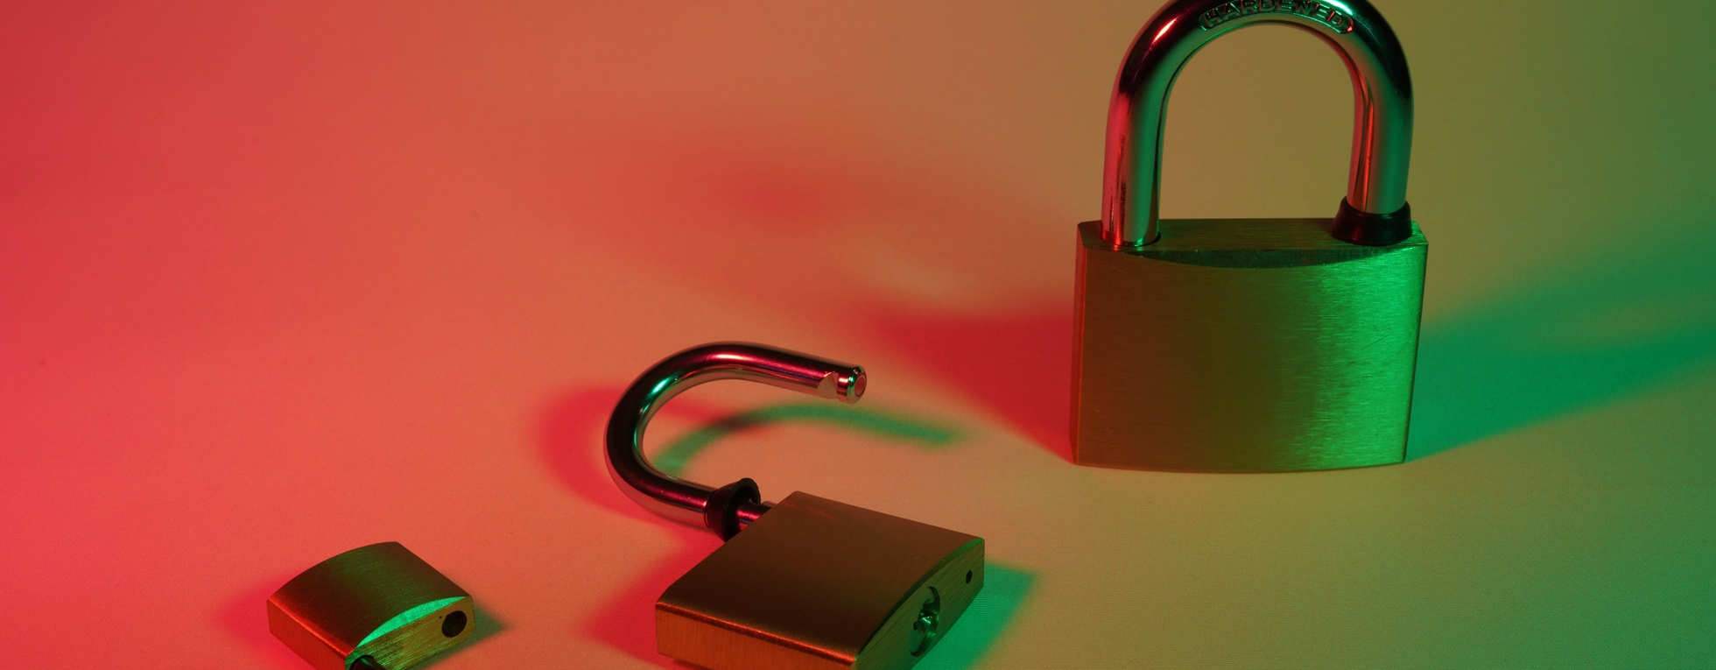
Renewable Energy's Frenemies: Counterparty Risk
This presentation explores the critical challenges and risks that renewable energy projects face from their contractual counterparties, such as power purchasers, suppliers, and financial institutions.

Slide 2



What's Counterparty Risk?
Contractor with a history of bankruptcy
Utility company in legal troubles
Social media storms
Dealing with a utility provider embroiled in legal disputes can lead to service interruptions and unreliable performance, impacting your operations.
Negative publicity and online backlash against a partner can significantly damage your reputation and disrupt your relationship, had you done more thorough research upfront.
When your trusted contractor has a track record of financial instability and sudden business closures, it puts your project at risk.
Counterparty risk is the potential for your trusted partners to become liabilities, highlighting the importance of thorough due diligence and risk assessment before engaging in business relationships.

Slide 3




Why It's Different
Transparent Analyses
No Black-Box Nonsense
Actionable Insights
Trust Backed by Evidence
Every analysis comes with the supporting evidence, so you can see exactly how the results were obtained.
We don't hide our methods or algorithms - everything is fully transparent and open for your inspection.
Our analyses provide clear, data-driven insights that you can act on, instead of just guessing.
You can trust our recommendations because they're based on rigorous analysis, not hunches or hearsay.
With transparent analyses, clear insights, and a commitment to trustworthiness, we offer a fundamentally different approach to data-driven decision making.

Slide 4
