Slide 1
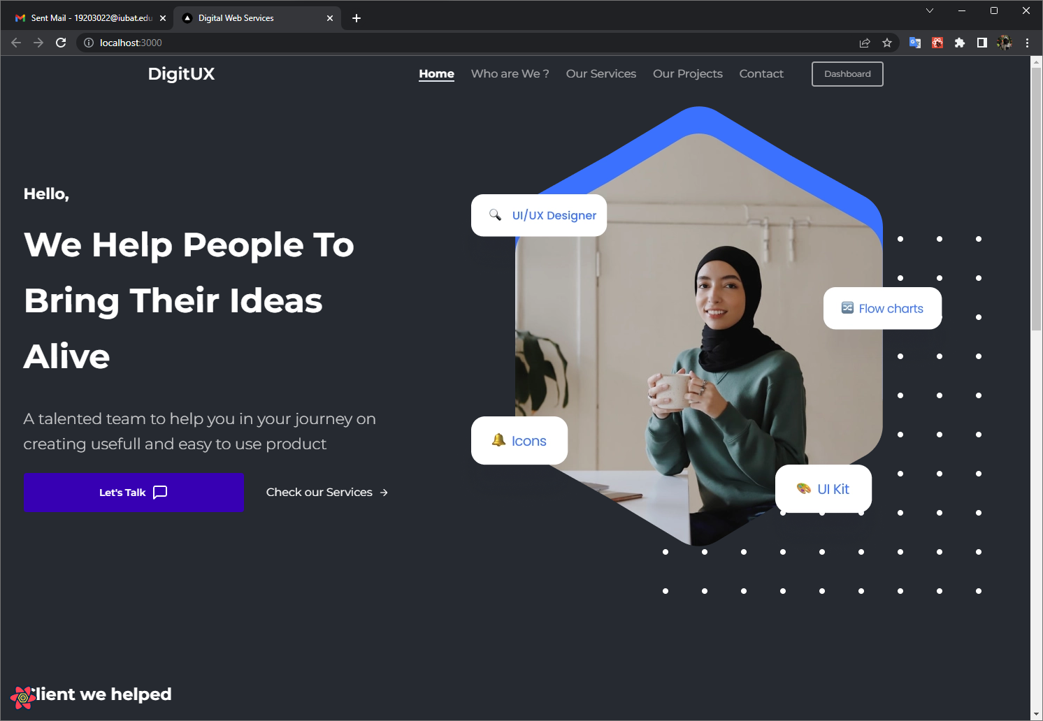
Digital Service Portal
an digital service portal
for Ztrios Tech and Marketing
Digital service Portal

Slide 2

IUBAT— International University of Business Agriculture and Technology
Development of Digital
Service portal for Ztrios Tech and Marketing
Prepared for
Practicum Defense Committee
Department of Computer Science and Engineering , IUBAT
Supervised By
Krishna Das
Assistant Professor
Dept. of Computer Science and Engineering
Prepared By
Md. Mahamud Hasan
ID : 19203022
Dept. of Computer Science and Engineering

Slide 3
Table of contents
01
Organization Overview
05
Requirement Engineering
09
Use Case
Diagrams
02
Project Overview
06
System
Planning
10
Analysis
Modeling
03
Process Model
07
Function Point
Estimation
11
Risk
Management
04
Feasibility Study
08
Cost
Estimation
12
Testing &
Limitation
13
Future
Plan
14
Reveal &
Conclusion

Slide 4

Organization
Overview-
specializing in software solutions.
delivering high-quality products and exceptional customer service.
help our clients stay ahead of the competition and achieve their goals
-Mission
Streamline operations, increase efficiency, and drive growth.
Empower business with innovative and user-friendly technology solutions.
Provide personalized support and guidance to help clients achieve their goals.
Vision-
Be a leader in digital transformation.
Deliver value to clients through innovation and creativity

Slide 5
02
Project Overview
Content no
Web-based platform developed to provide digital marketing related services.
Aim to offer effective solutions and optimum results at a suitable cost
Reduce Paperwork
Save time and save data on cloud storage
Acessible from anywhere

Slide 6

Objectives
To build a web based digital service portal where agency manager can manage all the order and services of customers. Customers can track their order and do partial payments.

Slide 7
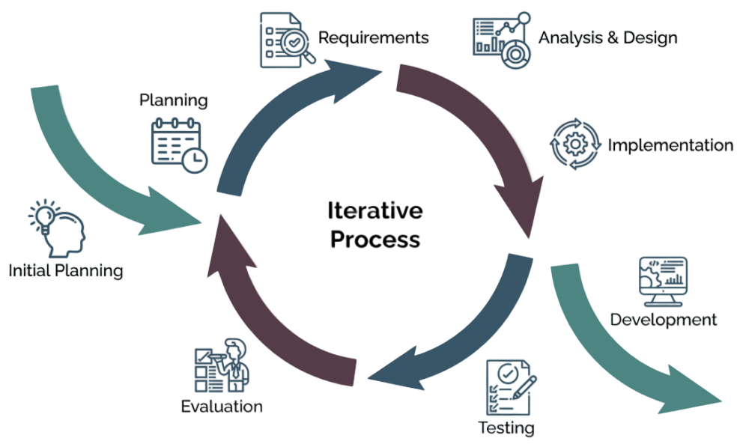
Process Model
The Iterative process based on cyclical approach , trail-and-error process intended to deliver a product. Develop prototype then Test with users.

Slide 8
Reason to Choice Iterative Design
Early error detecttion
Risk reduction
Continous improvement
Client feedback
Flexibility and adaptability
Efficiency in development

Slide 9
Feasibility Study
Technical Feasibility
Operational Feasibility
Economic Feasibility
all the modern technologies like JavaScript , REACT, NEXT JS ,
Express are needed for this project.
The entire development & production is cost effective and easily upgradeable.
This system is designed and develop from a end to end user’s point of view & included all features.

Slide 10
Requirement Engineering
User and System Requirements
Customers can see announcements
2.1 customers notified with offers and announcements
2.2 information to display relevant announcements and offers to customers.
General Customer can registration and login
1.1 provide required info for registration
1.2 system check credential’s validity
1.3 it will notify with successful or error notification.

Slide 11
Requirement Engineering cont…
User and System Requirements
Users can see statistics and reports
4.1 generate and display reports related to services and order
4.2 east to understand graphical representation of data
user check offering services
3.1 clear and concise description of each service
3.2 filter and search services based on preference

Slide 12
Requirement Engineering cont…
User and System Requirements
Robust security measures to protect customers data and prevent fraud
6.1 system have authorization for role
6.2 System will change access permission followed by the designation accordingly.
System allows users to view their purchase order
5.1 provide a detailed view of the order, including date-time, amount and status of the order
5.2 allow customers to track the status of the order.

Slide 13
Requirement Engineering cont…
User and System Requirements
Allow admin to list the services under main categories
8.1 provide a clear and concise description of each categories
8.2 admin can add , edit and delete categories as needed
Allow Admin to manage orders
7.1 view , edit and cancel order as needed
7.2 real-time updates on the status of orders

Slide 14
Requirement Engineering cont…
More User Requirements…
Allow Admin to view the services that are currently running
User-friendly interface for managing orders and services
System shall allow users to amake partial payments for their orders
Admin to create order for customers
System shall allow admin to generate reports based on orders
The system shall allow admin to check all types of order
So on…

Slide 15
Funtional & Non-Functional requirements
Functional
Allow users to register with providing their personal details and creating unique login ID and password
Enable admins to list various services provided by businesses under the main category
Provide customers with a range of payment options .
Generates reports for admins and customers
Non-Functional
user-friendly interface.
Fast and reliable with minimal downtime or errors
handle growing numbers of users without compromising performance
Compatible with different browsers

Slide 16
Software & Hardware requirements
Visual Studio Code
Figma and git
Nodejs environment
Postman
Browser
only With a browser
user can easily navigate this software
DEVELOPER

Slide 17
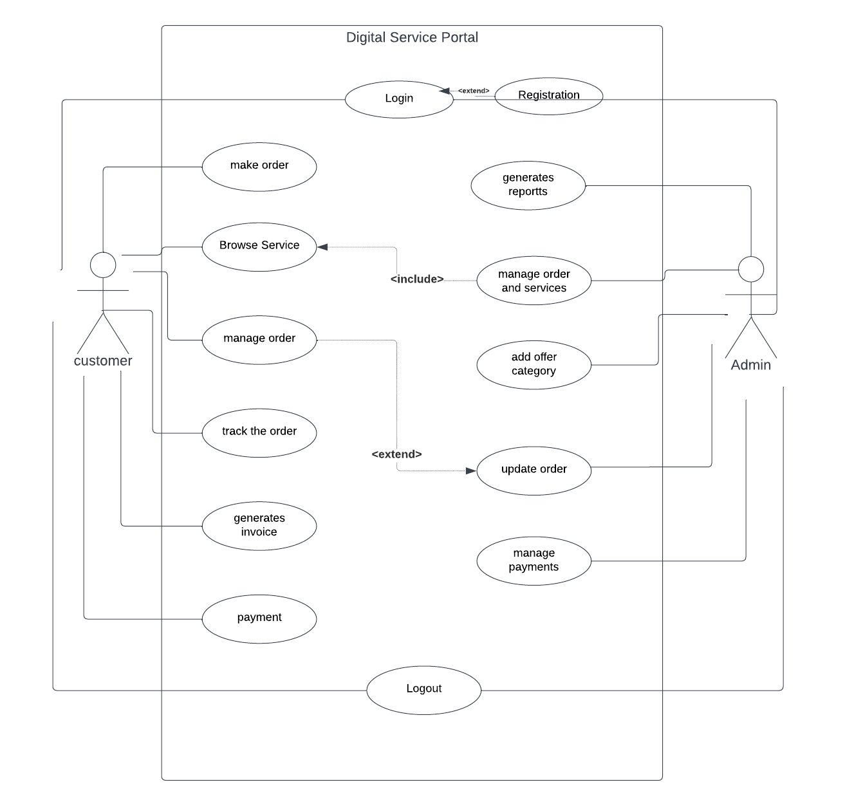
Use Case Diagram

Slide 18
Analysis Modeling

Slide 19
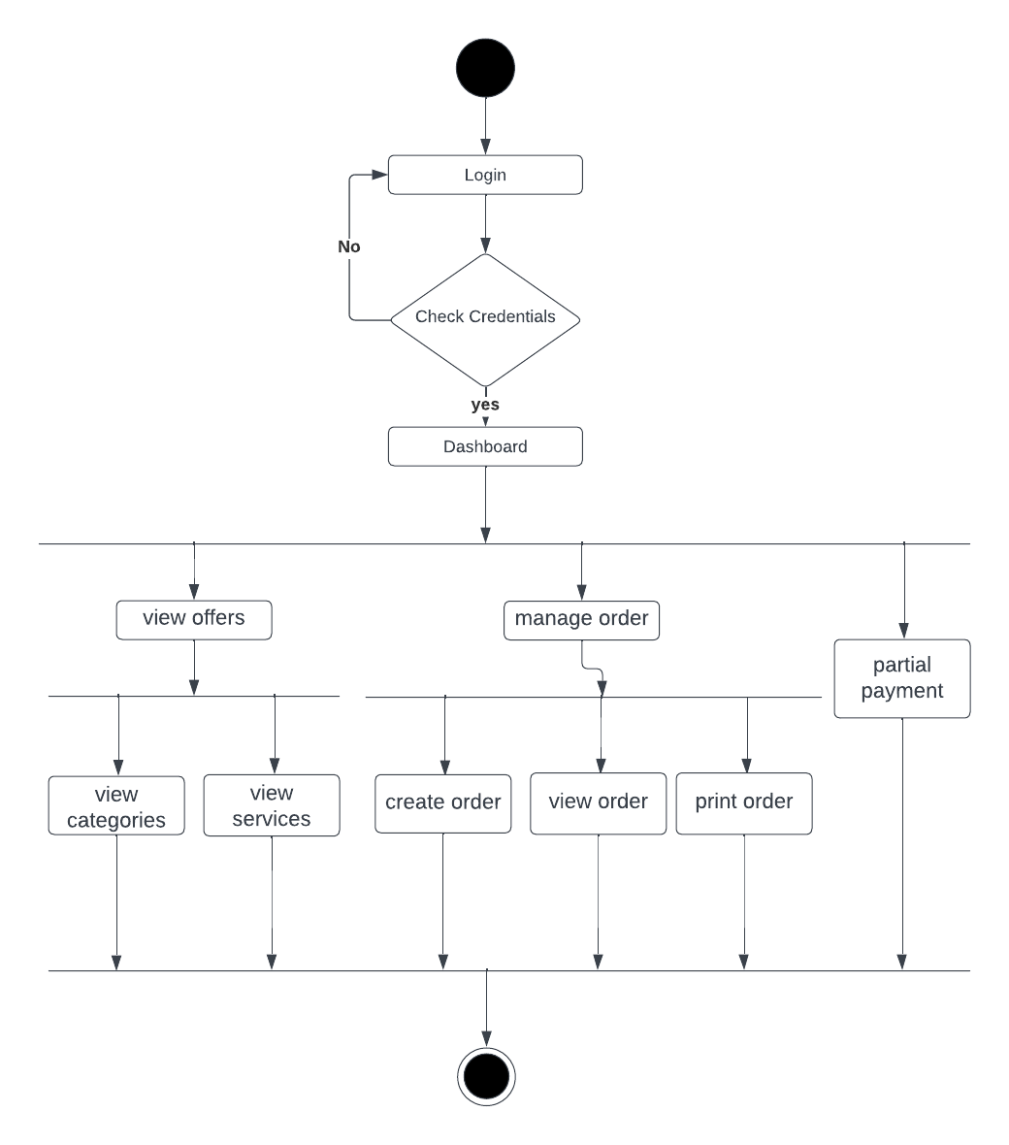
Activity Diagram for Customer

Slide 20
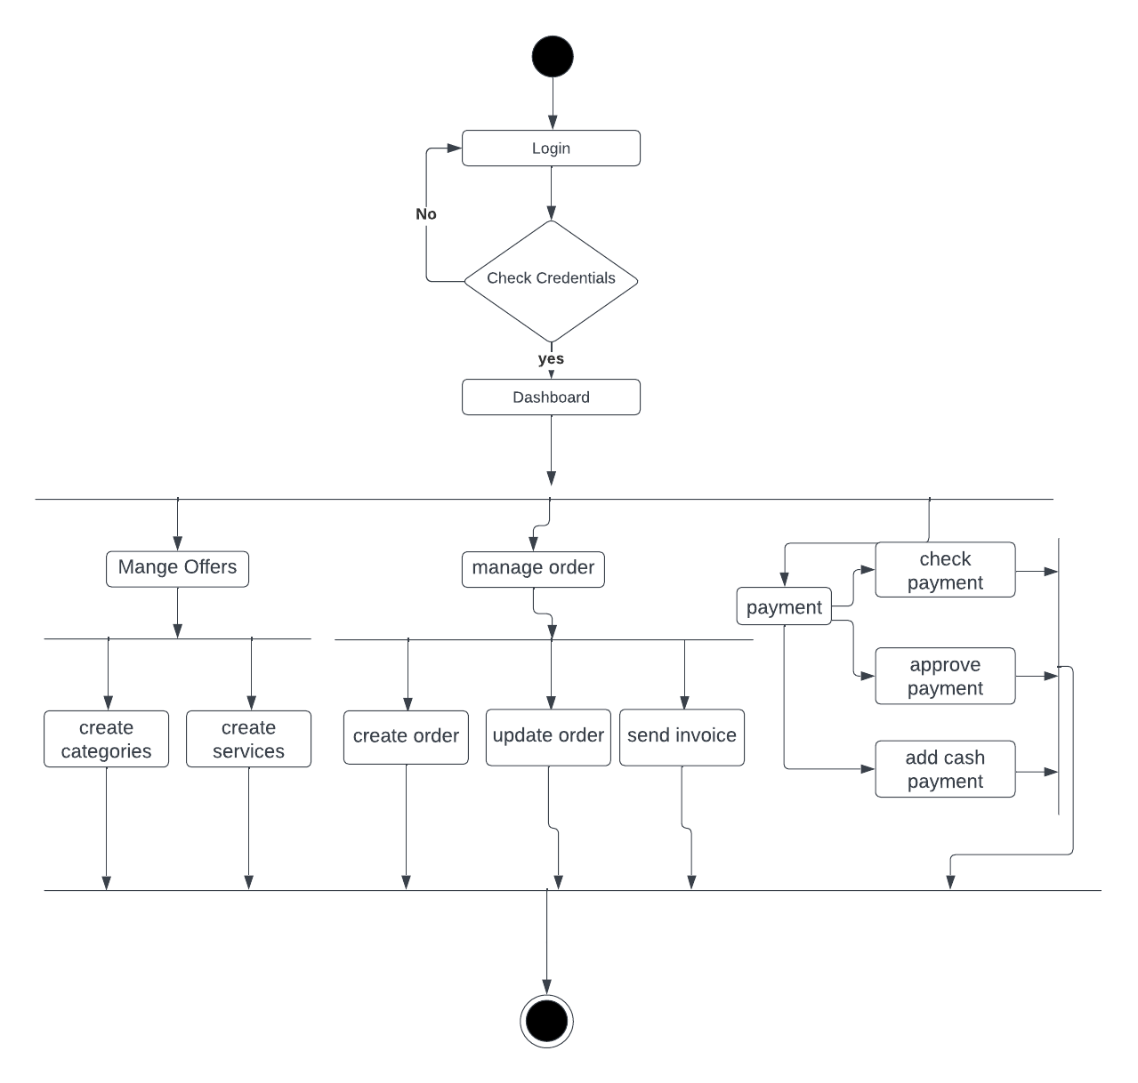
Activity Diagram for Admin

Slide 21
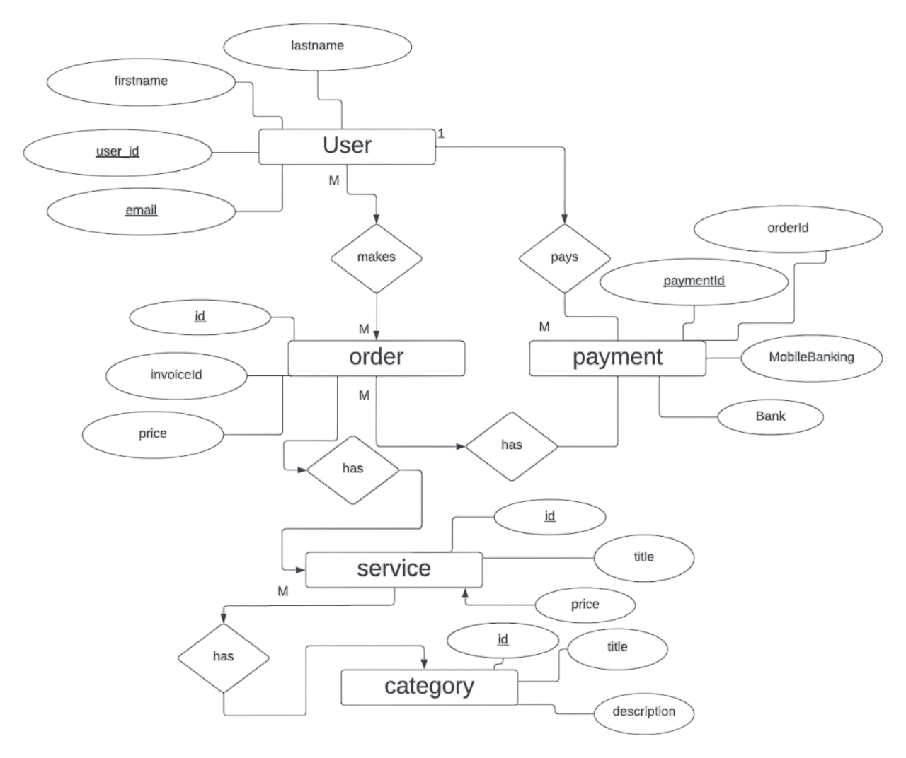
Entity Relationship Diagram

Slide 22
System Planning
This activities of software project planning have followed in this project are:
Function point estimation of the project
Hardware cost for running this software
Estimation of the software cost

Slide 23
Function Point Estimation
Value Adjustment Factor (VAF) = (0.65 + (0.01*TDI))= (0.65 + (0.01*34)) = 0.99
UFP = UFP (Data function) + UFP (Transaction function)= 26 + 100 = 126
AFP = UFP * VAF = 126 * 0.99 = 124.74 Approx.
Total time calculation frame = 124.74 * 15.5 = 1934.04 person-hours
= 1934.04 person-hours / 8 hours
=241.76 person-days Approx / 3 person
= 81 days [Approx]
2 months and 10 days
*excluding weekend
UFP : Unadjusted function point
AFP : Adjusted function point

Slide 24
Effort Based Estimation

Slide 25
Cost Estimation
Total
1,31000৳

Slide 26
Data Flow Diagram

Slide 27
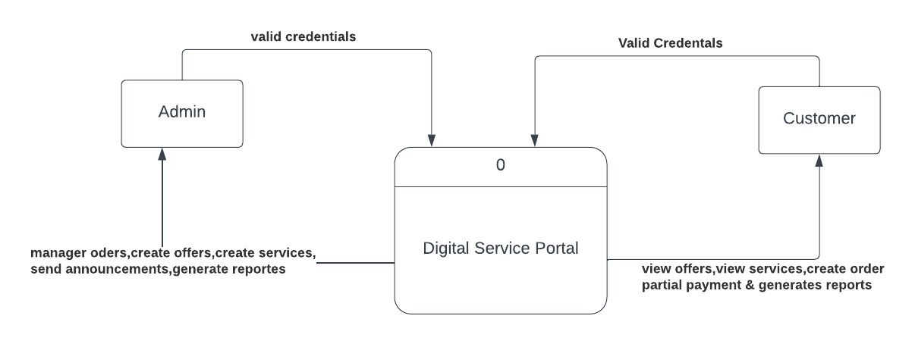
Data Flow Diagram
Context Level

Slide 28
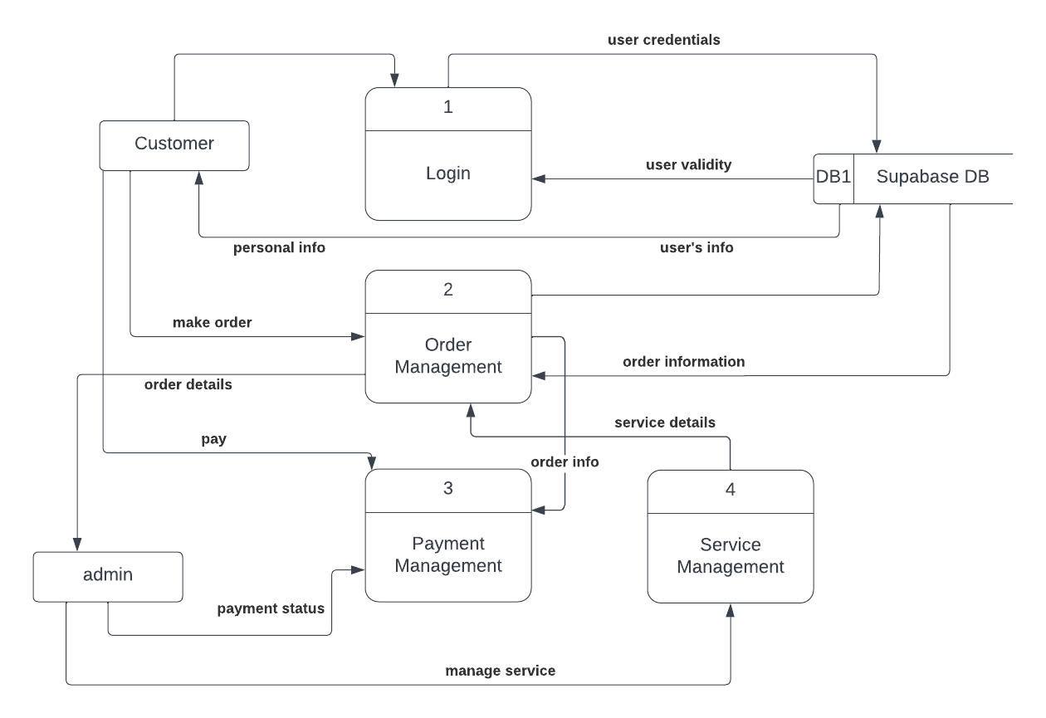
Data Flow Diagram cont…
Level : 1

Slide 29
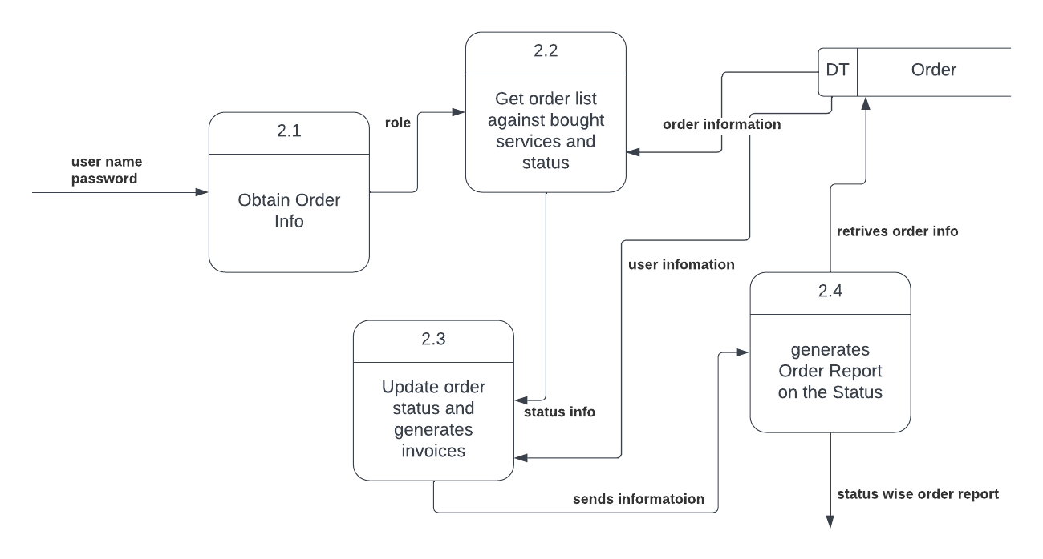
Data Flow Diagram cont…
Level : 2

Slide 30
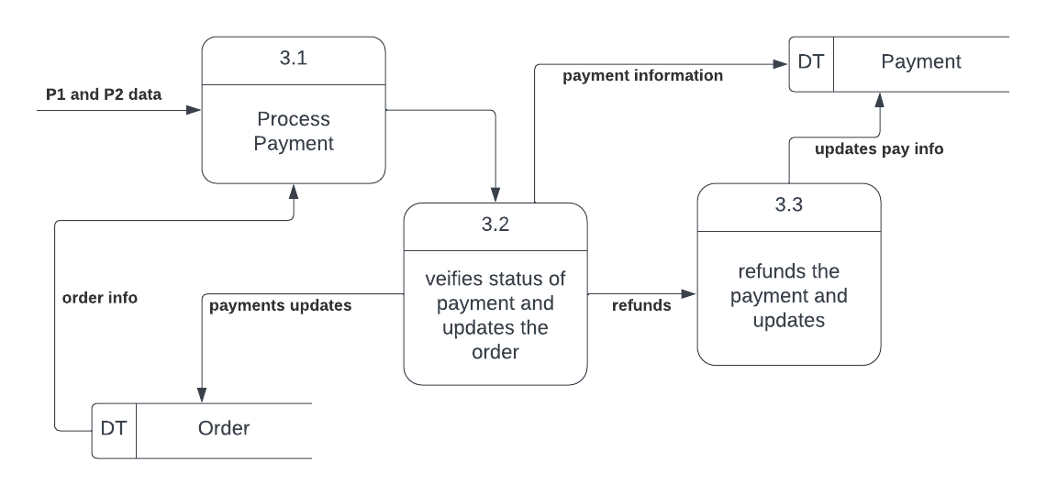
Data Flow Diagram cont…
Level : 2 | Process : 3

Slide 31
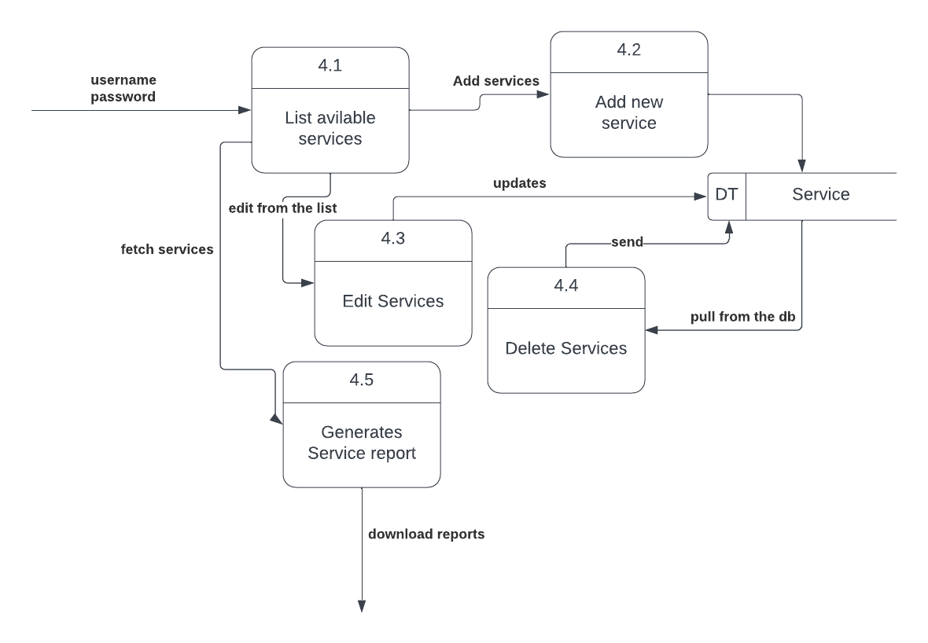
Data Flow Diagram cont…
Level : 2 | Process : 4

Slide 32
Risk Management

Slide 33
Risk Identification
Risk Type | Possible Risks
Technology | Less use of future technologies. (1) Complexity in implementation. (2)
People | Staffs are ill and unavailable at critical times. (3)
Organizational | -
Tools | Confusion in choosing right framework. (4)
Requirements | Failing to understand customer demand. (5)
Estimation | The size of the software is underestimated. (6) Wrong/Improper budget estimation. (7)

Slide 34
Technology Risk : 1 cont…
Project Risk 1
Name | Less use of future technologies
Probability | Moderate
Impact | Tolerable
Description | Technology is updating very fast. So the chosen technology may be market-out very soon
Mitigation and Monitoring | Have to proper knowledge about current market and all technologies
Management | The whole system should be converted to new technologies very soon
Status | Monitoring it

Slide 35
Technology Risk : 2 cont…
Project Risk 2
Name | Complexity in implementation
Probability | Moderate
Impact | Serious
Description | Developers may fall into a difficult situation in implementing the required functionalities
Mitigation and Monitoring | Skilled developers should be assigned and proper collaboration needed while developing
Management | The meeting will call and discuss to overcome the current situation
Status | Managed it

Slide 36
People Risk : 1 cont…
Project Risk 3
Name | Staffs are ill and unavailable at critical times
Probability | High
Impact | Serious
Description | Sometimes employees may have some issues that may effect in the development process
Mitigation and Monitoring | Employees should not be over-pressurized and the full team should be monitored
Management | An instant meeting should call and work should be organized with every employees properly
Status | Monitoring it

Slide 37
Tools Risk : 1 cont…
Project Risk 4
Name | Confusion in choosing right framework
Probability | Low
Impact | Serious
Description | Multiple options may come forward for choosing the right tools
Mitigation and Monitoring | Have to be focused on the goal and have to choose the right path for the project
Management | Have to research and arrange a meeting with the whole team to take the right decision
Status | Not occur

Slide 38
Requirement Risk : 1 cont…
Project Risk 5
Name | Failing to understand customer demand
Probability | Moderate
Impact | Catastrophic
Description | Customer demand may vary for the different clients. So sometimes it may create some confusion
Mitigation and Monitoring | Have to discuss with the clients properly and recheck their demands over and over
Management | The working procedure should be changed for those requirements
Status | Not occur

Slide 39
Estimation Risk : 1 cont…
Project Risk 6
Name | The size of the software is underestimated
Probability | High
Impact | Tolerable
Description | The system size may be much larger than the expectation
Mitigation and Monitoring | The whole requirements and customer demand should be analyzed and revised properly
Management | Work speed should increase and more developer should be assigned if needed
Status | Monitoring it

Slide 40
Estimation Risk : 2
Project Risk 7
Name | Wrong/Improper budget estimation
Probability | Moderate
Impact | Serious
Description | Budget can be underestimated
Mitigation and Monitoring | By analyzing the whole requirement full budget should be prepared
Management | Have to discuss with the client and take a proper decision by discussing with the team
Status | Not held

Slide 41
Testing
Software Testing is necessary ?

Slide 42
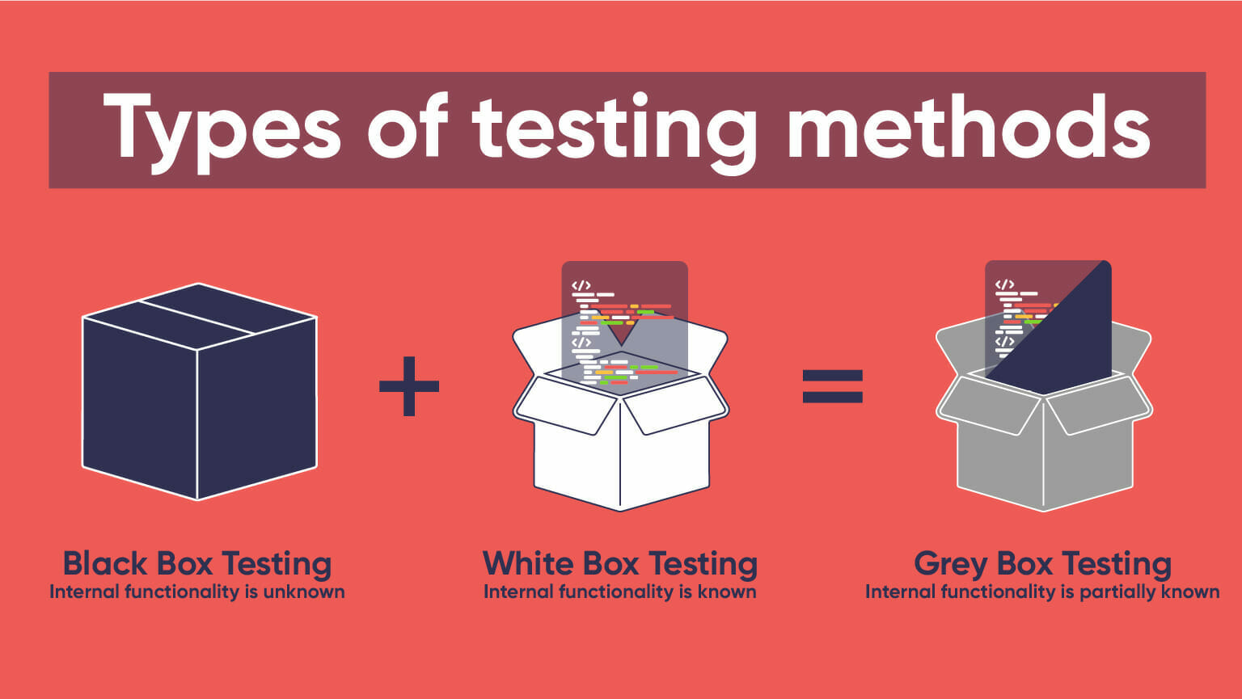
Testing

Slide 43
Testing cont…
Testing scenario, No:1
Scenario |  | User Login testing scenario of this system
Input’s |  | E-mail, password of User
Desired Output’s |  | When valid email, password will be entered then user and admin will get access to their corresponding modules otherwise not
Actual Output’s |  | For login my system works correctly if it found authenticated user
Verdict |  | Getting result from Desired Output’s and
 |  | Actual Output’s decided this system is
 |  | successful for login.

Slide 44
Testing cont…
Testing scenario, No:2
Scenario |  | User Registration
Input’s |  | Email, password, name, phone
Desired Output’s |  | When valid email , user will get confirming their registration in digital service portal platform.
Actual Output’s |  | For valid email and users can confirm their registration
Verdict |  | Desired output and actuals output indicate that system login works properly

Slide 45
Testing cont…
Testing scenario, No:3
Scenario |  | Purchase Services
Input’s |  | User credentials, service details, payment information
Desired Output’s |  | After completing payment process, the user should be able to access the purchased service.
Actual Output’s |  | Providing valid user credentials , service details and payment information , user be able to access purchased service.
Verdict |  | Desired output and actuals output indicate that function of purchasing services works properly

Slide 46
Limitations
Difficult to manage and maintain as it grows
Compatibility testing to ensure system works
Difficult to adapt to new technology
Integration with existing systems can be a challenge

Slide 47
Future Plan
Real-time
Order tracking
1
2
Online
payment
Enhanced
Reporting
3
4
User
Documentation

Slide 48
finally!
This system helps ton of digital agencies to track all the manual records more efficiently online.

Slide 49
Thanks
Questions ?
Digital Service Portal

