Slide 1
CS327E Final Project
Hyeongju and Alex

Slide 2
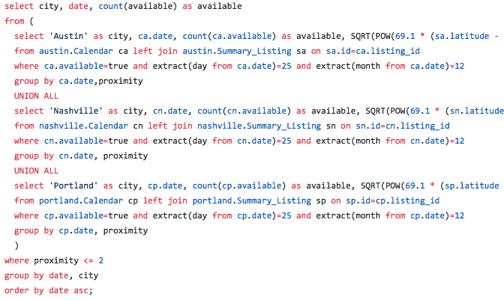
Metric: Availability On Holidays As A Function Of Downtown Proximity
Notes:
/* Find the number of available places within a 2-mile radius from the center
of downtown for each city on christmas of each year */
/* ANALYSIS OF RESULTS: Portland's number of available listings on christmas stay relatively constant each year while Texas and Nashville decrease and increase, respectively.
One possible explanation is that in Portland, approximately the same number of people travel out of state for the christmas holiday, while more people in Texas are choosing
to stay and, conversely, more people in Nashville are leaving */
Subqueries: Subqueries, combined with the Union All statement, allowed us to read data across multiple data sets, set them to identical aliases, and input the data into generic columns.
Aggregation: The COUNT() function returns the number of rows that matches a specified criteria
Group by ← required for all non-aggregated columns.
Join: The LEFT JOIN keyword returns all records from the left table (table1), and the matched records from the right table (table2). In this case, we didn’t want data included if it didn’t exist on the desired date (Christmas) but was still listed on other dates ← we don’t want the data to show up if the value for christmas is null in summary listing
extract() ← we can analyze days and months
Where ← allows us to filter out data

Slide 3
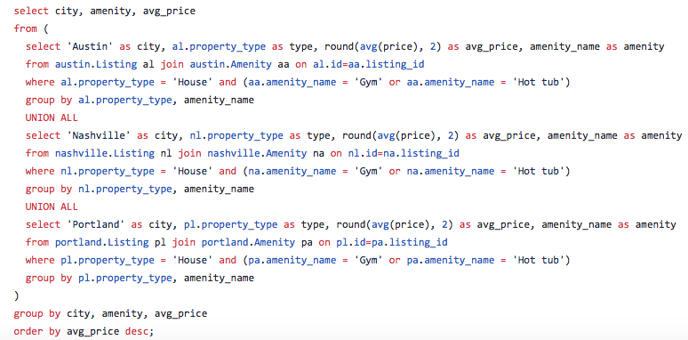
Metric: average prices of Houses for each city with gym or hot-tub amenity provided.
Notes:
/* Find the average price of Houses for each city with gym or hot-tub provided */
/* ANALYSIS OF RESULTS: The average price of the house with gym or hot tub are both in order of Austin > Nashville > Portland.
Also, the average prices for the hot tub is all higher than those of the gym for each city. */
Which function did which job on this metric:
-Subqueries: returned a set of two rows to its parent query.
-Union All: combined the result sets of 3 SELECT statements.
-Aggregation : round() function rounded the average prices up to 2 decimal places.
-Join: combines columns from each city’s Listing table with that of Amenity table by values common to each table.
-Where: filtered out data so it only gives property_type = House, and amenity_name = Gym or Hot tub
-Group by: Grouped all non-aggregated columns
-Order by: Ordered from top average price to bottom average price

Slide 4
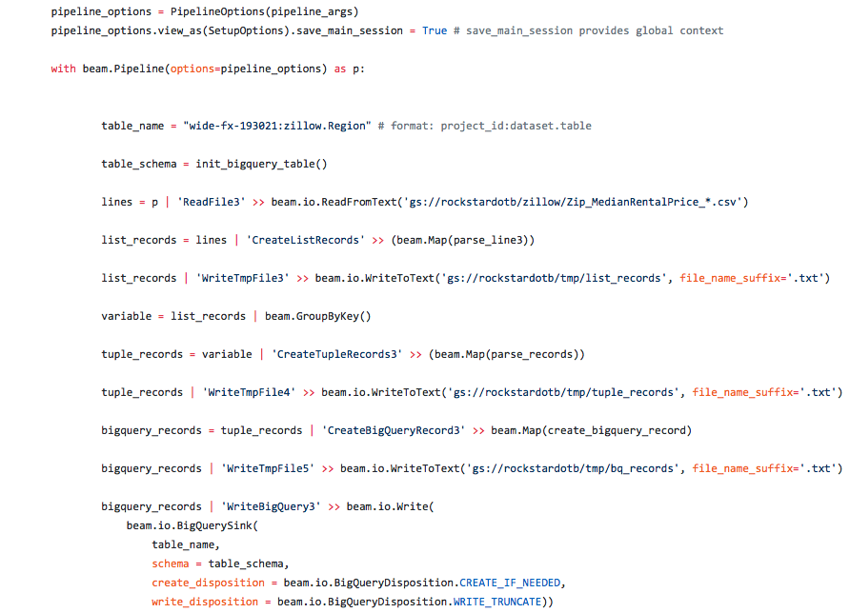
Transformations with MapReduce
Notes:
For the Region table, the zillow dataset, which consisted of data from 5 different tables (ones for listings with 1, 2, 3, 4, and 5 or more bedrooms), had to be transformed into data types consistent with what BigQuery expects. Standard python loops could easily transform the data, but it would be done with a heap and could potentially take a very long time. With MapReduce, the data can be “Mapped” to custom functions in segments, all of which run in parallel and cut down computing time significantly. Once you have started a process with apache beam’s MapReduce, The data is put into groups called pcollections. As a result, processes, such as filtering, can no longer be done with simple techniques such as loops, because only the current pcollection would be affected. Fortunately, beam includes a vast library of methods for all sorts of data filtering or manipulation. For example, once the data from all five tables were combined, there existed duplicate records. Instead of creating a loop to store unique rows and get rid of duplicates instead of appending them, you have to use the GroupByKey() method. This method turns multiple rows into a key, list pair. The key, list pair can be indexed, which allows you to extract only the key (or list) to be used in further computation.

Slide 5
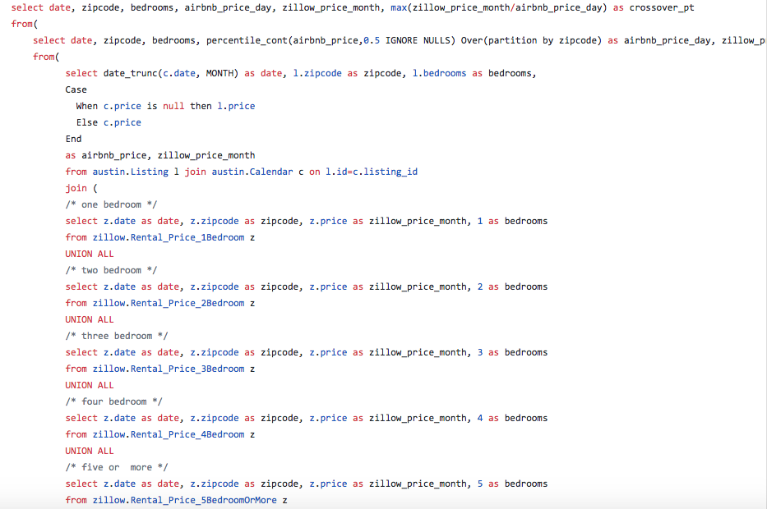
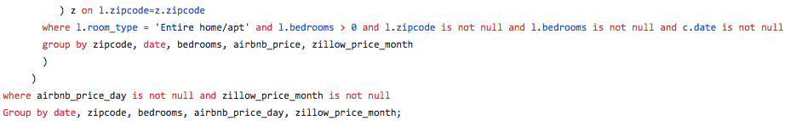
Cross-Dataset Joins: Airbnb and Zillow
Notes:
/*So, we had the Airbnb data for Austin, Nashville, Portland, and zillow data (1,2,3,4,5 or more bedrooms and region). So, we wanted to join the Airbnb and Zillow datasets on the date, zipcode, and bedroom fields to compute the Revenue Crossover Point metric and utilize these data objectively as a whole.
First, for the zillow data, we collected table of date, zipcode, zillow_price_month, and number of bedrooms (1,2,3,4,5 or more) using subqueries and Union All.
Second, for the airbnb data, using data_trunc(c.date, MONTH), we could match the Airbnb booking dates to Zillow dates, which is in monthly, and, for more accuracy, by using the Case expression in select clause, we put the case that the Airbnb rental price for a listing comes from Calendar.price if the value exists or Listing.price if it doesn't.
By using where clause, we could filter out all Airbnb listings for shared housing/apartment rentals, bedrooms > 0, and any Airbnb dates, zipcodes or bedrooms with Null values.
So, then we had airbnb_price, zillow_price_month. We used a group by statement on zipcode, date, bedrooms, airbnb_price, and zillow_price_month.
Third, we could get the Airbnb's median rental price per day using the windowed function: percentile_cont(airbnb_price,0.5 IGNORE NULLS) Over(partition by zipcode) as airbnb_price_day
Lastly, we used max(zillow_price_month/airbnb_price_day) as crossover_pt to get the crossover_pt and used a where clause to filter out airbnb_price_day and zillow_price_month that are null values.
*/
Difficulties we faced:
We weren’t sure how to get data from the Zillow tables while also joining the Listing and Calendar tables -> tried joining Airbnb and zillow on zipcode
Exceeding memory in over() -> added a group by statement before the window function and added a where clause because there were a lot of null values for prices.

