Slide 1
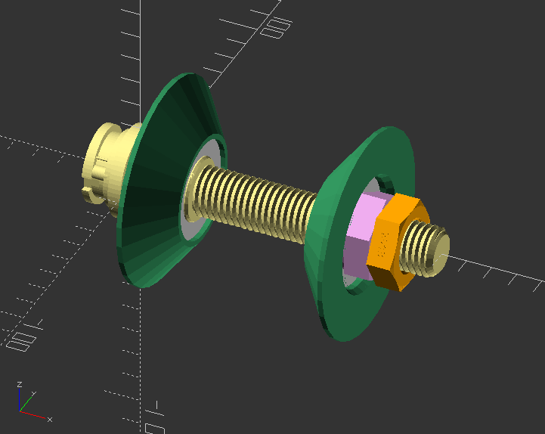
3
1
2
2
Screw
Bearing
Clamp
Nut, Bearing
Nut
5
4

