Slide 1
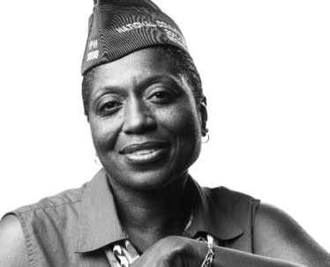
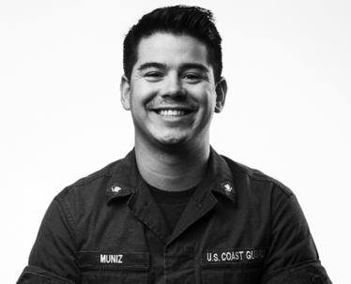
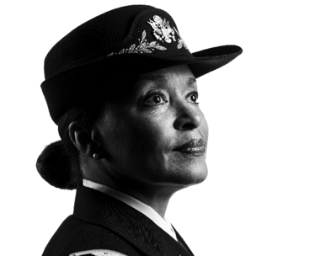
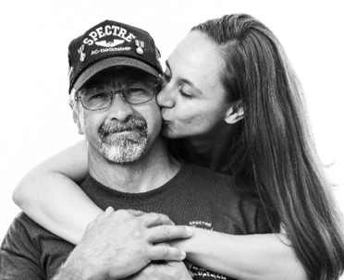
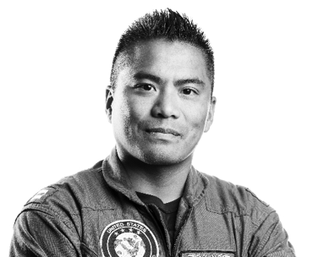
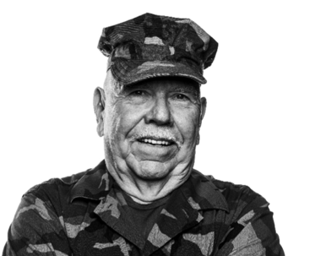
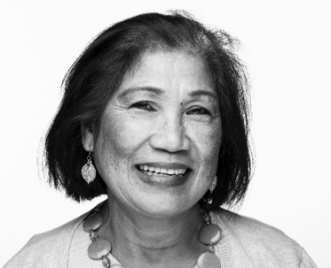
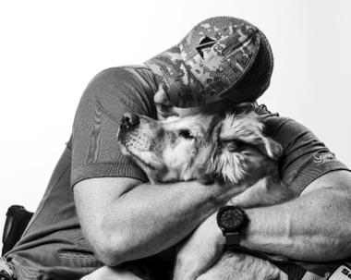


User Research Readout
Title of readout - what you tested
2.17.18

Slide 2
What We Wanted to Learn
What We Did What We Learned Appendix

Slide 3
What We Wanted to Learn
The Problem | The Product | Why This Testing

Slide 4
The Problem
[state the problem the research investigated]

Slide 5
The Product
[state the service/product and what the intended outcome is, e.g., an improved flow that helps Veterans do X]

Slide 6
Why This Testing?
[state the reasons for this testing, e.g, We want to validate that our rough draft flow solves these problems for Veterans before we build it.]

Slide 7
What We Did
Participants | Prototype

Slide 8
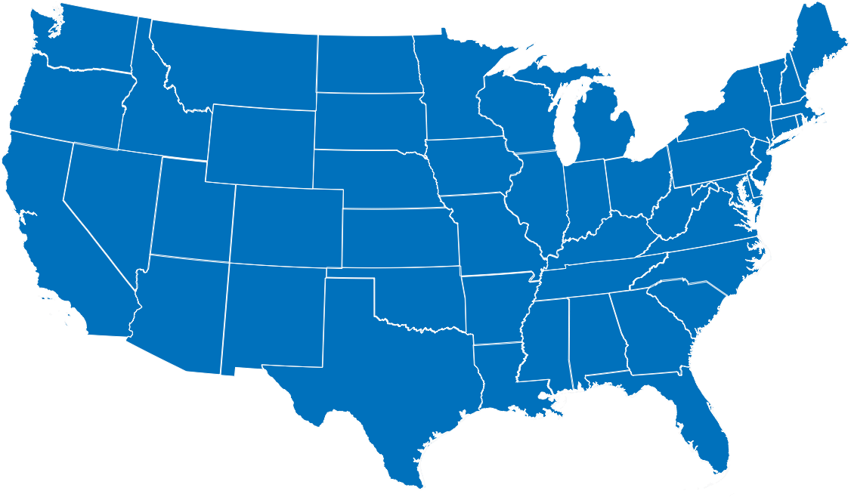
Participants
P7
p6
P8
p1
p2
p3
P5
p4
3
branches
35-74
years old
4
ethnic backgrounds
1
spouse helping the Veteran use the web
2 women
7 men
(including a Veteran plus spouse on one session)
Notes:
In general - include gender, service branches, age range, and ethnic background (if known). Include other details as relevant to the research goals

Slide 9
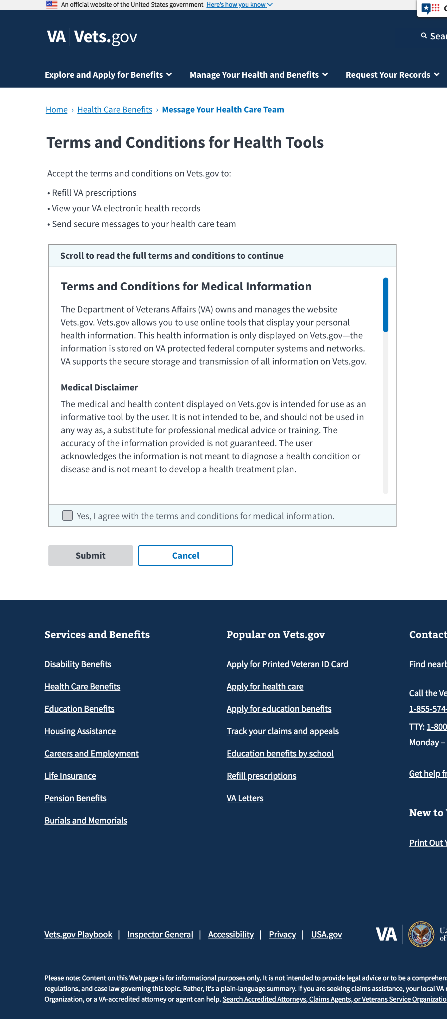
Prototype
[A high-level description of how you used the prototype, e.g., Remote, moderated usability testing.
Provide a link to the conversation guide and/or prototype if that’s useful for your audience.]

Slide 10
What We Learned

Slide 11
[state the overall results here]

Slide 12
[quote that summarizes the entire testing round]
Notes:
Use 1 or 2 quotes to capture the findings of the entire testing round.

Slide 13
[quote that summarizes the entire testing round]
Notes:
Use 1 or 2 quotes to capture the findings of the entire testing round.

Slide 14
Finding 1 (repeat as needed)
Difficulty with UI
4
Had difficulty scrolling the Terms and Conditions before clicking the checkbox
8
Notes:
You can organize your findings the way this template does.
OR group all Findings together and group all Recommendations together. Depends on your audience and what you’re trying to achieve.

Slide 15
[quote(s) related to Finding 1 - repeat as needed]

Slide 16
Recommendation: Findings 1-3
[ list of top-level design recommendations for a group of related findings]
Notes:
Group related findings, and summarize the top design recommendations based on them, e.g., Put self selection of claim type first so we can mitigate unnecessary sign-in burden.
OR group all findings together and all recommendations together.

Slide 17
Additional Findings
Notes:
Additional Findings are:
Unanticipated findings that came up during the research that you may want to investigate further
Findings that are of interest, but not as impactful as the primary findings in the earlier section

Slide 18
Additional Finding A (repeat as needed)
[state the problem/finding here]
List support for that finding - quotes, analysis of participant actions during the testing, e.g., 6/8 participants thought they’d already verified their identity when they went through two-factor authentication.

Slide 19
[quote(s) related to the additional finding - optional - repeat as needed]

Slide 20
Recommendation: Additional Findings A-C
[ list of top-level design recommendations for a group of related findings]
Notes:
Group related findings, and summarize the top design recommendations based on them, e.g., Put self selection of claim type first so we can mitigate unnecessary sign-in burden.
OR group all findings together and all recommendations together.

Slide 21
Next Steps

Slide 22
Next Steps
List the team’s immediate next steps.
This shouldn’t be where the team records their project timeline - use it indicate the team’s next intentions. For example:
Begin design and development.
Establish a GA event for T&Cs (if one does not exist).
Evaluate in 6 weeks. Compare pre- and post-launch event metrics to see if additional changes should be made.

Slide 23

Thank you
Notes:
16

Slide 24
Appendices
Participant Details | Findings for Other Projects

Slide 25
Participant Details

Slide 26
P1 45 - 54 | Male | Hispanic or Latino | Suburban Chicago | Air Force, 1986 - 1990
Account Level /
Background:
MyHealtheVet Premium. Sets up appointments, messages his doctor and has downloaded health records on eBenefits.
Key findings:
When he created his account initially, he recalled that it took about 10 minutes, and he found it confusing, but he had a relatively easy time with the prototype flow.
Generally satisfied with how the flow worked and said it was worthwhile to verify in order to use secure messaging.
Notes:
The level of detail for each participant is up to you. Whatever is most helpful for your team and your stakeholders.
Repeat this slide as needed for all participants.

Slide 27
Findings for Other Projects
Notes:
Findings that are outside the scope of this project, but of interest to other Veteran Tools Platform teams, e.g., the example on the next slide.

Slide 28
Findings for Other Projects
Opportunities to avoid the verification burden
One participant suggested avoiding the need to verify by simply removing confidential information from the messages from her health care team and sending them by email.

Slide 29
No, I’m not going to go through all this to receive a message from my doctor’s office. He sees his doctor twice a year. There’s nothing critical, so we’re not interested in receiving information this way at all. We should just be able to exchange regular emails. You guys are trying to protect medical information, but I’d like to receive emails confirming appointments that don’t include medical information.
Notes:
P7

