Slide 1
ProjectFolio
Team

Slide 2
AGENDA
Introduction​
Problem Statement
Solution
Phases of Development
Flowchart
Our Team

Slide 3

Introduction
This application help us to expand your college network and improve junior-senior interaction.
We can find the team members needed for your project, within the institution.
Provide the enhanced search option for college internship and placements.

Slide 4
Problem Statement
Student finds it challenging to communicate with alumni and seniors in a college, Results in a lack of physical interaction.
In college, it is challenging to put together a team member with the right individual with required skill.
For placements and internship at the college level, gathering the data from students is challenging and time-consuming.
Beginners lack the necessary guidance to
create a professional CV.

Slide 5
Solution
Through this program, students can receive community support for their projects from working professionals, alumni, senior teachers, and college students.
By analyzing various profiles, we can quickly identify the team members for our project.
It helps with data gathering and data management so that the project can be presented to prospective companies and recruiters during placement drives.
Automatic resume building through profile analysis along with a personalized design.

Slide 6





Phases of Development
UI/ux design
Front end
database connectivity
Backend
Deployment
The entire program has a proper UI style.
The code base includes the entire front end of the program.
Admin and others have access to the data stored in applications.
Integrating the program with the server
Use the cloud to deploy the entire application.

Slide 7
Phases of Development
UI/ux design
Front end
database connectivity
Backend
Deployment
The entire program has a proper UI style.
The code base includes the entire front end of the program.
Admin and others have access to the data stored in applications.
Integrating the program with the server
Use the cloud to deploy the entire application.

Slide 9
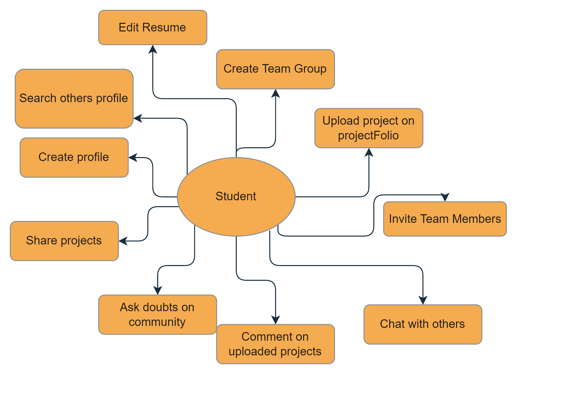
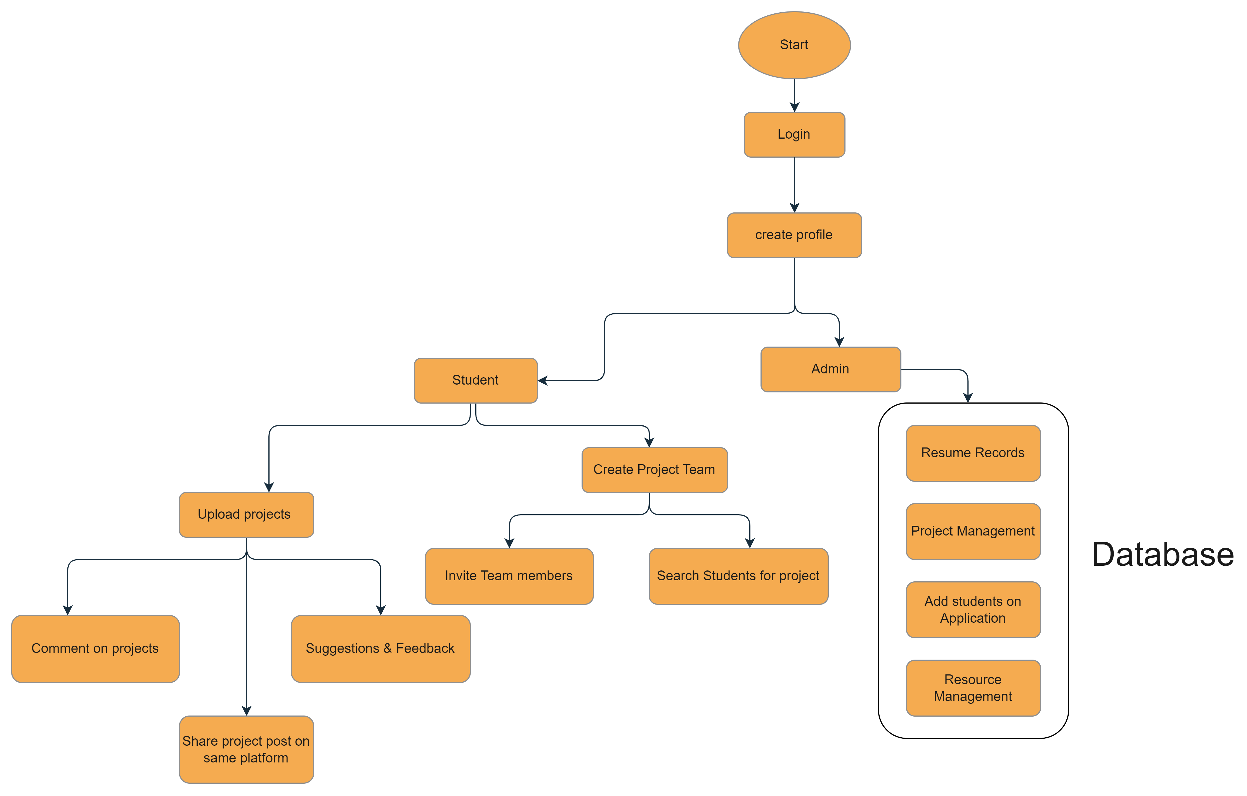
Flowchart

Slide 10
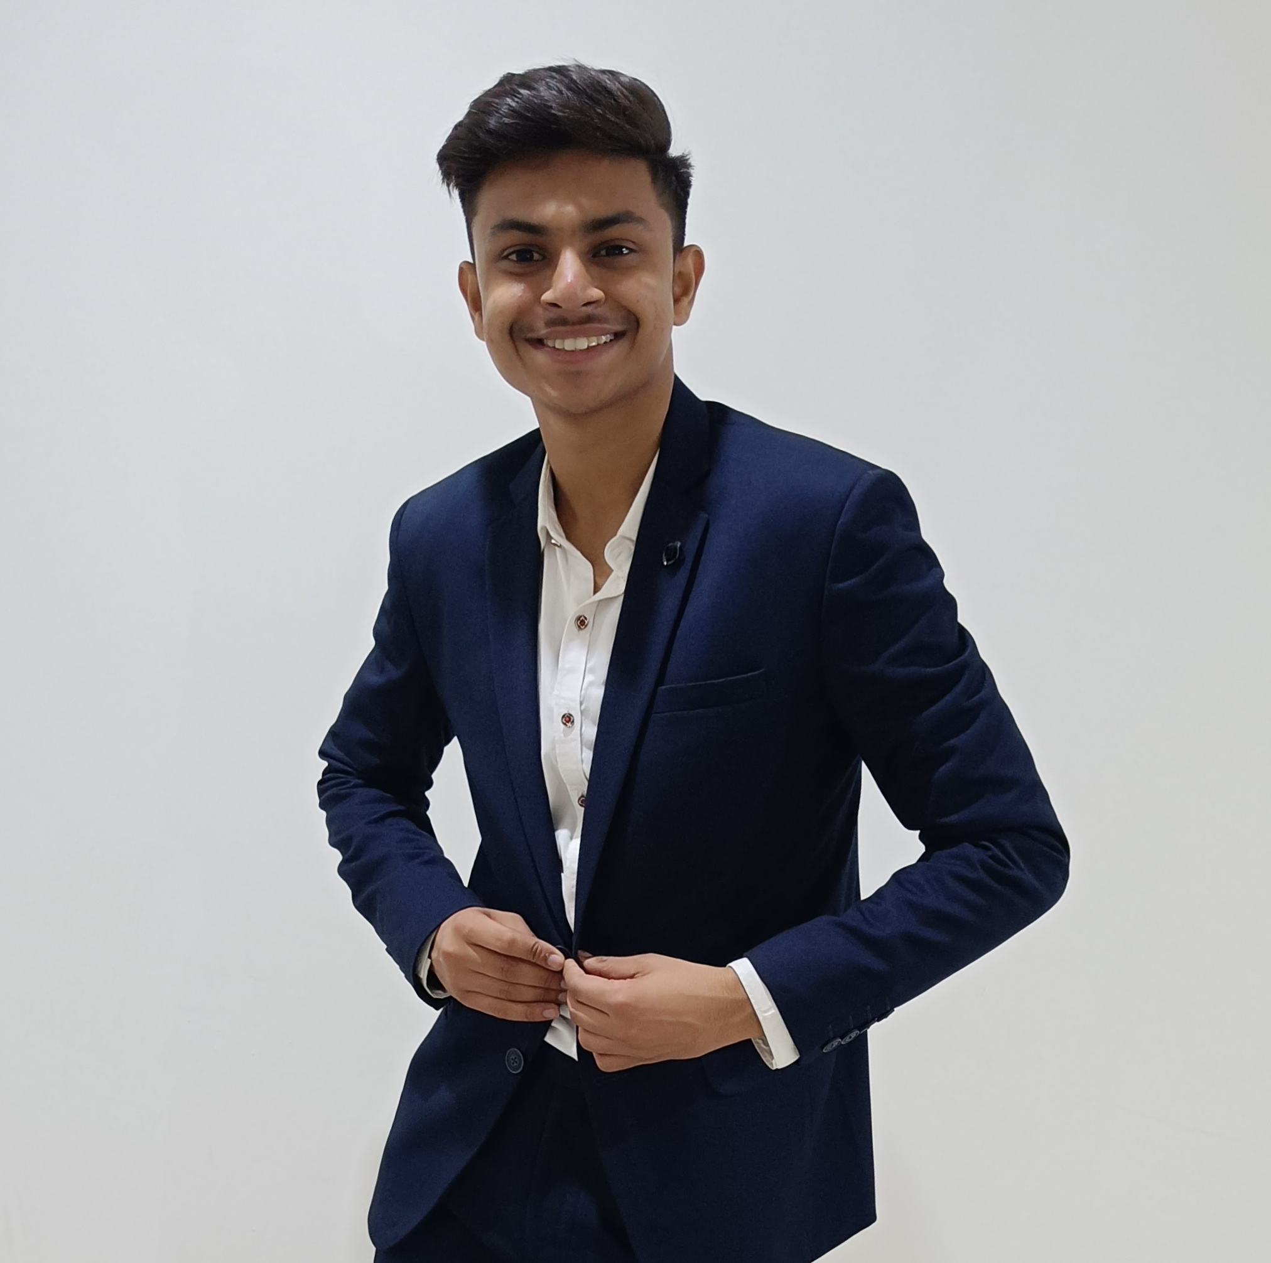
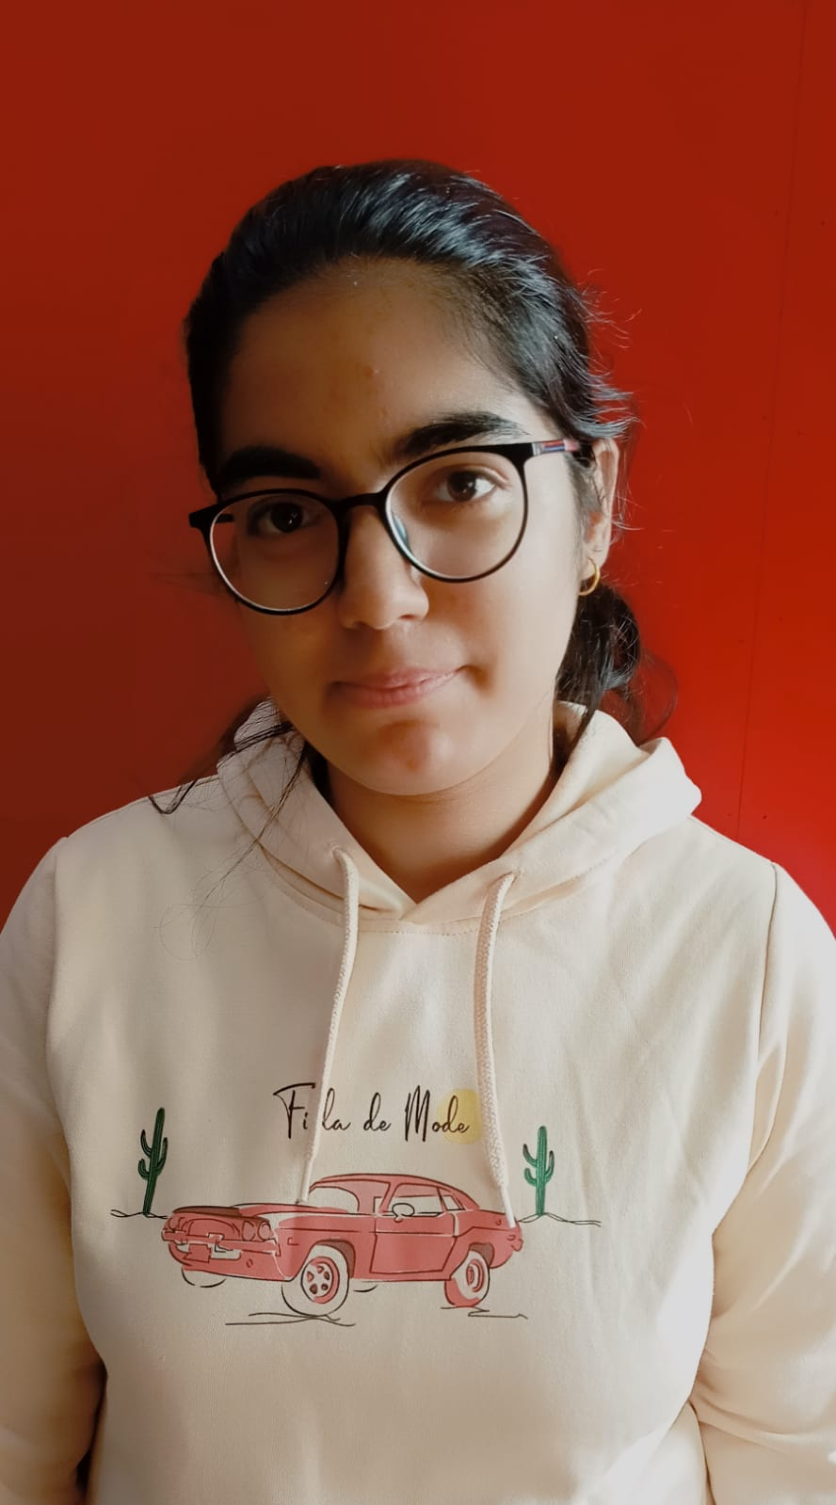
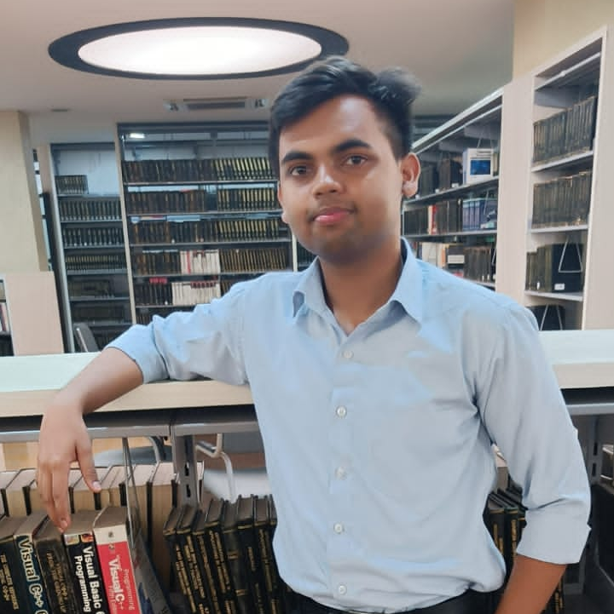
MEET OUR TEAM
Abhishek Chauhan
Divya Prabhakar
Utkarsh raj
Team Leader
Team Member
Team Member
UI/UX & Back-end
Front-end
UI/UX Front-end

Slide 11
THANK YOU

