Slide 1
Recruitment Test
Software Engineering
4th March 2019

Slide 2
Guidelines for the test (I/II)
1
There is only 1 question in the test. It is to build a single working app
Concentrate on the functionality of your app and closing the requirements. Visually attractive responsive design of the application is a nice to have
Do not share your code publicly for the test
We are providing the following on this system
Editors - IntelliJ, Visual Studio Code
Database - MySQL, MongoDB
Other tools - JDK x64 bit, Maven, NodeJS
You also have a working internet connection to search for relevant code
You are free to use MySQL or MongoDB as your database. The data file to be used will be provided with the test
2
3
4
5
6

Slide 3
Guidelines for the test (II/II)
6
Create your Private github project using following naming standard
<first name>_<last name>_<test date>_pttep_software_dev_test
Put description with the same project name
Extract all content stored in pttep-software_dev_test-master.zip and add into your repository
Create four milestone in Issues with the Due date of your test date
  00_prepare_database
  01_develop_backend
  02_develop_frontend
  03_improve_usability
Adding user sittapongs@pttep.com to be your collaborator.
Once your issue is closed, Assign those issue to sittapongs@pttep.com
Start your test.
7

Slide 4
Set up your github
0

Slide 5
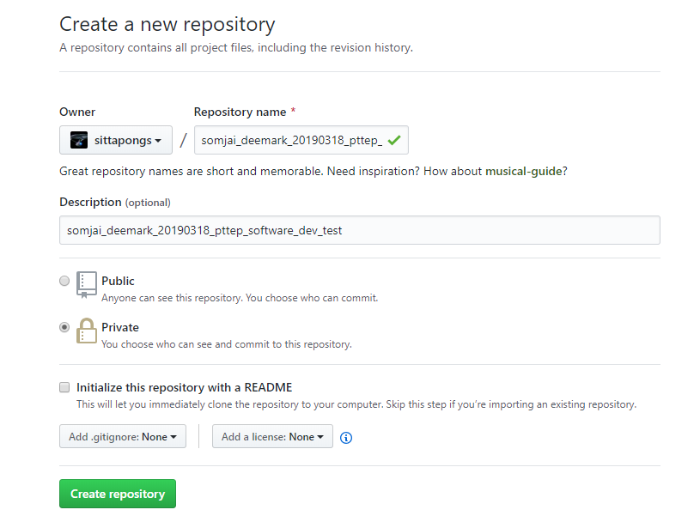
How to Create your repository

Slide 6
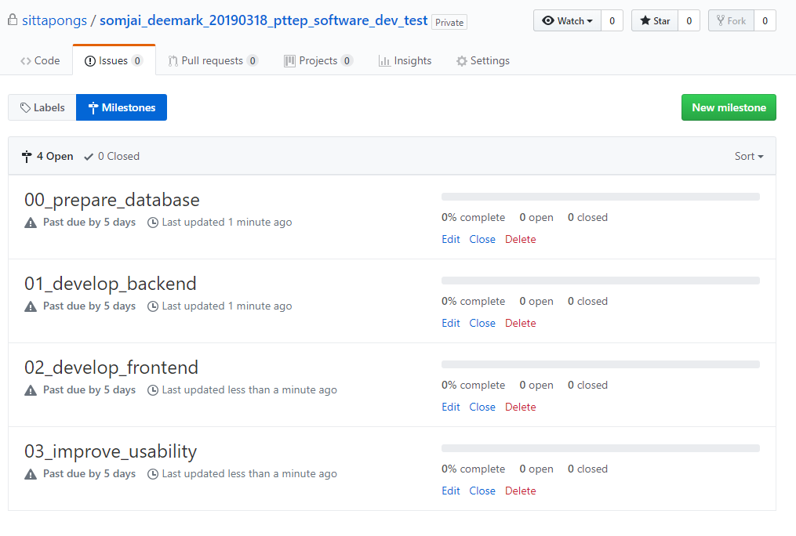
Create your Milestone

Slide 7
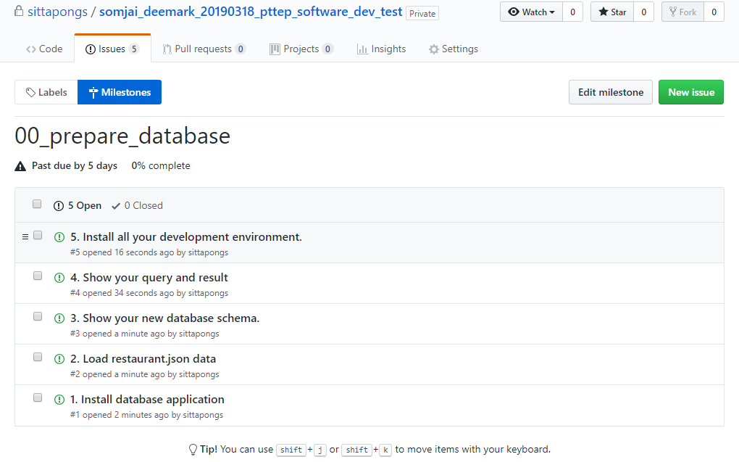
Create Issue for each milestone

Slide 8
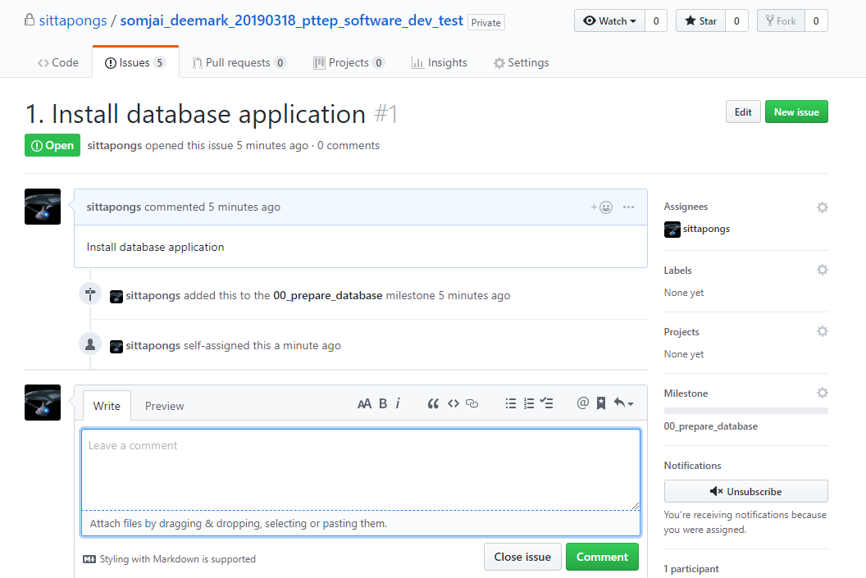
Make sure you assign your issue with the right Milestone

Slide 9
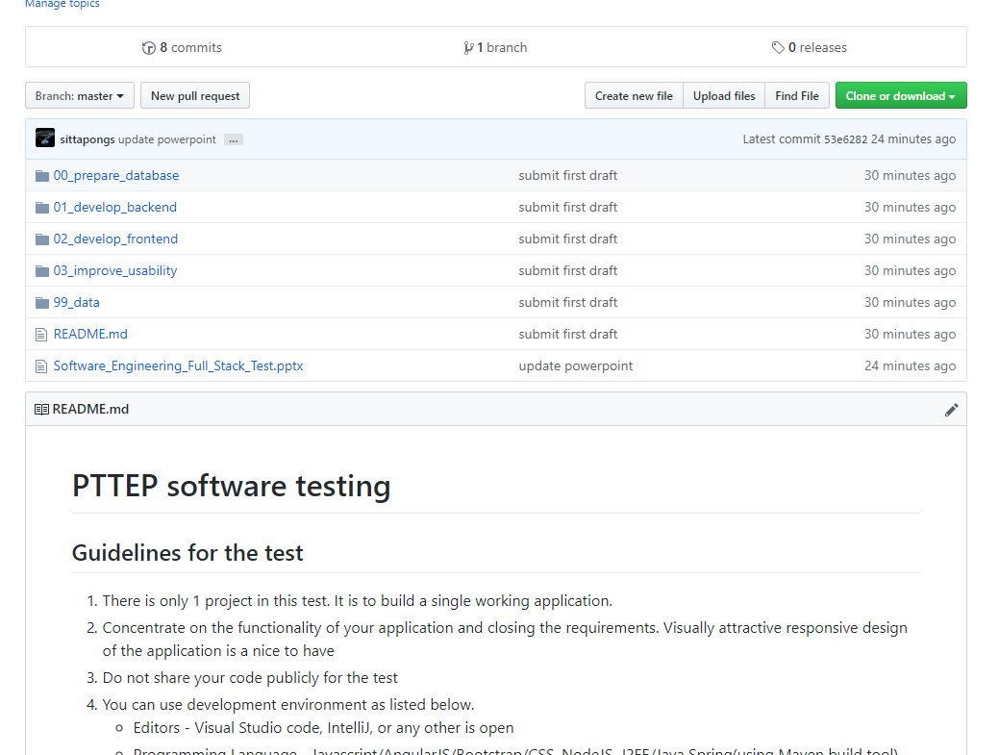
Adding all project template into your repository

Slide 10
Options Available
1

Slide 11
Option 1: using NodeJS
Option 2: Using Java
Test Duration: 2 hours
Test Duration: 3 hours
Objective: Building an app using
Front End: Javascript / AngularJS / Bootstrap / CSS
Backend: NodeJS
Database: MongoDB or MySQL
Objective: Building an app using
Front End: Javascript / AngularJS / Bootstrap / CSS
Backend: J2EE / Java Spring (using Maven build tool) with
Database: MongoDB or MySQL

Slide 12
Test Details
2

Slide 13
Details to be conducted
Task Type
Details
1
Objective
  Build a pseudo web application to list restaurants and browse them
  Browse restaurants based on Pin Code (needs to be constructed by appending strings (outcode + postcode) available in Data file)
  Build a web API to fetch data from a Database - Supports GET/POST/PUT requests on HTTP)- API needs to be prepared for only one purpose which is to search for restaurants given a Pin Code- Example of the URL to be prepared - "http://localhost:8080/search_restaurants?query=RG208NJ"
  Download data in CSV
  Suggest further improvements in the App which can be done
2
Requirements in Order of priority
3
  URL - String
  id - String
  address - String
  address line 2 - String
  name - String
  outcode - String
  postcode - String
  rating - float
  type_of_food - String
Data Variables in file available (restaurant.json)

Slide 14
User Interface Requirement
http://localhost:8080? ?query=RG208NJ
ABC Restaurant Search Engine
Search Pincode
RG208NJ
Search Results
Download Results
Restaurant List
Restaurant Name
Address
Rating
Restaurant Name
Address
Rating
Restaurant Name
Address
Rating

