Slide 1
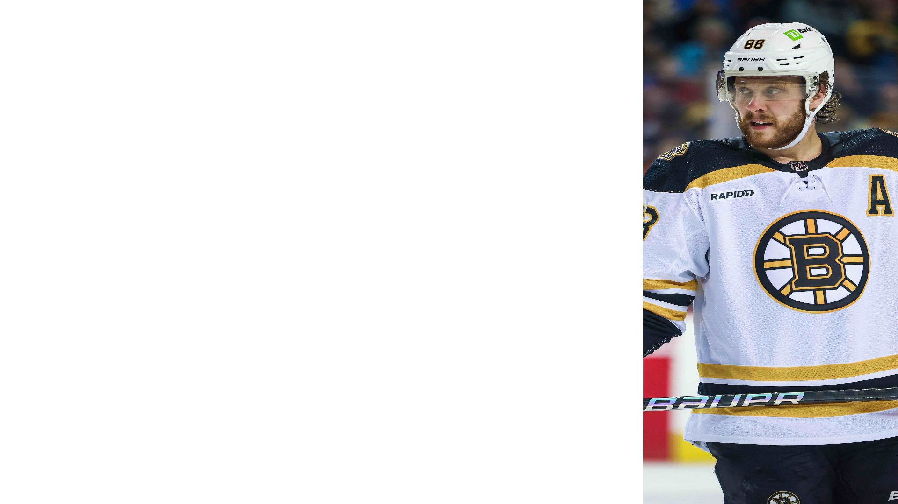
Shots on Goal: An Overrated Statistic?
Data analysis against one of the innermost tenets of modern hockey coaching
Boston Bruins sniper David Pastrnak

Slide 2
Current Wisdom:
My Observations:
Maximize shots on goal
“Shoot first, position later”
Try to capitalize on rebounds from low-percentage shots
Chaos at the netfront
Outshooting the opponent == dominating the game
“Shoot first” mentality only leads to low-quality scoring chances
Accumulating low-percentage shots pads stats but does not necessarily translate to goals
If a team is able to restrict their opponent to only low-quality opportunities, that team is the one really in control of the game

Slide 3
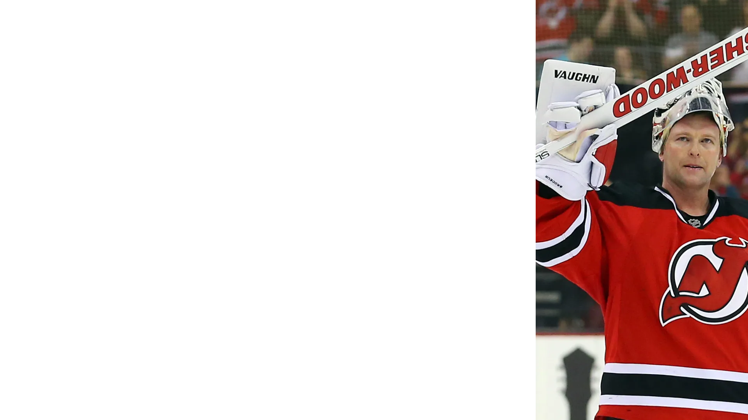
The Hypothesis:
Null Hypothesis:
Alt. Hypothesis:
Legendary New Jersey Devils goalie Martin Broedeur
Shots on goal (adjusted for time on ice) will only weakly correlate with goals scored (adjusted for time on ice)
High-danger shots when adjusted for time on ice will be a much stronger explanatory variable
This is because raw shots on goal is a cope statistic for mediocre coaching
Too ridiculous to be seriously looked into: no shot data correlates with goals scored
Traditional knowledge is correct: shots on goal (adjusted for time on ice) can be used to predict goals scored (adjusted for time on ice)

Slide 4
Terminology:
To avoid excessively long graph titles, abbreviations will be used. They are as follows:
SOG: Shots On Goal
PP: Power Play
AFT: Adjusted For Time (on ice)

Slide 5
Game Plan:
(Get it? We’re talking about sports)
Use linear regression to predict goals scored AFT with shots AFT
Make some predictions and calculate an R^2 value
Graph our predictions against reality
If R^2 is within the significant range and/or the graph lines up, then the first half of the hypothesis is incorrect
If it is not incorrect, then we can proceed with testing the second half of the hypothesis

Slide 6
Game Plan (Visualized):
Use linreg to predict goals scored using shots on goal
Calculate R^2 and graph predicted goals vs real goals
Repeat same process using power play shots on goal
Calculate R^2 and graph predicted goals vs real goals
Does data corroborate hypothesis?
Does data corroborate hypothesis?
NO
YES
NO
YES
Explore alternate hypothesis/admit defeat
Null hypothesis is the correct one (How???)
Primary hypothesis is likely correct

Slide 7
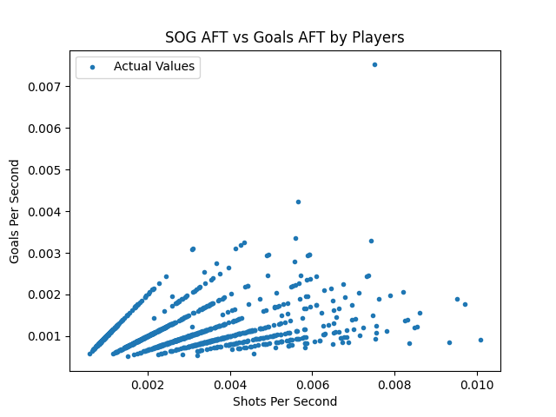
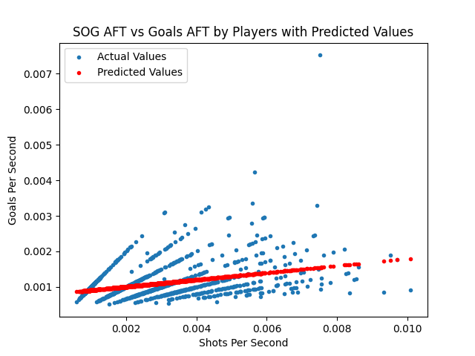
Linear Regression Results:
Coefficients:
m = 0.09844402270831117,
b = 0.0008075772818899287
R^2 = 0.11558077036955272
This is a very weak correlation!

Slide 8
Interpretation:
Following the first part of the hypothesis, the R^2 value constitutes a weak relationship between shots AFT and goals AFT.
Now, if only there were a metric to measure “high-danger” chances…

Slide 9

The Power Play:
To create a high-danger chance, players must position themselves carefully and wait for the right conditions to shoot
This is the opposite of “shoot first, position later”
When teams are on the power play (for the non-hockey fans: that’s when the other team has committed a penalty and is playing without one of their players), they typically adopt this type of approach, carefully moving the puck until they can create a high-percentage chance
Dallas Stars forward Tyler Seguin

Slide 10
Game Plan (cont’d.):
Perform linear regression the same way as before but with shots adjusted for power play ice time instead of shots adjusted for all ice time (high-percentage shots)
Graph our predictions against reality once again
If the graphs are closer and if R^2 is within the range of significance, then the second half of the hypothesis is accurate

Slide 11
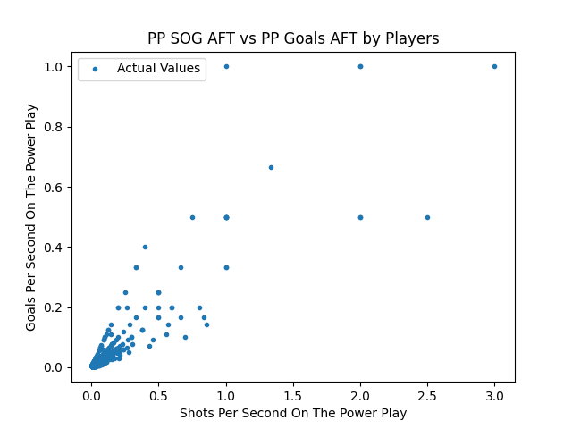
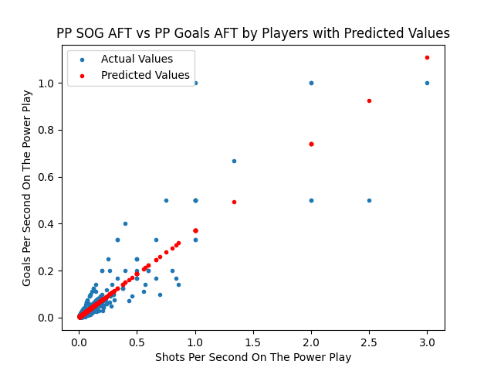
Linear Regression Results (cont’d.):
Coefficients:
m = 0.3684983298124175,
b = 0.002305714763299869
R^2 = 0.8135615979554637
This is a very strong correlation!

Slide 12
Conclusion
As hypothesized, taking a smaller number of high-quality shots is more effective for scoring goals than taking many low-quality shots
This exposes a flaw in contemporary coaching and is in defiance of many modern coaches’ systems

Slide 13
Possible Sources Of Error:
Use of individual player data: team data for these variables was unavailable, resulting in the need for individual player data to be used. This could potentially lead to misleading predictions about the efficacy of the proposed “quantity over quality” approach from a team perspective
Lack of an official “high-danger shots” statistic: an official statistic for high-danger shots taken by a player was unavailable, requiring the experiment to fashion its own statistic by adjusting shots and goals for power play time. Power plays are inherently biased towards the team with the man advantage, which could cause inaccurate results

Slide 14
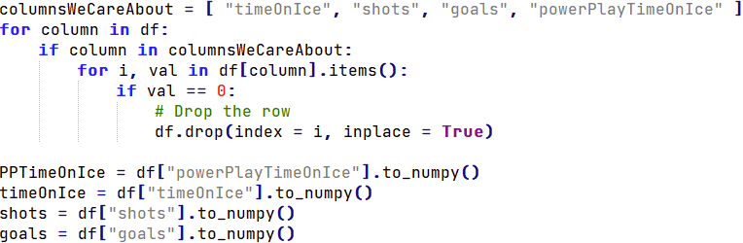
How To Clean NHL Data:
Turns out a lot of these people are freeloaders and don’t score all that much…

Slide 15
Thank You
Any questions?

