Slide 1












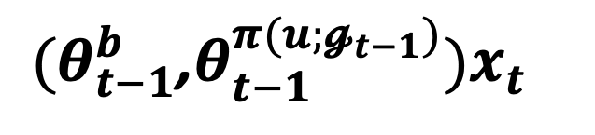



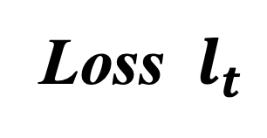
Temporary user adapters $θ_{t−1}^{u}$
Activate adapter
${(θ}_{t−1}^{b}$,$θ_{t−1}^{π(u;𝓰_{t−1})})x_{t}$
Ungrouped
user 1
Ungrouped
user 2
Ungrouped
user 3
Ungrouped
user 4
Group
refinement
Shared Backbone $θ_{t−1}^{b}$
User Gradient signature
…
Passive-sensing input stream
reassign
prediction
S₁
merge
Group adapters $θ_{t−1}^{𝓰_{t−1}}$
S₂
Group 1
Group 1
Group 1
Group 1
…
split
S_{u}
Loss $l_{t}$
Update

