Slide 1
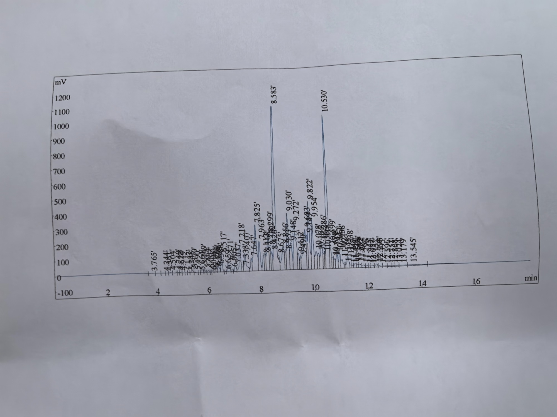

GC-MS Peak Findings — This Lot
Speculative IDs from RT order in a C9–C11 D40 cut • confirm vs method + MS library
RT (min) | Likely family | QC reading
3.765 | C8–C9 light end (IBP) | Keep tiny — not MC / MeOH
7.825 | C9 / early-C10 isomers | First body cluster
8.583 ★ | C10 iso / naphthene | Giant — heart of the cut
9.030 | C10 isomer satellite | Should track the 8.583 giant
9.822 / 9.954 | C10–C11 isomer pair | Adjacent boiling points
10.530 ★ | C11 iso / naphthene | 2nd giant — ratio vs 8.583
13.179 / 13.545 | C11–C12 heavy end (DP) | Keep small — pore-residue risk
Read: two giants (8.583 & 10.530 min) = D40 fingerprint. Growing 3.765 = light adulterant. Growing 13.x = wrong / wide cut.
Confidential

Slide 2
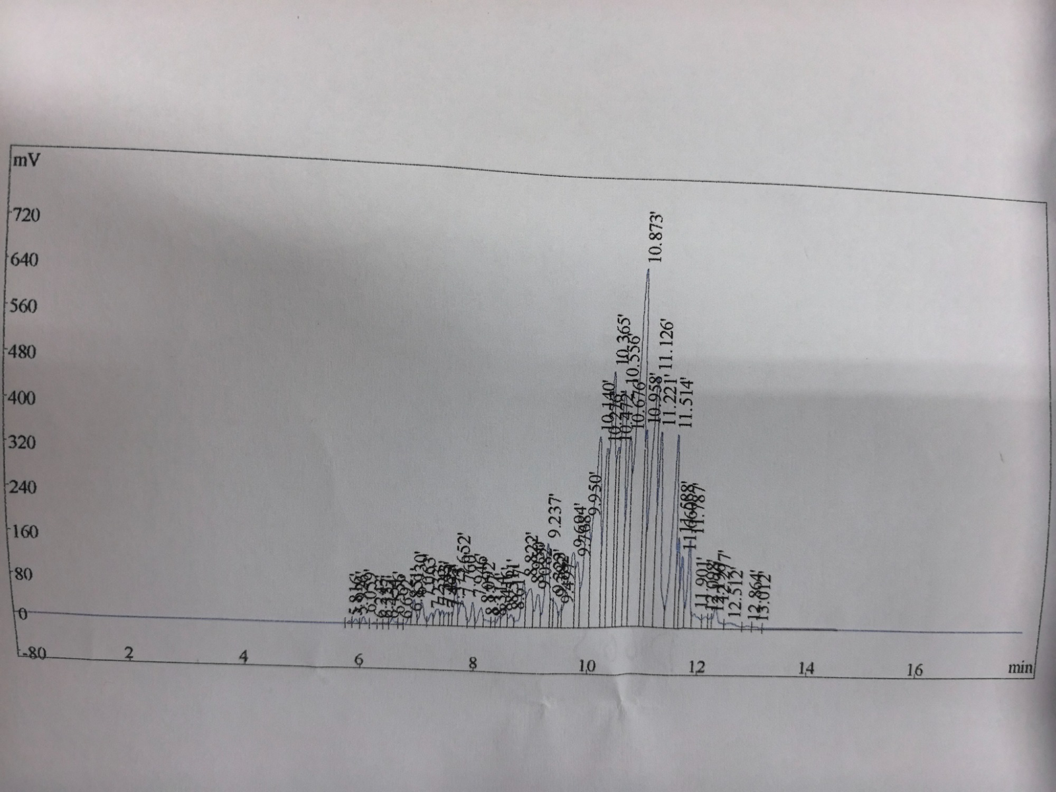
GC-MS Peak Findings — D60(S)
Speculative IDs from RT order in a C10–C13 D60 cut • confirm vs method + MS library
RT (min) | Likely family | QC reading
5.8 – 8.9 | C10 light front | Small — lights already cut
9.237 / 10.140 | C11 isomers | Rising flank of the cut
10.365 / 10.556 | C11–C12 cluster | Pre-giant body
10.873 ★ | C12 iso / naphthene | Giant — heart of D60
11.126 / 11.514 | C12 satellites | Should track 10.873
12.5 – 13.2 | C13 heavy end (DP) | Keep small — slow dry
Read: D60 heart is one mountain at 10.873 min — not D40’s twin giants at 8.58 / 10.53. Envelope starts ~2 min later.
Confidential

Slide 3
D40 vs D60(S) — Why the Charts Differ
Same GC principle: heavier molecules spend longer on the column
D40 • giants 8.583 & 10.530 min • C9–C11
D60(S) • giant 10.873 min • C10–C13
Feature | D40 | D60(S) | Logical reason
Envelope start | ~3.8 min | ~5.8 min | D60 IBP higher — C8–C9 lights removed
Heart (giant) | 8.58 + 10.53 (twin) | 10.87 (one mountain) | Cut centered C10/C11 vs C11–C12
Main mass | 7 – 11 min | 9 – 12.5 min | BP 163–187 °C vs 180–220 °C
Shape | Two tall spikes | Late dense hump | Heavier isomers cluster later
Confidential

