Slide 1


Exxsol D40 Supply Chain Risk
Quality • Traceability • Anti-Adulteration
Risk Committee Briefing | Powder Metallurgy Cleaning September 2026
Confidential

Slide 2
Executive Summary
D40 cleans porous PM parts before plating and coating
Cost pressure raises drum adulteration risk
Fake fluid = fire, HSE and quality failures
Defense: authorized supply + CoA + GC-MS
A cheaper drum can cost more than it saves.
Confidential

Slide 3
Agenda
01
02
03
04
Why D40 specs matter
Boiling range & aromatics
Supply risk & adulteration
Controls & actions
Focus: protect solvent integrity from plant to production line.
Confidential

Slide 4
Business Context
Why D40 is on the Risk Agenda
PM pores trap oils — need residue-free clean
D40: fast dry, low odor, metal-safe
Not a commodity — specs are critical
Look-alike solvents raise fraud risk
Confidential

Slide 5
Product Profile
Exxsol D40 key specifications
Spec | Value | Why it matters
Distillation (IBP–DP) | 163–187 °C | Uniform drying; no heavy-end residue
Flash point | ~48 °C | Flammable — ignition controls required
Aromatics | <0.1% | Low odor, safer, clean surface
OEL | 1,200 mg/m³ | 4× safer than white spirit
KB / viscosity | ~31 / ~1.28 mm²/s | Controlled solvency; pore penetration
Confidential

Slide 6
Boiling Range
IBP • Dry Point • Narrow window
IBP = first drop; Dry Point = last drop
Narrow ~24 °C range = predictable drying
Wide range leaves heavy ends in PM pores
MC / methanol collapses the profile
Adulteration = residue in pores and unstable drying.
Confidential

Slide 7
Low Aromatics
Dearomatized = engineered safety
Less odor and toxicity for operators
Safer for seals and elastomers
Clean surface for plating / coating
Adulteration voids the certified profile
Confidential

Slide 8
D40 vs D60
Same family — different process window
 | Exxsol D40 | Exxsol D60 / D60(S)
Boiling range | 163–187 °C | 180–210 °C
Flash point | ~48 °C | ~68 °C
Dry speed | Faster | Slower
Best for | PM fast clean | Higher flash-point needs
D60(S) is a supplier designation — not a different formula.
Confidential

Slide 9
Supply Chain Risk
Price pressure raises fraud incentive
Middle East conflict stresses feedstock
ExxonMobil +$0.06/lb (Mar 2026)
China terminal price +5% and rising
Wide price gap invites adulteration
Do not buy on price alone. Verify the chain.
Confidential

Slide 10
Adulteration Threat
How unscrupulous traders cut cost
Mix cheaper MC and methanol into D40
Reuse genuine drums and fake CoA / labels
Looks clear — visual check is not enough
Illegal — voids SDS and fire-risk assessment
Confidential

Slide 11
Impact of Fraud
Property | Genuine D40 | Adulterated
Distillation | 163–187 °C | Starts ~40 °C
Flash point | ~48 °C | Much lower (methanol ~12 °C)
Cleaning | Controlled, residue-free | Fails or attacks parts
Downstream | Clean active surface | Plating / coating peel
Confidential

Slide 12
Enterprise Risk
Safety
Quality
Operations
Reputation
Fire & SDS breach
Plating / coating fail
Scrap & downtime
Customer stop-ship
One adulterated lot can hit safety, quality and customer delivery together.
Confidential

Slide 13
Distributor QC
Three lines of defense
Buy only ExxonMobil-authorized distributors
Batch CoA before goods receipt
Check IBP, flash point and aromatics
Inspect seals, holograms and drum labels
Confidential

Slide 14
Traceability
Chain of custody
Track lot: plant → ISO tank → drum → line
Barcode drum to CoA in ERP
Annual distributor audit + right-to-audit
Quarantine suspect lots in < 4 hours
Confidential

Slide 15
Detection Controls
Control | When | Goal
CoA review | Every batch | Match ExxonMobil spec
On-site screen | Each lot | Density / flash / odor flag
GC-MS test | Quarterly + anomalies | Prove purity / ID adulterants
Price check | Ongoing | Spot “too cheap” offers
Confidential

Slide 16
Recommended Actions
Risk Committee approval requested
1
Authorized distributors only
2
CoA + quarantine all D40 receipts
3
Fund quarterly GC-MS testing
4
ERP drum-to-line traceability
5
Distributor audit within 90 days
Confidential

Slide 17
Governance & KPIs
Approve Solvent Integrity Program
100% CoA verified before use
Zero unauthorized suppliers
Quarterly GC-MS minimum
Prevention costs less than one fire, scrap event or stop-ship.
Confidential

Slide 18
Appendix
Supply chain • GC-MS quality control
Confidential

Slide 19
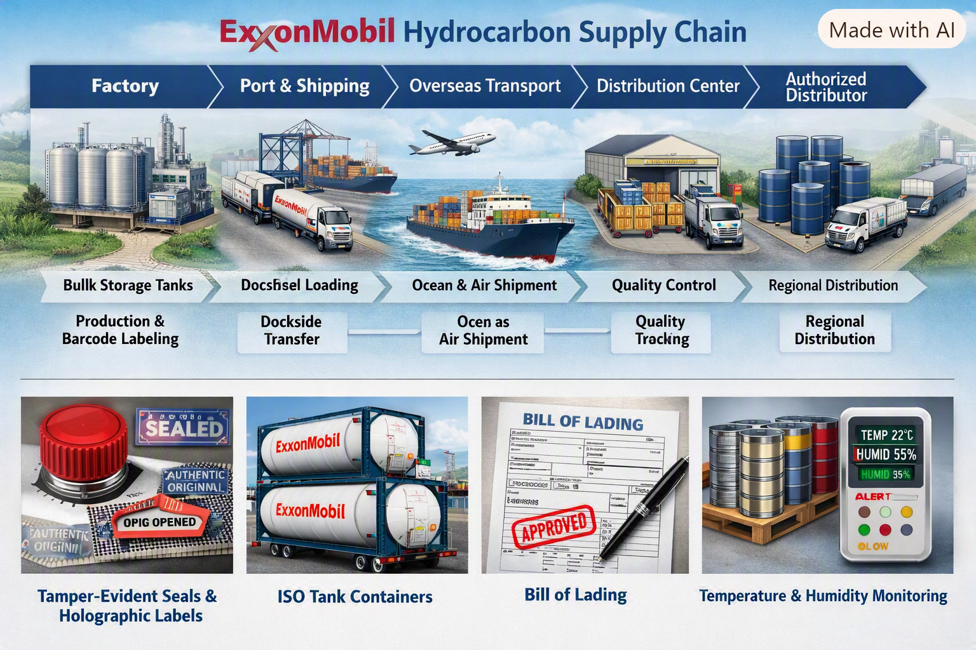
D40 Supply Chain
Plant → ISO tank → authorized distributor
Confidential
Confidential

Slide 20
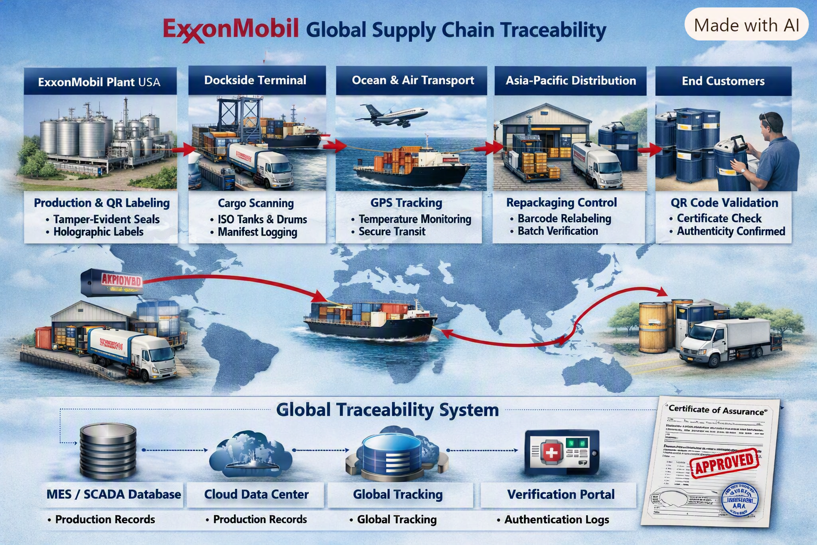
Traceability Controls
Seals, holograms, QR and CoA at every handoff
Confidential

Slide 21
Repackaging — Highest Risk Point
Plant fills ISO tanks with sealed, labeled product
Ocean / air move under GPS and manifest control
Distributor repack into drums is the fraud window
Demand: tamper seals, holographic labels, batch CoA
Never accept a drum that cannot be traced back to the ISO-tank lot.
Confidential

Slide 22
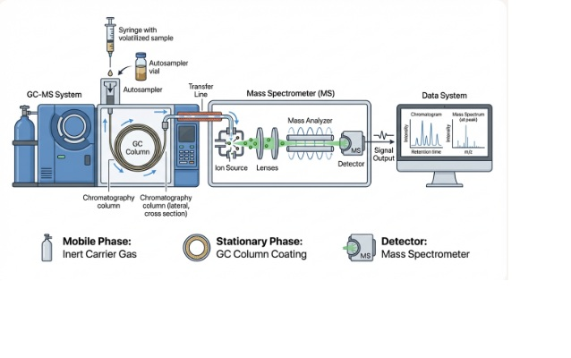
GC-MS Equipment
Gold-standard identity test for D40
GC separates the mix
MS fingerprints each peak
Finds MC, methanol, others
Not visible by eye
Confidential

Slide 23
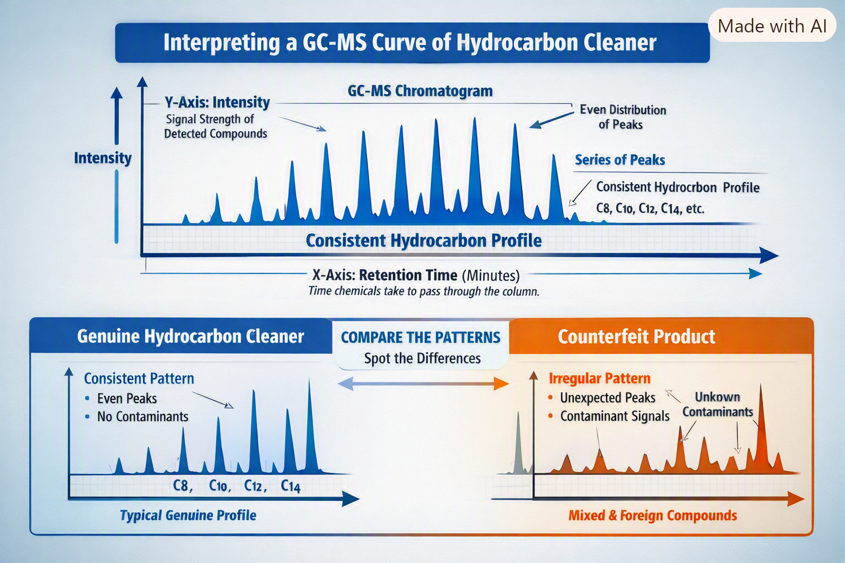
How GC-MS Detects Abnormalities
Genuine: even C8–C14 peaks
Fake: extra / irregular peaks
Contaminants = fraud signal
Use as lot fingerprint
Confidential

Slide 24
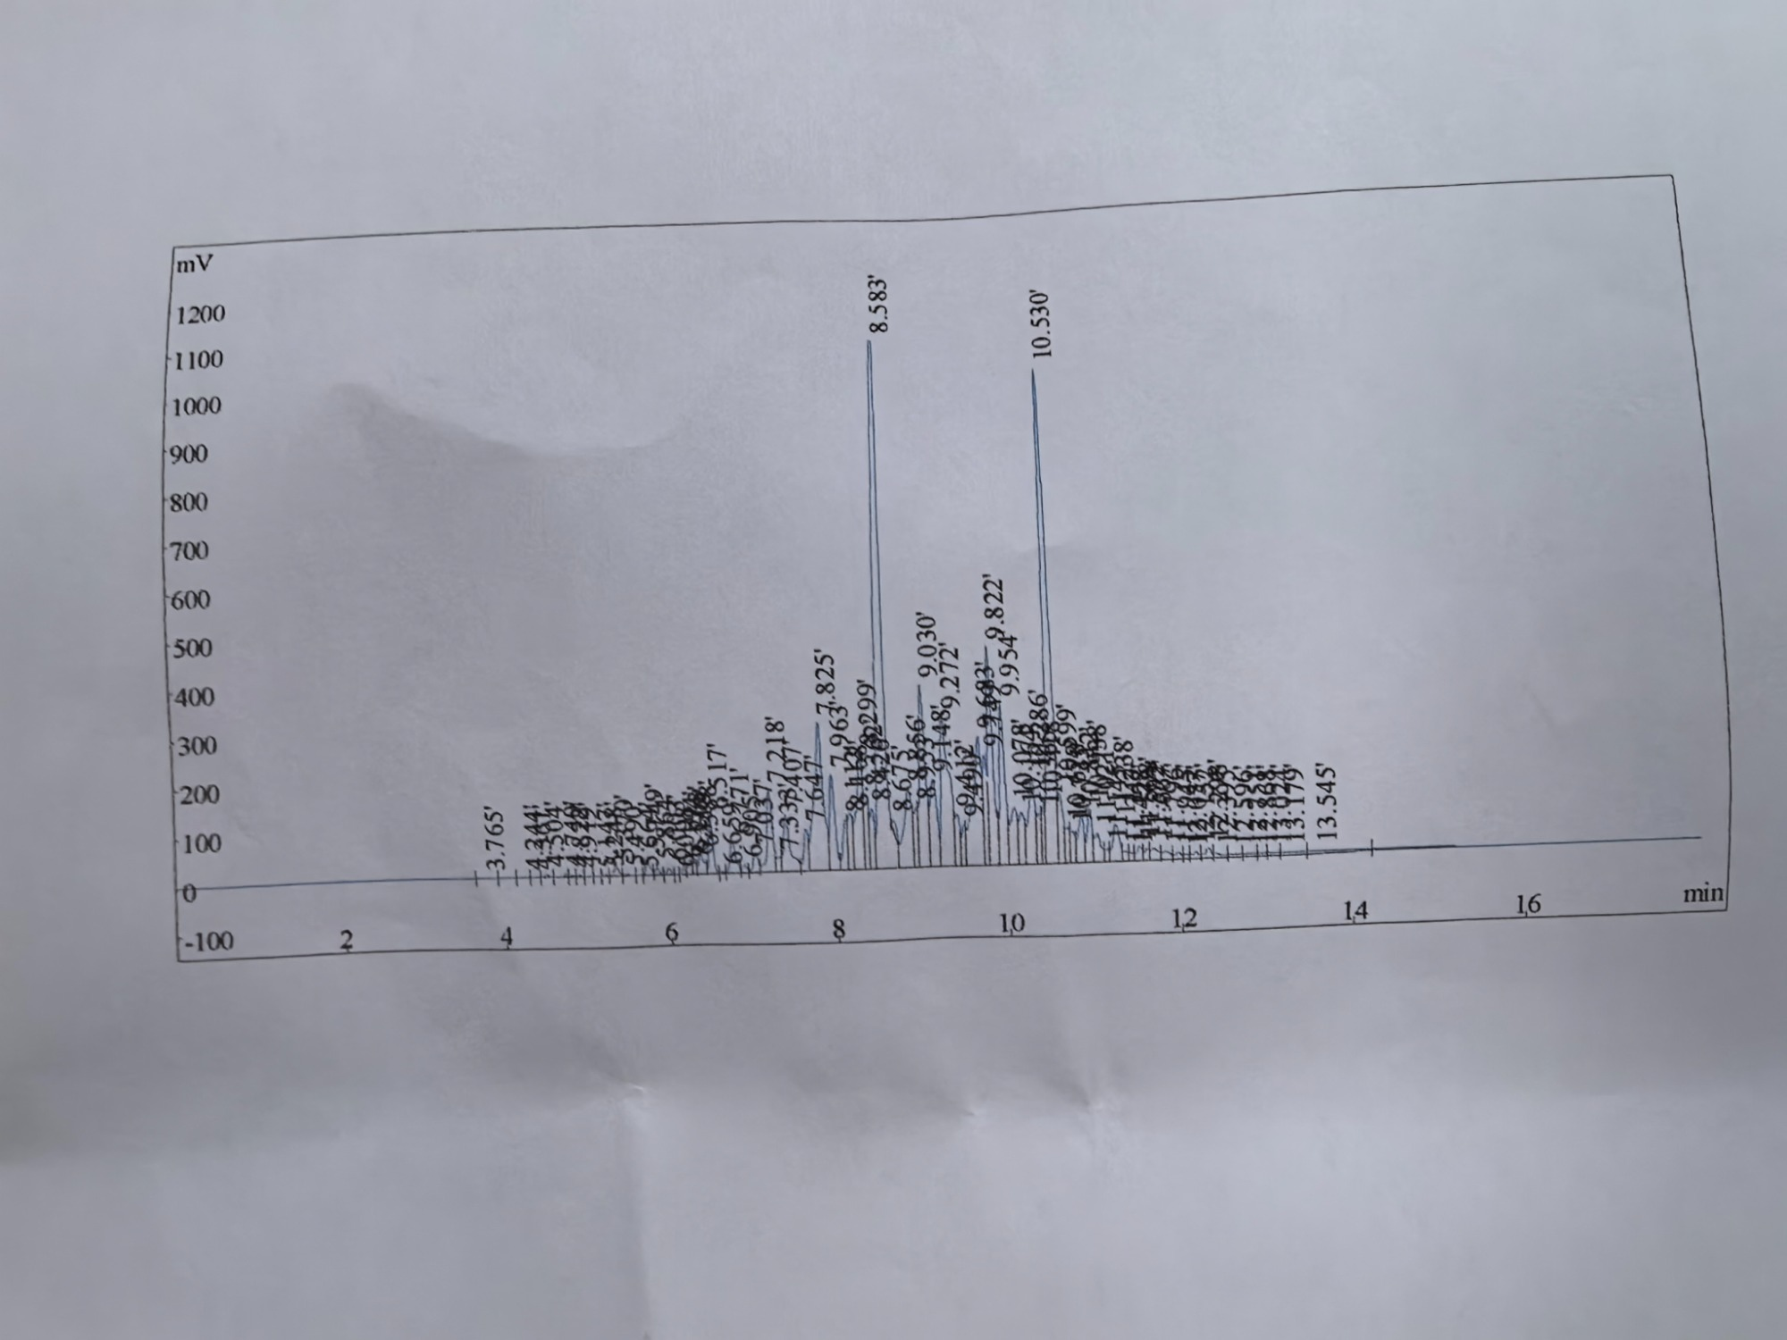
GC-MS Peak Findings — This Lot
Speculative IDs from RT order in a C9–C11 D40 cut • confirm vs method + MS library
RT (min) | Likely family | QC reading
3.765 | C8–C9 light end (IBP) | Keep tiny — not MC / MeOH
7.825 | C9 / early-C10 isomers | First body cluster
8.583 ★ | C10 iso / naphthene | Giant — heart of the cut
9.030 | C10 isomer satellite | Should track the 8.583 giant
9.822 / 9.954 | C10–C11 isomer pair | Adjacent boiling points
10.530 ★ | C11 iso / naphthene | 2nd giant — ratio vs 8.583
13.179 / 13.545 | C11–C12 heavy end (DP) | Keep small — pore-residue risk
Read: two giants (8.583 & 10.530 min) = D40 fingerprint. Growing 3.765 = light adulterant. Growing 13.x = wrong / wide cut.
Confidential

Slide 25
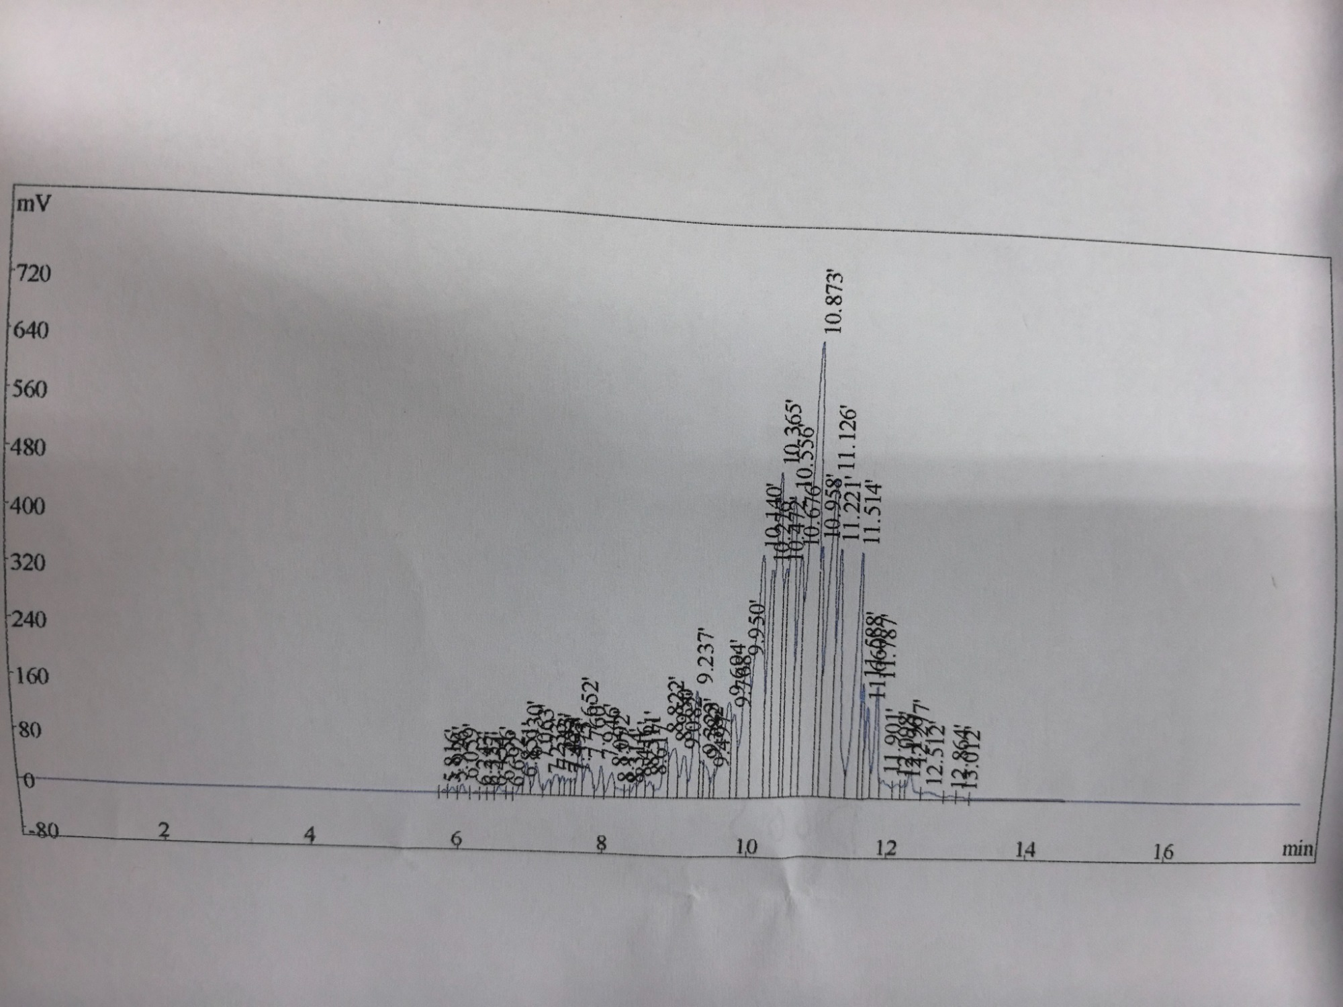
GC-MS Peak Findings — D60(S)
Speculative IDs from RT order in a C10–C13 D60 cut • confirm vs method + MS library
RT (min) | Likely family | QC reading
5.8 – 8.9 | C10 light front | Small — lights already cut
9.237 / 10.140 | C11 isomers | Rising flank of the cut
10.365 / 10.556 | C11–C12 cluster | Pre-giant body
10.873 ★ | C12 iso / naphthene | Giant — heart of D60
11.126 / 11.514 | C12 satellites | Should track 10.873
12.5 – 13.2 | C13 heavy end (DP) | Keep small — slow dry
Read: D60 heart is one mountain at 10.873 min — not D40’s twin giants at 8.58 / 10.53. Envelope starts ~2 min later.
Confidential

Slide 26
D40 vs D60(S) — Why the Charts Differ
Same GC principle: heavier molecules spend longer on the column
D40 • giants 8.583 & 10.530 min • C9–C11
D60(S) • giant 10.873 min • C10–C13
Feature | D40 | D60(S) | Logical reason
Envelope start | ~3.8 min | ~5.8 min | D60 IBP higher — C8–C9 lights removed
Heart (giant) | 8.58 + 10.53 (twin) | 10.87 (one mountain) | Cut centered C10/C11 vs C11–C12
Main mass | 7 – 11 min | 9 – 12.5 min | BP 163–187 °C vs 180–220 °C
Shape | Two tall spikes | Late dense hump | Heavier isomers cluster later
Confidential

Slide 27
Why GC-MS Matters for QC
Proves the drum is Exxsol D40 — not a look-alike
Identifies MC (~40 °C) and methanol (~65 °C) peaks
Protects flash-point, residue-free dry and worker safety
Creates auditable evidence for IATF / PPAP material control
Recommended: GC-MS every critical lot + quarterly random drums.
Confidential

Slide 28
Questions?
Risk Committee • Exxsol D40 Integrity
Confidential

