Slide 1
Nailvana/ GAL
Joquanna Scott
Eliza Berard
Daniel Rappaport
Li Ting Chen

Slide 2
What and Why
Business Overview:
Platform for people to schedule nail appointments online
Eliminates the need for in-person visits to book appointments
Enables users to find technicians with specific art style preferences
Benefits:
For Customers:
Convenient appointment scheduling
Ability to filter technicians based on availability and style preferences
For Technicians:
Provides a platform to offer services independently
Increases visibility and accessibility for potential customers

Slide 3
Use cases
(maybe looking for specific/niche service)
Nail biter wants to paint nails to help with healthy nail growth.
Someone wants to shape their nails into cat claws for their Halloween costume.

Slide 4

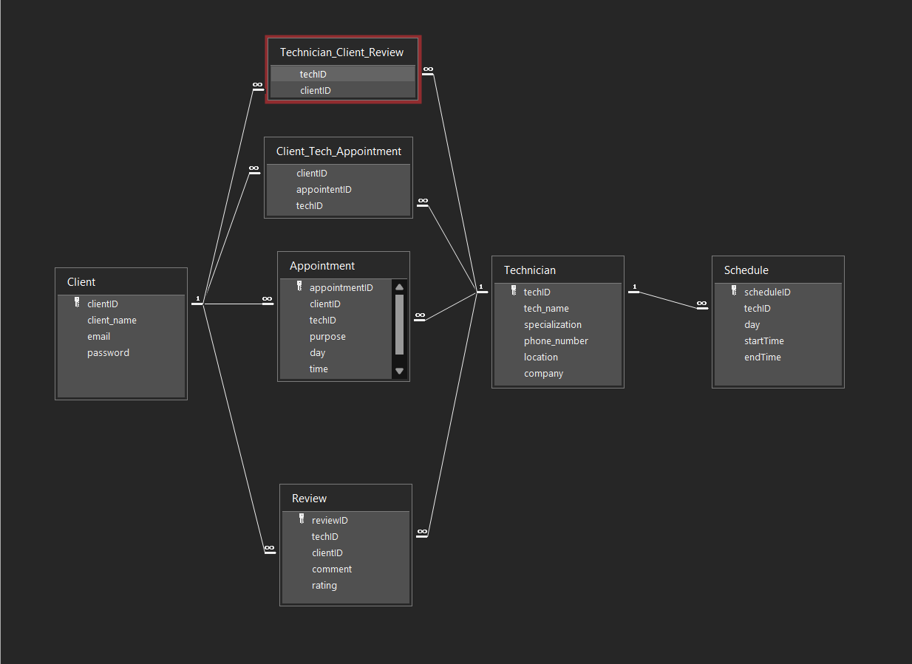
The Data
(rec: Relational Data Model)
Entities & Relationships
Primary entities: Client, Technician, Appointment
Represent the core of our system: Many clients can book appointments with technicians
Other entities: Schedule, Review
The schedule entity will be used to keep track of the available openings
Reviews will help the clients make informed decisions

Slide 5
Marketable Data
Market/product trends and preferences
preferences in nail designs, colors, styles
preferred brands, specific products, services
Demographics and consumer behavior
Frequency of customer appointments and customer loyalty data
Marketing insights
Engagement patterns and responsiveness to certain promotions or advertisements

Slide 6


Front End
React.js:
Fast rendering
Interactive UIs
JavaScript Library
Axios:
Simple HTTP requests
Promise-based API
Wide browser support
Request cancellation
Excel
Highly customizable
simple and easy to use

Slide 7


Back End
Python
Ease of use
Readability and collaboration
Useful libraries
Flask
Python based
Easy to deploy
Lightweight and modular
Libraries and extensions
SQLAlchemy (ORM)
Good documentation

Slide 8

Database
SQLite
Self contained
Highly portable
Free and open source
Easy to learn and use
ACID Compliant
Cross-platform compatibility

Slide 9
Member Roles
Joquanna - Back end development, SQLite
Eliza - Front end development, Axios
Daniel - Back end development, Flask
Li Ting - Front end development, SQLite

Slide 10
Thank you!
Any questions?

